Slide 1

User Login form
Username
User type
Select User type
Password
Clear
Login

Slide 2
User: Arul
Type: Technician
Logout
Add Patient
PERSONAL DETAILS
Date:
--automatic--
ADDITIONAL DETAILS
Patient ID :
SWCA00005 (automatic)
Age:
--from DOB--
Patient Name :
First name
Weight:
Last name
Height:
Gender:
BMI:
---by formula--
Ethnicity:
Allergic to
DOB:
Additional 1:
Additional 2:
Contact number:
Additional 3:
Email ID:
Remarks:
Address:
TEST REQUEST
LABORATORY INFO
Genetic report:
Order By:
Fitness report:
Collection Date:
Exercise report:
Received Date:
Report Generated:
Save
Exit

Slide 3

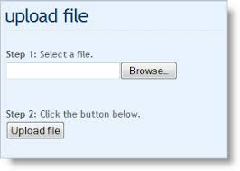
User: Arul
Type: Technician
Logout
New analysis
Add Patient
Patient ID | Patient Name | Test name | Gender | Upload DNA results |  |  |  | Upload Blood results |  |  |  | Upload Allergy results |  |  |  | Submit for analysis
SWCA00005 | Arul | Genetic test | Male | Upload | DNAA0005 (view) | Delete |  | Upload | BLOODA0005 (view) | Delete |  | Upload | ALLERGYA0005 (view) | Delete |  | Submit
SWCA00005 | Arul | Fitness test | Male | Upload | DNAA0006 (view) | Delete |  | Upload | BLOODA0006 (view) | Delete |  | Upload | ALLERGYA0006 (view) | Delete |  | Submit
SWCA00007 | Tommy | Fitness test | Male | Upload | DNAA0007 (view) | Delete |  | Upload | BLOODA0007 (view) | Delete |  | Upload | ALLERGYA0007 (view) | Delete |  | Submit
SWCA00008 | Peter | Fitness test | Male | Upload | DNAA0008 (view) | Delete |  | Upload | BLOODA0008 (view) | Delete |  | Upload | ALLERGYA0008 (view) | Delete |  | Submit
SWCA00009 | James | Exercise test | Male | Upload | DNAA0009 (view) | Delete |  | Upload | BLOODA0009 (view) | Delete |  | Upload | ALLERGYA0009 (view) | Delete |  | Submit
SWCA00010 | Murphy | Genetic test | Female | Upload | DNAA0010 (view) | Delete |  | Upload | BLOODA0010 (view) | Delete |  | Upload | ALLERGYA0010 (view) | Delete |  | Submit
Analysis
Upload
Upload
Upload
Submit
Upload
Upload
Upload
Submit
Upload
Upload
Upload
Submit
Upload
Upload
Upload
Submit
Upload
Upload
Upload
Submit
Upload
Upload
Upload
Submit
Re-run
Patient ID | Patient Name | Test name | Gender | Upload DNA results |  |  |  | Upload Blood results |  |  |  | Upload Allergy results |  |  |  | Submit for analysis
SWCA00005 | Tommy | Genetic test | Male | Upload | DNAA0005 (view) | Delete |  | Upload | BLOODA0005 (view) | Delete |  | Upload | ALLERGYA0005 (view) | Delete |  | Submit
Upload
Upload
Upload
Submit

Slide 4


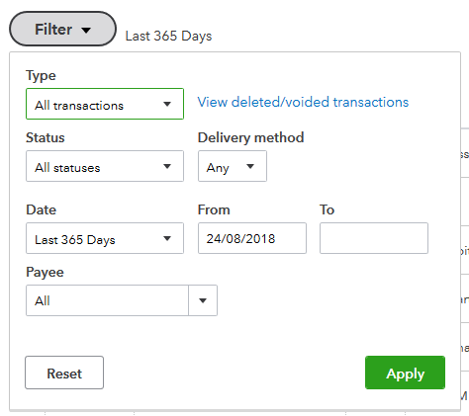
User: Arul
Type: Technician
Logout
Add Patient
Search
Analysis
Patient ID | Patient Name | Test name | Date submitted | Results status | Physician status | Date Physician reviewed | Mail id | Send | Date | Print and Issue | Date
SWCA00005 | Arul | Genetic test | 8/24/2019 | Done | Approved | 8/24/2019 | arul@gmail.com |  | 8/24/2019 |  | 8/24/2019
SWCA00005 | Arul | Fitness test | 8/24/2019 | Done | Approved with notes | 8/24/2019 | arul@gmail.com |  | 8/24/2019 |  | 8/24/2019
SWCA00007 | Tommy | Fitness test | 8/24/2019 | Done | Resent for review | 8/24/2019 | arul@gmail.com |  | 8/24/2019 |  | 8/24/2019
SWCA00008 | Peter | Fitness test | 8/24/2019 | Done | Approved | 8/24/2019 | arul@gmail.com |  | 8/24/2019 |  | 8/24/2019
SWCA00009 | James | Exercise test | 8/24/2019 | Pending |  | 8/24/2019 |  |  | 8/24/2019 |  | 8/24/2019
SWCA00010 | Murphy | Genetic test | 8/24/2019 | Pending |  | 8/24/2019 | arul@gmail.com |  | 8/24/2019 |  | 8/24/2019
View

Slide 5
User: Arul
Type: Physician
Logout
View Results
Search
Patient ID | Patient First Name | Last Name | Gender | Ethnicity | Test name | View report | Physician Notes | Include notes yes/no | Approve | Reject
SWCA00005 | Arul | AA | Male | Whites | Genetic test | View | Been observed for having good exercise and nutrition.
SWCA00005 | Arul | AA | Male | Whites | Fitness test | View | Add/Edit
SWCA00007 | Tommy | AA | Male | Whites | Fitness test | View | Add/Edit
SWCA00008 | Peter | AA | Male | Whites | Fitness test | View | Add/Edit
SWCA00009 | James | AA | Male | Whites | Exercise test | View | Add/Edit
SWCA00010 | Murphy | AA | Female | Whites | Genetic test | View | Add/Edit

Slide 6
User: Arul
Type: Admin
Logout
User List
first name | last name | role | mail id | contact number | address | edit | delete
Arul | P | Admin | arul@gmail.com | +919448201663 | Bangalore | edit | delete
Tommy | P | Physician | arul@gmail.com | +919448201663 | Bangalore | edit | delete
Peter | P | Technician | arul@gmail.com | +919448201663 | Bangalore | edit | delete

Slide 7
User: Arul
Type: Admin
Logout
User List
PERSONAL DETAILS
Username :
First name
Last name
Add user
Gender:
DOB:
Contact number:
Email ID:
Address:
User role :
Select User type
Submit

