Slide 1

Building GUI for Nutrigenomics Panel

Slide 2
Project Requirements
A web-based user interface or a tool which can take patients details, processing all necessary input files, necessary scripts/programs to perform analysis, processing the results, generating the reports in pdf and displaying the same in a web page, and overall management of patient details and testing.
Patients, 23&me, blood and allergy results will be provided by client in pdf/word/text/excel/API format and will be used as input to generate report.
The necessary data in csv format will be provided by the client for creating the database and necessary process of taking input file, analysis, and generating results will be done by contractor.
The end deliverable of this service will be a tool/website where the client can input the genetic, blood test, and allergy test data and get the recommended diet and exercise plan report.
The complete module will be delivered by end of Feb 2021 and we will try to submit

Slide 3
Technical Requirements
GUI of project will be developed in html, css , bootstarp and javascript
HTML, CSS is used for basic Web Pages development.
Bootstarp is used for responsiveness of page in any size of device.
Javascript is used for client side validation.
For server side scripting as well as database connection python flask framework will be used.
Any server side scripting language will work as middle ware between GUI and database where all data is stored
MySQL / PostgreSQL database will be used for storing all data which is coming from user side

Slide 4
Deployment
All deployment will be done on Amazon Cloud.
Currently we will be using our Amazon account and local server for development phase of project.
Later after project completion, all deployment of project will be done on your provided Amazon cloud account.

Slide 5

User Login form
Username
User type
Select User type
Password
Clear
Login

Slide 6
User: Arul
Type: Technician
Logout
Add Patient
PERSONAL DETAILS
Date:
--automatic--
ADDITIONAL DETAILS
Patient ID :
SWCA00005 (automatic)
Age:
--from DOB--
Patient Name :
First name
Weight:
Last name
Height:
Gender:
BMI:
---by formula--
Ethnicity:
Allergic to
DOB:
Additional 1:
Additional 2:
Contact number:
Additional 3:
Email ID:
Remarks:
Address:
TEST REQUEST
LABORATORY INFO
Genetic report:
Order By:
Fitness report:
Collection Date:
Exercise report:
Received Date:
Report Generated:
Save
Exit

Slide 7

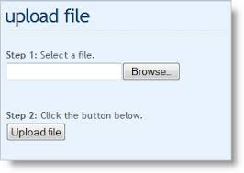
User: Arul
Type: Technician
Logout
New analysis
Add Patient
Patient ID | Patient Name | Test name | Gender | Upload DNA results |  |  |  | Upload Blood results |  |  |  | Upload Allergy results |  |  |  | Submit for analysis
SWCA00005 | Arul | Genetic test | Male | Upload | DNAA0005 (view) | Delete |  | Upload | BLOODA0005 (view) | Delete |  | Upload | ALLERGYA0005 (view) | Delete |  | Submit
SWCA00005 | Arul | Fitness test | Male | Upload | DNAA0006 (view) | Delete |  | Upload | BLOODA0006 (view) | Delete |  | Upload | ALLERGYA0006 (view) | Delete |  | Submit
SWCA00007 | Tommy | Fitness test | Male | Upload | DNAA0007 (view) | Delete |  | Upload | BLOODA0007 (view) | Delete |  | Upload | ALLERGYA0007 (view) | Delete |  | Submit
SWCA00008 | Peter | Fitness test | Male | Upload | DNAA0008 (view) | Delete |  | Upload | BLOODA0008 (view) | Delete |  | Upload | ALLERGYA0008 (view) | Delete |  | Submit
SWCA00009 | James | Exercise test | Male | Upload | DNAA0009 (view) | Delete |  | Upload | BLOODA0009 (view) | Delete |  | Upload | ALLERGYA0009 (view) | Delete |  | Submit
SWCA00010 | Murphy | Genetic test | Female | Upload | DNAA0010 (view) | Delete |  | Upload | BLOODA0010 (view) | Delete |  | Upload | ALLERGYA0010 (view) | Delete |  | Submit
Analysis
Upload
Upload
Upload
Submit
Upload
Upload
Upload
Submit
Upload
Upload
Upload
Submit
Upload
Upload
Upload
Submit
Upload
Upload
Upload
Submit
Upload
Upload
Upload
Submit
Re-run
Patient ID | Patient Name | Test name | Gender | Upload DNA results |  |  |  | Upload Blood results |  |  |  | Upload Allergy results |  |  |  | Submit for analysis
SWCA00005 | Tommy | Genetic test | Male | Upload | DNAA0005 (view) | Delete |  | Upload | BLOODA0005 (view) | Delete |  | Upload | ALLERGYA0005 (view) | Delete |  | Submit
Upload
Upload
Upload
Submit

Slide 8


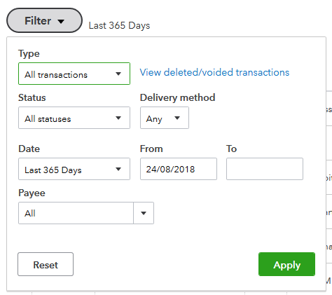
User: Arul
Type: Technician
Logout
Add Patient
Search
Analysis
Patient ID | Patient Name | Test name | Date submitted | Results status | Physician status | Date Physician reviewed | Mail id | Send | Date | Print and Issue | Date
SWCA00005 | Arul | Genetic test | 8/24/2019 | Done | Approved | 8/24/2019 | arul@gmail.com |  | 8/24/2019 |  | 8/24/2019
SWCA00005 | Arul | Fitness test | 8/24/2019 | Done | Approved with notes | 8/24/2019 | arul@gmail.com |  | 8/24/2019 |  | 8/24/2019
SWCA00007 | Tommy | Fitness test | 8/24/2019 | Done | Resent for review | 8/24/2019 | arul@gmail.com |  | 8/24/2019 |  | 8/24/2019
SWCA00008 | Peter | Fitness test | 8/24/2019 | Done | Approved | 8/24/2019 | arul@gmail.com |  | 8/24/2019 |  | 8/24/2019
SWCA00009 | James | Exercise test | 8/24/2019 | Pending |  | 8/24/2019 |  |  | 8/24/2019 |  | 8/24/2019
SWCA00010 | Murphy | Genetic test | 8/24/2019 | Pending |  | 8/24/2019 | arul@gmail.com |  | 8/24/2019 |  | 8/24/2019
View

Slide 9
User: Arul
Type: Physician
Logout
View Results
Search
Patient ID | Patient First Name | Last Name | Gender | Ethnicity | Test name | View report | Physician Notes | Include notes yes/no | Approve | Reject
SWCA00005 | Arul | AA | Male | Whites | Genetic test | View | Been observed for having good exercise and nutrition.
SWCA00005 | Arul | AA | Male | Whites | Fitness test | View | Add/Edit
SWCA00007 | Tommy | AA | Male | Whites | Fitness test | View | Add/Edit
SWCA00008 | Peter | AA | Male | Whites | Fitness test | View | Add/Edit
SWCA00009 | James | AA | Male | Whites | Exercise test | View | Add/Edit
SWCA00010 | Murphy | AA | Female | Whites | Genetic test | View | Add/Edit

Slide 10
User: Arul
Type: Admin
Logout
User List
first name | last name | role | mail id | contact number | address | edit | delete
Arul | P | Admin | arul@gmail.com | +919448201663 | Bangalore | edit | delete
Tommy | P | Physician | arul@gmail.com | +919448201663 | Bangalore | edit | delete
Peter | P | Technician | arul@gmail.com | +919448201663 | Bangalore | edit | delete

Slide 11
User: Arul
Type: Admin
Logout
User List
PERSONAL DETAILS
Username :
First name
Last name
Add user
Gender:
DOB:
Contact number:
Email ID:
Address:
User role :
Select User type
Submit

