Slide 1
Cover Page

Slide 2
Patient name, DOB
About the report

Slide 3

Summary of Genetic test results

Slide 4
Trait name
ABOUT
Genetic risk analysis
Actual blood analysis
Typical/ SLIGHTLY ENHANCED/ ENHANCED
NORMAL/ SLIGHTLY ENHANCED/ ENHANCED
How do these results connect?
You have an average genetic risk for lower magnesium, but you don't have any blood test results for magnesium. Find out how your genetic risk compares to what is actually happening in your body by uploading recent blood test results or by getting a blood test for magnesium done.
Dietary sources/WHAT TO DO

Slide 5

Physician/Nutrition notes

Slide 6
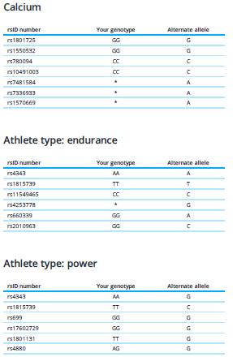
Genetic data
Genetic data
Your genetic data table shows your genotype for each gene, which is identified by its rsID number. Your genotype is characterized by an allele combination. The effect allele is the allele that has an effect on your genetic risk analysis.
* Indicates a missing SNP from your DNA data. DNA sampling and analysis is complex and subject to occasional technical errors. Missing some data is not unusual, and it won't affect the accuracy of your genetic analysis.
Adiponectin Levels
rs17366568
rs12051272
rs4783244
rs17300539
AA
TT
TT
AA
Effect allele
A
A
A
A

Slide 7
Disclaimer

Slide 8
