Slide 1
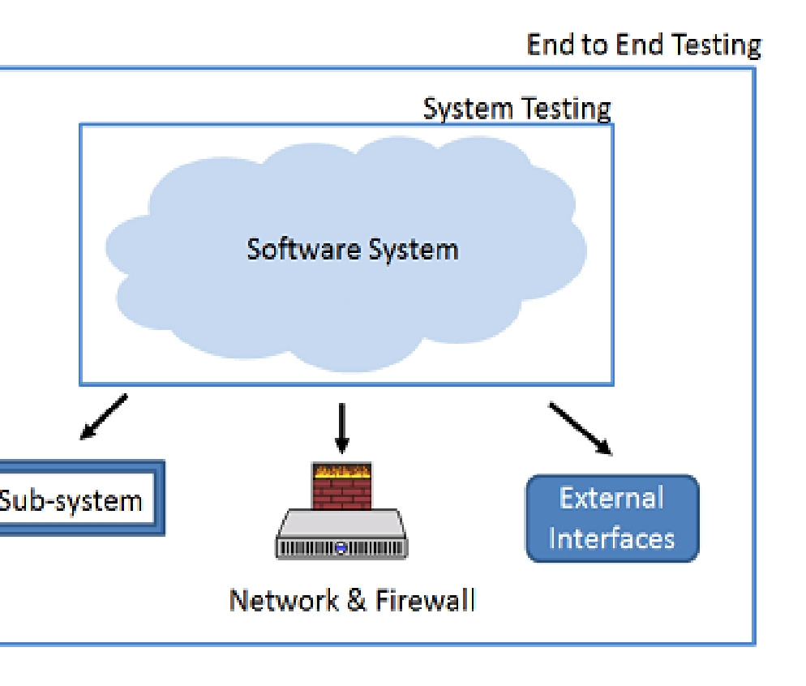
End to End
End-to-End Testing is
not only validates the software system under test but also checks it's integration with external interfaces

Slide 2
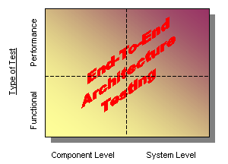
End to End Architecture

Slide 3
Functional Testing
User Acceptance
System test
Integration
Unit

Slide 4
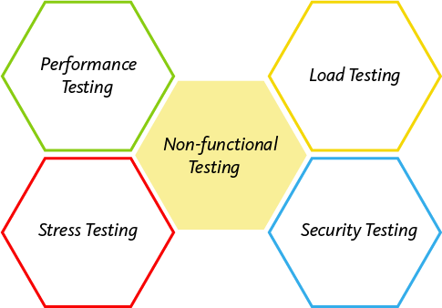
Non Functional Testing

Slide 5
End to End Testing Process
Test report
Test Execution
Environment Setup
Requirement/Planning
Design
Development

Slide 6
End To End Design Framework
Build User Functions
Build conditions
Build Test case
End to End Design

Slide 7
Thank you

