Slide 1
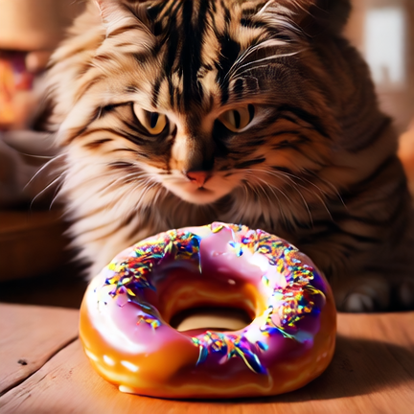
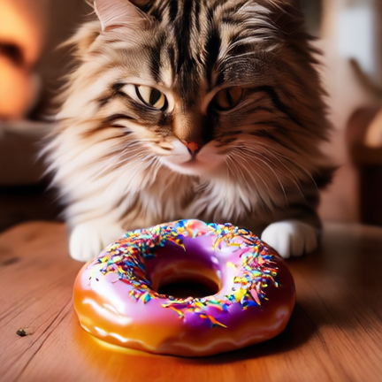
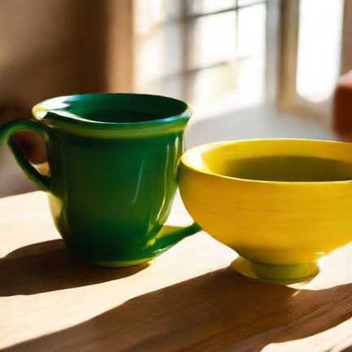
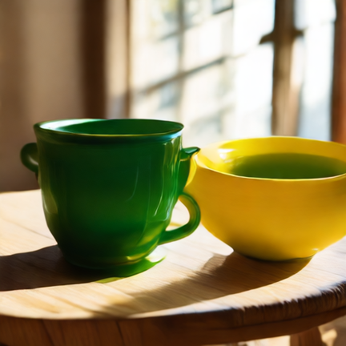
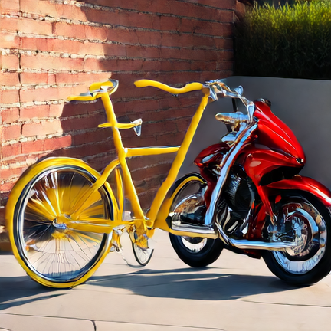
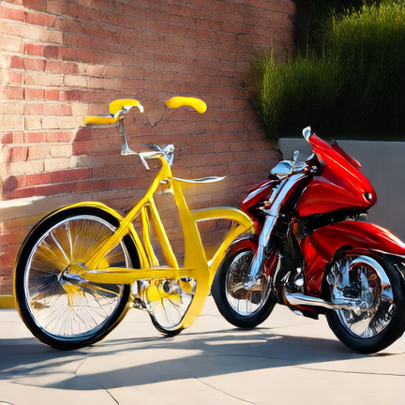
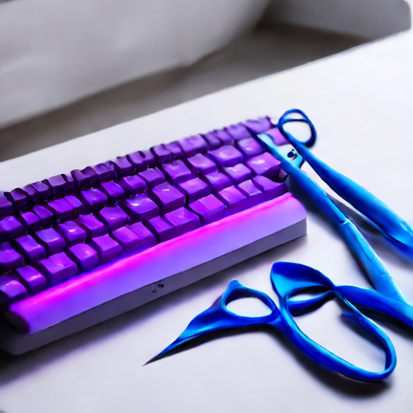

(a) Donut below a cat
(b) Green cup, yellow bowl
Show-o2
DepGraph-U
Show-o2
DepGraph-U
(c) Yellow bicycle, red motorcycle
(d) Purple keyboard, blue scissors
Show-o2
DepGraph-U
Show-o2
DepGraph-U
Notes:
Figure A3. Native Show-o2 and the complete DepGraph-U system. Show-o2-1.5B, GenEval, seed 0, 432 × 432.
DepGraph-U includes the inherited FlashU pruning/cache policy and the CADD/VocabBypass execution rewrites. Native and system schedules use 100 and 70 timepoints, respectively.
The four examples have identical rewritten prompts and seed labels, but come from separate archived runs. They do not establish matched initial noise or output equivalence. These illustrative cases were selected from an existing six-case visual shortlist and do not estimate aggregate quality. No per-example latency or speedup is assigned.
Sources: paper_rewrite_20260908/figure1_figma_20260909/geneval_candidates_20260909/{showo,full}/. Native source: ShowO2_1p5b_geneval_local_latency_20260908/formal/seed0/output/Baseline. Full system source: FlashU_geneval_rewritten_ab_20260823/final_seed0/FlashU_rp20_rLS20_T70_HN21_CADD_LOGBYPASS.
Prompt IDs in display order: 451, 514, 548, 506. The full prompt text, original-file hashes, scorer records, and source paths are retained in figureA3_native_comparison_20260923/evidence/SELECTED_CASES.json.

