Slide 1


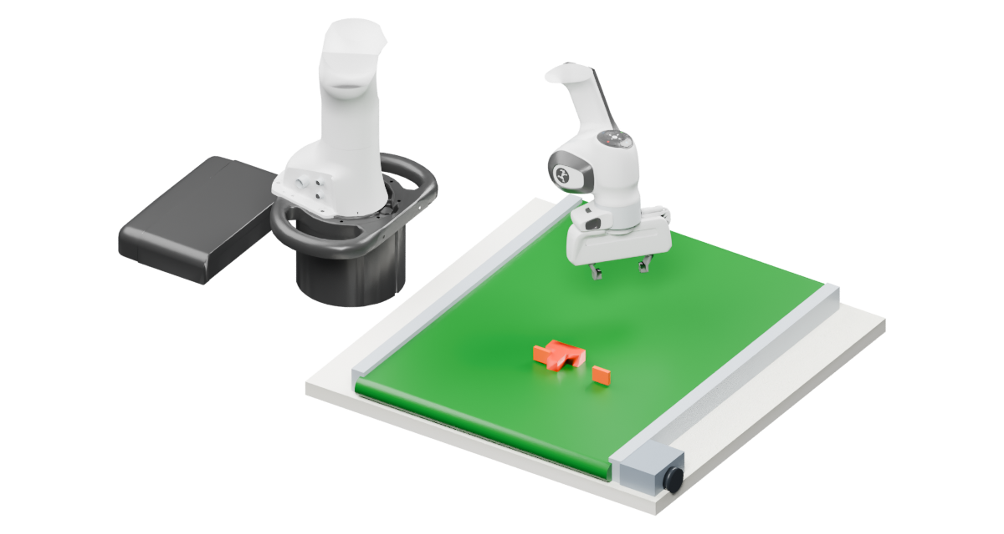
×
L
Current
Vision
RGB-D
Encoder
Sparse 3D flow
ℓ
+1
Flow
S
ℓ
Decoder
S
Target
LN
World FFN
SE(3)
World stream
LN
history
Encoder
Target SE(3)
Shared attention
+1
ℓ
Q / K / V
Output proj.
SE(3)
M
ℓ
Decoder
M
Robot
State
state
Encoder
Action chunk
ℓ
+1
Action
A
ℓ
Decoder
Summary M
Action
A
…
…
AdaLN
AdaLN
FFN
Action stream
Noisy
Action
actions A
Encoder
Flow time
u
(a) FoveaWAM
K
S
M
A
S
Q
M
A
Notes:
Grouped inputs/readouts v23. Each observation is joined to its input encoder; each set of three output examples is joined to its decoder using a light, unfilled outline. Panel titles remain below, with more space between a and the lower row. Source boundaries only group illustrations; they do not add model operators. References: WorldBridge Fig.3, SelfWAM Fig.2, LAW Fig.5 and Faster-WAM Fig.2(b). S/M share World FFN; A uses its own FFN and two scalar-flow-time-conditioned AdaLNs. QKV and attention-output weights are shared across S/M/A. Attention permissions are S:S, M:S/M, A:S/M/A. Both residual updates and layer-wise state updates are retained. World conditioning is differentiable during training. Inference caches projected S/M K/V from each layer input and iterates only Action. RGB and flow context are Blender illustrations of the recorded current state. Flow and SE(3) examples are recorded supervision references; decoded geometry is not an Action input. Native annotations, text, arrows and shapes remain editable. The Blender context source is assets/blender/flow_context.blend. Token counts and layer stacking are schematic. The adopted manuscript has not been changed.

