Slide 1


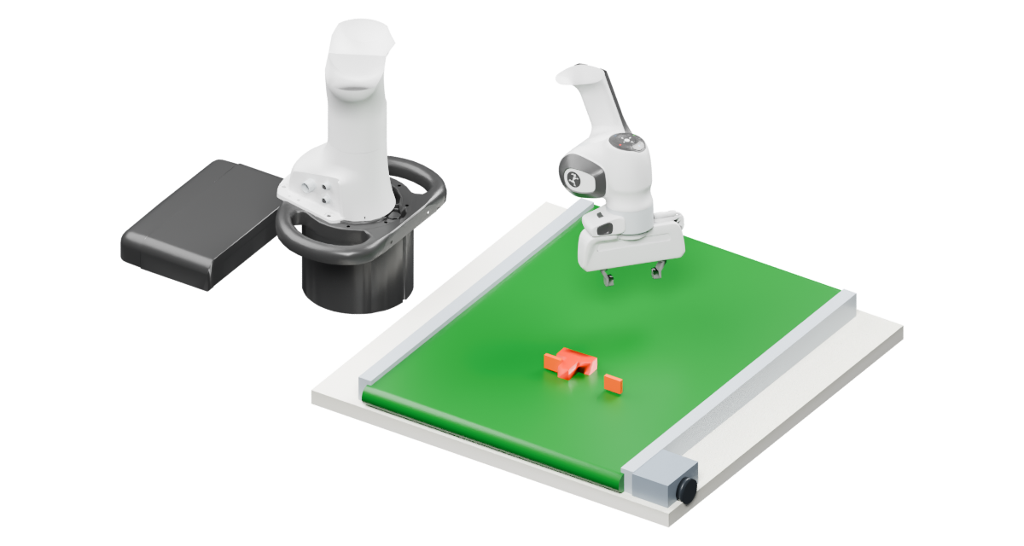
(a) FoveaWAM
×
L
Current
Vision
RGB-D
Encoder
Sparse 3D flow
ℓ
+1
Flow
S
ℓ
Decoder
S
Target
LN
World FFN
SE(3)
World stream
LN
history
Encoder
Target SE(3)
Shared attention
+1
ℓ
Q / K / V
Output proj.
SE(3)
M
ℓ
Decoder
M
Robot state
State
Action chunk
Encoder
ℓ
+1
Action
…
…
A
ℓ
Decoder
Summary M
Action
A
AdaLN
AdaLN
FFN
Action stream
Noisy actions A
Action
Encoder
Flow time
u
(b) Attention mask
(c) Training and cached inference
K
Training
S
M
A
World loss
Flow matching
S
Q
M
World
Action
A
S
M
Notes:
Publication refinement v21: input/output projections and Blender flow context. References: WorldBridge Fig.3 (arXiv:2610.40748v1), SelfWAM Fig.2 (2608.00725v1), LAW Fig.5 (2610.23334v2), Faster-WAM Fig.2(b) (2608.04404v1). S/M share World FFN; A uses its own FFN and two scalar-flow-time-conditioned AdaLNs. QKV and attention-output weights are shared across S/M/A. Attention permissions are S:S, M:S/M, A:S/M/A. Residuals are shown after attention output and FFN. The entire coupled layer repeats. World conditioning is differentiable during training. Inference caches each layer input projected S/M K/V and iterates only Action. RGB and flow context are Blender renderings of the recorded frame-29 state; flow vectors retain the recorded supervision and remain separate native annotations. Input encoders and output decoders represent existing learned projections/readouts, not additional backbones. The shared QKV box contains representative token blocks of the same size as input tokens. The native context scene is assets/blender/flow_context.blend. Depth, SE(3) and flow examples are recorded supervision references. Decoded geometry is not an Action input. No fixed token count, layer count or solver-step count is asserted. The adopted manuscript has not been changed.

