Slide 1
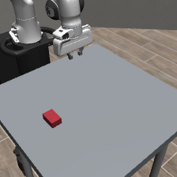
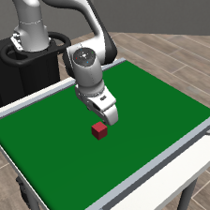

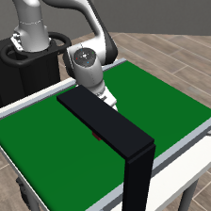
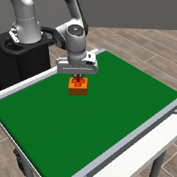
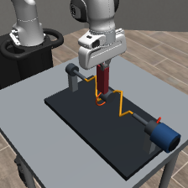
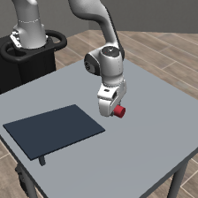
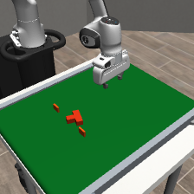
DB0 v0.4 · Active-Full-13-v0.3 · representative frozen environment views
P0
Future Pose
T1
Belt Capture
T1
SE(3) Split
T1
Occlusion
P0
T1-Belt
T1-XYZ / SO3
T1-OCC
robot still
intercept
matched XYZ
physical screen
8 future SE(3)
grasp + lift
independent yaw
hidden interval
50–400 ms
stable hold
causal contrast
history needed
forecast only
moving support
T-shaped target
no pose oracle
T2
Moving Goal
T3
Buzz Wire
T4
Free Physics
T5
Impact Replan
T2-TRANS / SE3
T3-Phase / Full
T4-Sphere
Slider / Can
T5-Replan
future release
phase align
branch impact
containment
traverse loop
ramp exit
observe + correct
settle + dwell
no wire touch
unsupported catch
keyed grasp
moving receptacle
rotating obstacle
roll / slide / slip
post-event state
Shared physical clock
Separate reports
20 Hz RGB-D/control · 500 Hz physics · waiting, inference, actuation, contact, and dwell all consume time
forecast · SR · TC · CT · safety · latency
Notes:
[Sources]
- Internal DB0 v0.4 environment, canonical revision 5564f479e77b4cda90116f8cdae6ace85989038e.
- Embedded frames: figures/benchmark_frames/*.png; detailed provenance and crop coordinates are in figures/benchmark_frames/README.md.
- These are frozen environment/scripted-review snapshots, not learned-policy results.
[/Sources]

