Slide 1
U5 Wild Type Random Forest Classifier 5/7/19
Arren Liu

Slide 2


Goals
Use RandomForest to build classifier
Report votes from Random Forrest
Validate RF classifier on validation set

Slide 3
U5_WT Top Markers
p_val | avg_logFC | pct.1 | pct.2 | p_val_adj | cluster | gene
3.61E-49 | 0.41063363 | 0.936 | 0.868 | 1.18E-44 | 0 | IGFBP3
7.19E-40 | 0.37587626 | 0.784 | 0.626 | 2.35E-35 | 0 | MAP3K7CL
2.58E-24 | 0.36689117 | 0.944 | 0.872 | 8.43E-20 | 0 | TAGLN
1.60E-10 | 0.57134757 | 0.379 | 0.291 | 5.23E-06 | 0 | CTGF
3.74E-06 | 0.40607685 | 0.261 | 0.202 | 0.12243975 | 0 | CYR61
1.42E-130 | 1.09479456 | 0.959 | 0.741 | 4.64E-126 | 1 | BEX1
3.31E-120 | 0.96398532 | 0.779 | 0.359 | 1.08E-115 | 1 | PTPRZ1
8.50E-109 | 0.93518835 | 0.705 | 0.273 | 2.78E-104 | 1 | SCRG1
4.27E-96 | 1.04138567 | 0.755 | 0.414 | 1.40E-91 | 1 | PRCP
7.18E-84 | 0.98834825 | 0.718 | 0.371 | 2.35E-79 | 1 | S100B
4.15E-267 | 2.18659741 | 0.981 | 0.379 | 1.36E-262 | 2 | HIST1H4C
2.14E-247 | 1.243206 | 0.959 | 0.218 | 7.02E-243 | 2 | CDK1
1.14E-231 | 1.04953285 | 0.965 | 0.222 | 3.72E-227 | 2 | UBE2C
3.74E-224 | 1.20939318 | 0.881 | 0.201 | 1.22E-219 | 2 | RRM2
1.30E-190 | 1.07972628 | 0.972 | 0.307 | 4.26E-186 | 2 | HMGB2
5.52E-103 | 0.77793716 | 0.832 | 0.286 | 1.81E-98 | 3 | GINS2
4.11E-86 | 0.63616713 | 0.645 | 0.179 | 1.34E-81 | 3 | CLSPN
1.77E-76 | 0.75886612 | 0.869 | 0.442 | 5.79E-72 | 3 | PCNA
1.03E-63 | 0.68385377 | 0.798 | 0.401 | 3.38E-59 | 3 | SLBP
2.02E-56 | 0.62117206 | 0.807 | 0.389 | 6.63E-52 | 3 | GMNN
1.35E-76 | 0.730119 | 1 | 0.896 | 4.41E-72 | 4 | HMGN2
8.30E-74 | 0.80342779 | 0.833 | 0.342 | 2.72E-69 | 4 | BIRC5
1.24E-72 | 0.7549561 | 0.987 | 0.841 | 4.06E-68 | 4 | STMN1
5.67E-48 | 0.91717116 | 0.777 | 0.459 | 1.86E-43 | 4 | PTTG1
6.14E-38 | 0.74414014 | 0.88 | 0.768 | 2.01E-33 | 4 | ARL6IP1
3.45E-172 | 1.78980358 | 0.973 | 0.253 | 1.13E-167 | 5 | CCNB1
1.47E-149 | 1.74184781 | 0.995 | 0.419 | 4.81E-145 | 5 | CKS2
1.03E-146 | 1.79793195 | 1 | 0.423 | 3.37E-142 | 5 | CENPF
1.76E-145 | 1.9417901 | 0.95 | 0.287 | 5.76E-141 | 5 | UBE2C
1.38E-134 | 1.59682391 | 1 | 0.451 | 4.51E-130 | 5 | PTTG1
2.66E-45 | 0.74288222 | 1 | 1 | 8.71E-41 | 6 | ACTB
1.90E-37 | 0.73442052 | 1 | 1 | 6.21E-33 | 6 | RPL21
7.90E-34 | 0.67029901 | 1 | 0.998 | 2.59E-29 | 6 | RPL12
3.34E-25 | 0.79751294 | 1 | 0.98 | 1.09E-20 | 6 | S100A10
1.16E-10 | 0.67329205 | 0.866 | 0.853 | 3.79E-06 | 6 | MYL9

Slide 4
U5_WT confusion matrix
 | 1 | 2 | 3 | 4 | 5 | 6 | 7
1 | 1091 | 22 | 2 | 4 | 13 | 0 | 0
2 | 156 | 256 | 0 | 0 | 2 | 0 | 1
3 | 1 | 0 | 442 | 8 | 2 | 9 | 0
4 | 94 | 4 | 42 | 172 | 9 | 0 | 1
5 | 72 | 0 | 4 | 2 | 212 | 10 | 0
6 | 0 | 0 | 18 | 0 | 3 | 200 | 0
7 | 28 | 2 | 1 | 1 | 7 | 0 | 58
OOB estimate of error rate: 16.99%

Slide 5
U5.rf Votes
 | 1 | 2 | 3 | 4 | 5 | 6 | 7
AAACATACTAACCG | 0.35978836 | 0.4973545 | 0 | 0.03703704 | 0.02645503 | 0 | 0.07936508
AAACATTGAGTTCG | 0.24102564 | 0.14358974 | 0.0974359 | 0.42564103 | 0.07692308 | 0.00512821 | 0.01025641
AAACATTGCACTGA | 0.01142857 | 0.01142857 | 0.58285714 | 0.08571429 | 0.05142857 | 0.25714286 | 0
AAACATTGCTCAGA | 0.42708333 | 0.30729167 | 0.00520833 | 0.07291667 | 0.17708333 | 0 | 0.01041667
AAACATTGGTTTCT | 0.42285714 | 0.13714286 | 0.05142857 | 0.20571429 | 0.12571429 | 0.01142857 | 0.04571429
AAACCGTGTAACGC | 0 | 0 | 0.07361963 | 0 | 0.03067485 | 0.89570552 | 0

Slide 6
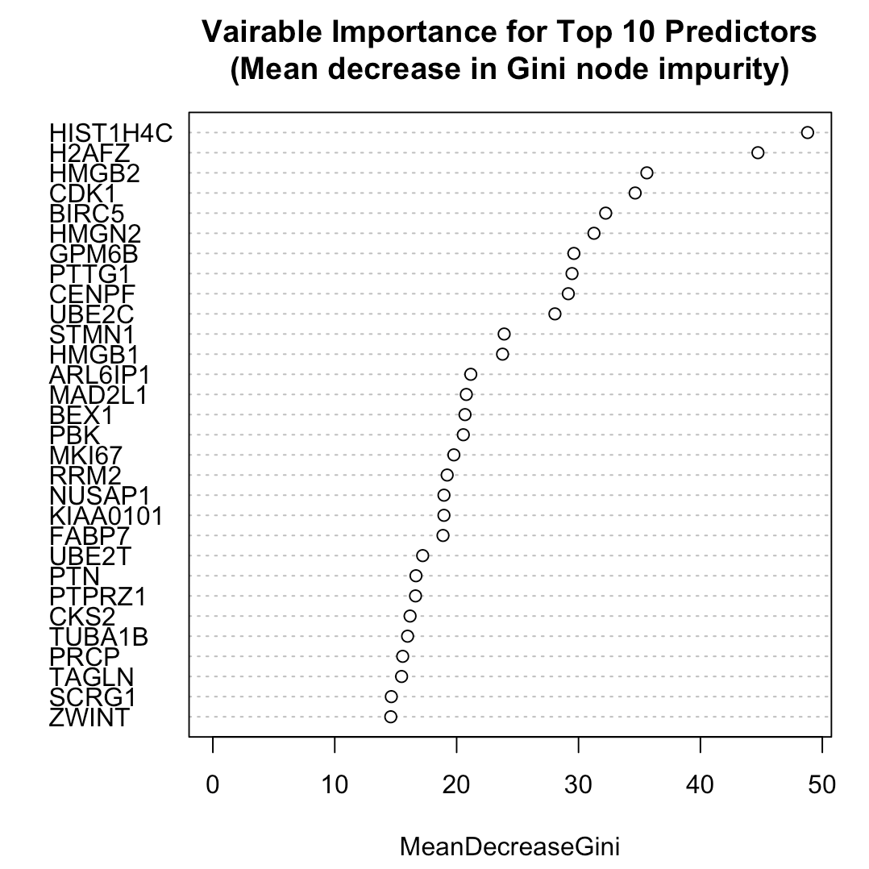
Vairable Importance for Top 10 Predictors

Slide 7
Final Summary/Future Work
Code is able to create a random forest classifier
Classifier cannot be applied to data sets that don’t use the same key genes for cluster definitions
Will apply classifier to verification data set
Will filter only use genes shared between data sets

