Slide 1
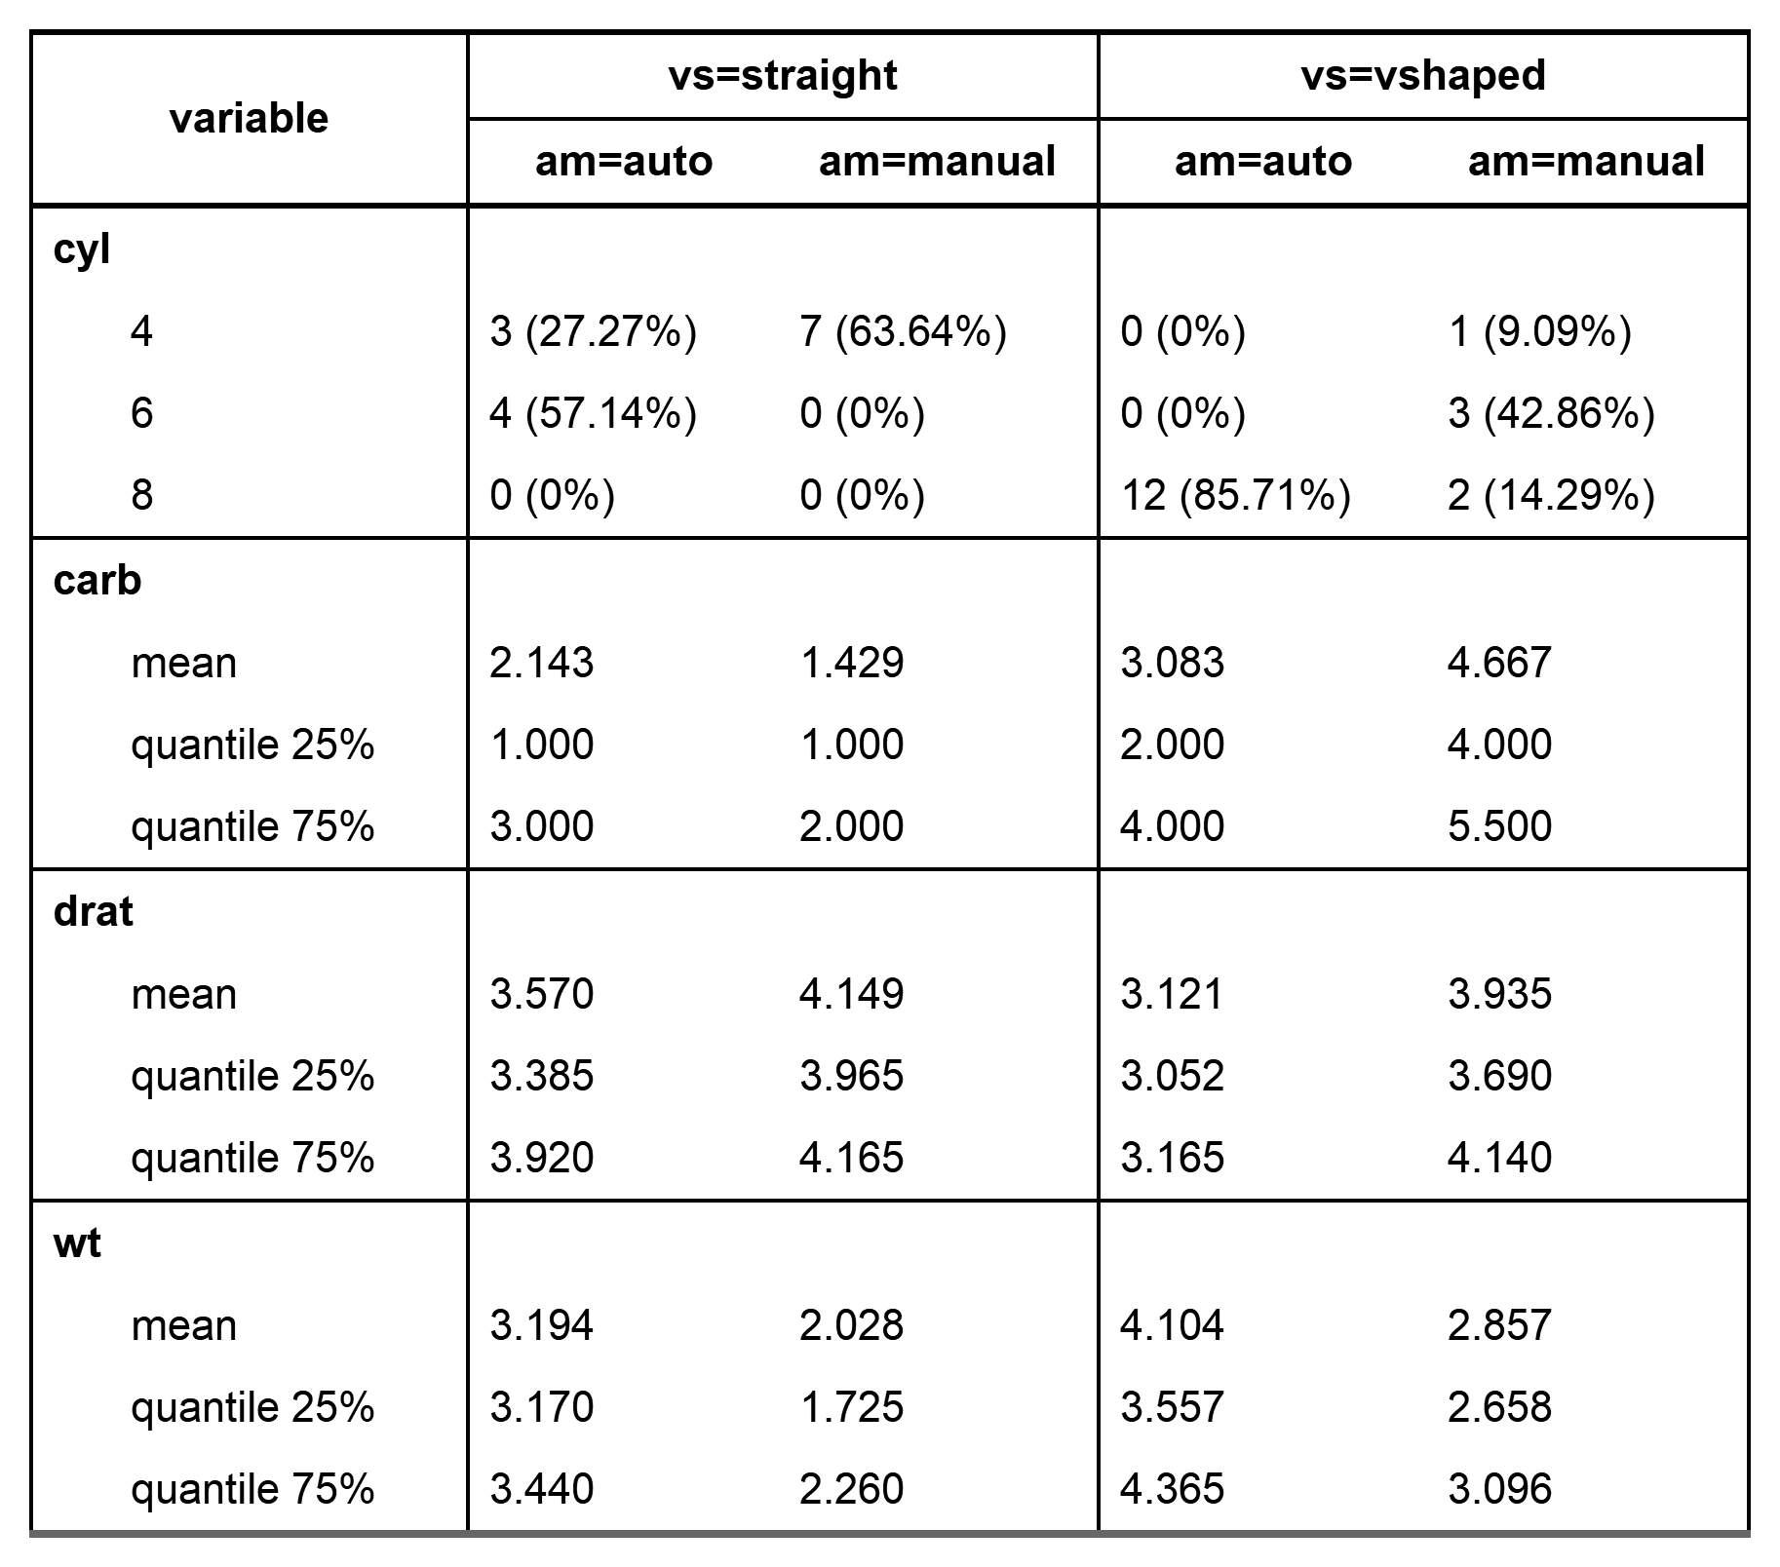
label=FALSE
Variable name instead of label
by=c(am, vs)
starts_with("c")
funs=c(mean, quantile)
funs_arg=list(digits=3)
funs_arg=list(probs=c(.25,.75))
ends_with("t")

