Slide 1
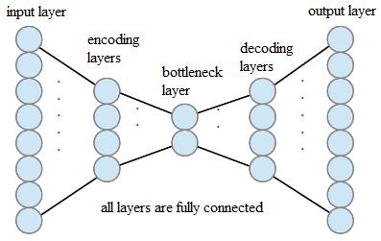
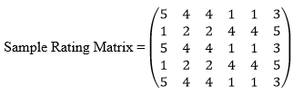
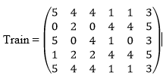
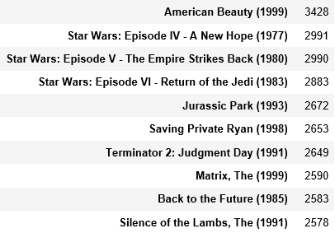
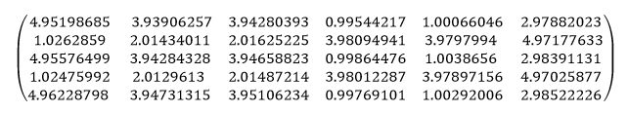
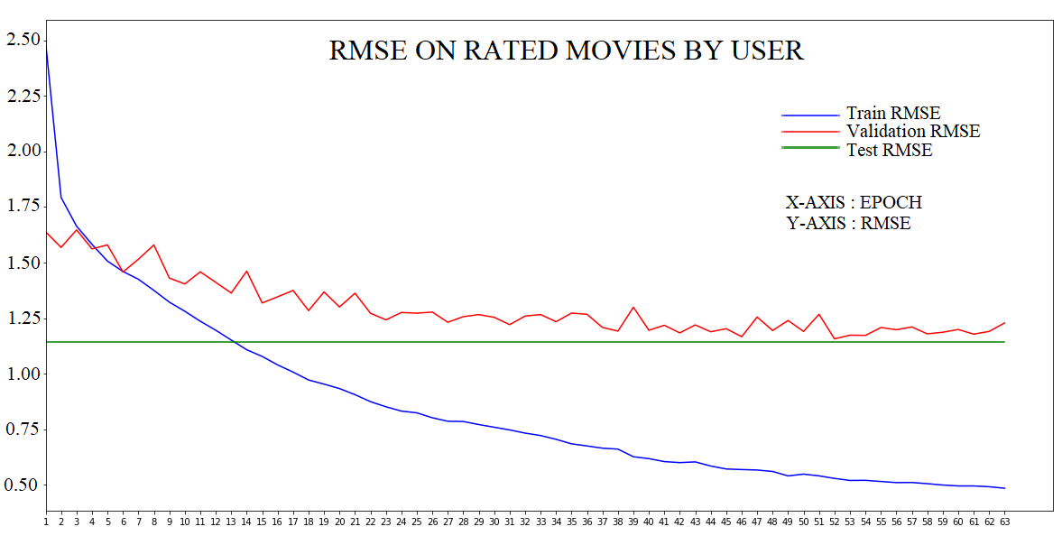
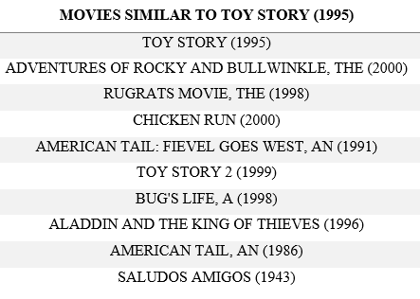
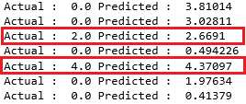
RECOMMENDATION SYSTEMS - APPROACHES
Arjun C & Prof. Neil Bergmann
ABSTRACT
Recommendation systems are tools that help in solving information overload problem by suggesting items to users. In this study, different approaches are implemented and evaluated on movielens 1-million ratings dataset.
HISTORY
Tapestry, Usenet were the pioneers in solving the problem. Then came the state-of-the-art techniques like popularity (PO), content based (CB) and collaborative filtering (CF) methods. Netflix Prize challenge has shown the importance of these systems.
POPULARITY METHOD
Aim: Recommend items in the decreasing order of the number of ratings received.
Experiment: Identify the top 10 items based on the number of ratings.
CB METHOD
Aim: Find items with similar identified features (genres for movies).
Experiment: Identify the top 10 movies similar to the genres of the given movie. Implemented using nearest neighbors method with Minkowski distance measure of order 2.
CF METHOD
Aim: Predict ratings of unrated movies by user using past user-item interactions.
Experiment: Using Matrix factorization (MF) and autoencoders (AE), try to identify low rank matrices and latent features respectively to reconstruct given ratings.
MF: Identify matrices P and Q for rating matrix R such that R = PQ
Autoencoder: Using deep learning with encoding and decoding layers, try to reconstruct the ratings.
RESULTS
PO: Top 10 movies in decreasing order were identified successfully and built recommendations.
CB: Successful implementation with average RMSE of Minkowski distance of 0.05
CF-MF: Not a successful implementation given the sparsity of dataset. However, worked well on sample dense matrix of order (5x6) with test RMSE of 0.03.
CF-AE: Successful implementation, given the attained RMSE of 1.14. Close to other presented researches.
A hybrid of these methods could help in achieving better recommendations as each method has its own limitations.
AUTOENCODER MODEL
PO RESULTS
CB RESULTS
It can be seen that movies identified as similar to Toy Story are all of the same genres
MF RESULTS
AE RESULTS
Estimated Matrix
Prediction Comparison for a user

