Slide 1


Classification of News Headlines using Machine Learning
Supervisor, Presented By,
Prof. Neil Bergmann Arjun C
44632339

Slide 2
Motivation
Variety in Applications like spam filter and web search.
Eliminate manual classification methodology.
Understanding basics of Text processing for machine learning.
Understanding usage of machine learning techniques.
Possible implementation in personal digital space customizations.

Slide 3
Contents
Problem Statement
Dataset information
Data analysis
The process
Text processing
Learning process and the algorithms
Test result analysis and Comparison
Estimated Plan for next semester
Conclusion

Slide 4
Problem statement and data
Classifying headlines of the news articles as belonging to a particular category of news.
Data considered here will be from Business and Entertainment classes.
“News Aggregator Dataset” downloaded from UCI machine learning repository [1] also available on Kaggle.
Dataset consists of 422,419 samples.
Consists of news data belonging to four categories.
Business – 115967 samples
Science & Technology – 108344 samples
Entertainment – 152469 samples
Health – 45639 samples

Slide 5
Dataset description
Features | Description | Sample
ID: | Numeric ID of the article. | 1
TITLE: | Headline of the article | "Fed official says weak data caused by weather, should not slow taper"
URL: | URL of the article | "http://www.latimes.com/business/money/la-fi-mo-federal-reserve-plosser-stimulus-economy-20140310,0,1312750.story\?track=rss"
PUBLISHER: | Publisher of the article | Los Angeles Times
CATEGORY: | The category of the news item. b for business, t for science and technology, e for entertainment and m for health. | B
STORY: | Alphanumeric ID of the news story that the article discusses | ddUyU0VZz0BRneMioxUPQVP6sIxvM
HOSTNAME: | Hostname where the article was posted | www.latimes.com
TIMESTAMP: | Approximate timestamp of the article's publication, given in Unix time (seconds since midnight on Jan 1, 1970) | 1394470370698

Slide 6
Data analysis
Title – Main feature for classification.
Category – Target class.
Meaningful correlation - Publisher
Other features show almost no correlation.

Slide 7
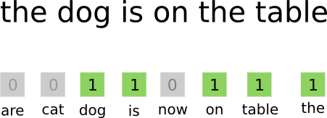
The Process
Data is first divided into training and test sets (80% and 20%).
Text processing to get feature vectors , the bag of words approach.
Use feature vectors to train the model.
Choose the machine learning techniques.
Train the model. Tune the model.
Test the model.

Slide 8
Text Processing
Start
Case folding: All words to lower case
Filtering: Removing special characters and html tags if any.
Tokenizing: Separation of words
Stop word removal: Removal of the general most occurring and the least occurring words.
Stemming: In this step, the derived words are replaced by the parent word to reduce the chances of noise in that data.
Case Folding
Filtering
Tokenizing
Stop Word Removal
Stemming
Return
Feature Extraction [2]

Slide 9
Machine Learning techniques
Considered based on presented research [3,4]
Naïve Bayes
Multinomial Naïve Bayes
Comparatively easier and widely used for Text Classification purpose
Very less timing for training
Logistic Regression
Simple implementation
Reasonably less time for training
Support Vector Machines
Used widely for Text Classification
Training did not finish in reasonable time

Slide 10
Implementation
Regular expression to keep only words.
Lower Case conversion.
NLTK corpus for stopword removal.
Python sklearn library for feature extraction, performing PCA, training and testing the model.

Slide 11
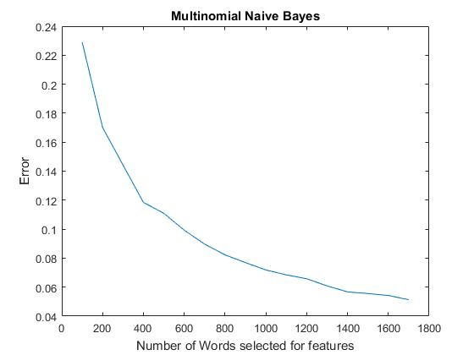
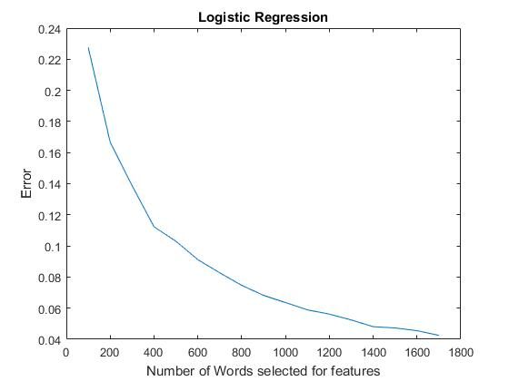
Results
Errors with increase in number of Feature Words

Slide 12
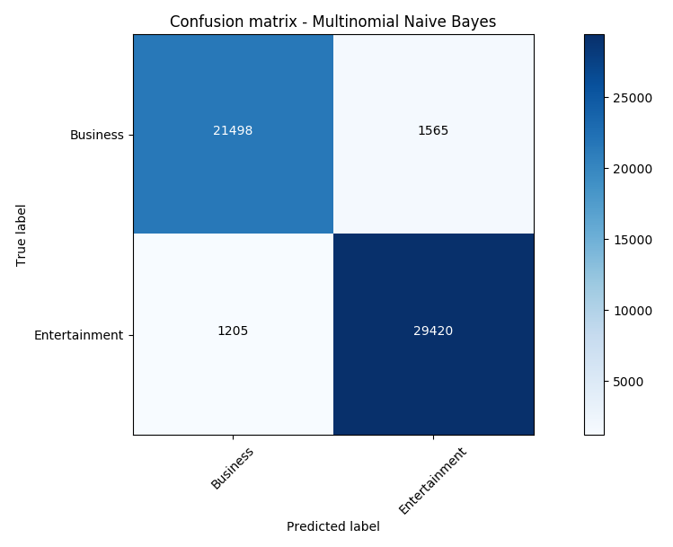
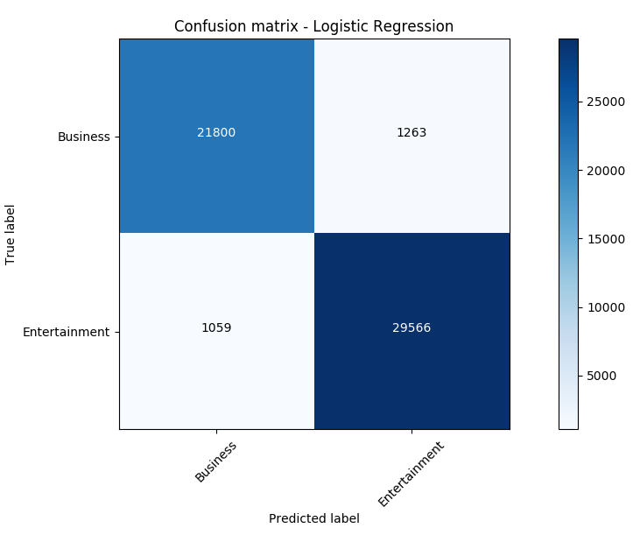
Results
Confusion Matrix – MNB with 1700 feature words
Confusion Matrix – LR with 1700 feature words

Slide 13
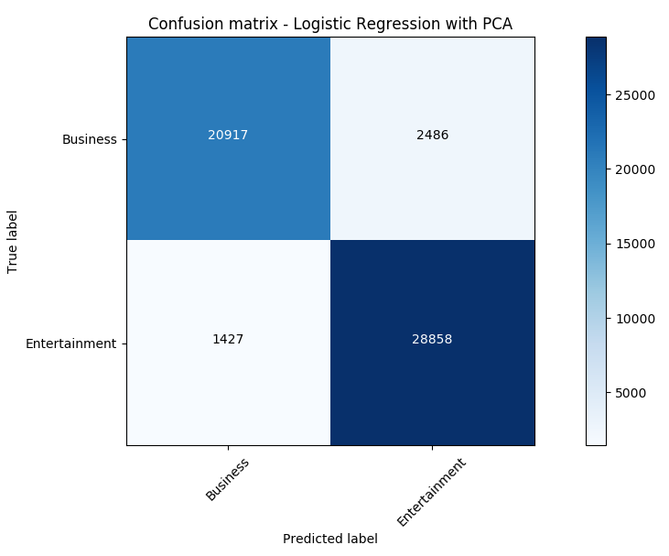
Results
 | Precision | Recall | Accuracy
Multinomial Naïve Bayes | 0.94692331 | 0.93214239 | 94.84 %
Logistic Regression | 0.95367251 | 0.94523696 | 95.67 %
Logistic Regression - PCA | 0.94 | 0.89 | 92.71 %
Confusion Matrix – LR PCA with 500 reduced components

Slide 14
Observations
With Initial feature count selected to be 1000, and reducing its dimensionality to 100 using PCA resulted in a very good prediction accuracy (89%) compared to implementation without PCA.
With increase in the number of components, error decreased linearly for PCA implementation.
On average, 95.7% of the test set was classified with Logistic Regression and 1700 features selected.
Time taken by SVM was way too high than MNB and LR and could not be evaluated.
Resource utilization like memory and available system speed influenced the performance of the algorithms (not in terms of accuracy).

Slide 15
Comparison
Multiple Kernels on Kaggle showing an accuracy of 92%.
Implementation error where test and train sets are both fit and transform to get the feature words separately.
Consideration of very few samples to reduce computation time.
Implementation that I have followed gives reasonably good performance.

Slide 16
Project Timeline Estimation for Next Semester
Select Problem and gather data, understand the requirements for the conference paper and start working on the paper. | Week 1 (28-07-2017) and Week 2 (04-08-2017)
Data processing and feature Extraction. | Week 3 (11-08-2017) and Week 4 (18-08-2017)
Train models and fine tune the parameters. | Week 5 25-05-2017
Start writing the Conference paper. | Week 6 02-09-2017
Test the models. | Week 7 08-09-2017
Start working on Thesis report. | Week 8 15-09-2017
Compare the models and evaluate them. | Week 9 22-09-2017
Complete the conference paper and verify the project. | Week 10 06-10-2017
Conference Paper Submission | Week 11 13-10-2017
Project Demo | Week 12 20-10-2017
Thesis Report Submission | Week 13 27-10-2017

Slide 17
Conclusion and Takeaway
Text classification is possible without actually understanding the actual meaning of the sentence.
Feature selection is very important for text classification.
Simple Machine Learning Techniques perform better.
System configuration plays a very important role.
Stepping stone for sentiment analysis and real time text data analysis.
A better understanding of model evaluation and machine learning techniques.

Slide 18
References
[1] M. Lichman. (2013). {UCI} Machine Learning Repository. Available: http://archive.ics.uci.edu/ml
[2] A. A. Turdjai and K. Mutijarsa, "Simulation of marketplace customer satisfaction analysis based on machine learning algorithms," in 2016 International Seminar on Application for Technology of Information and Communication (ISemantic), 2016, pp. 157-162.
[3] R. Khanna and M. Awad, Efficient Learning Machines Theories, Concepts, and Applications for Engineers and System Designers (The expert's voice in machine learning). Berkeley, CA : Apress : Imprint: Apress, 2015.
[4] P. Tsangaratos and I. Ilia, "Comparison of a logistic regression and Naïve Bayes classifier in landslide susceptibility assessments: The influence of models complexity and training dataset size," Catena, vol. 145, pp. 164-179, 2016.

Slide 19
Thank You

