Slide 1
Luxun - A Persistent Messaging System Tailored for Big Data Collecting & Analytics
By William http://bulldog2011.github.com

Slide 2
Performance Highlight
On Single Server Grade Machine with Single Topic
Average producing throughput > 100MBps, peak > 200MBps
Average consuming throughput > 100MBps, peak > 200MBps
In Networking Case,
Throughput only limited by network and disk IO bandwidth

Slide 3
Typical Big Data or Activity Stream
Logs generated by frontend applications or backend services
User behavior data
Application or system performance trace
Business, application or system metrics data
Events that need immediate action

Slide 4
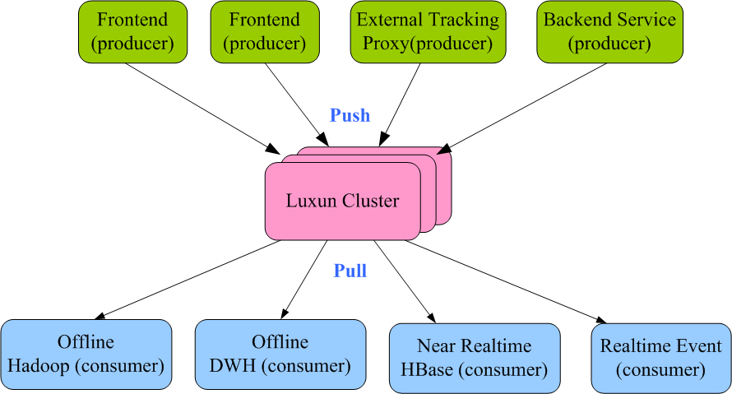
Unified Big Data Pipeline

Slide 5
Luxun Design Objectives
Fast & High-Throughput
Top priority, close to O(1) memory access
Persistent & Durable
All data is persistent on disk and is crash resistant
Producer & Consumer Separation
Each one can work without knowing the existence of the other
Realtime
Produced message will be immediately visible to consumer
Distributed
Horizontal scalable with commodity machines
Multiple Clients Support
Easy integration with clients from different platforms, such as Java, C#, PHP, Ruby, Python, C++…
Flexible consuming semantics
Consume once, fanout, can even consume by index
Light Weight
Small footprint binary, no Zookeeper coordination

Slide 6
Basic Concepts
Topic
Logically it’s a named place to send messages to or to consume messages from, physically it’s a persistent queue
Broker
Aka Luxun server
Message
Datum to produce or consume
Producer
A role which will send messages to topics
Consumer
A role which will consume messages from topics
Consumer Group
A group of consumers that will receive only one copy of a message from a topic

Slide 7
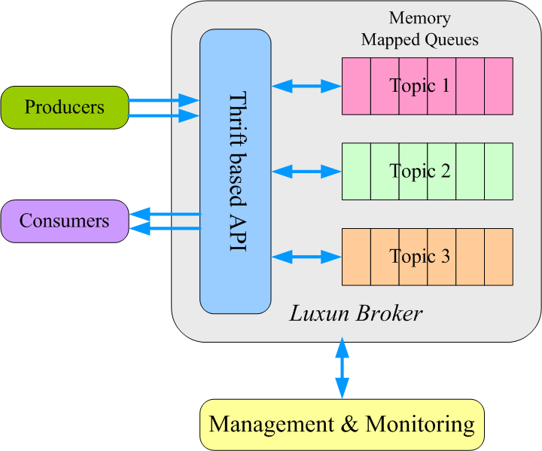
Overall Architecture

Slide 8
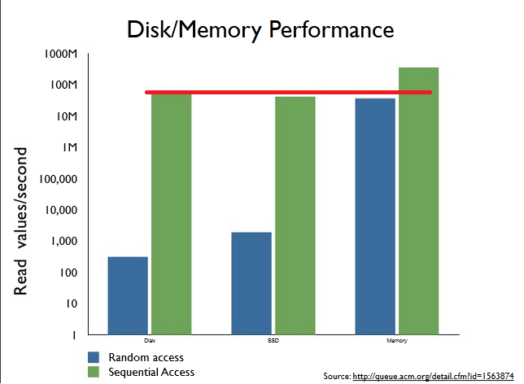
Core Principle
Sequential disk read can be comparable to or even faster than random memory read

Slide 9
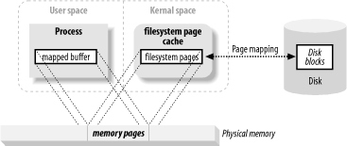
Core Technology – Memory Mapped File
Map files into memory, persisted by OS
OS will be responsible to persist messages even the process crashes
Can be shared between processes/threads
Produced message immediately visible to consumer threads
Limited by the amount of disk space you have
Can scale very well when exceeding your main memory size
In Java implementation, does not use heap memory directly, GC impact limited

Slide 10
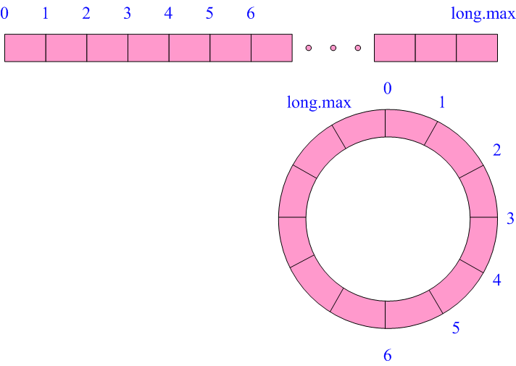
Persistent Queue – Logic View
Just like a big array or circular array, message appended/read by index

Slide 11
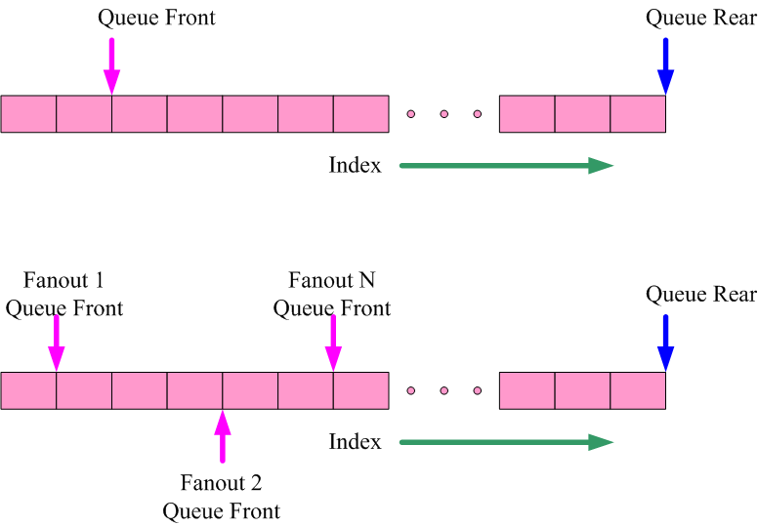

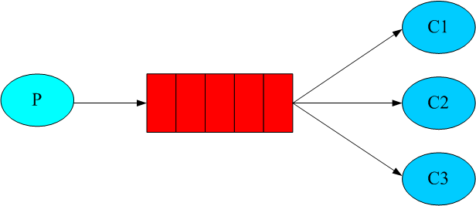
Persistent Queue – Consume Once & Fanout Queue

Slide 12
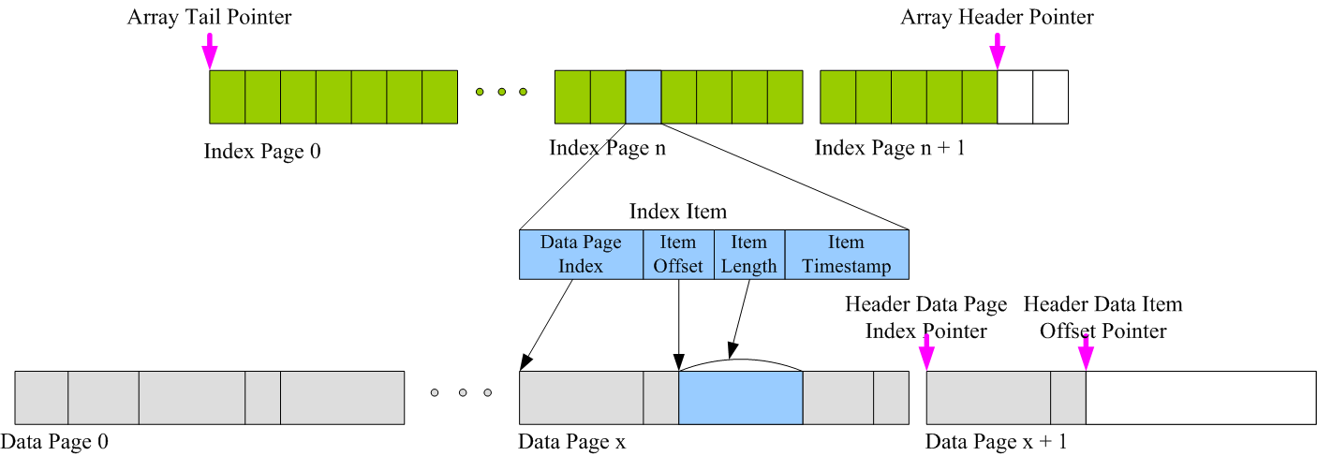
Persistent Queue – Physical View
Paged index file and data file

Slide 13
Persistent Queue - Concurrency
Append operation is synchronized in queue implementation
Read operation is already thread safe
Array Header Index Pointer is a read/write barrier

Slide 14
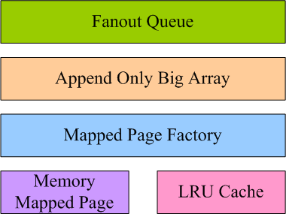
Persistent Queue – Components View

Slide 15
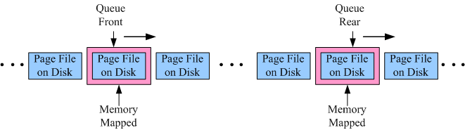
Persistent Queue – Dynamic View
Memory Mapped Sliding Window
Leverage locality of rear append and front read access mode of queue

Slide 16
Communication Layer – Why Thrift
Stable & Mature
Created by Facebook, used in Cassandra and HBase
High Performance
Binary serialization protocol and non-blocking server model
Simple & Light-Weight
IDL driven development, auto-generate client & server side proxy
Cross-Language
Auto-generate clients for Java, C#, C++, PHP, Ruby, Python, …
Flexible & Pluggable Architecture
Programming like playing with building blocks, components are replaceable as needed.

Slide 17
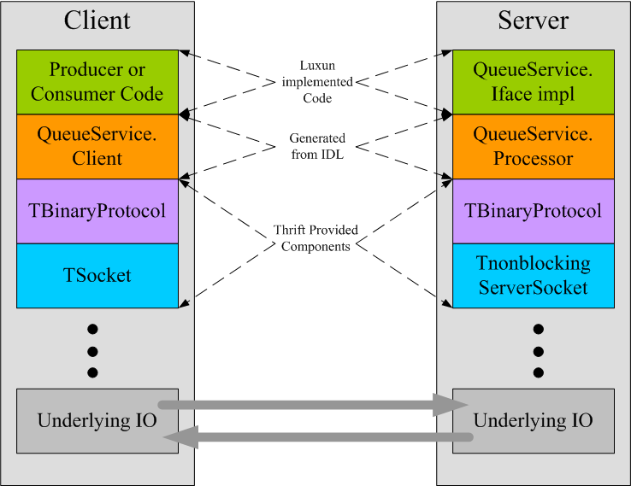
Communication Layer – Components View

Slide 18
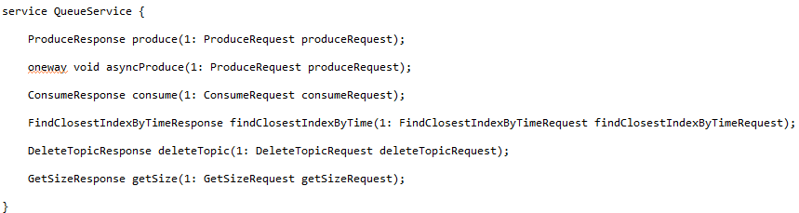
Communication Layer – Luxun Thrift IDL

Slide 19
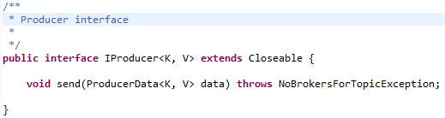
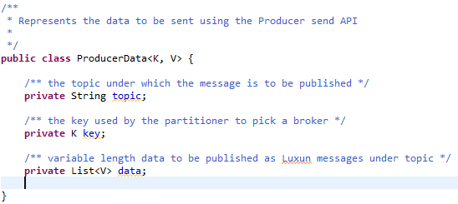
Producer – The Interface

Slide 20
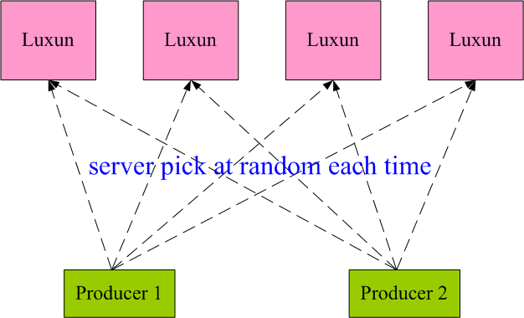
Producing Partitioning on Producer Side

Slide 21
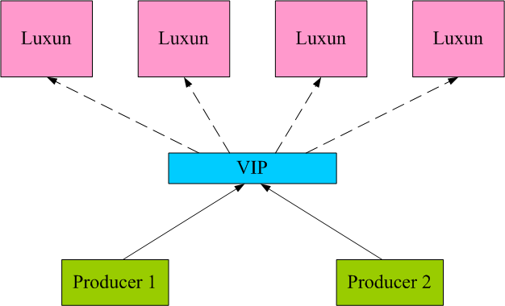
Producing Partitioning through VIP

Slide 22
Producing Compression
Current Support
0 – No compression
1 – GZip compression
2 – Snappy compression
Enable Compression for better utilization of
Network bandwidth
Disk space

Slide 23
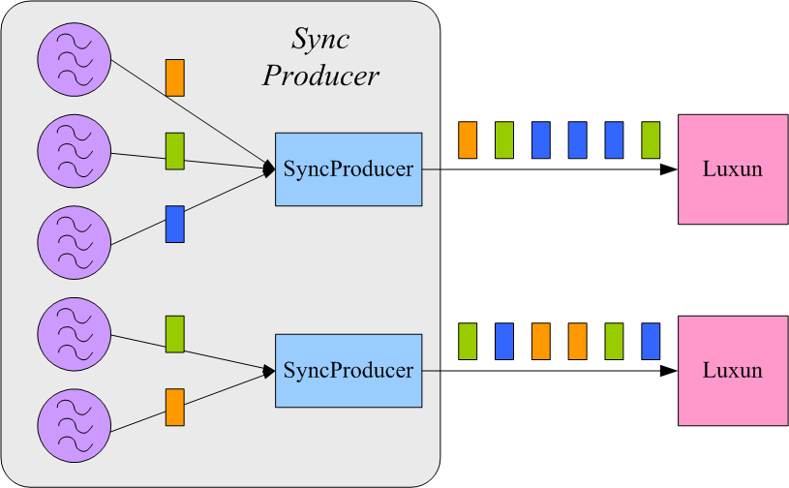
Sync Producing
Better real-time, worse throughput
Use this mode only if real-time is the top priority

Slide 24
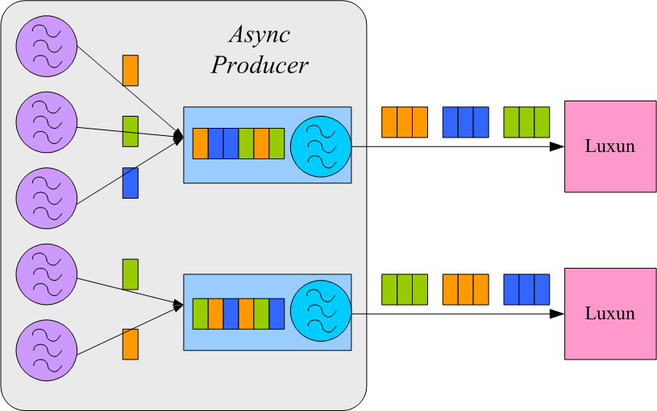
Async & Batch Producing
Better Throughput, sacrifice a little real-time
Should be enabled whenever possible for higher throughput

Slide 25


Simple Consumer

Slide 26
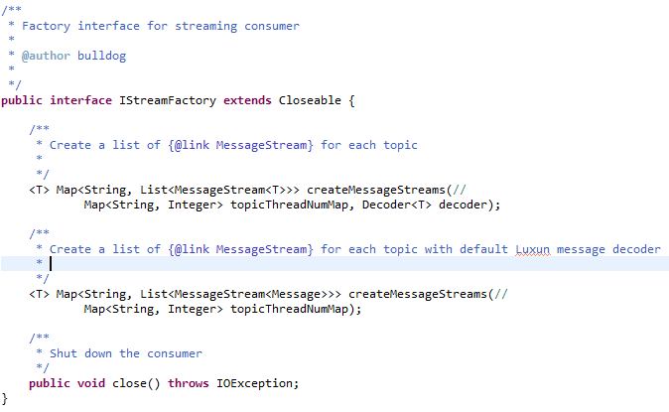

Advanced Stream Style Consumer

Slide 27
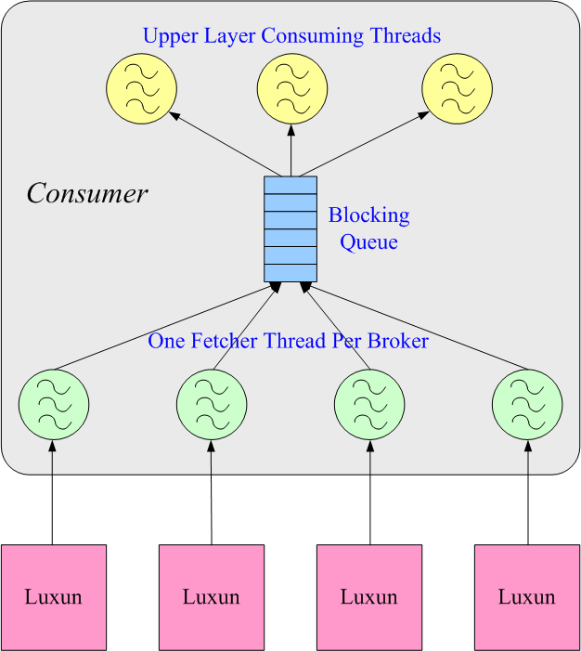
Advanced Consumer Internals

Slide 28
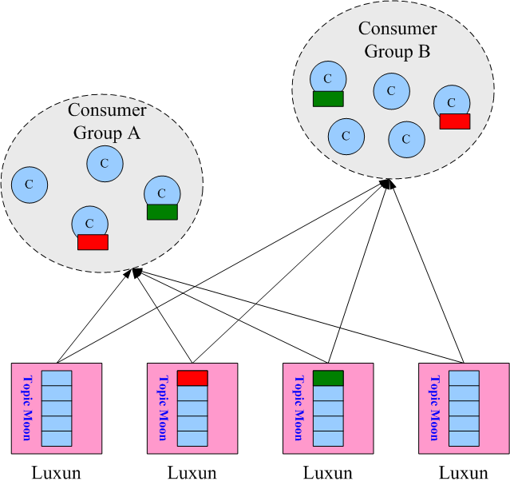
Consumer Group
Within same group, consume once sematics
Among different groups, fanout semantics

Slide 29
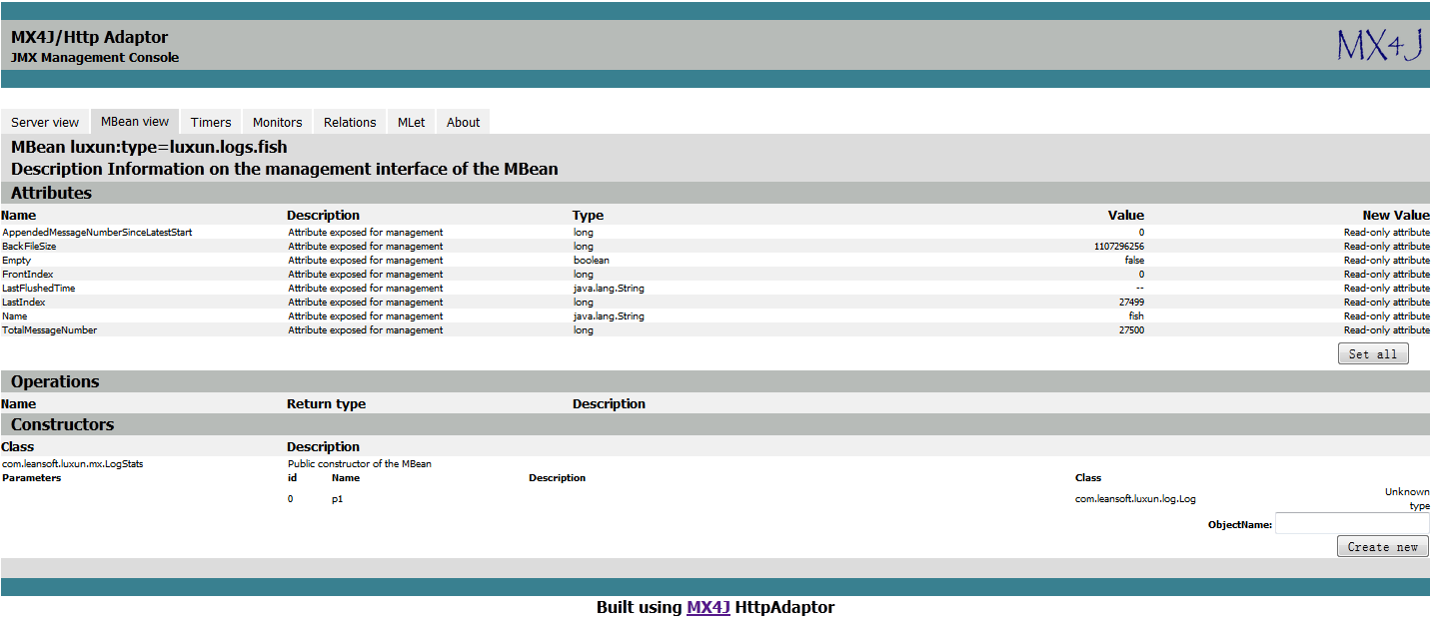
JMX Based Monitoring

Slide 30
Key Performance Test Observations
On single machine, throughput is only limited by disk IO bandwidth
In networking case, throughput is only limited by network bandwidth
1Gbps network is ok, 10Gbps network is recommended
Not sensitive to JVM heap setting,
Memory mapped file uses off-heap memory
4GB is ok, >8GB is recommended
Throughput > 50 MBps even on normal PC

Slide 31
Key Performance Test Observations Continue
Performs good on both Windows and Linux platforms
The throughput of async batch producing is order of magnitude better than sycn producing
Flush on broker has negative impact on throughput, recommend to disable flush because of unique feature of memoy mapped file
The throughput of one way not confirmed produce interface is 3 times better than two way confirmed produce interface

Slide 32
Key Performance Test Observations Continue
The overall performance will not change as number of topics increase, the throughput will be shared among different topics.
Compression should be enabled for better network bandwidth and disk space utilization, Snappy has better efficiency than GZip.

Slide 33
Operation - Most Important Performance Configurations
On broker
Flush has negative impact to performance, recommend to turn it off.
On producer side
Compression
Sync vs async producing
Batch size
On consumer side
Fetch size

Slide 34
Operation – Log Cleanup Configurations
Expired log cleanup can be configured with:
log.retention.hours – old back log page files outside of the retention window will be deleted periodically.
log.retention.size – old back log page files outside of the retention size will be deleted periodically

Slide 35
Luxun vs Apache Kafka – the Main Difference
Luxun is inspired by Kafka, however, they have following main differences:
 | Luxun | Kafka
Persistent Queue | Memory Mapped File | Filesystem & OS page cache
Communcation layer | Thrift RPC | Custom NIO and messaging protocol
Message access mode | Index Based | Offset based
Distribution for scalability | Random distribution | Zookeeper for distributed coordination
Partitioning | Only on server level | Partition within a topic

Slide 36
Credits
Luxun borrowed design ideas and adapted source from following open source projects:
Apache Kafka - http://kafka.apache.org/index.html
Jafka - https://github.com/adyliu/jafka
Java Chronicle - https://github.com/peter-lawrey/Java-Chronicle
Fqueue - http://code.google.com/p/fqueue/
Ashes-queue - http://code.google.com/p/ashes-queue/
Kestrel - https://github.com/robey/kestrel

Slide 37
Next Steps
Add a sharding layer for distribution and replication
More clients, C#, PHP, Ruby, Python, C++, etc
Big data apps, such as centralized logging, tracing, metrics and events systems based on Luxun.

Slide 38
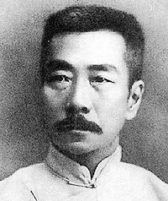
Origin of the Name
In memorial of LuXun, a great Chinese writer

Slide 39
Source, Docs and Downloadable
https://github.com/bulldog2011/luxun

