Slide 1
Day-1
Introduction to .NET Framework& C# And
Windows Forms Applications & Forms Designer

Slide 2
Objective
After completing this unit you will be able to:
What is .NET Platform?
What is .NET Framework
.NET Framework, Languages, and Tools
.NET Framework Major Components
Common Language Runtime (CLR)
Compilation and Execution in .NET
Understand the .NET Framework 4.5 stack
Know the new productivity enhancements in VS2019

Slide 3
Objective
Introduction to Winforms
Basic Concepts of GUI Programming
Components and Controls for Windows Forms
Layout of Controls

Slide 4
What is .NET Platform?
C# and the .NET platform were first introduced to the world in 2002 and were intended to offer a much more powerful, more flexible, and simpler programming model than COM.

Slide 5
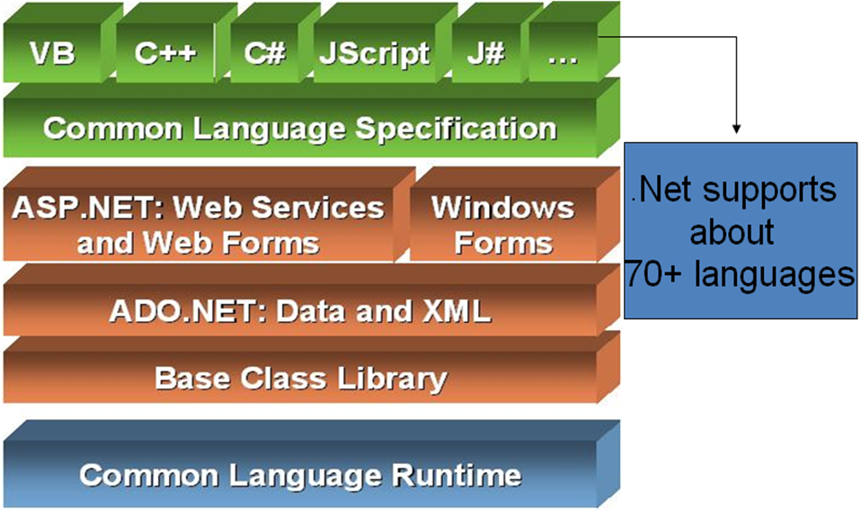
What is .NET Framework

Slide 6
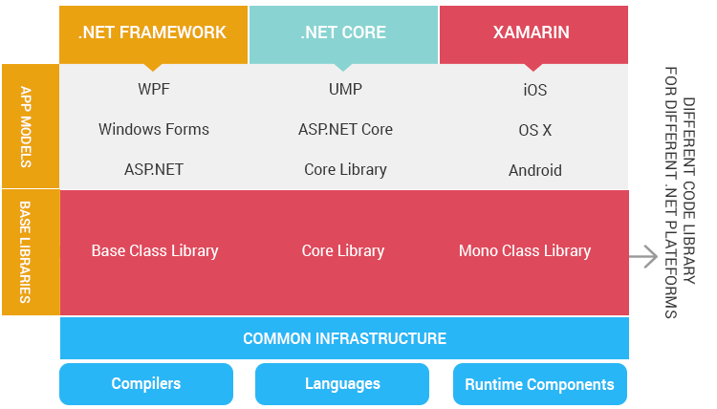
Components of Framework

Slide 7
Versions of the .NET Framework:
.NET Framework 4.8
.NET Framework 4.7.2
.NET Framework 4.7.1
.NET Framework 4.7
.NET Framework 4.6.2
.NET Framework 4.6.1
.NET 2015 and .NET Framework 4.6
.NET Framework 4.5.2
.NET Framework 4.5.1
.NET Framework 4.5

Slide 8
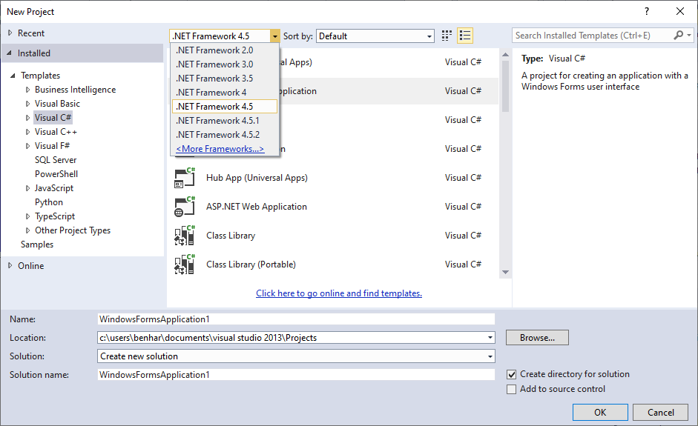
Versions of the .NET Framework:

Slide 9
.NET Framework, Languages, and Tools
C#.NET
VB.NET
C++.NET
J#.NET
F#.NET
JSCRIPT.NET
WINDOWS POWERSHELL

Slide 10
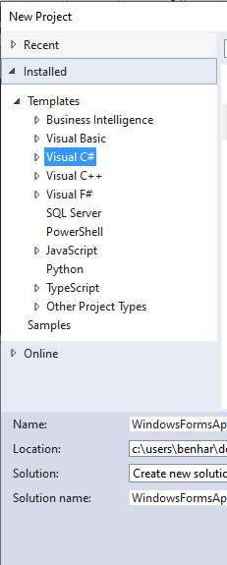
.NET Framework

Slide 11
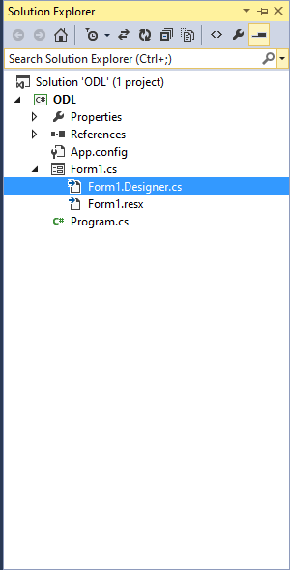
.NET Framework

Slide 12

.NET Framework

Slide 13
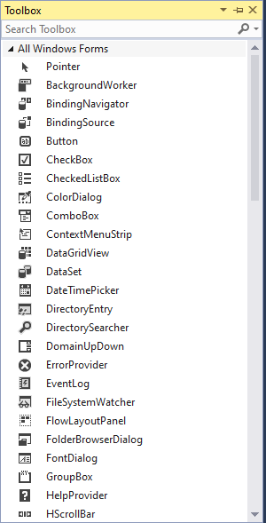
.NET Framework

Slide 14
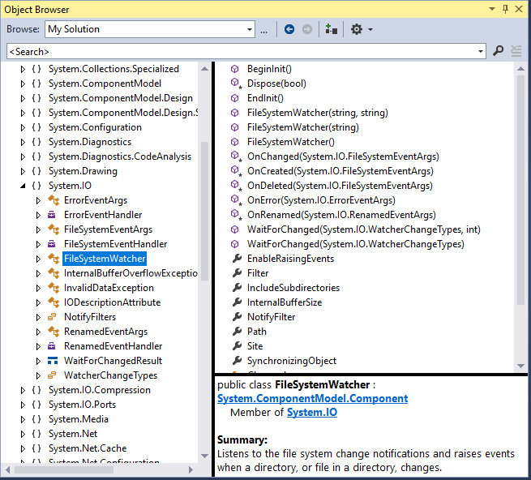
.NET Framework

Slide 15
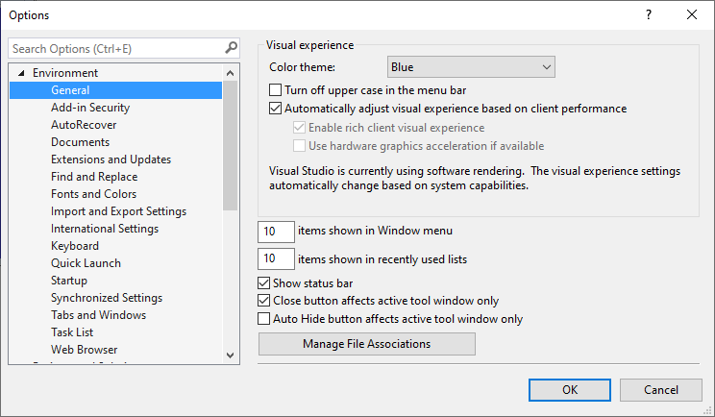
.NET Framework

Slide 16
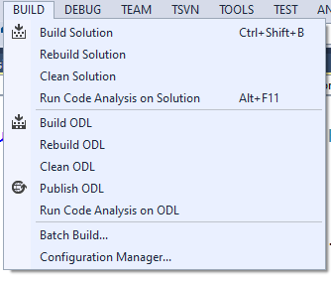
.NET Framework

Slide 17
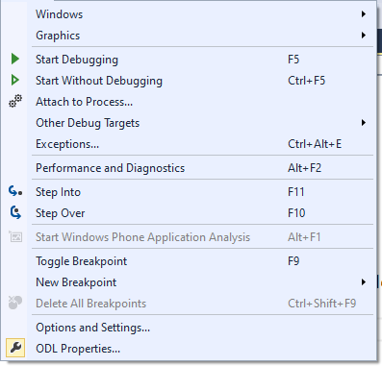
.NET Framework

Slide 18
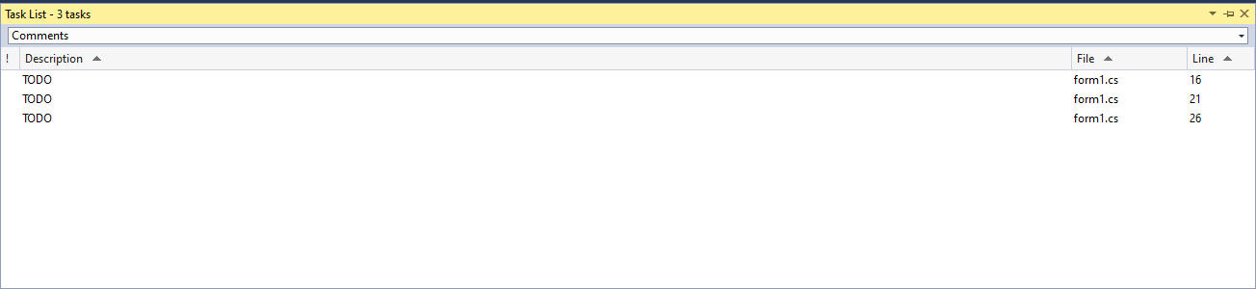
.NET Framework

Slide 19
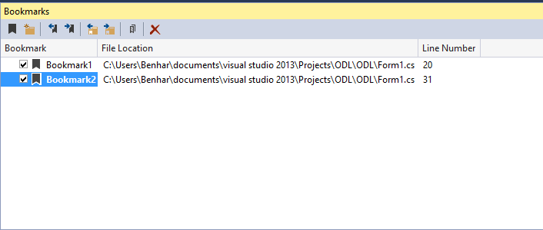
.NET Framework

Slide 20
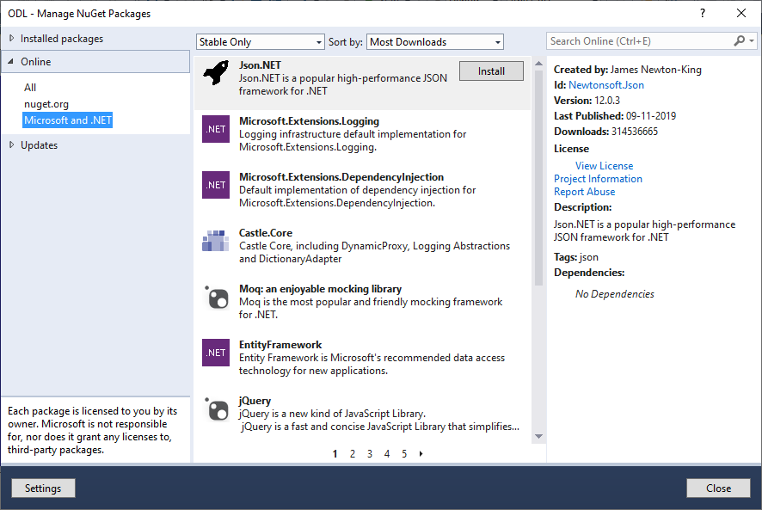
.NET Framework

Slide 21
.NET Framework Versions
4.5 | 4 | Visual Studio 2012 | 8
4.5.1 | 4 | Visual Studio 2013 | 8.1
4.5.2 | 4 | N/A | N/A
4.6 | 4 | Visual Studio 2015 | 10 v1507
4.6.1 | 4 | Visual Studio 2015 Update 1 | 10 v1511
4.6.2 | 4 | N/A | 10 v1607
4.7 | 4 | Visual Studio 2017 | 10 v1703
4.7.1 | 4 | Visual Studio 2017 | 10 v1709
4.7.2 | 4 | Visual Studio 2017 | 10v 1803

Slide 22
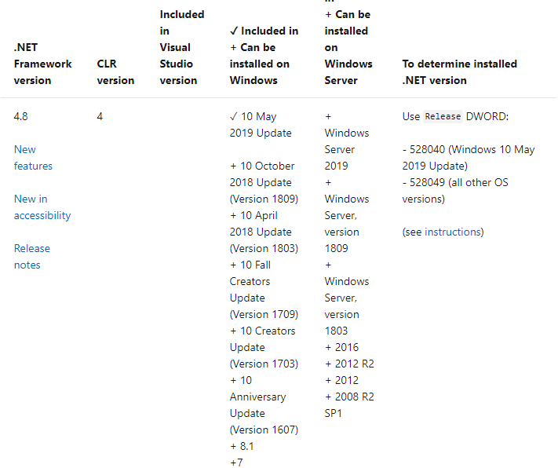
.NET Framework

Slide 23
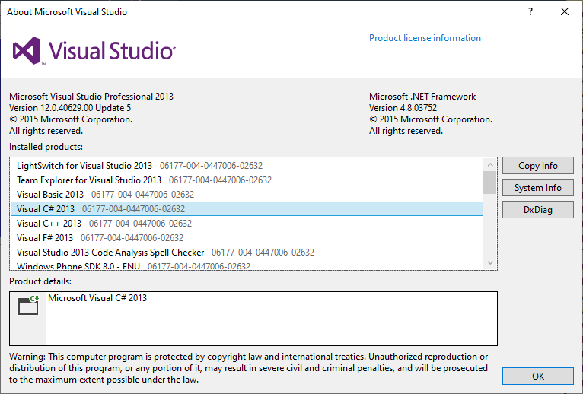
.NET Framework – Visual Studio

Slide 24
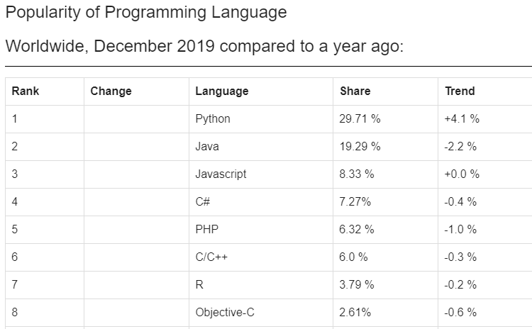
.NET Framework – Visual Studio

Slide 25
Common Language Runtime (CLR)
CLR is the heart of .NET Framework.
Execution environment for code written in .NET Framework.
The CLR works with every language available for the .NET Framework.
But CLR is not a common compiler for all .NET compatible languages.

Slide 26
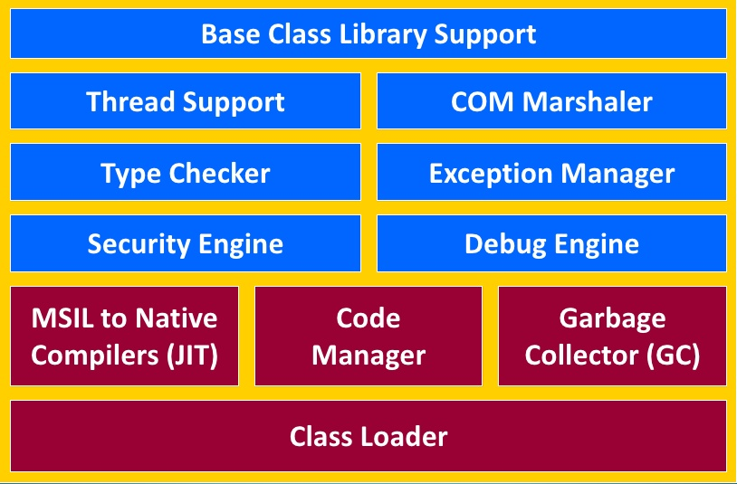
.NET Framework Major Components

Slide 27
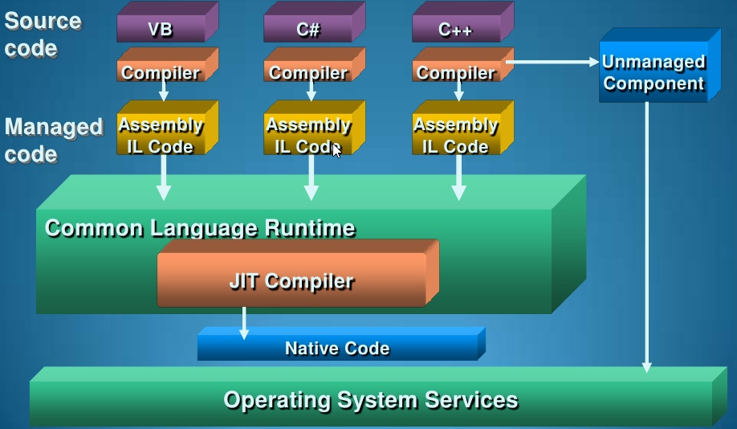
Compilation and Execution in .NET

Slide 28
Compilation and Execution in .NET
MSIL stands for Microsoft Intermediate Language During the compile time, the source code is converted into Microsoft Intermediate Language (MSIL) by compiler.
MSIL is a CPU-independent set of instructions that can be efficiently converted to the native code.

Slide 29
Compilation and Execution in .NET
It is used to create platform-specific, optimized versions of .NET Framework applications that have faster performance than applications that have to be compiled by the just-in-time compiler before they can be run.

Slide 30
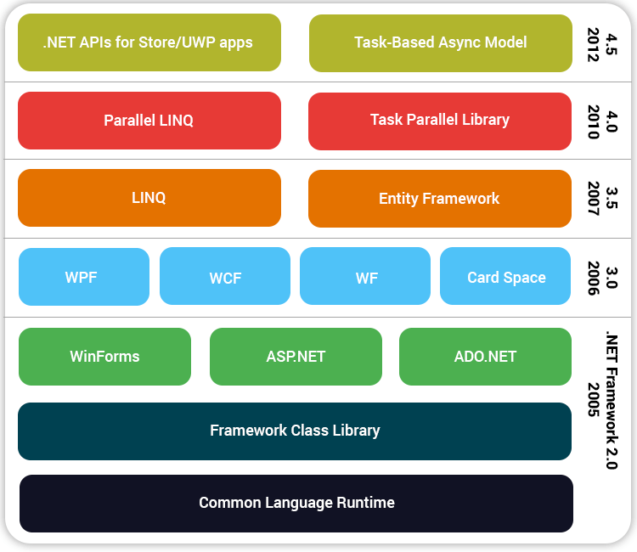
Understand the .NET Framework 4.5 stack

Slide 31
Know the new productivity enhancements in VS2019
There are 3 flavors of CLR available
.NET Framework CLR
.NET CoreCLR
.NET Mono CLR
.NET Framework 4.8 introduces new features in the following areas:
Base classes
Windows Communication Foundation (WCF) – Web services
Windows Presentation Foundation (WPF)
Common language runtime

Slide 32
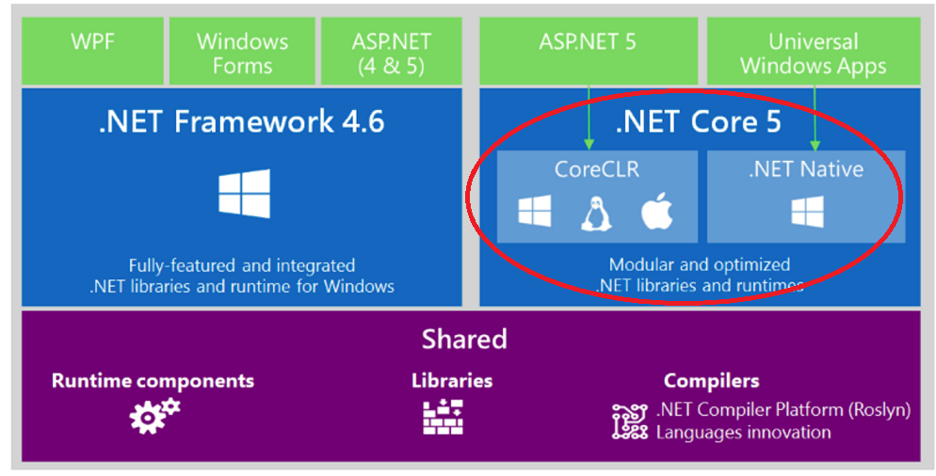
What actually is .NET Core?

Slide 33
Oop Fundamentals
OOP (Object-Oriented Programming) is a programming paradigm based on objects and classes.

Slide 34
OOP Pillars Overview
Encapsulation: Encapsulation means binding data and methods together into a single unit (class) and restricting direct access to data.
Inheritance: Inheritance allows one class to acquire properties and methods of another class.

Slide 35
Cont.,
Polymorphism: Polymorphism means one method behaving differently in different situations.
There are two types:
Method Overloading (Compile-time)
Method Overriding (Run-time)

Slide 36
Basic Structure of a C# Program
A simple C# program structure:
using System;
namespace MyApplication
{
class Program
{
static void Main(string[] args)
{
Console.WriteLine("Hello World");
}
}
}

Slide 37
Exercises
Write a console application that obtains four int values from the user and displays the product.
Hint: you may recall that the Convert.ToDouble() command was used to convert the input from the console to a double; the equivalent command to convert from a string to an int is Convert.ToInt32().

Slide 38
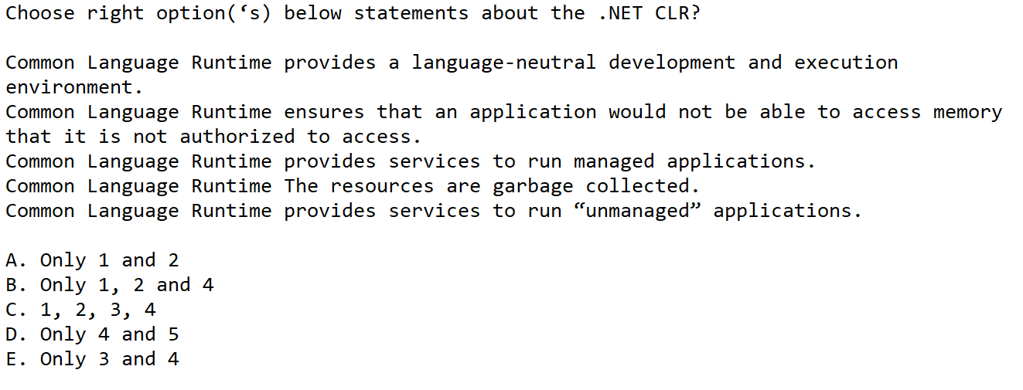
Test Your Knowledge
C. 1, 2, 3, 4

Slide 39
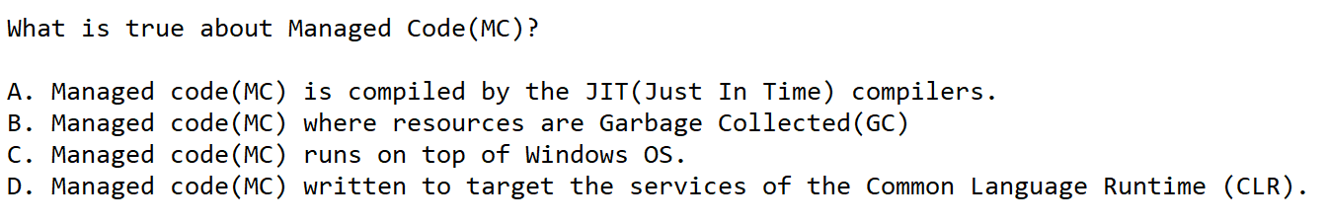
Test Your Knowledge
D. Managed code(MC) written to target the services of the Common Language Runtime (CLR).

Slide 40
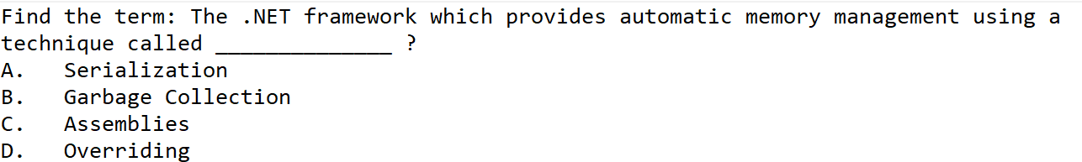
Test Your Knowledge
B. Garbage Collection

Slide 41
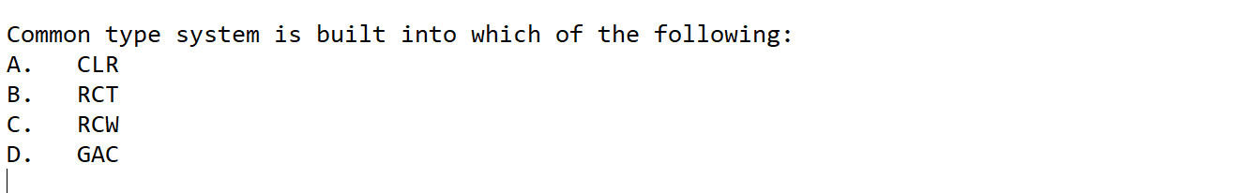
Test Your Knowledge
A. CLR

Slide 42

Test Your Knowledge
D. Many

Slide 43
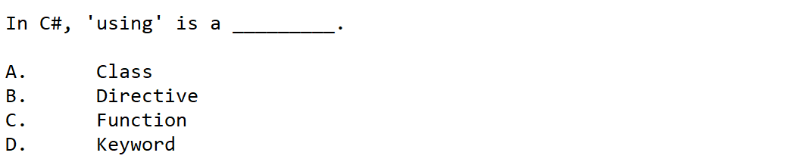
Test Your Knowledge
B. Directive

Slide 44
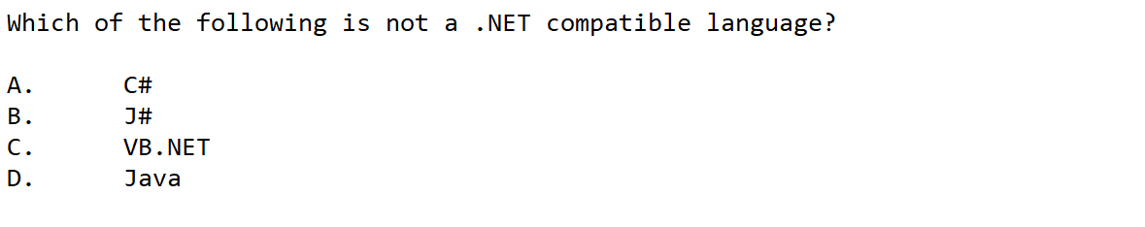
Test Your Knowledge
D. Java

Slide 45
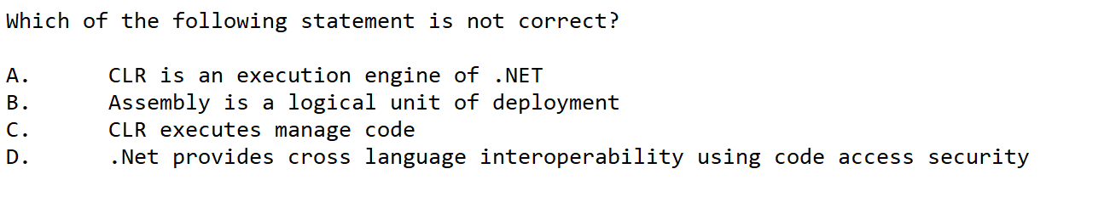
Test Your Knowledge
D. .Net provides cross language interoperability using code access security

Slide 46
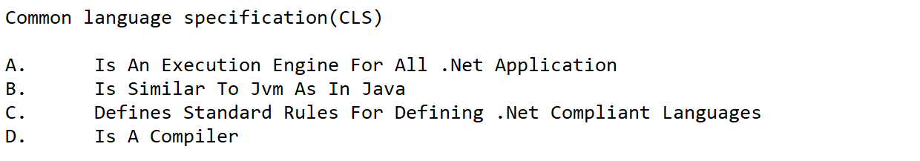
Test Your Knowledge
C. Defines Standard Rules For Defining .Net Compliant Languages

Slide 47
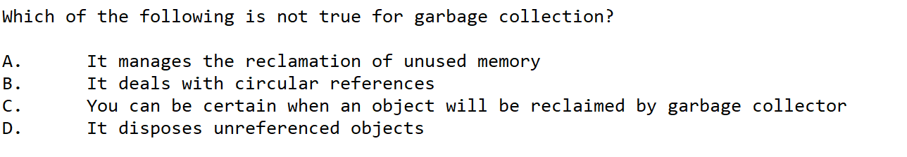
Test Your Knowledge
C. You can be certain when an object will be reclaimed by garbage collector

Slide 48
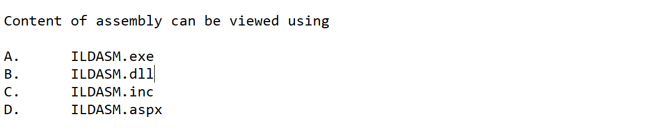
Test Your Knowledge
A. ILDASM.exe

Slide 49
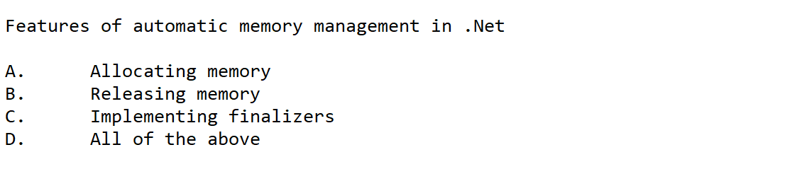
Test Your Knowledge
D. All of the above

Slide 50
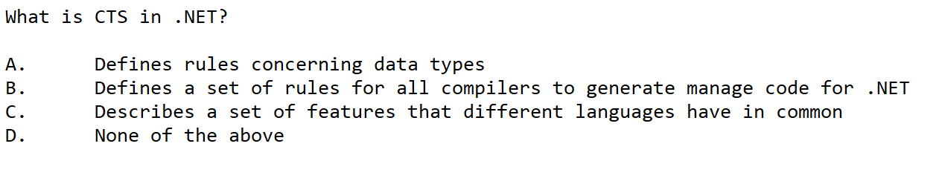
Test Your Knowledge
A. Defines rules concerning data types

