Slide 1
Day-2
Data Types and Arrays in C# And
OOP with C#

Slide 2
Objective
Data Types in C#
Value Types and Reference Types
Single Dimensional, Multi-Dimensional & Jagged arrays
Nullable Types
Implicitly Typed Local variables
Classes and Objects
Constructors

Slide 3
Objective
Structures in C#
Inheritance
Properties and Indexers
Concept of Function Overloading & Overriding
Abstract Class, Virtual and Abstract Methods Sealed Class
Interfaces
Method Parameters (out, ref)
Object Initializers

Slide 4
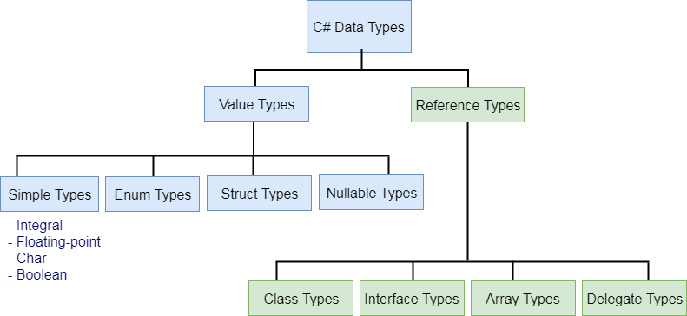
Data Types in C#
C# is a strongly-typed language.

Slide 5
Data Types in C#
Type | Description | Range
byte | 8-bit unsigned integer | 0 to 255
sbyte | 8-bit signed integer | -128 to 127
short | 16-bit signed integer | -32,768 to 32,767
ushort | 16-bit unsigned integer | 0 to 65,535
int | 32-bit signed integer | -2,147,483,648 to 2,147,483,647
uint | 32-bit unsigned integer | 0 to 4,294,967,295
Long | 64-bit signed integer | -9,223,372,036,854,775,808 to 9,223,372,036,854,775,807
ulong | 64-bit unsigned integer | 0 to 18,446,744,073,709,551,615
float | 32-bit Single-precision floating point type | -3.402823e38 to 3.402823e38
double | 64-bit double-precision floating point type | -1.79769313486232e308 to 1.79769313486232e308
decimal | 128-bit decimal type for financial and monetary calculations | (+ or -)1.0 x 10e-28 to 7.9 x 10e28
char | 16-bit single Unicode character | Any valid character, e.g. a,*, \x0058 (hex), or\u0058 (Unicode)
bool | 8-bit logical true/false value | True or False

Slide 6
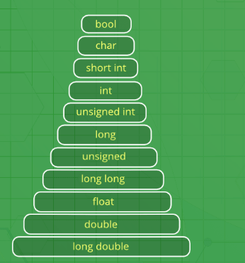
Data Types in C#

Slide 7
Value Types and Reference Types
A data type is a value type if it holds a data value within its own memory space. It means variables of these data types directly contain their values.
A reference type doesn't store its value directly. Instead, it stores the address where the value is being stored. In other words, a reference type contains a pointer to another memory location that holds the data.

Slide 8
Value Types

Slide 9
Reference Types

Slide 10
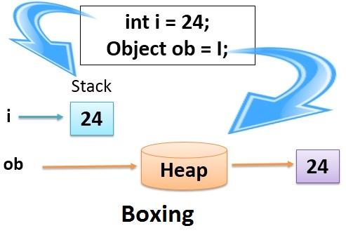
Implicit Conversions
Implicit conversions are easier to use and understand. For example, assigning an integer to a double is implicit conversion and of course there is no data loss.
For Example:
int val1 = 10;
double val2 = val1; ← Implicit conversion

Slide 11
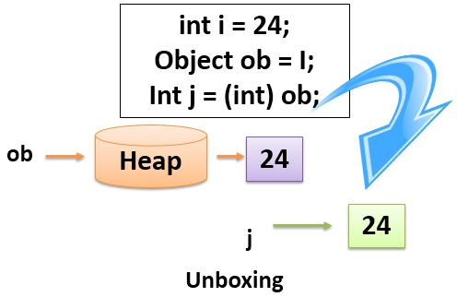
Explicit Conversions
Converting from double to int is not allowed without type casting. It is called explicit type casting.
For Example:
int val1 = 10;
double val2 =val1;
int val3 = (int) val2; ← Explicit conversion

Slide 12
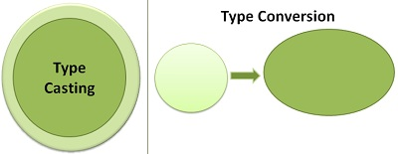
Type Casting and Type Conversion
The basic difference between type conversion and type casting, i.e. type conversion is made “automatically” by compiler whereas, type casting is to be “explicitly done” by the programmer.

Slide 13
Nullable Types
A value type cannot be assigned a null value.
For example, int b2 = null will give you a compile time error.
A Nullable type can be created as Nullable<T>. The T here is the type that cannot have null values.
The type Nullable<T> will either have a null value or any possible value that T can have.
For Example, Nullable<T> b2 = null;
Instead of writing Nullable<T> every time, we can use the shorthand version for creating The Nullable types as T? t.

Slide 14
Nullable Types
Using System;
class Program
{
static void Main(string[] args)
{
DateTime? dt = null;
dt = DateTime.Now;
object o = dt;
// Unboxing to a nullable
DateTime? dt2 = o as DateTime?;
if (dt2 != null){
Console.WriteLine(dt2.Value.ToString());}
Console.ReadLine();
}
}

Slide 15
Nullable Types
The Null coalescing operator ?? will return the value of the contained T type if it has some value otherwise it will return the default value.

Slide 16
Nullable Types
Using System;
class Program
{
static void Main(string[] args)
{
int? j = null; int? k = 54;
int result1 = j ?? 0;int result2 = k ?? 0;
// this will print 0 and 54 Console.WriteLine("result1 = {0}, result2 = {1}", result1, result2);
Console.ReadLine();
}
}

Slide 17
Types of arrays
Single Dimensional arrays
Multi-Dimensional arrays
Jagged arrays

Slide 18
Sort Int Array
Using System;
Class ODLExample1
{
public static void Main()
{
int[] intArray = new int[5] { 34,23,41,89,77 };
Array.Sort(intArray);
// write array
foreach (int i in intArray)
{
Console.Write(i + " ");
}
}
}

Slide 19
Sort String Array
Using System;
Class ODLExample1
{
public static void Main()
{
string[] stringArray = new string[5] { "Csharp", "ASP.net", "EntityFramework", "ADO.net", "WCF" };
Array.Sort(stringArray);
// write array
foreach (string str in stringArray)
{
Console.Write(str + " ");
}
}
}

Slide 20
Control Statements
If Statement
Simple If Statement
If – else Statement
Else – If Statement
Switch Statement
While Loop
Do…While Loop
For Loop
Foreach Loop

Slide 21
If – else Statement
Syntax:
Using System;
Class Sampleif
{
public static void Main()
{
int a = 12;
int b = 10;
if(a>b){
Console.Writeline(“a is greater”);
}
else {
Console.Writeline(“b is greater”);
} } }
if {condition}
{
statements;
}
else {condition}
{
statements;
}

Slide 22
Switch Statement
Break :
Leaves the switch block.
Goto :
Leaves the switch block and jumps directly to the label of the form.
Default :
If none of the choices match , then the default choice statements are executed.

Slide 23
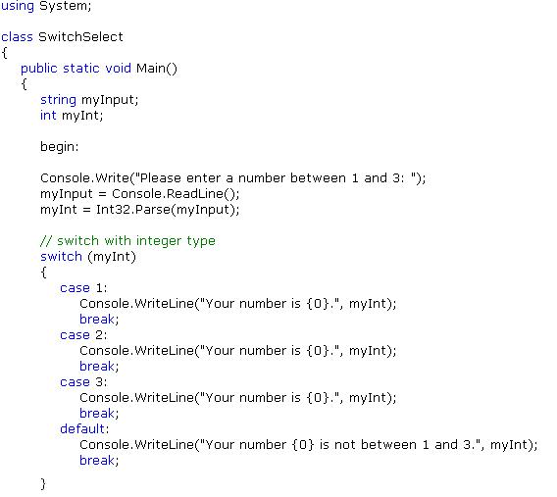
Switch Statement

Slide 24
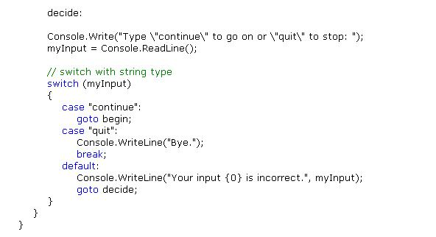
Switch Statement

Slide 25
While Loop
While loop checks the condition and then continues to evaluate the block of code until the condition evaluates to a Boolean value of true.
Syntax:
while {condition}
{
statements;
}

Slide 26
Do - While
It is similar to while loop , except it checks its condition at the end of the loop.
Even when the condition is initially false, the block runs once.
Syntax:
Using System;
Class Sampledowhile
{
public static void Main()
{
int a = 4;
do
{
Console.Writeline(a);
}While (a < 3);
}
}
do
{
statements;
}

Slide 27
For Loop
Syntax:
for ( (initialization) ; (condition) ; (iteration) )
{
Statement;
}

Slide 28
For Each
Syntax:
foreach (data-type variable1 in collection-variable)
{
statement[s] ;
}

Slide 29
C# Data Types: Exercise-1
Write a C# Sharp program that takes three letters as input and display them in reverse order.
Test Case
Enter letter: O
Enter letter: D
Enter letter: L
Expected Output :
L D O

Slide 30
C# Data Types: Exercise-2
Write a C# Sharp program that takes a number value as 2 and a width value as 6 also a number, as input and then displays a triangle of that width, using that number.
Test case:
Enter a number: 6
Enter the desired width: 6

Slide 31
Contd.,
Expected Output :
666666
66666
6666
666
66
6

Slide 32
C# Data Types: Exercise-3
Write a C# Sharp program that takes two numbers as input and returns true or false when both numbers are even or odd.
Test Case:
Input First number: 4
Input Second number: 6
Expected Output :
There're numbers bothEven

