Slide 1
Day-3
OOP with C#

Slide 2
OOPs Concepts
There are some basic concepts of object oriented programming as follows:
Class
Object
Data abstraction
Data encapsulation
Inheritance
Polymorphism

Slide 3
Class
A class is a set of objects with similar properties (attributes), common behavior (operations), and common link to other objects.
The complete set of data and code of an object can be made a user defined data type with the help of class.
The objects are variable of type class. A class is a collection of objects of similar type.
Classes are user defined data types and work like the build in type of the programming language.

Slide 4
Class
Once the class has been defined, we can make any number of objects belonging to that class.
Each object is related with the data of type class with which they are formed.
The important thing about the class is to identify the properties and procedures and applicability to its instances.

Slide 5
Object
Objects are important runtime entities in object oriented method.
They may characterize a location, a bank account, and a table of data or any entry that the program must handle.
Each object holds data and code to operate the data.
Object can interact without having to identify the details of each other‘s data or code.
It is sufficient to identify the type of message received and the type of reply returned by the objects.

Slide 6
Object
using System;
class ODLExercise
{
public void Addition()
{
int a = 10;
int b = 20;
int sum = a + b;
Console.WriteLine("Sum ="+sum);
}
}
class Demo
{
static void Main()
{
ODLExercise obj1 = new ODLExercise();
obj1.Addition();
}
}

Slide 7
Constructor and Destructor
Constructors and destructors are special member functions of classes that are used to construct and destroy class objects.
A constructor initializes an object when it is created. It has the same name as its class and is syntactically similar to a method. However, constructors have no explicit return type.
The general form of a constructor is shown here:
access class-name(param-list)
{
// constructor code
}

Slide 8
Constructor and Destructor
There are 3 types of constructor
Static Constructor
Default constructor - takes no parameters.
Overloaded constructor - takes parameters.

Slide 9
Constructor and Destructor
A static constructor is first called when the runtime first accesses the class.
Static variables are accessible at all times, so the runtime must initialize it on its first access.

Slide 10
Constructor and Destructor
using System;
class ODLExercise
{
private static int number;
public static int Number { get { return number; } }
static ODLExercise(){
Random r = new Random();
number = r.Next();
}
}
class Program
{
static void Main(string[] args)
{
Console.WriteLine("Static Number = " + ODLExercise.Number);
}
}

Slide 11
Constructor and Destructor
using System;
class ODLExercise
{
private int number;
public int Number { get { return number; }
}
public ODLExercise()
{
Random r = new Random();
number = r.Next();
}
}
class Program
{
static void Main(string[] args)
{
ODLExercise num=new ODLExercise();
Console.WriteLine("Static Number = " +num.Number);
}
}

Slide 12
Constructor and Destructor
using System;
class ODLExercise
{
private int number;
public int Number { get { return number; }
}
public ODLExercise()
{
Random r = new Random();
number = r.Next();
}
public ODLExercise(int seed)
{
Random r = new Random(seed);
number = r.Next();
}
}
class Program
{
static void Main(string[] args)
{
ODLExercise num=new ODLExercise();
Console.WriteLine("Static Number = " +num.Number);
ODLExercise num1=new ODLExercise(500);
Console.WriteLine("Static Speed = " +num1.Number);
}
}

Slide 13
Constructor and Destructor
Constructors and destructors do not have return types nor can they return values.
References and pointers cannot be used on constructors and destructors because their addresses cannot be taken.
Constructors cannot be declared with the keyword virtual.
Constructors and destructors cannot be declared const, or volatile.
The general form of a destructors is shown here:
~ class-name()
{
}

Slide 14
Enumeration
The “enum” keyword is used to declare an enumeration, a distinct type that consists of a set of named constants called the enumerator list.
The enumerator is an object that can return each item in a collection, one by one,in order, as they’re requested. For Example:
enum Day
{
Sunday, Monday, Tuesday, Wednesday, Thursday, Friday, Saturday
};

Slide 15
Enumeration
The enumerator “knows” the order of the items and keeps track of where it is in the sequence. It then returns the current item when it is requested.

Slide 16
Enumeration
All enums are of type System.Enum.
Enum types are limited to long, int, short and byte only.
By default, the value of an enum member is int and starts with 0 in an increment of 1.

Slide 17
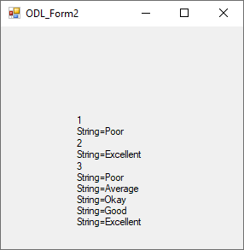
Enumeration

Slide 18
Enumeration
Enum method | Description
Format | Converts the specified value of enum type to the specified string format.
GetName | Returns the name of the constant of the specified value of specified enum.
GetNames | Returns an array of string name of all the constant of specified enum.
GetValues | Returns an array of the values of all the constants of specified enum.
object Parse(type, string) | Converts the string representation of the name or numeric value of one or more enumerated constants to an equivalent enumerated object.
bool TryParse(string, out TEnum) | Converts the string representation of the name or numeric value of one or more enumerated constants to an equivalent enumerated object. The return value indicates whether the conversion succeeded.

Slide 19
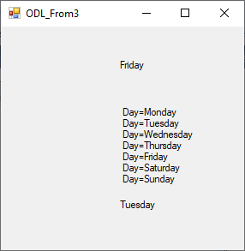
Enumeration

Slide 20
Inheritance
Inheritance means getting some thing (properties) as heredity. To get that, we need a hierarchical structure. And that is provided by OOP using Inheritance.
The properties (variables) and methods are accessible to the sub class, but keep in mind that only the public ones.
The private methods or variables are not accessible from the child class.

Slide 21
Inheritance
And the methods are accessible can be called without creating the object of that super class.
The reason behind OOP programming is to promote the reusability of code and to reduce complexity in code and it is possible by using inheritance.

Slide 22
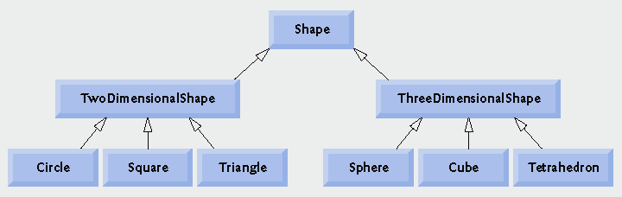
Inheritance

Slide 23
Inheritance
There are
Single Inheritance
Multi Level Inheritance
Multiple Inheritance
Hierarchical Inheritance
Hybrid Inheritance

Slide 24
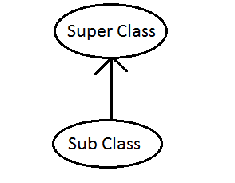
Inheritance
Single Inheritance
Example
public class BaseClass
{
public BaseClass()
{
// Default Constructor
}
}
public class SubClass : BaseClass > Derived
{
public SubClass()
{
// Default Constructor
}
}

Slide 25
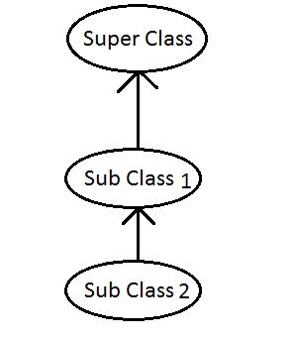
Inheritance
Multi Level Inheritance
public class BaseClass
{
public BaseClass()
{
// Default Constructor
}
}
public class SubClass1 : BaseClass{
public SubClass1()
{
// Default Constructor
}
}
public class SubClass 2: SubClass1
{
public SubClass2()
{
// Default Constructor
}
}

Slide 26
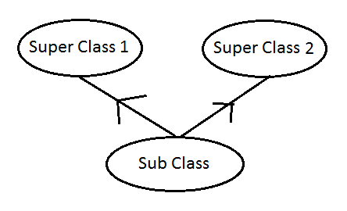
Inheritance
Multiple Inheritance
interface interface1
{
}
interface interface2
{
}
public class Subclass : interface1, interface2
{
}

Slide 27
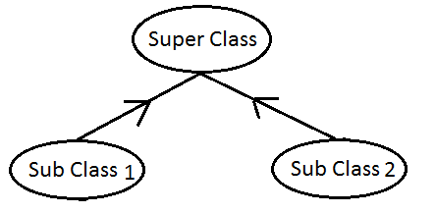
Inheritance
Hierarchical Inheritance
public class BaseClass
{
public BaseClass()
{ BaseClass
// Default Constructor
}
}
public class SubClass1 : BaseClass
{
public SubClass1()
{
// Default Constructor
}
}
public class SubClass2 : BaseClass
{
public SubClass2()
{
// Default Constructor
}
}

Slide 28
Inheritance
Hybrid Inheritance
public class Class1
{
}
public class Class2 : Class1
{
}
public class DerSubClass1 : Class2
{
}
public class DerSubClass2 : Class2
{
}

Slide 29
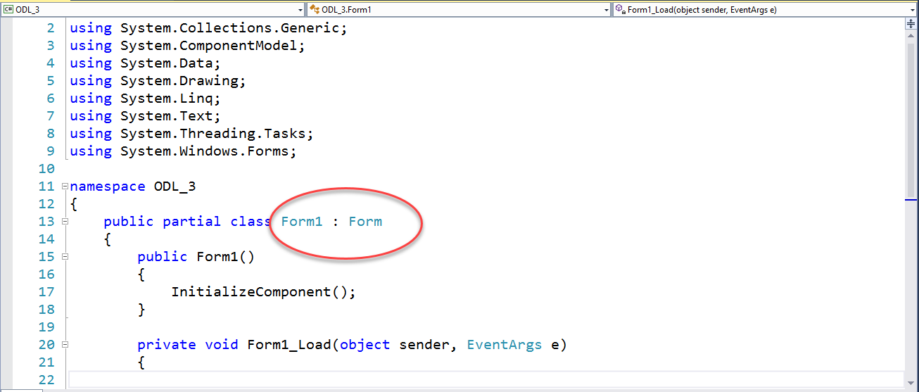
Inheritance
Here we got a bunch of very similar forms in the windows application, so here trying to use one as a master form and inherit from it for the other forms.

Slide 30
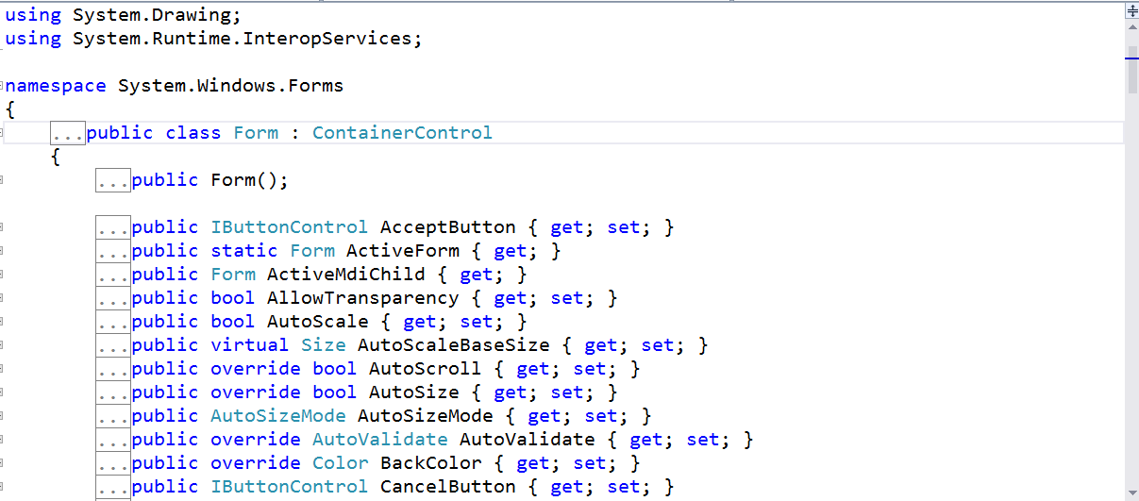
Inheritance

Slide 31
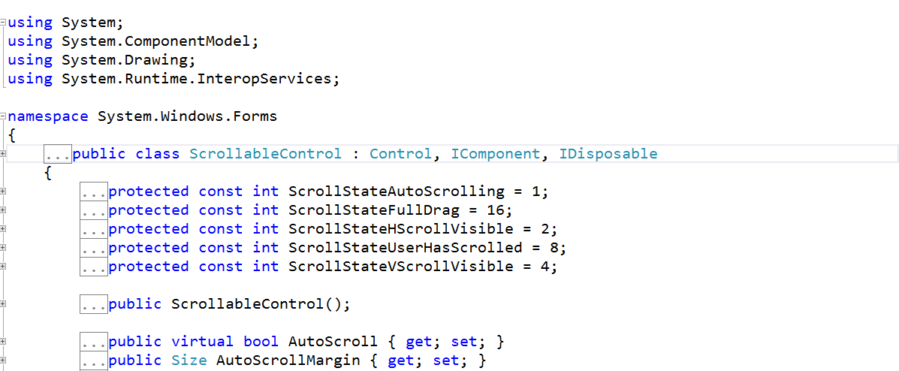
Inheritance

Slide 32
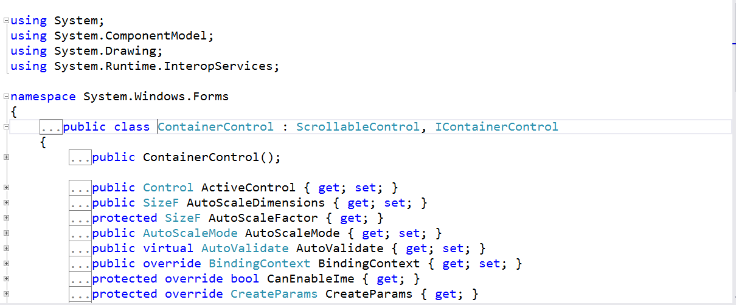
Inheritance

Slide 33
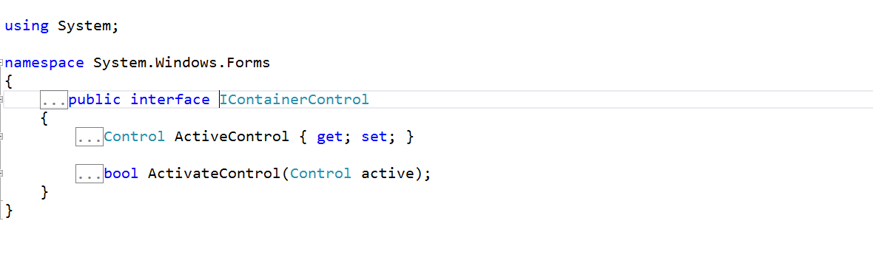
Inheritance

Slide 34
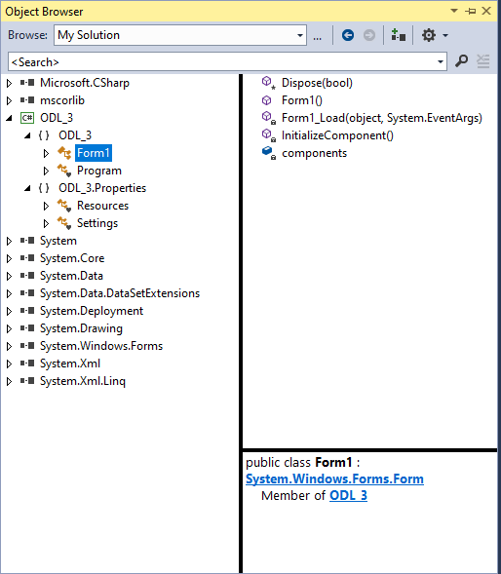
Inheritance

Slide 35
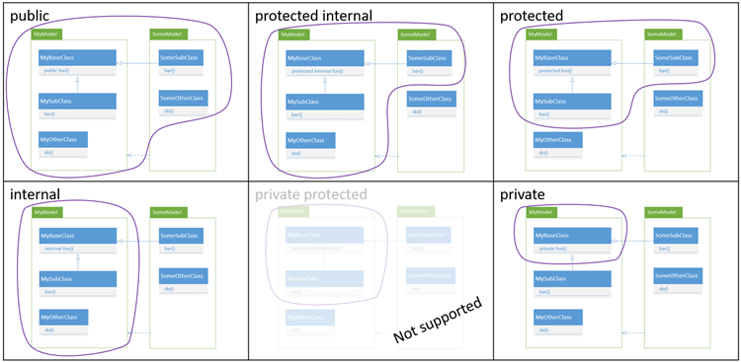
C#'s access modifiers

Slide 36
Polymorphism
Poly means ―many and morph means ―form).
Polymorphism means the ability to take more than one form.
Polymorphism plays a main role in allocate objects having different internal structures to share the same external interface.

Slide 37
Polymorphism
This means that a general class of operations may be accessed in the same manner even though specific activities associated with each operation may differ.
Polymorphism is broadly used in implementing inheritance.

Slide 38
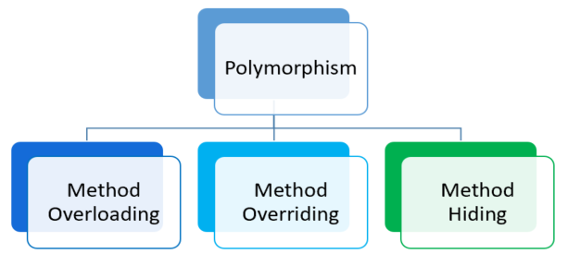
Polymorphism
Overloading happens on methods. It means that a method does a specific job according to the parameter that the user provides.

Slide 39
Polymorphism
Compile Time Polymorphism
Compile time polymorphism is method and operators overloading. It is also called early binding.
In method overloading method performs the different task at the different input parameters.
There is no limit to how many overload of a method you can have.

Slide 40
Polymorphism
Runtime Time Polymorphism
Runtime time polymorphism is done using inheritance and virtual functions. Method overriding is called runtime polymorphism. It is also called late binding.
When overriding a method, you change the behavior of the method for the derived class. Overloading a method simply involves having another method with the same prototype.
Whereas Overriding means changing the functionality of a method without changing the signature.
This is done by using virtual/override keywords.

Slide 41
Concept of Function Overriding
Derived class contains data and methods defined in the original class
Polymorphism
Using the same method or property name to indicate different implementations
Derived class can override and hide methods and data from the base class

Slide 42
Contd.,
using System;
class Car
{
public Car()
{ Name = "NoName"; NumberOfDoors = 3;
}
public Car(string name, int numberOfDoors)
{ Name = name; NumberOfDoors = numberOfDoors;
}
public Car(string name)
{ Name = name; NumberOfDoors = 0;
}
public Car(int numberOfDoors) { Name = ""; NumberOfDoors = numberOfDoors;
}
class ODLExce
{
static void Main(string[] args) {
Car c1 = new Car();
Car c2 = new Car( 3 );
Car c3 = new Car( "MyName" );
Car c4 = new Car( "MyName", 4 ); Console.WriteLine (c1.NumberOfDoors ); Console.WriteLine (c1.Name );
}

Slide 43
The virtual and override Keywords
The Virtual keyword is used for generating a virtual path for its derived classes on implementing method overriding.
Polymorphism provides a way for a subclass to define its own version of a method defined by its base class, using the process termed method overriding runtime polymorphism Causes late binding.
The New keyword is also used for polymorphism but in the case of method overriding.
New keyword is compile-time polymorphism Causes early binding.

Slide 44
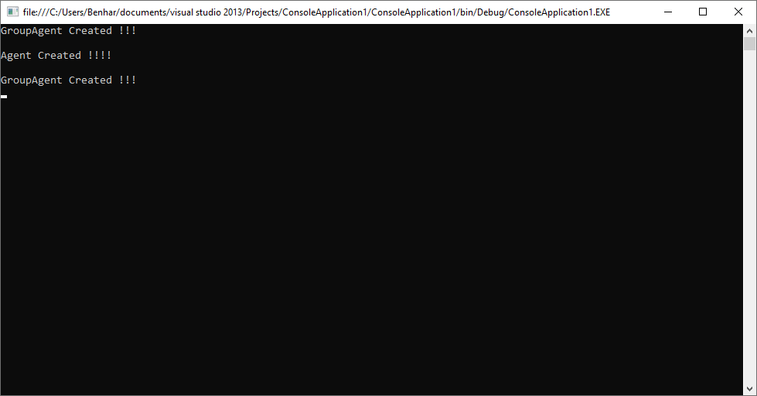
Method Overhiding
class GroupAgent {
public void show() { Console.WriteLine("GroupAgent Created !!!");Console.ReadLine();
}
}
class Agent : GroupAgent {
public new void show() { Console.WriteLine("Agent Created !!!!"); Console.ReadLine();
}
}
class ODLExercise
{
public static void Main()
{
GroupAgent a1 = new GroupAgent();
a1.show();
Agent b1 = new Agent();
b1.show();
GroupAgent a2 = new Agent();
a2.show();
}
}

Slide 45

Method Overriding
class GroupAgent {
public virtual void show() { Console.WriteLine("GroupAgent Created !!!");Console.ReadLine();
}
}
class Agent : GroupAgent {
public override void show() { Console.WriteLine("Agent Created !!!!"); Console.ReadLine();
}
}
class ODLExercise
{
public static void Main()
{
GroupAgent a1 = new GroupAgent();
a1.show();
Agent b1 = new Agent();
b1.show();
GroupAgent a2 = new Agent();
a2.show();
}
}

Slide 46
Abstract Class, Abstract Methods & Sealed Class
An abstract class cannot be instantiated. The purpose of an abstract class is to provide a common definition of a base class that multiple derived classes can share.

Slide 47
Sealed Class
Recall that a sealed class cannot be extended by other classes.
A sealed class is class that cannot be inherited.
When you mark a class as sealed using the sealed keyword, any attempts by the other classes to derive from it will fail.

Slide 48
Contd.,
The sealed method prevents a derived class from further overriding of method in the next level derived class.
The method declaration specified with sealed modifier must also include the override modifier.

Slide 49
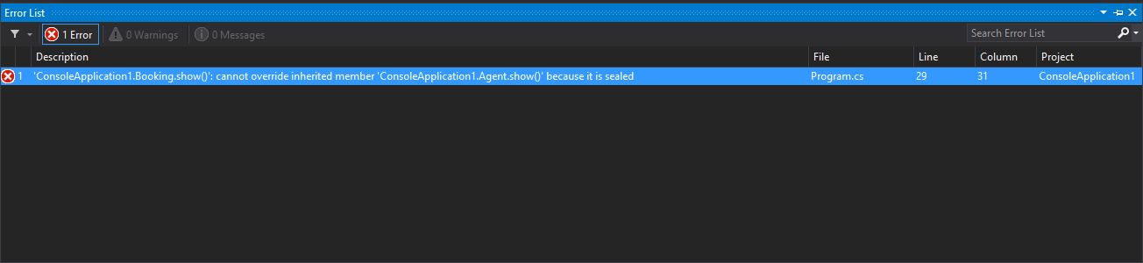
Contd.,
It is also sealed to prevent from further overriding the method.
class ODLExercise
{
public static void Main()
{
GroupAgent a1 = new GroupAgent();
a1.show();
Agent b1 = new Agent();
b1.show();
GroupAgent a2 = new Agent();
a2.show();
}
}
class Agent : GroupAgent
{
public sealed override void show()
{
Console.WriteLine("Agent Created !!!!");
Console.ReadLine();
}
}
class Booking : Agent
{
public override void show()
{
Console.WriteLine("Booking Created !!!!");
Console.ReadLine();
}
}

Slide 50
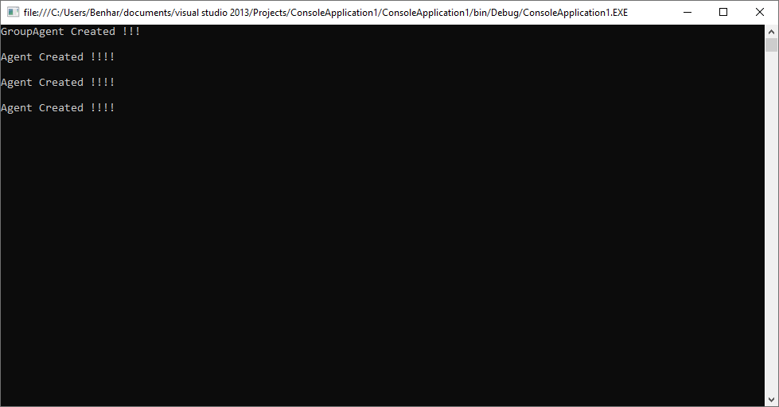
Contd.,
class Agent : GroupAgent
{
public sealed override void show()
{
Console.WriteLine("Agent Created !!!!");
Console.ReadLine();
}
}
class Booking : Agent
{
public new void show()
{
Console.WriteLine("Booking Created !!!!");
Console.ReadLine();
}
}
class ODLExercise {
public static void Main() {
GroupAgent a1 = new GroupAgent();
a1.show();
Agent b1 = new Agent();
b1.show();
GroupAgent a2 = new Agent();
a2.show();
GroupAgent a3 = new Booking();
a3.show();
}
}

