Slide 1
Day-4

Slide 2
Interfaces
An interface looks like a class, but has no implementation.
The only thing it contains are declarations of events, indexers, methods and/or properties.
The reason interfaces only provide declarations is because they are inherited by structs and classes, that must provide an implementation for each interface member declared.

Slide 3
Interfaces
Interface can not be instantiated.
An interface can’t contain:
Constants
Fields
Operators
Constructors
Destructors
An access modifier cannot be specified for an interface member.

Slide 4
Interfaces
All Interface members are public.
Interface can Inherit another Interface.
All methods in an interface are public and abstract by default.

Slide 5
Delegates
a delegate is a reference type used to encapsulate
Delegate is a type which holds the method(s) reference in an object.
a method with a specific signature and return type.
A delegate is created with the delegate keyword
public delegate int WhichIsFirst(object obj1, object obj2);
It is also referred to as a type safe function pointer.

Slide 6
Multicasting
With multicasting you create a single delegate that will call multiple encapsulated methods.
Forexample, when a button is pressed you might want to take more than one action.
You could implement this by giving the button a collection of delegates, but it is cleaner and easier to create a single multicast delegate.

Slide 7
Two multicast delegates can be combined with the addition operator (+).
You can add delegates to a multicast delegate using the plus-equals (+=) operator.
Finally, you selectively remove delegates using the -= operator:

Slide 8
Encapsulating the method's call from caller
Effective use of delegate improves the performance of application
Used to call a method asynchronously

Slide 9
Lambda expressions are like anonymous methods but with much more flexibility.
Lambda expressions were first introduced in .NET 3.5, at the same time that Language Integrated Query (LINQ) was made available.

Slide 10
Exception Handling in C#
The C# language's exception handling features help you deal with any unexpected or exceptional situations that occur when a program is running.
A try block is used by C# programmers to partition code that might be affected by an exception.

Slide 11
Exception Handling in C#
Associated catch blocks are used to handle any resulting exceptions.
A finally block contains code that is run regardless of whether or not an exception is thrown in the try block, such as releasing resources that are allocated in the try block.

Slide 12
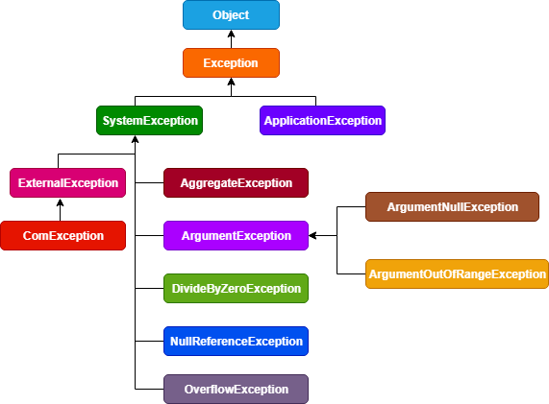
The System.Exception class

Slide 13
Using try and catch
These keywords work together; you can’t have a catch without a try.
The general form of the try/catch exception
try
{
// block of code to monitor for errors
}
catch (ExcepType1 exOb)
{
// handler for ExcepType1
}

Slide 14
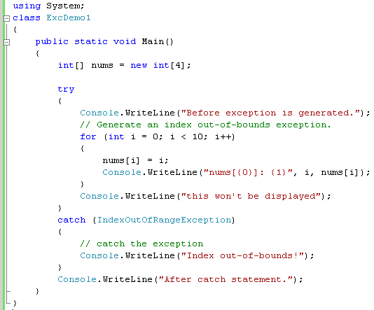
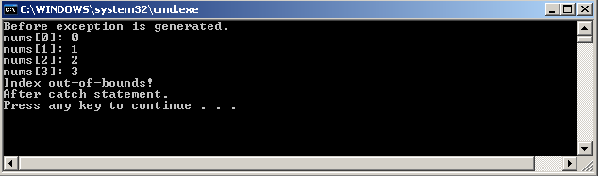

Slide 15
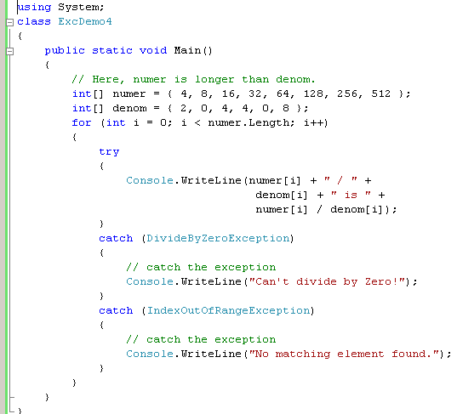
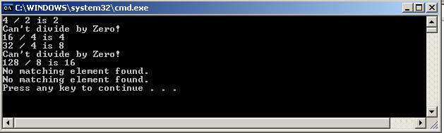
Using Multiple catch Statements

Slide 16
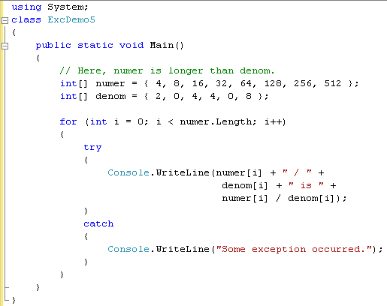
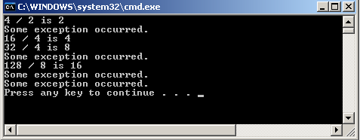
Catching All Exceptions

Slide 17
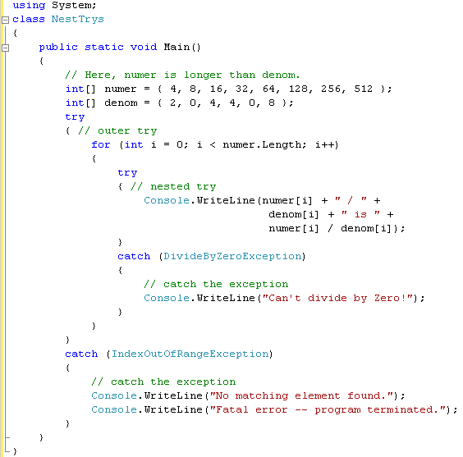
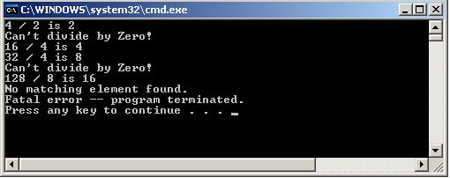
Nesting try Blocks

Slide 18
Throwing an Exception
The preceding examples have been catching exceptions generated automatically by C#. However, it is possible to manually throw an exception by using the throw statement.
Its general form is shown here:
throw exceptOb;
The exceptOb must be an object of an exception class derived from Exception

Slide 19
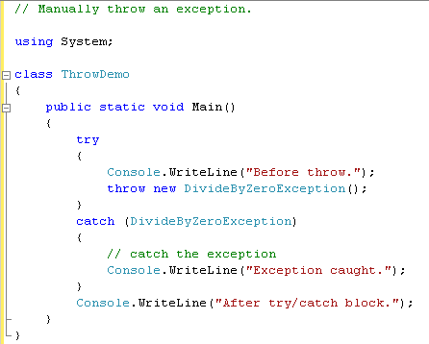
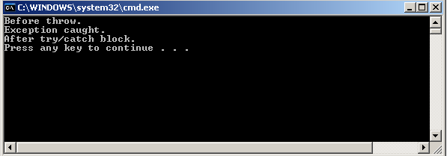

Slide 20
Using Finally
To specify a block of code to execute when a try/catch block is exited, include a finally block at the end of a try/catch sequence.
The general form of a try/catch that includes finally is :

Slide 21
Using Finally
try
{
// block of code to monitor for errors
}
catch (ExcepType1 exOb)
{
// handler for ExcepType1
}
catch (ExcepType2 exOb)
{
// handler for ExcepType2
}
.
.
finally
{
// finally code
}

Slide 22
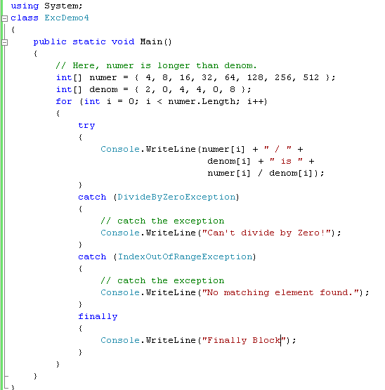
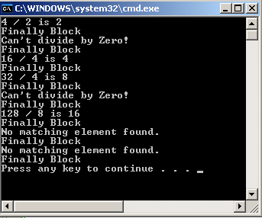
Using Finally

Slide 23
User Defined Exception
We have seen built-in exception classes in the previous section.
However, you often like to raise an exception when the business rule of your application gets violated.
So, for this you can create a custom exception class by deriving Exception or ApplicationException class.

Slide 24
User Defined Exception
The .Net framework includes ApplicationException class since .Net v1.0.
It was designed to use as a base class for the custom exception class.
However, Microsoft now recommends Exception class to create a custom exception class.

Slide 25
User Defined Exception
using System;
using System.Collections.Generic;
using System.Linq;
using System.Text;
using System.Threading.Tasks;
namespace CustomExceptionExampleCode {
class MyException: Exception {
public MyException(string Message): base(Message) {}
public MyException() {}
public MyException(string Message, Exception inner): base(Message, inner) {}
}
}

Slide 26
User Defined Exception
class Program {
static void Main(string[] args) {
int a = 50;
int b = 10;
int k = a / b;
try {
if (k < 10) {
throw new MyException("value of k is less than 10");
}
} catch (MyException e) {
Console.WriteLine("Caught My Exception");
Console.WriteLine(e.Message);
}
Console.Read();
}
}

