Slide 1
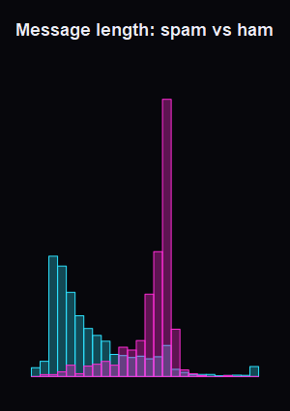
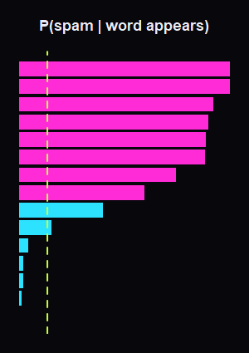
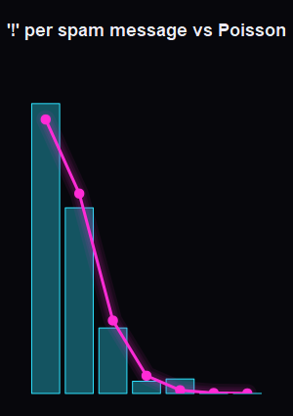
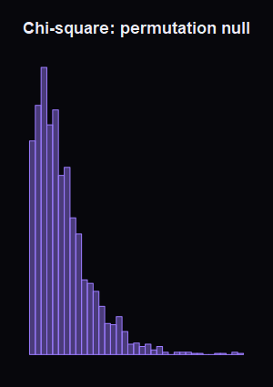
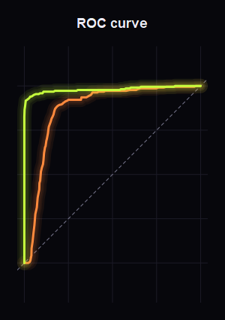

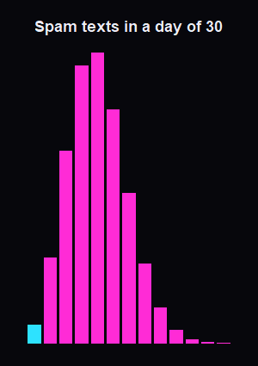
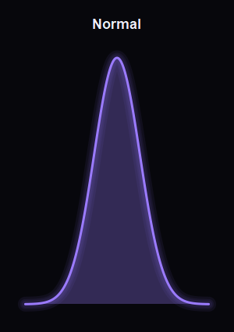
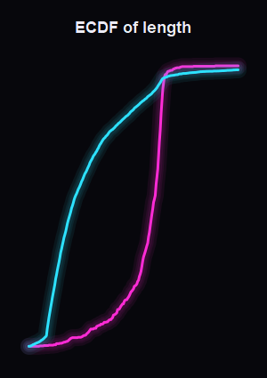
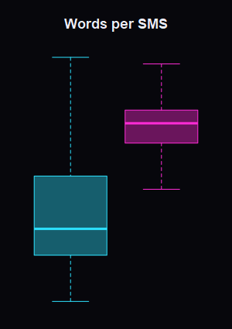
How does your phone know it's spam?
The probability and statistics behind every spam filter, worked out in R on 5,574 real text messages
Binomial · Bayes · Poisson · χ² · t-test · Naive Bayes · ROC · Edit distance
Notes:
[The 20 cards fly in, line up and form a circle. Wait for the circle.] Raise your hand if you got a spam message this week. … Most of you. Today I want to show you that the thing protecting you from those messages is not magic, and not even really “AI” — it's probability and statistics that we all study in this course. [Press ↓. The circle opens into an arc and the title appears.] So the question for today is: how does your phone know it's spam? Every card you see here is a real plot we made in R from the data we'll use. (Hover one card so it flips.) Each card flips to show what it is. [Press ↓ twice more: the cards slide along the arc, then the deck moves on.]

Slide 2
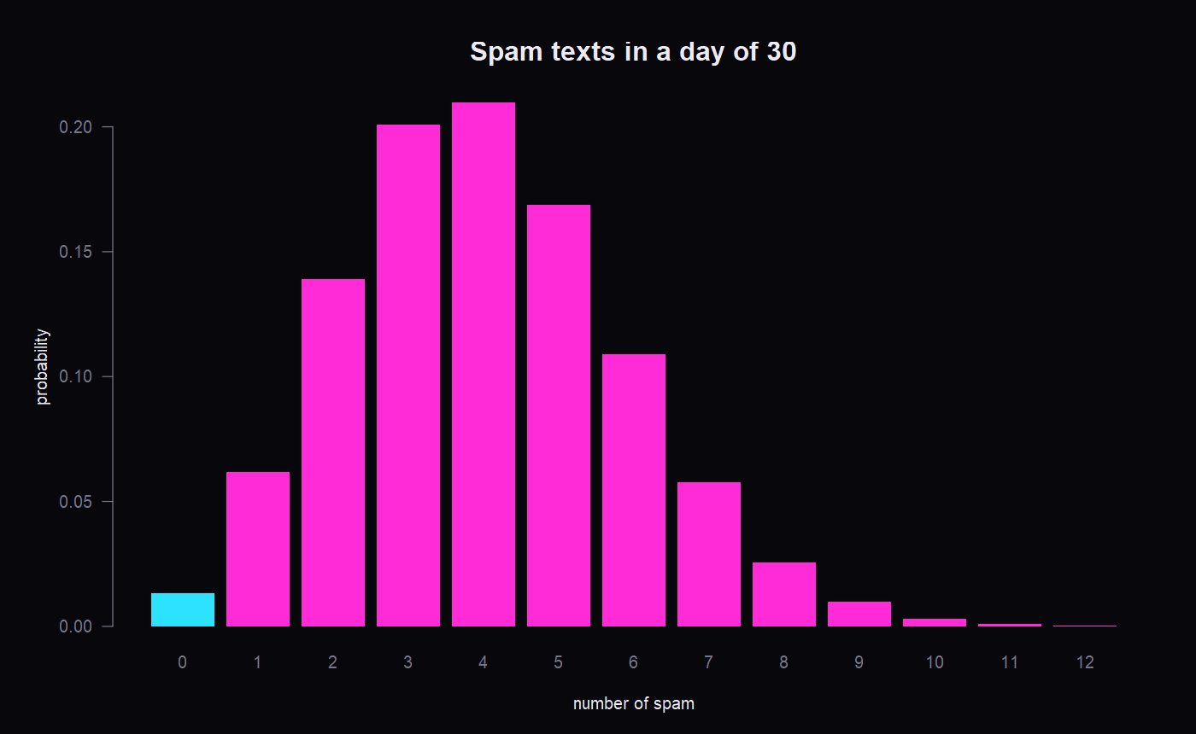
Your inbox is under siege
02 · THE PROBLEM · BINOMIAL
13.4% of text messages in our data are spam. With 30 texts a day, the number of spam texts is X ~ Binomial(n = 30, p = 0.134)
98.7%
P(at least one spam today) = 1 − (1 − p)ⁿ
4.02
1.87
expected spam per day (np)
standard deviation √(np(1−p))
On the website: drag n and p, and press “Simulate a day” to watch the average converge to np.
Notes:
In our dataset, 13.4 % of all text messages are spam. Suppose you get 30 texts a day, and each one is spam with probability p = 0.134, independently of the others. Then the number of spam texts you receive in a day, X, follows a binomial distribution with n = 30 and p = 0.134. [Point at the formula.] The probability of exactly k spam messages is n choose k, times p to the k, times (1 − p) to the n − k. The bar chart is that formula. The most likely outcome is 3 or 4 spam messages a day. [Point at the big pink number.] What's the chance you get at least one spam today? Instead of adding up k = 1, 2, 3 … all the way to 30, we use the complement: 1 minus the probability of zero spam, which is 1 − (1 − p)ⁿ. That's 98.7 %. You are almost guaranteed to be targeted every single day. [Drag the n slider down to 5, then back to 30.] Even with only 5 texts a day it's still over 50 %. The expected number is n·p = 4.02, with a standard deviation of √(np(1 − p)) = 1.87. [Click ▶ Simulate a day two or three times.] Now let's simulate a day. Each bubble is a real message from the dataset; pink ones are spam. Each click is one day. Watch the average across days settle near 4 — that's the law of large numbers: the simulated average converges to the expected value np.

Slide 3
5,574 real text messages
03 · THE DATA
5,574
747
4,827
7,211
messages
spam
ham (normal)
different words
SPAM
HAM
“SIX chances to win CASH! From 100 to 20,000 pounds txt> CSH11 and send to 87575. Cost 150p/day, 6days, 16+ TsandCs apply Reply HL 4 info”
“U dun say so early hor... U c already then say...”
Source: UCI SMS Spam Collection (Almeida & Hidalgo, 2011). Every number in this talk was computed by analysis.R.
Notes:
All of this is real data: the UCI SMS Spam Collection, a public research dataset. 5,574 texts, each labelled by a human as spam or ham — ham just means a normal message. 747 spam and 4,827 ham, with 7,211 different words. [Click the red “SMSSpamCollection” folder to open it, then click “spam examples”.] Here are some real spam messages. You'll notice the patterns straight away: “FREE”, “WIN”, “call now”, long phone numbers, money signs. (Close with Esc.) [Click the “+” on the analysis.R folder, then open one of the code sheets.] Every number in this talk comes from one R script. This folder holds its sections. R reads the whole dataset with a single `read.delim()` call. [Open the “R plots” folder and click a plot.] And these are the plots R produced.

Slide 4
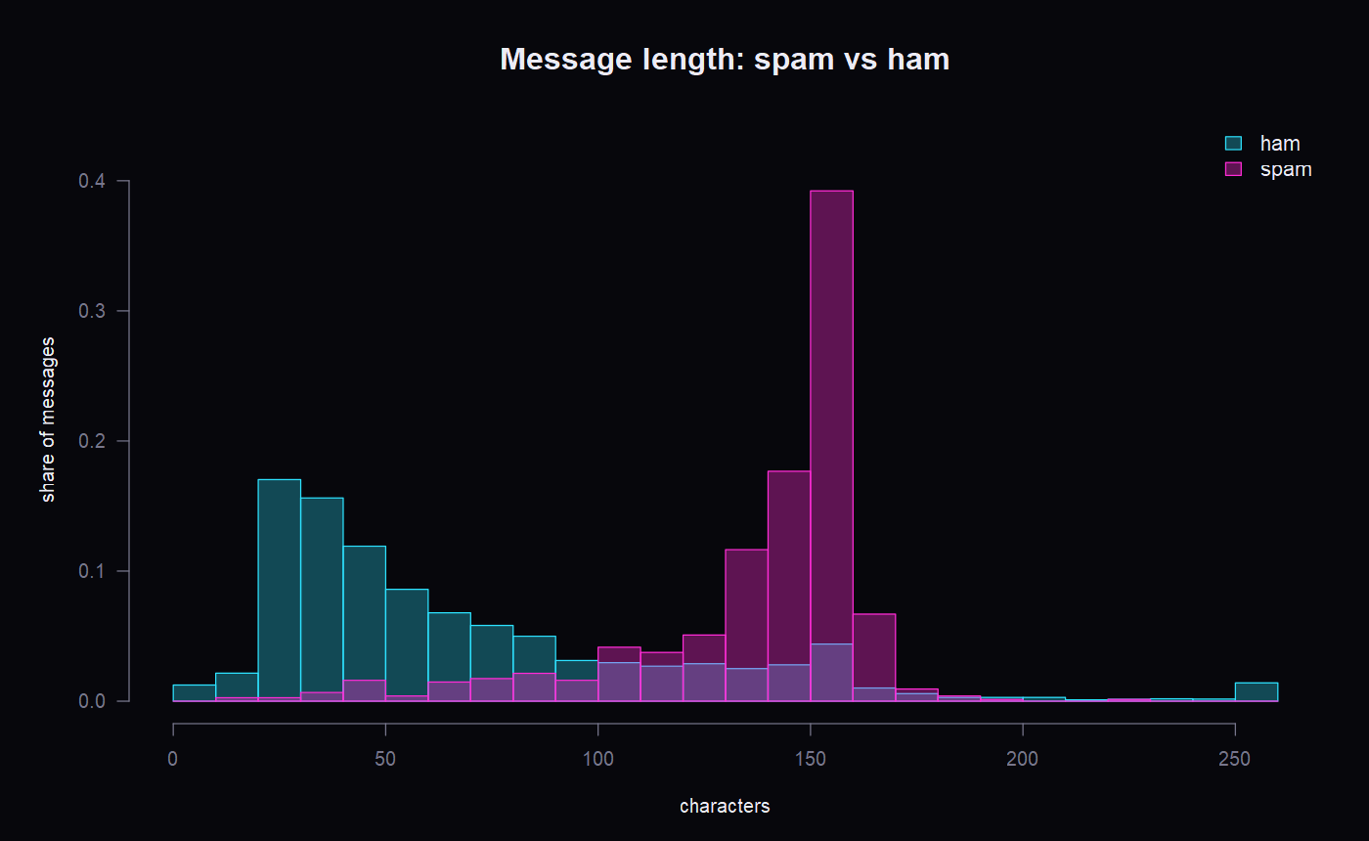
Spam talks too much
04 · DESCRIPTIVE STATISTICS · WELCH T-TEST
52
149
ham median (chars)
spam median (chars)
Is the difference real?
Welch t = -49.8, p < 2.2e-16
Spam is 65–70 characters longer (95% CI)
Ham is right-skewed: mean 71.5 > median 52. Spam fills one SMS (160 chars).
Notes:
Before building any model, a statistician first describes the data. The simplest thing to measure is message length. [Point at the histogram (cyan = ham, pink = spam).] Normal messages are short: median 52 characters. Spam is long: median 149. Look at the shapes. Ham is right-skewed: lots of tiny “ok”, “on my way” texts and a long tail. Spam piles up just under 160 characters, which is exactly the length of one SMS. Spammers fill every character they pay for. [Point at the stat tiles.] Notice ham's mean (71.5) is bigger than its median (52). That's the skew pulling the mean up, so the median is the better summary for ham. Spam's spread is also much smaller: SD 28.9 vs 58.3. [Point at the t-test box.] Is the difference real, or could it be chance? Null hypothesis: both groups have the same mean length. We use Welch's t-test because the two variances are clearly different. t = −49.8, and the p-value is smaller than R can even print: < 2.2 × 10⁻¹⁶. The 95 % confidence interval says spam is between 65 and 70 characters longer. We reject H₀. Since the data are skewed, I also checked with the non-parametric Wilcoxon test, and it agrees. So length alone is a clue. Remember that, because later it's the baseline our real filter has to beat.

Slide 5
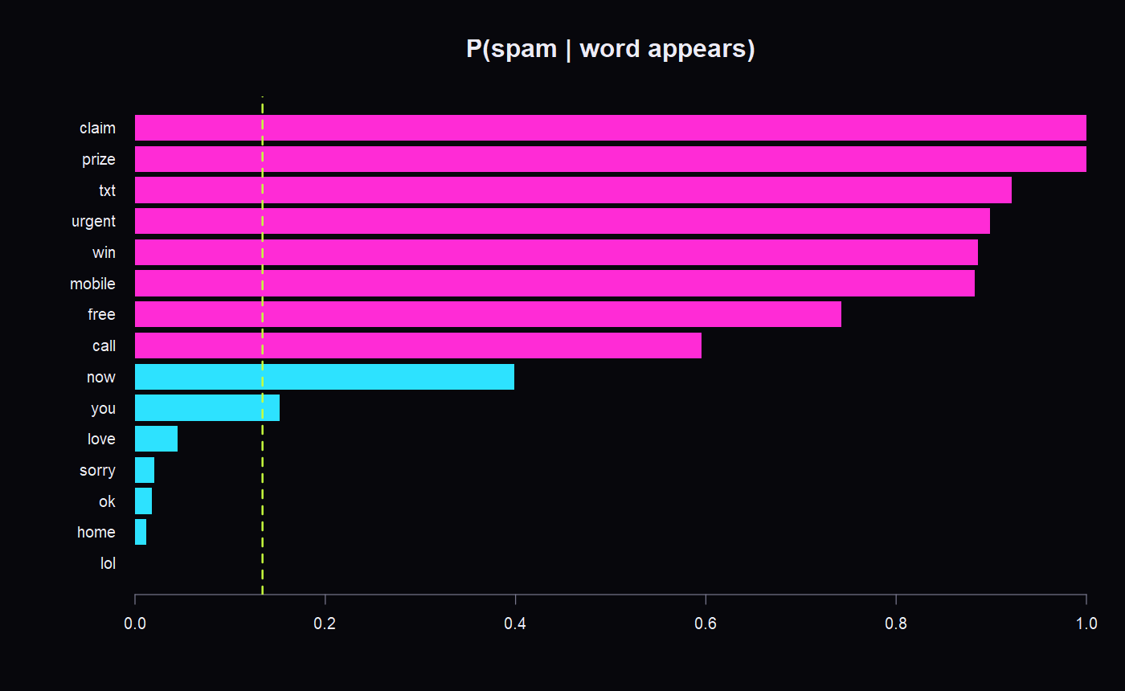
The word “free”
05 · BAYES' THEOREM
P(spam | free) = P(free | spam) · P(spam) / P(free)
= 0.228 × 0.134 / 0.041 = 74.2%
THE BASE-RATE TRAP
A test that is 99% sensitive, 5% false alarms, for a disease 1 in 100 people have. You test positive. Chance you're sick?
≈ 17%
Out of 1,000 people: 10 real positives vs ~50 false ones. When the bad thing is rare, most alarms are false. That's why a filter combines every word.
Notes:
Here's the key idea of the whole talk. Counting gives us P(word | spam): 22.8 % of spam messages contain the word “free”. But that's the wrong way round! When a message arrives, we know the word and want the class. We want P(spam | “free”). Bayes' theorem flips the condition: P(spam | free) = P(free | spam) × P(spam) / P(free) = 0.228 × 0.134 / 0.041 ≈ 74 %. [Click the chips: “prize”, then “call”, then “you”, then “ok”.] “prize” never appears in a normal message in this dataset, so P(spam | prize) = 100 %. “call” is only 60 %: real people say “call me” too. “you” is just 15 %, which is close to the prior, so it's useless as evidence. And “ok” drops it to 2 %. The green line is the prior, 13.4 %. Words to the right of it push towards spam, words to the left push towards ham. [Move to the right panel and click the “medical test” preset.] Now the most important lesson in probability. Imagine a disease that 1 in 100 people have, and a test that is 99 % sensitive with a 5 % false-positive rate. You test positive. What's the chance you're sick? Most people say 99 %. (Pause.) It's about 17 %. [Point at the dots.] Look at 1,000 people. 10 are sick and the test catches them: the pink dots. But 990 are healthy, and 5 % of them, about 50, also get a positive: the orange dots. So out of 60 positives, only 10 are really sick. This is the base-rate fallacy: when something is rare, most alarms are false. [Click “rare scam”, then drag the prior slider up slowly.] As the bad thing gets more common, the posterior climbs. That's exactly why a spam filter never trusts one clue. It combines every word in the message, which is the next slide.

Slide 6
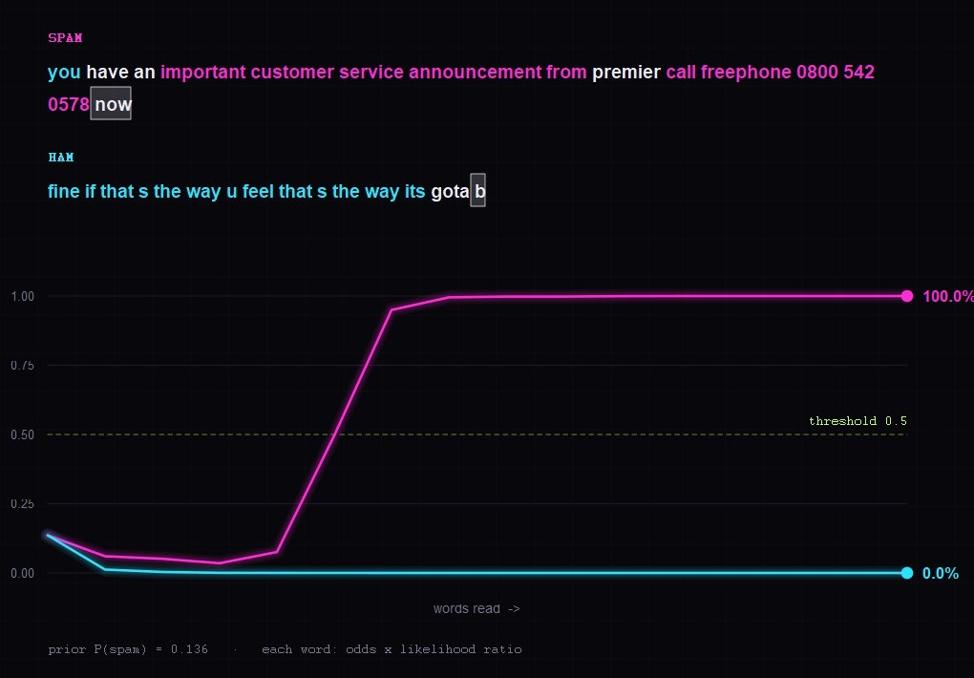
Reading, word by word
06 · BAYESIAN UPDATING · NAIVE BAYES
01
Prior
Start at the base rate, P(spam) = 13.6%
02
Likelihood
Each word multiplies the odds by P(word|spam) / P(word|ham)
03
Log-odds
Add log likelihood ratios instead of multiplying tiny numbers
04
Verdict
Spam ends at ~100%, ham at ~0%, on messages the model never saw
log odds(spam | words) = log prior odds + Σ log [ P(wᵢ | spam) / P(wᵢ | ham) ]
Notes:
[Scroll slowly (or press ↓ once per card). R rendered every frame of this animation.] Card 1 · Prior. Two real messages the model has never seen are read one word at a time. Pink is spam, cyan is ham. Before reading anything, the filter only knows the base rate, so both lines start at 13.6 %. Card 2 · Likelihood. Every word is evidence. It multiplies the odds by its likelihood ratio: P(word | spam) divided by P(word | ham). Watch the pink message. “you have an” actually pushes it down to 3.5 %, because normal people say those words too. Then “customer” jumps it to 50 %, “service” to 95 %, and “announcement” to 99.5 %. Meanwhile the ham message “fine if that's the way u feel” drops to almost zero after just three words. Card 3 · Posterior. Multiplying hundreds of small probabilities makes numbers too tiny for a computer, so we take logarithms and add instead. Log posterior odds = log prior odds + the sum of the words' log likelihood ratios. That single sum (the formula at the bottom right) is the Naive Bayes classifier. “Naive” because it assumes the words are independent given the class. That's not really true, but it works remarkably well. Card 4 · Verdict. Final answer: the spam ends at essentially 100 %, the ham at essentially 0 %. And notice the phone number: “0800” alone added a huge amount of evidence.

Slide 7
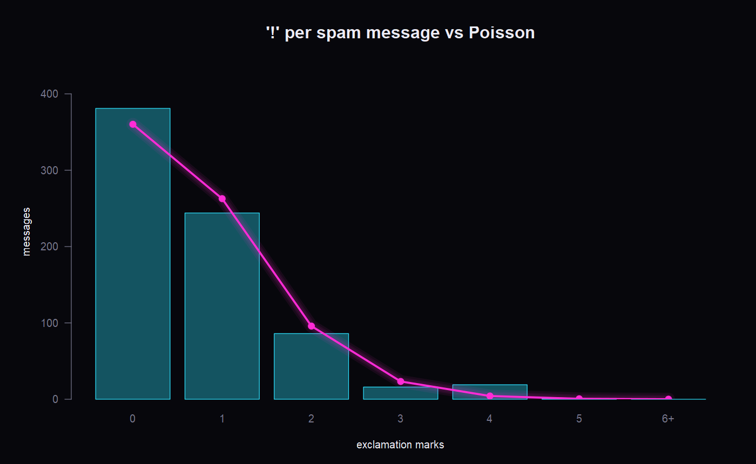
Spammers are predictable!
07 · POISSON DISTRIBUTION · GOODNESS OF FIT
0.73
0.18
spam λ̂ ('!' per msg)
ham λ̂ ('!' per msg)
Spam fits Poisson: p = 0.059
Spammers use '!' at a steady, template-like rate.
Ham doesn't: variance ≈ 2.1× the mean
Most people never type '!', a few type '!!!!!'. Humans are bursty.
Notes:
Let's count something: exclamation marks per message. Counts of rare events that happen at a steady rate follow a Poisson distribution, with one parameter λ, the average rate. The maximum-likelihood estimate of λ is just the sample mean: 0.73 “!” per spam message. [Point at bars (data) and the green line (Poisson model).] The bars are the real data, the green dots are what Poisson(0.73) predicts. They match well. A χ² goodness-of-fit test gives p = 0.059, which is above 0.05, so we cannot reject the Poisson model. [Drag the λ slider away from the MLE, to about 1.5, and watch χ² explode. Then drag it back to 0.73.] If I pick the wrong λ, the fit gets terrible. The MLE is the value that fits best. [Click the “ham” chip.] Now normal messages. λ is only 0.18, so spam uses about 4× more exclamation marks. But here the Poisson model fails badly: p ≈ 10⁻⁸². Why? For a Poisson distribution, the variance equals the mean. For ham the variance is about twice the mean; we call that overdispersion. Most people never type “!”, and a few people type “!!!!!”. Humans are bursty. Spammers use a template, so they're regular. The variance-to-mean ratio is a quick fingerprint of who wrote a message.

Slide 8
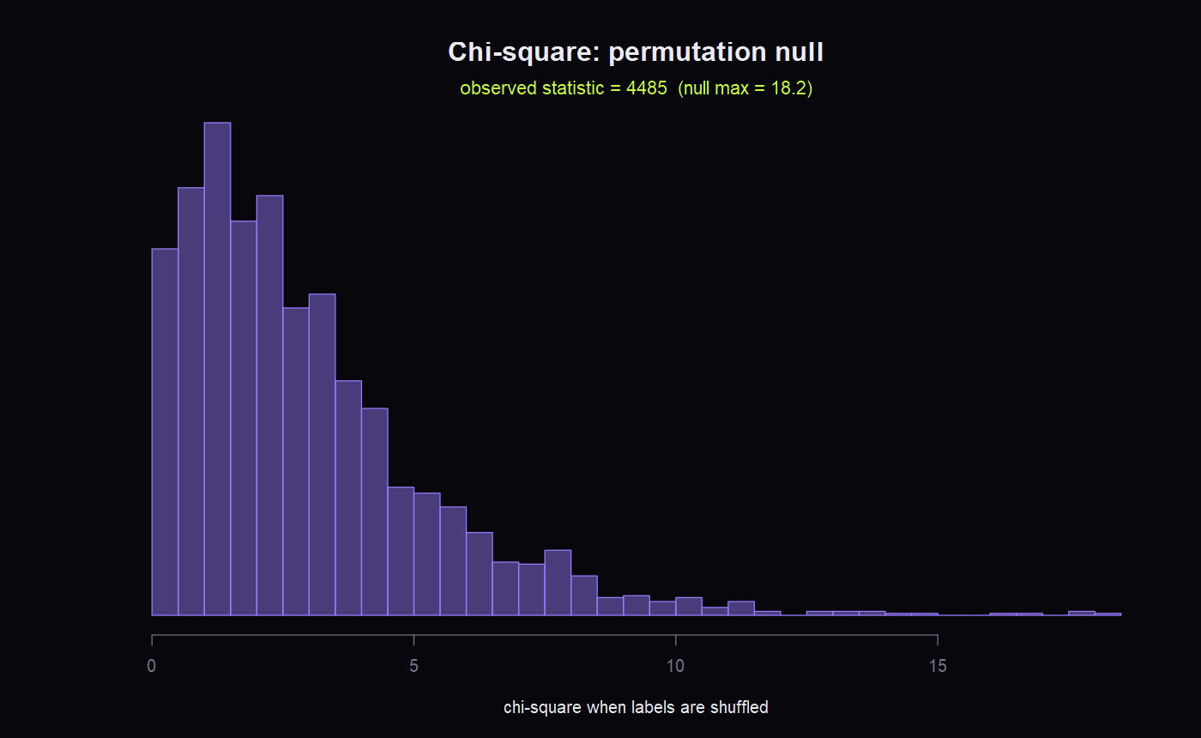
Could it be pure chance?
08 · Χ² TEST OF INDEPENDENCE · PERMUTATION TEST
clue | ham | spam
phone number | 3 | 585
money sign | 19 | 25
web link | 16 | 33
plain text | 4789 | 104
585 of 588 messages with a phone number are spam.
4,485
18.2
Reject independence: p < 2.2e-16, Cramér's V = 0.90 (very strong).
observed χ² (df 3)
largest of 2,000 shuffles
Notes:
I sorted every message by its strongest clue: does it contain a phone number (5+ digits), a £ or $ sign, a web link, or none of those? [Point at the table.] Look at the first row. Of 588 messages with a phone number, 585 are spam. Our null hypothesis is that the clue and the label are independent. [Click “expected E under H₀”.] If they were independent, we'd expect only about 79 spam messages in that row, using E = row total × column total / N. We observed 585. The χ² statistic adds up (O − E)² / E over every cell. [Click “⤨ shuffle once” two or three times, then “⤨ ×250”.] Here's the intuition behind a hypothesis test. If H₀ were true, the labels wouldn't matter, so I can shuffle the spam labels randomly across all 5,574 messages and recompute χ². Each shuffle is one “world where H₀ is true”. Let's do 250 of them. The purple histogram is the null distribution: chance alone gives values around 3, rarely above 18. [Point at the pink line on the right.] Our real value is 4,485. The axis even has to break to fit it. With 3 degrees of freedom the 5 % critical value is 7.81. The p-value is effectively zero, so we reject independence. Cramér's V = 0.90, on a 0-to-1 scale, says the association is very strong.

Slide 9
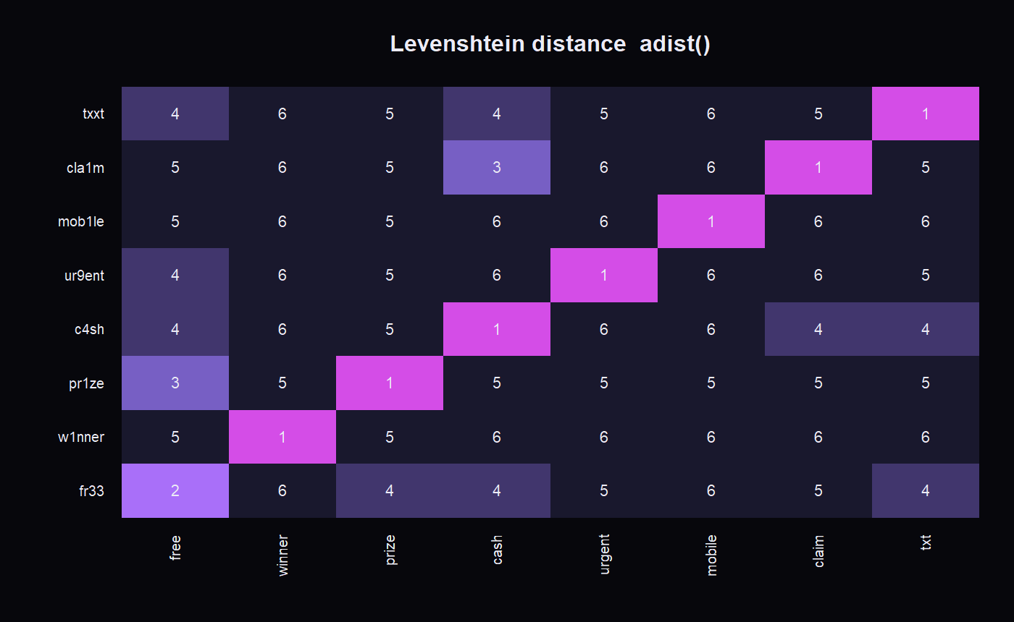
FR33 PR1ZE, w1nner!!
09 · DISTANCE METRICS · DYNAMIC PROGRAMMING
Spammers misspell trigger words so exact matching misses them.
Levenshtein distance = fewest single-letter edits between two words.
fr33 → free (2 edits)
w1nner → winner (1 edit)
pr1ze → prize (1 edit)
c4sh → cash (1 edit)
Notes:
Spammers know filters look for “free”, so they write “fr33”. To a computer that's a completely new word with no evidence. The fix is to measure how close two words are. The Levenshtein distance is the fewest single-letter insertions, deletions or substitutions that turn one word into another. [Point at the grid.] We compute it with dynamic programming: each cell is the minimum of three neighbours plus one, and the green path is the cheapest sequence of edits. “fr33” → “free” takes 2 substitutions. [Click the chips: “w1nner”, “pr1ze”, “c4sh”. Then type your own, e.g. “m0bile”.] Within 2 edits of a known spam word, we treat it as that word, and it gets its evidence back. In R this is a single built-in function: `adist()`.

Slide 10
Try to fool the filter
10 · YOUR TURN · LIVE DEMO
congratulations +2.7
you -0.9
have -0.2
won +2.1
P(spam | words)
>99.9%
a -0.0
free +2.4
holiday +1.5
call +1.5
now +0.7
to +0.2
claim +5.4
your +0.6
prize +5.2
→ SPAM FOLDER
Each word carries its log likelihood ratio from the model R trained: pink pushes towards spam, cyan towards ham.
prior log-odds -1.85 + sum of words = 19.2
Live on the website: the audience types any message, and the same 7,211-word model scores it instantly.
Notes:
This is the real model R trained on 3,902 messages: 7,211 words, each with its own likelihood ratio. Let's try it. [Click “example 1” (prize spam), then “example 2” (lunch), then “example 5” (bank PIN scam).] Every chip is a word with its log likelihood ratio: pink pushes towards spam, cyan towards ham, grey means the model has never seen that word, so it carries no evidence. The needle is P(spam | your words). The table underneath shows the actual sum: prior log-odds plus each word's contribution. [Turn to the audience.] Now you. Shout out a message, a spam one or a normal one, and let's see if you can fool it. [Type what they say. Good things to try if nobody speaks:] When it gets one wrong: “Good, so the model isn't perfect, and the next slide measures exactly how imperfect.” [If the dot under the verdict says “computed live by R 4.6.1 (plumber API)”, point it out:] “And this answer was just computed by R running on a server, not by the web page.”

Slide 11
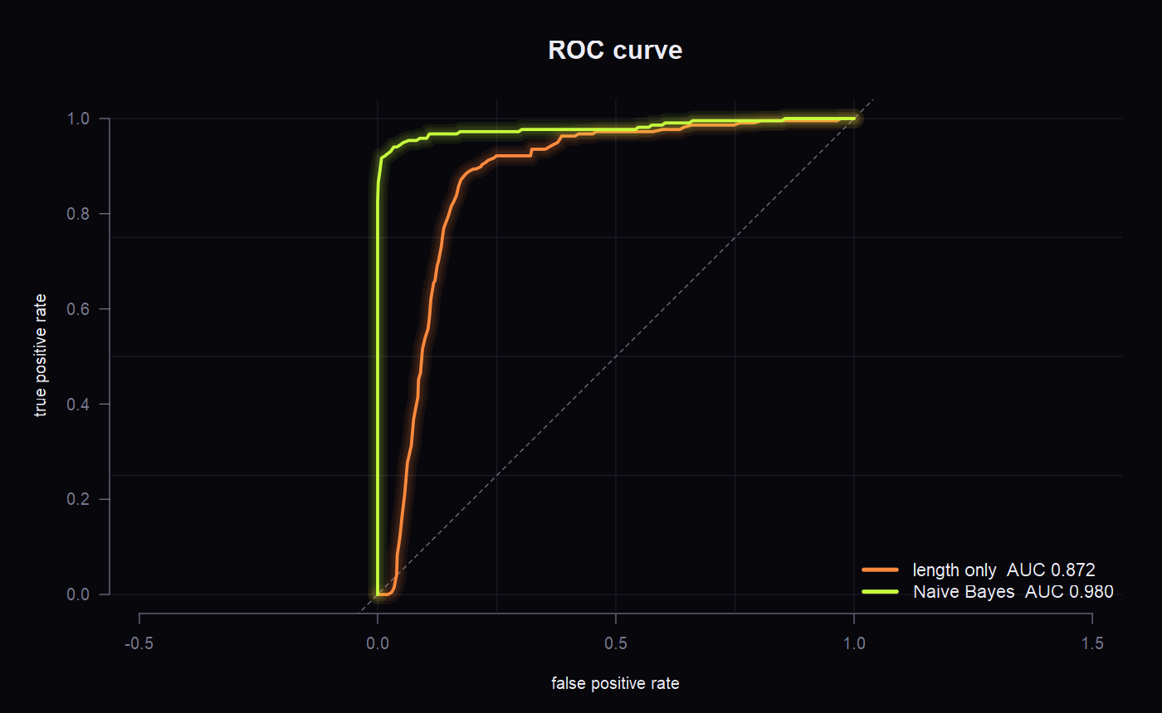
98.3% right. Is that good?
11 · EVALUATION · ROC · EXPECTED COST
 | predicted spam | predicted ham
actually spam | 193 caught | 24 missed
actually ham | 5 lost | 1,450 kept
0.980
0.872
AUC, Naive Bayes
AUC, message length only
Mistakes aren't equal: losing a real message is worse than seeing one spam.
If a lost message costs 10× more, the cost-minimising threshold rises from 0.5 to ≈ 0.96.
Tested on 1,672 messages the model never saw.
Notes:
We tested on 1,672 messages the model never saw while learning. At threshold 0.5 it gets 98.3 % right: 193 spam caught, 1,450 real messages kept, 24 spam missed and only 5 real messages wrongly sent to spam. [Point at the ROC curve.] The ROC curve shows every possible threshold at once: true-positive rate against false-positive rate. The area under it, AUC, is 0.98 for Naive Bayes, against 0.87 for message length alone, the baseline from slide 4. [Drag the threshold slider down to 0.05, then up to 0.95, and watch the four boxes.] Lower threshold: we catch more spam, but we also lose real messages. Higher: the opposite. Which is better? Accuracy can't answer that, because the two mistakes aren't equal. Losing a message from your boss is far worse than seeing one spam. [Point at the cost sliders. Default is: losing a real message costs 10, one spam costs 1. Click “use best t”.] We define an expected cost, 10 × false positives + 1 × false negatives, and choose the threshold that minimises it. The best threshold moves up to about 0.96: only act when you're very sure. (Drag “cost of one spam” to 10 as well.) If both mistakes cost the same, it drops back toward 0.5. Every email provider makes exactly this decision. It's not maths alone; it's maths plus values.

Slide 12
Your spam filter is a statistician
12 · WHAT R TOLD US
Binomial
t-test
Bayes
Base rate
98.7% chance of spam today
spam is ~67 chars longer
P(spam | free) = 74%
99% test, rare disease → 17%
Poisson
χ² test
Edit distance
Naive Bayes
spam regular, humans bursty
V = 0.90, not chance
fr33 → free in 2 edits
98.3% accurate, AUC 0.98
Bonus: the same maths protects code. PhishGuard.js uses Bayes, edit distance (loadsh vs lodash) and a Poisson test to catch malicious packages.
Thank you · Questions?
Notes:
[Point across the 10 tiles.] So in one spam filter we used: the binomial distribution, descriptive statistics, a t-test, Bayes' theorem and the base-rate fallacy, the Poisson distribution with a goodness-of-fit test, a χ² test of independence, edit distance, Naive Bayes, and expected-cost decision making. All on real data, all in R. [Point at the “Spam filters for code” card.] One last thing. The same maths works far beyond SMS. In a project from our team, PhishGuard.js, we use these exact ideas to protect software: Bayes to find which code library triggered an alarm, edit distance to catch fake packages like “loadsh” pretending to be “lodash”, and a Poisson test to spot malware that phones home on a timer. Once you know the maths, you see it everywhere. Thank you, and I'm happy to take questions.

