Slide 1
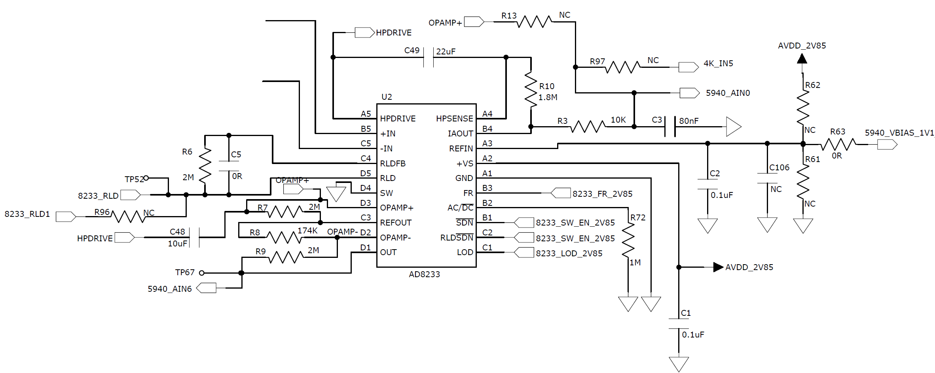
prefilter out+
prefilter out-

