Slide 1
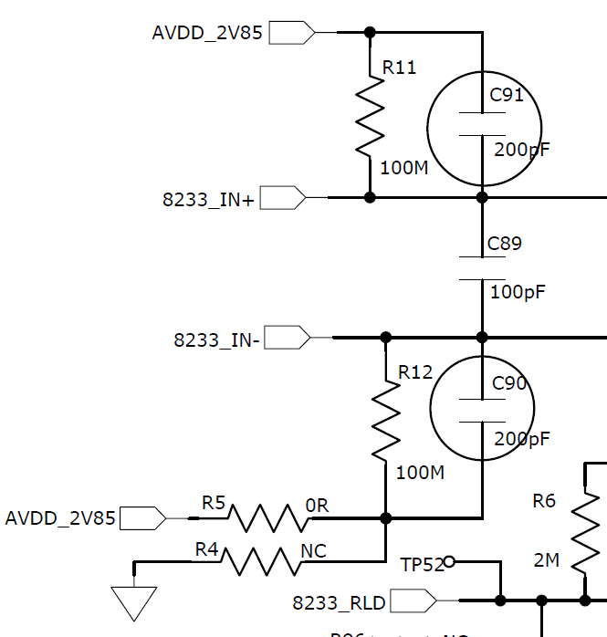
AD8233_pre+
AD8233_in+
AD8233_pre-
AD8233_in-

