Slide 1
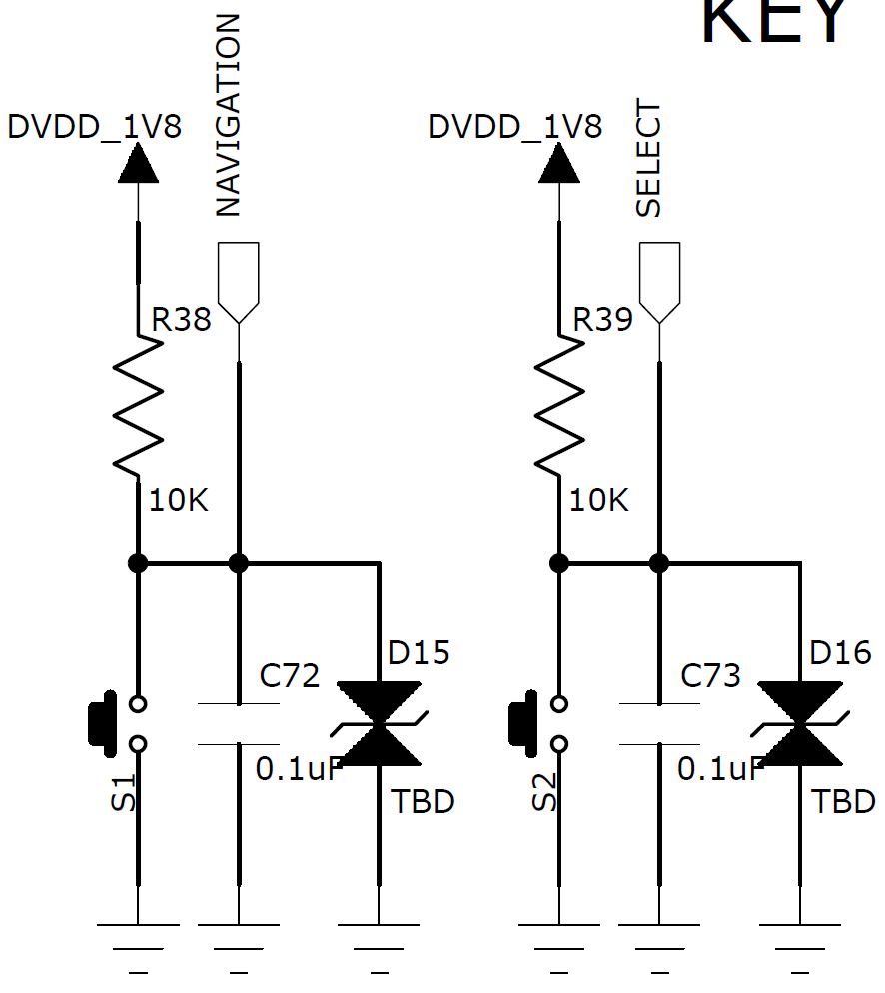
P0.25
P1.00

