Slide 1
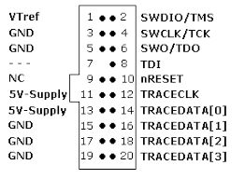
Debug Mode
USB Mode
4 pin header
GND EB1 EB2 GND
EB1
EB2
Dock
Dock
20 pin jlink
header

Slide 2
Debug Mode
USB Mode
4 pin header
GND EB1 EB2 GND
EB1
EB2
Dock
Dock
20 pin jlink
header

Slide 3
Debug Mode
USB Mode
n pin header
GND EB1 EB2 GND
ET1 ET2?
Dock
Dock
20 pin jlink
header

