Slide 1



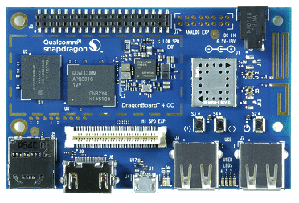


PUT
Invoke
PUBLISH
GET
Invoke
Query

