Slide 1


Getting Started
Arrowhead Core Systems G3.2 Milestone 3

Slide 2
Documentation structure – reading sequence
Note:
Please start with the System-of-Systems document (SoSDD), called „Core Systems Architecture” before proceeding with the quick start
After the SosDD, you may proceed with this installation and quick start guide.
Then for details please read the SysDD, SD and IDD documents in order.
For each System, please read the System Description (SysDD) first
Then read the appropriate Service Descriptions (SD) and finally the Interface Descriptions (IDD)

Slide 3
Table of Contents
This tutorial helps setting up the Arrowhead reference framework G3.2 Milestone 3
Setting up and configuring the databases
Generating proper X.509 certificates
Setting up and starting the Core Systems
Getting started with the built-in manual (orchestration) examples
Getting started with the Application System skeletons

Slide 4
Core modules - overview
Service Registry: Arrowhead Systems register and revoke the Services they offer. Such an entry also includes the http endpoint where the offered Service is accessible.
Orchestrator: Arrowhead Systems turn to the Orchestrator with Service requests if they wish to consume various Services. The initiated orchestration process returns with a single one or a list of Service Providers that are suitable to the request. After orchestration, the requester System has to consume the specified Service from the specified Provider(s).
Authorization System: the Orchestrator queries this Core System for checking authorization information. This System stores the intra-cloud and inter-cloud access rights. It is also responsible for issuing authorization token – if needed.
Gatekeeper: this Core System assists in handling all the inter-cloud orchestrational tasks among Arrowhead Local Clouds. They provide two Services for their Orchestrators: the Global Service Discovery and Inter-Cloud Negotiations services.
Gateway: this Core System is responsible for creating a data path between the provider and consumer Arrowhead Systems, when these systems are in different Local Clouds. The Gateway services are used by the Gatekeeper. This Core System can also provide payload encryption.

Slide 5
Arrowhead G3.2 code bases / testbed servers
The core framework source codes can be found at:
https://github.com/hegeduscs/arrowhead
The client skeletons are developed at:
https://github.com/hegeduscs/arrowheadclient
Cloud 1 test server to try out the examples:
http://arrowhead.tmit.bme.hu
Cloud 2 test server to try out the examples:
http://arrowhead2.tmit.bme.hu

Slide 6
Setting up a database
This framework uses MySQL server through the Java Hibernate ORM (via JDBC)
https://dev.mysql.com/downloads/installer/
It is recommended to use a database manager GUI (e.g. the built-in MySQL Workbench)
Username and password is arbitrary
Remote access for the account is needed, if the Core Systems will run on different machines
Please import the create_arrowhead_database_1.sql script
This will create the database schema „arrowhead” with all the tables and inserts dummy entries for the examples showed later in this guide
Please import the create_log_db_empty.sql script
This will create the database schema „log” and the „logs” table inside it; and will be used by the Core Systems for joint logging
Separate instances of logging for each Core System can be achieved by modifying its log4j.properties file

Slide 7
Generating Certificates (optional)
If secure connections are required (using SSL), the Core Systems have to be installed with the appropriately created X.509 certificates stemming from the master Arrowhead CA. There are two options:
Using the provided testcloud certificate sets (testcloud1 and testcloud2)
Creating an own set of certificates
For the latter scenario, a detailed 10 step guide is provided inside certificates/Notes.txt on how to create new, Arrowhead complient certificates.
A freeware certificate manager tool is recommended here: KeyTool Explorer
http://keystore-explorer.org/downloads.html available for all platforms
However, all Core Systems can be started in an unsecured manner, using simple http.
For this quick start guide, it is recommended to start unsecured first. Using certificates and the secured versions are advised, but later on – for development.

Slide 8
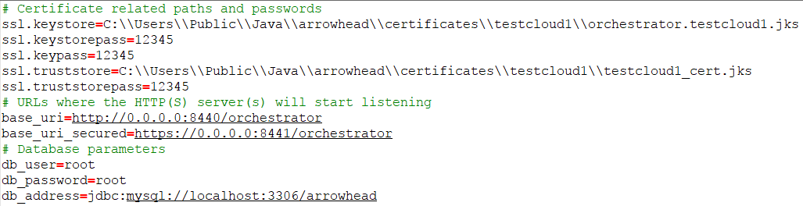
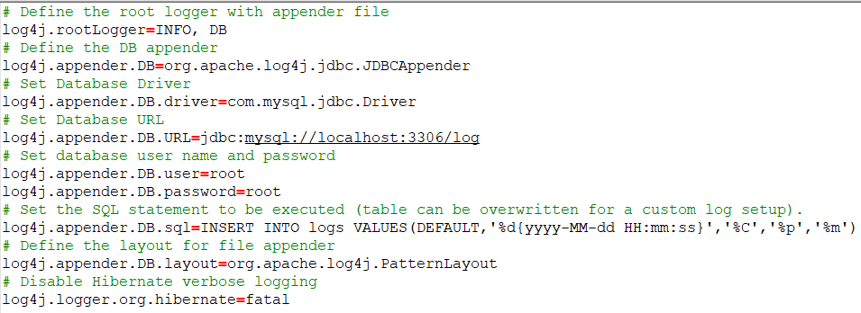
Configuring the core modules
Every module is a runnable Java executable jar file and has two properties file:
The „config/app.properties” includes general configuration
The „config/log4j.properties” configures the logging.
Logging levels:
By default everything is logged in a verbose manner.
To disable the verbose, replace the „INFO” field in the rootLogger property to a higher level: OFF> FATAL > ERROR > WARN > INFO > DEBUG
The app.properties file: The log4j.properties:

Slide 9
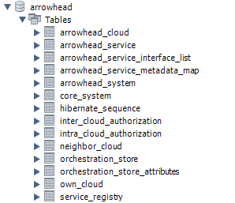
The Arrowhead core database structure
Each core system can have its own separate database: run the create_arrowhead_database_1 each time you want a separate DB for a core system.
The joint core database contains the following tables:
These tables contain the common descriptors. They are referenced by other tables.
This table is used by the ORM engine, not to be changed.
These tables store the authorization access rights.
These tables stores the orchestration rules per Application Systems.
These tables contain run-time configuration for the Core Systems. Needs setting up.
This table stores the available Services and their provider Systems.

Slide 10
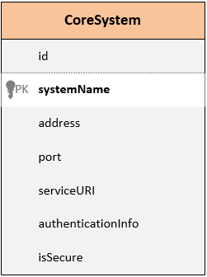
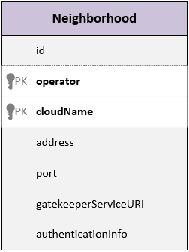
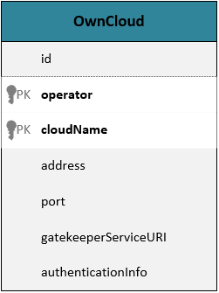
Configuration tables
These tables can be easily modified by using e.g. the MySQL workbench. In a later version REST resources for CRUD operations will also be provided for each database table.
The „CoreSystem” table stores where each core system can be reached. This is used by the Core Systems for locating other Core Systems.
For example if we start the Authorization server at https://example.org:8080/endpoint/ , then its CoreSystem table entry is the following:
Note: the system_name field is not to be changed.
The service_uri contains the full URL path (after the port number)
The is_secure boolean is indicating that the Authorization System is started in secure mode (SSL)
There are hardcoded URL subpaths in the java modules, e.g. „/authorization”.
This has to be in accordance with the settings in the app.properties of the authorization:
base_uri_secured=https://example.org:8080/endpoint
The „neighborhood” table references trusted Arrowhead Local Clouds. This data is used by the Gatekeeper in the inter-Cloud orchestration process. This table is a sublist of the „arrowhead_cloud” table.
The OwnCloud table holds information about the Local Cloud itself. This is used by the Gatekeeper to identify what it is representing in inter-Cloud scenarios. Also a sublist of the „arrowhead_cloud” table.

Slide 11
Deploying modules
Each module can be deployed by running the appropriate JAR file.
Every module has its own „config” and „lib” folders, these have to be in the same folder as the jar file. The config files have to be edited to match the real setup environment (URIs, passwords, etc.).
Insecure (plain HTTP) deployment on the console:
java –jar modulename.jar –m insecure
Secure (HTTPS/SSL) deployment:
java –jar modulename.jar –m secure
Running both (insec and sec) version of the module at the same time:
java –jar modulename.jar –m both

Slide 12
Setting up a secondary Local Cloud for testing inter-Cloud orchestration
To test out inter-Cloud orchestration, the secondary Cloud can be set up similarly.
Please import the create_arrowhead_database_2.sql script on the 2nd machine.
Both databases have 2 entries in the „arrowhead_cloud” table. The first one is the „own_cloud” entry, the second one refers to the „neighbor_cloud” (the other machine). Modify the „address” field for all 4 entries to be in accordance with your setup.
Set the configuring property files as needed and start the modules.

Slide 13
Using the examples
We provided a few different scenarios on how to use the Advanced Orchestration Service.
These are consistent with the dummy data imported in the databases by executing the create_arrowhead_database_1 & 2 scripts .
Testing these are recommended in plain HTTP, manually.
Recommended development test tool for sending the requests: Postman (Google Chrome extension)
https://www.getpostman.com/
These scenarios include sending Service Requests to the Orchestrator and receiving Orchestration Response based on the dummy data.

Slide 14
Use case scenario for manual testing
This test scenario shows an automotive case. There are two Local Clouds defined:
Cloud 1 belongs to a charging infrastructure owner with charging stations and their management systems (servers).
Cloud 2 belongs to an electric car manufacturer and its systems include electric cars that can look for charging services, and servers providing optimal charging profiles for different types of electric cars.
There are 4 Application Services defined for testing out orchestration. Some Service Providers are missing qualifications (e.g. missing authorization or simply are offline).
„Billing” can be requested by „ChargePointSystems” and a „SmartGridManagerSystem” can provide this service in the same cloud.
The „ChargingReservation” service has the same requester and provider system, but for this service the charging station has no hardwired providers prepared in the Orchestration Store.
The „DCCharging” service is requested by electric cars and the charging stations can provide this service (inter-cloud servicing).
And finally the „ChargingProfile” service will be provided by the „BatteryProfiles” system from the EV cloud, to the charging stations.

Slide 15
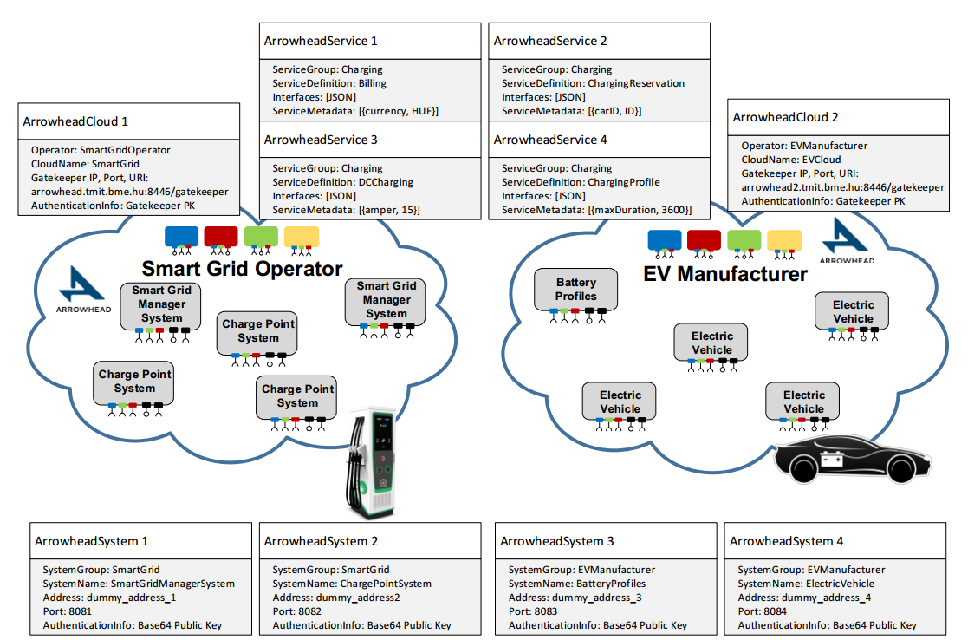
Electric Vehicle Use Case Scenario

Slide 16
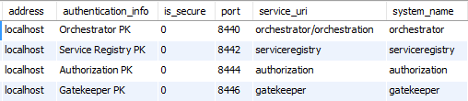
Testbed servers deployment information
The secure versions of the Core Systems use the odd numbered port numbers, e.g. the secure Orchestration service is at port 8441 by default
The port allocations can be changed arbitrary in the app.properties file for each Core System (with the base_uri and base_uri_secured properties)
Service URIs (where the server is deployed) can also be changed, but the end paths (orchestration, serviceregistry, authorization, gatekeeper) are hardcoded in the REST resource classes and are not part of the configuring property value.
The is_secure column is a boolean indicating whether the server is in secure (HTTPS) or insecure (HTTP) mode. Important utility functions rely on this information being updated when a change happens.
Core Systems names should not be changed, they are used to fetch the address information of other Core Systems.

Slide 17
Store-based orchestration test
Charging stations from the SmartGrid Cloud (#1) are hardwired to use a certain list of Management Servers.
However, which station can access which server is dynamic (e.g. changes with time of day)
Some servers go offline or night-time management of stations belongs to an external party
These orchestration rules are stored and iterated through based on their priority. Check the Advanced Orchestration Service SD

Slide 18
Store-based orchestration
Service Request Form
{
"requesterSystem":
{
"systemGroup": "SmartGrid",
"systemName": "ChargePointSystem",
"address": "dummy_address_2"
},
"requestedService":
{
"serviceGroup": "Charging",
"serviceDefinition": "Billing",
"interfaces": ["JSON"]
}
}
Orchestration Response (expected)
{
"response": [{
"instruction": "command args",
"provider": {
"address": "dummy_address_3",
"authenticationInfo": "Base64 coded Public Key",
"port": 8083,
"systemGroup": "SmartGrid",
"systemName": "SmartGridManagerSystem3"
},
"service": {
"interfaces": [
"JSON"
],
"serviceDefinition": "Billing",
"serviceGroup": "Charging",
"serviceMetadata": {
"entry": [{
"key": "security",
"value": "token"
},
{
"key": "currency",
"value": "HUF"
}
]
}
},
"serviceURI": "billing"
}]
}
In this example the Orchestrator will iterate through the 3 store entries in priority order. (All store entries are for this consumer/service pair.) The 1st entry is not registered in the Service Registry (offline), while the 2nd entry is not registered in the Authorization System. The 3rd entry is registered into both (online) and should be the response the Orchestrator sends back.

Slide 19
Checking the dynamical orchestration process
The following examples test out the dynamical orchestration capabilities of the framework.

Slide 20
Local dynamical orchestration (no preferences or matchmaking)
Orchestration Response (expected)
{
"response": [{
"provider": {
"address": "dummy_address_3",
"authenticationInfo": "Base64 coded Public Key",
"port": 8083,
"systemGroup": "SmartGrid",
"systemName": "SmartGridManagerSystem3"
},
"service": {
"interfaces": [
"JSON"
],
"serviceDefinition": "ChargingReservation",
"serviceGroup": "Charging",
"serviceMetadata": {
"entry": [{
"key": "security",
"value": "token"
},
{
"key": "carID",
"value": "ID"
}
]
}
},
"serviceURI": "reserve_charging"
}]
}
Service Request Form
{
"requesterSystem":
{
"systemGroup": "SmartGrid",
"systemName": "ChargePointSystem",
"address": "dummy_address_2"
},
"requestedService":
{
"serviceGroup": "Charging",
"serviceDefinition": "ChargingReservation",
"interfaces": ["JSON"]
},
"orchestrationFlags": {
"entry": [
{
"key": "overrideStore",
"value": true
}
]
}
}
Here the contents of the Orchestration Store is ignored, and since the requester system did not have preferred providers and did not ask for matchmaking (via orchestration flag), all the providers will be returned which can serve the requester system at the moment (online and is authorized).

Slide 21
Inter-Cloud dynamical orchestration (with triggerInterCloud flag)
Service Request Form
{
"requesterSystem":
{
"systemGroup": "EVManufacturer",
"systemName": "ElectricVehicle",
"address": "dummy_address_4"
},
"requestedService":
{
"serviceGroup": "Charging",
"serviceDefinition": "DCCharging",
"interfaces": ["JSON"]
},
"orchestrationFlags": {
"entry": [
{
"key": "triggerInterCloud",
"value": true
}
]
}
}
Orchestration Response (expected)
{
"response": [{
"provider": {
"address": "dummy_address_4",
"authenticationInfo": "Base64 coded Public Key",
"port": 8084,
"systemGroup": "SmartGrid",
"systemName": "ChargePointSystem"
},
"service": {
"interfaces": [
"JSON"
],
"serviceDefinition": "DCCharging",
"serviceGroup": "Charging",
"serviceMetadata": {
"entry": [{
"key": "security",
"value": "token"
},
{
"key": "amper",
"value": "15"
}
]
}
},
"serviceURI": "charging/dc"
}]
}
This is the only example out of the 4 which has to be sent to the Orchestrator in the 2nd cloud (test server URL is http://arrowhead2.tmit.bme.hu:8440/orchestrator/orchestration) since the requester system is in this cloud this time. The requester system knows a suitable provider (a charging station) can only be found in the other cloud, so it triggers Inter-Cloud orchestration right away with a flag, skipping the local cloud checks.

Slide 22
Dynamical orchestration with Inter-Cloud enabled
Service Request Form
{
"requesterSystem":
{
"systemGroup": "SmartGrid",
"systemName": "ChargePointSystem",
"address": "dummy_address_2"
},
"requestedService":
{
"serviceGroup": "Charging",
"serviceDefinition": "ChargingProfile",
"interfaces": ["JSON"]
},
"orchestrationFlags": {
"entry": [
{
"key": "overrideStore",
"value": true
},
{
"key": "enableInterCloud",
"value": true
}
]
}
}
Orchestration Response (expected)
{
"response": [{
"provider": {
"address": "dummy_address_1",
"authenticationInfo": "Base64 coded Public Key",
"port": 8081,
"systemGroup": "EVManufacturer",
"systemName": "BatteryProfiles"
},
"service": {
"interfaces": [
"JSON"
],
"serviceDefinition": "ChargingProfile",
"serviceGroup": "Charging",
"serviceMetadata": {
"entry": [{
"key": "security",
"value": "token"
},
{
"key": "maxDuration",
"value": "3600"
}
]
}
},
"serviceURI": "charging_profile"
}]
}
In the final example, a charging station is looking for the optimal charging profile for a car, before starting the charging. It initiates the dynamical orchestraion process, and accepts providers from other clouds too with the „enableInterCloud” flag set. The local search for a provider will yield no result, but the 2nd cloud has a provider.

Slide 23
Getting started with the App. System skeleton
There are three client skeletons available:
Service Provider module (with SSL support): registers in SR, offers REST resource, unregisters from SR upon shutdown
Service Consumer module (with SSL support) based on the Jersey-client library: capable of requesting orchestration and based on that connecting to a running Service Provider skeleton to retrieve dummy temperature service information
Lightweight Service Consumer (basic) module (without Jersey-client library or SSL support): has the same capability as the other Consumer, but only uses JDK libraries and 2 small JARs for JSON parsing
All 3 can be also found at: https://github.com/hegeduscs/arrowheadclient
The first 2 are maven projects, the basic Consumer is a plain Java project
These projects also have their own app.properties files to avoid hardcoded string variables
Simple runnable projects, but JARs are also provided
Their demo service interactions are also configured (authorized) in the first database script (create_arrowhead_database_1.sql). Therefore, testable without further configuration.

Slide 24
Known issues and shortcomings
n.a.

Slide 25
Thank you!
For technical support ,please contact:
hegeduscs@aitia.ai
pvarga@tmit.bme.hu

