Slide 1
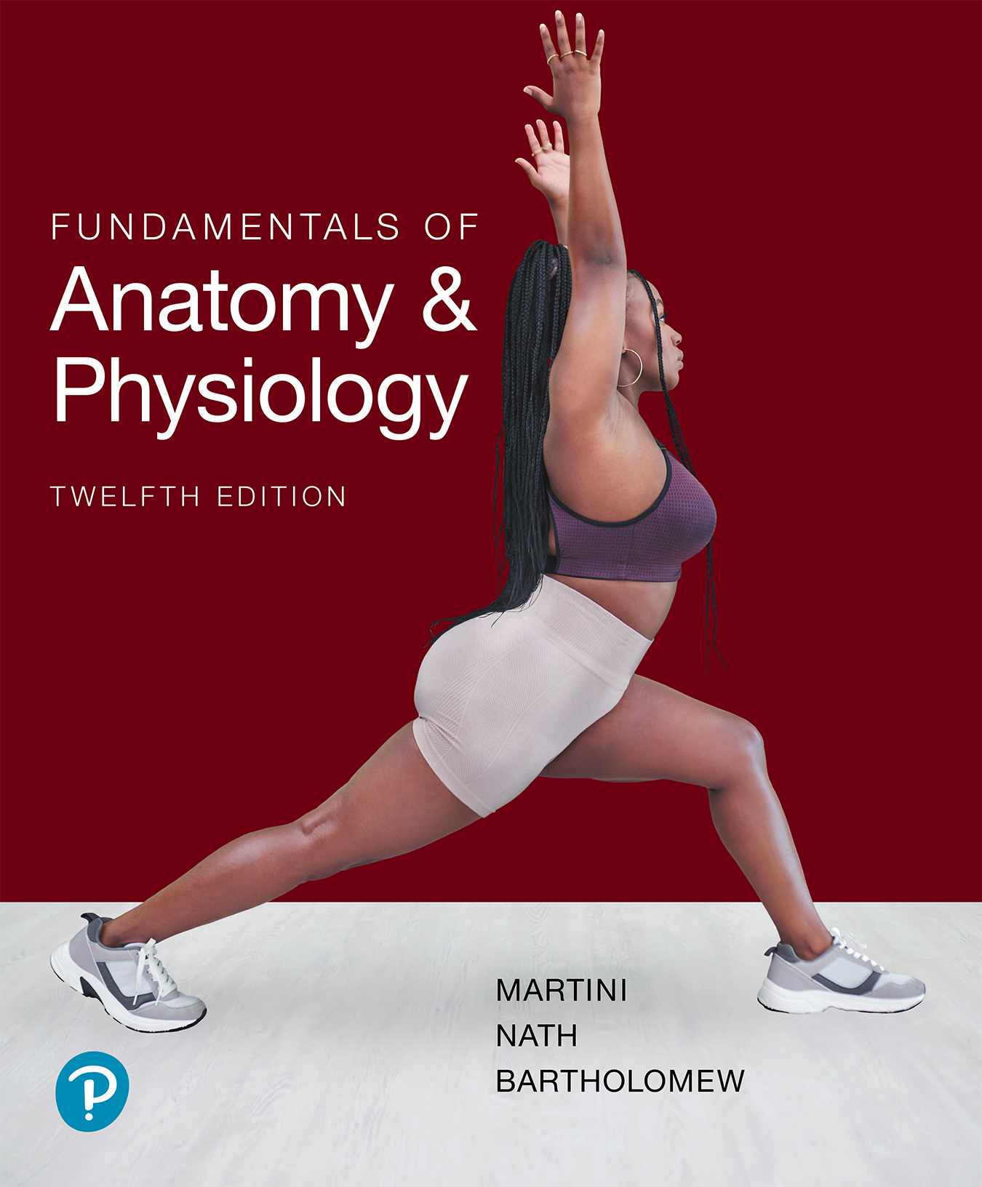

Fundamentals of Anatomy & Physiology
Twelfth Edition
Chapter 14
The Brain and Cranial Nerves
Lecture Presentation by Dr. Virginia Irintcheva, Truckee Meadows Community College
Copyright © 2024, 2018, 2015 Pearson Education, Inc. All Rights Reserved
Notes:
If this PowerPoint presentation contains mathematical equations, you may need to check that your computer has the following installed:
1) MathType Plugin
2) Math Player (free versions available)
3) NVDA Reader (free versions available)

Slide 2
Learning Outcomes (1 of 2)
14-1 Name the major brain regions, vesicles, and ventricles, and describe the locations and functions of each.
14-2 Explain how the brain is protected and supported, and discuss the formation, circulation, and function of cerebrospinal fluid.
14-3 Describe the anatomical differences between the medulla oblongata and the spinal cord and identify the main components and functions of the medulla oblongata.
14-4 List the main components of the pons and specify the functions of each.
14-5 List the main components of the midbrain and specify the functions of each.

Slide 3
Learning Outcomes (2 of 2)
14-6 List the main components of the cerebellum and specify the functions of each.
14-7 List the main components of the diencephalon and specify the functions of each.
14-8 Identify the main components of the limbic system and specify the locations and functions of each.
14-9 Identify the major anatomical subdivisions and functions of the cerebrum and discuss the origin and significance of the major types of brain waves seen in an electroencephalogram (E E G).
14-10 Describe representative examples of cranial reflexes that produce somatic responses or visceral responses to specific stimuli.

Slide 4
Introduction to the Brain and Cranial Nerves
The adult human brain contains almost 97 percent of body’s nervous tissue
  Average weight is 1.4 k g (3 l b)
  “Typical” volume is 1200 m L
    Ranges from 750 to 2100 m L in functionally normal individuals
  Brains of males are about 10 percent larger than those of females
    No correlation between brain size and intelligence

Slide 5
14-1 The Brain (1 of 8)
Learning Outcome: Name the major brain regions, vesicles, and ventricles and describe the locations and functions of each.
Regions of the brain
  Cerebrum
  Cerebellum
  Diencephalon
  Brainstem

Slide 6
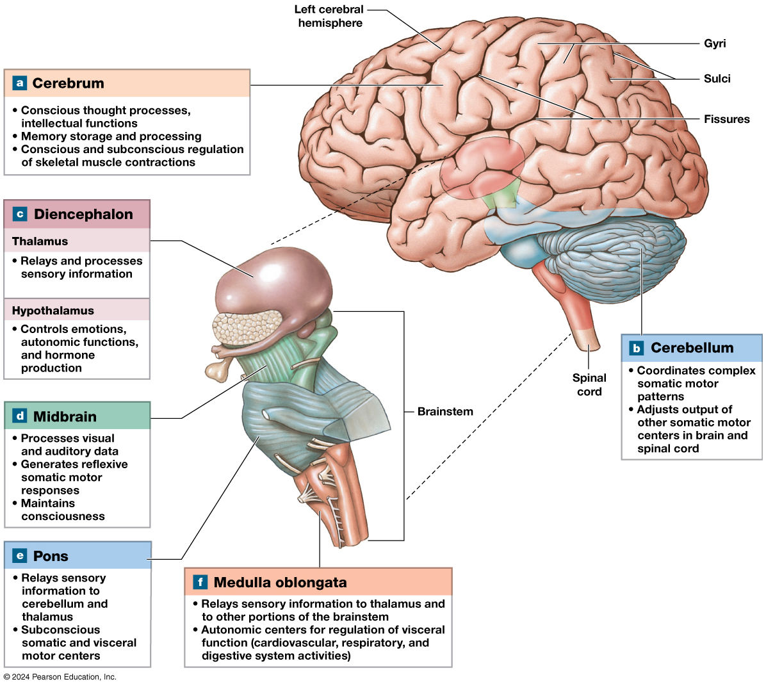
Figure 14–1
An Introduction to Brain Structures and Functions
Notes:
Long Description:
A side view of the brain is depicted, showing the left hemisphere. The brain is a walnut-shaped organ with several grooves and folds on its surface. The deep grooves are labeled fissures. The elevated regions, or folds, of the brain between the fissures, are labeled gyri. Shallow grooves on the gyri are labeled sulci. The spinal cord attaches to the inferior surface of the brain. Before entering the brain, the spinal cord becomes a little thicker and penetrates deep into the center of the brain. This part of the cord that penetrates the brain is labeled brainstem. The different parts of the brain are labeled and their functions are listed in parts a to f. Part a, Cerebrum. A large portion covering the anterior part of the brain is labeled cerebrum. The functions of the cerebrum are listed as follows: Conscious thought processes, intellectual functions; Memory storage and processing; Conscious and subconscious regulation of skeletal muscle contractions. Part b, Cerebellum. A spherical region inferior to the posterior part of the brain is labeled cerebellum. It is posterior to and makes contact with the posterior surface of the brainstem. The surface of the cerebellum is covered in several shallow grooves. The functions of the cerebellum are listed as follows: Coordinates complex somatic motor patterns; Adjusts output of other somatic motor centers in the brain and spinal cord. Part c, Diencephalon. A small oblong structure inferior to the cerebrum, at the superior end of the brainstem, is labeled diencephalon. It has two parts: the thalamus and the hypothalamus. The thalamus relays and processes sensory information. The hypothalamus controls emotions, autonomic functions, and hormone production. The brain stem is magnified and its different parts are labeled and described in parts d to f. The diencephalon can be seen posterior to the superior end of the brainstem with narrow processes wrapping around the brainstem. Part d, Midbrain. A short portion at the superior end of the brainstem is labeled midbrain. This part is present deep in the brain, just below the diencephalon. The functions of the midbrain are listed as follows: Processes visual and auditory data; Generates reflexive somatic motor responses; Maintains consciousness. Part e, Pons. A swollen region below the midbrain is labeled pons. This part is outside the brain, anterior to the cerebellum. The functions of the pons are listed as follows: Relays sensory information to the cerebellum and thalamus, Subconscious somatic and visceral motor centers. Part f, Medulla oblongata. A short region forming the inferior end of the brainstem is labeled medulla oblongata. The medulla oblongata connects the spinal cord and the rest of the brain stem. The functions of the medulla oblongata are listed as follows: Relays sensory information to the thalamus and other portions of the brainstem; Autonomic centers for regulation of visceral function (cardiovascular, respiratory, and digestive system activities).

