Slide 1

DockerENT
Open Source tool & framework to Analyse security issues with running containers.
Rohit Sehgal

Slide 2
DockerENT
Open Source tool to Analyse running container.
01
02
03
What is DockerENT
A quick overview of tool, and why do we need it.
Checks
List of checks which DockerENT can perform
Technical Details
Create your own plugins.
00
Who-am-I
04
05
06
Demo
Future Work
Q&A
It's not the end.

Slide 3
DockerENT
Analyse running container.
Security Engineer with ~4 years of Experience, Master from IITK
Started with Bug Hunting, but now I am on the other side of the table.
OSCP
Into : PenTesting, Secure Code Review, Design Review etc.
Into Development :
Open Source
TrashEmail - Disposable Email Solution for Telegram.
DoT-Proxy - DNS over TLS proxy (WIP)
Cloudmarker
BinExp
k8s-in-30-mins, etc
GitHub : r0hi7
LinkedIn : r0hitsehgal
Twitter : sehgal_rohit
More @ rsehgal.in
00
Who-am-I

Slide 4
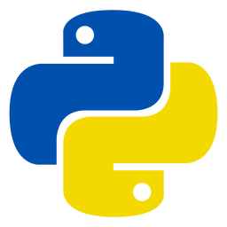
DockerENT
Analyse running container.
01
Docker runtimE security scaNning Tool.
Framework written in
It's extremely simple to create custom plugins.
Use it quickly with exiting plugins.
Tasks
Scan containers running in System with security misconfiguration.
Runtime docker level security misconfigurations.
Container Namespace level check and misconfigurations.
Audit results.
Customisable.
A DevSecOps friendly tool for quick and repetitive checks.
And Yes there is a Web App along with fully functional CLI.
What is DockerENT

Slide 5
DockerENT
Analyse running container.
01
Docker runtimE security scaNning Tool.
Be it K8S or Swarm Cluster, at the end of the day, they are running docker.
Fine grain and docker level checks.
Framework:
Similar to but powerful than DockerBench
I will talk about this in next slide.
What is DockerENT

Slide 6

DockerENT
Analyse running container.
DockerENT
DockerBench
Performs Runtime configuration checks.
Only performs checks for running containers.
Overlapping scan set with DockerBench
Also Performs checks by executing commands inside docker.
Perform CIS Benchmarks checks.
Performs Container and host level checks.
Cant identify security issues inside running containers.
01
What is DockerENT
ENT
Bench
Container Internal checks
Host level hardening checks

Slide 7
DockerENT
Analyse running container.
DockerENT
Install with PIP
Run From Source
pip install DockerENT
DockerENT -w
01
DockerENT --help
What is DockerENT
git clone https://github.com/r0hi7/DockerENT.git
make deps
make venv
python -m DockerENT --help

Slide 8
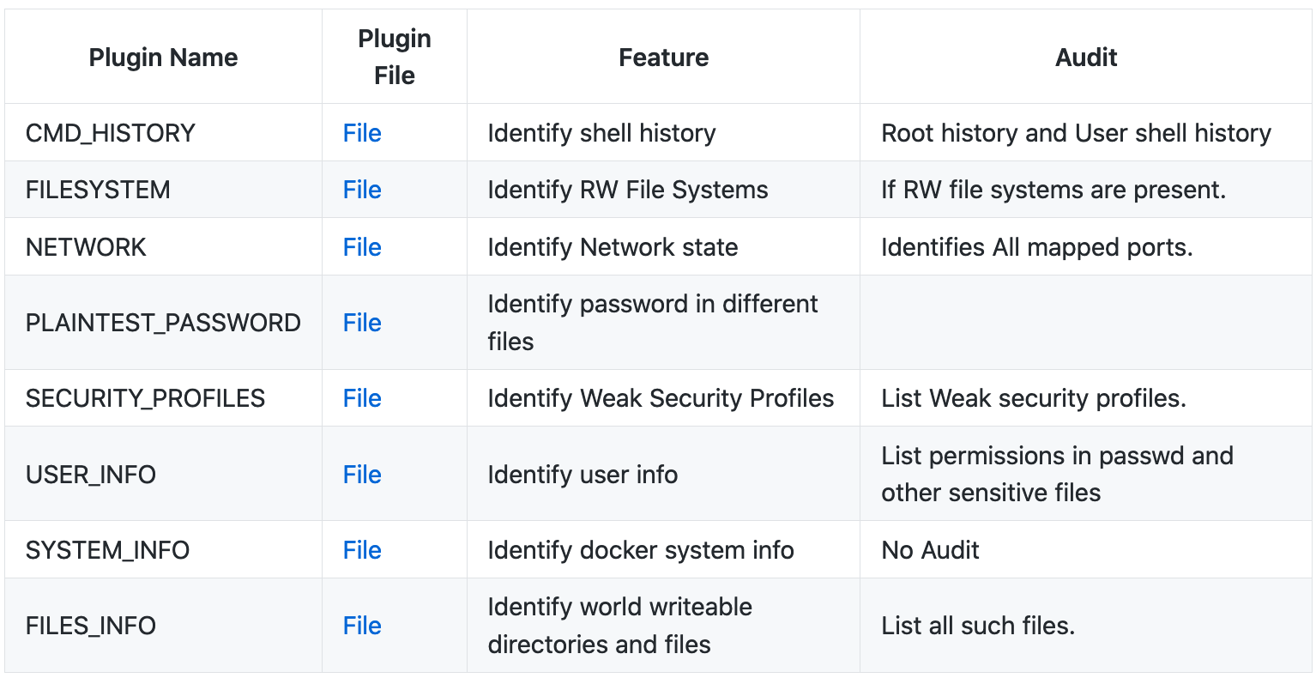
DockerENT
Analyse running container.
Most updated list can be found here : https://github.com/r0hi7/DockerENT#plugins-features
02
Checks
List of checks which DockerENT can perform

Slide 9
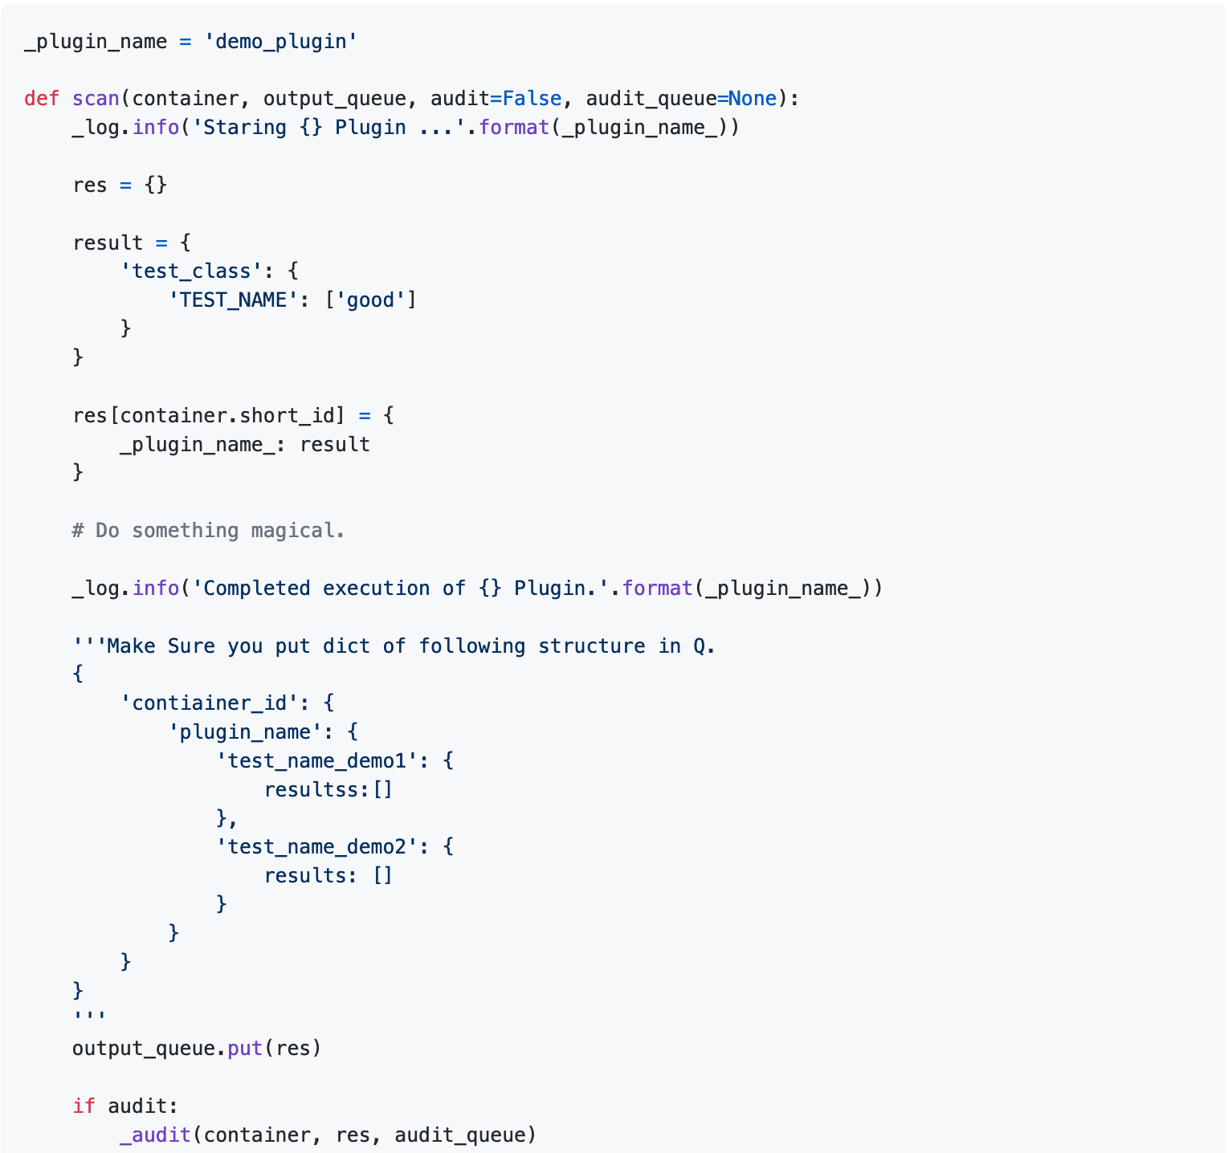
DockerENT
Analyse running container.
03
Technical Details
Create your own plugins.

Slide 10
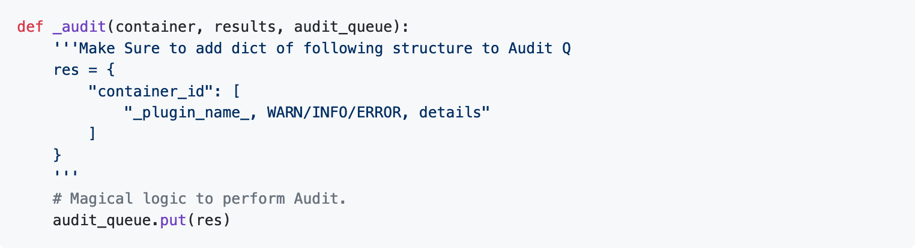
DockerENT
Analyse running container.
03
Technical Details
Create your own plugins.

Slide 11
DockerENT
Analyse running container.
03
Technical Details
Create your own plugins.
Scanning & Working: https://asciinema.org/a/357544

Slide 12
DockerENT
Analyse running container.
04
Demo

Slide 13
DockerENT
Analyse running container.
04
3:"security-profiles, WARN, No AppArmorProfile Found"
4:"security-profiles, WARN, SELinux disabled"
5:"user-info, WARN, Current USER is : root"
Demo
Plugin
Name
Alert Type
Description

Slide 14
DockerENT
Analyse running container.
Suggestions for remediation.
Better UI.
Support from community.
Simplified way of plugin creation.
Docker Network Monitoring.
Currently there is no Parallel processing when it come to UI.
Popularise it !!
05
Future

Slide 15
DockerENT
Analyse running container.
GitHub Link : https://github.com/r0hi7/DockerENT

Slide 16
DockerENT
Q & A

Slide 17
DockerENT
ThankYou !

