Slide 1

AUTOMATED VIDEO SEGMENTATION PROJECT
Arjun Sadashiv, Arun Gangadharan M Jibin Thomas Daniel, Sanat Jayakrishnan
Roll No: AM.EN.U4EAC20012, AM.EN.U4EAC20013, AM.EN.U4EAC20030, AM.EN.U4EAC20058
Guide: Ms. Anuraj K, Designation: Asst. Prof. Sr. Grade
Co-Guide: Dr.Vivek Venugopal, Designation: Asst. Prof. ECE Department of Electronics and Communication Engineering Amrita School of Engineering, Bengaluru
Technical Presentation

Slide 2
Content
No. | Content | Slide No.
1 | Objective | 3
2 | Dataset | 4
3 | Proposed Work | 5
4 | Recap | 6-7
5 | Work Done | 8-9
6 | Accuracy metrics | 10-11
7 | Result | 12-13
8 | Conclusion | 14
9 | Future Works | 15
10 | Timeline | 16
Technical Presentation

Slide 3
Objective
The main objective of our project is to create an automatically applied lecture video segmentation system that splits lectures into bite-sized topics using audio cues.
Technical Presentation

Slide 4
Dataset
We utilize a large-scale dataset of audio-visual lectures called AVLectures which contains around 86 courses with over 2,350 lectures covering various subjects from the STEM field.
Each course contains the video lectures themselves, transcripts, OCR outputs for lecture frames.
Supplementarily, it also contains lecture notes, slides, assignments and related educational content.
We use a part of this large-scale dataset in our dataset.
Technical Presentation

Slide 5
Proposed Work
Preprocessing of Input
Transcription
Embedding
Clustering
Topic Extraction
Accuracy Metrics
Technical Presentation

Slide 6
RECAP
Audio Conversion and Segmentation:
We first converted the video files into usable audio format. Here, we have converted it to a .mp3 file format.
This audio is then segmented into 10 second chunks is converted into a .wav file to ensure little to no compression and clear audio the audio volume is also increased to enable proper transcription.
Transcription and Embedding:
Transcription of the audio chunks is done using Whisper, text files of the audio chunks are received as output.
The transcriptions are then individually embedded using the SentenceTransformer embedding model.
Technical Presentation

Slide 7
RECAP
Clustering
We pass these embedded vectors through an Agglomerative Clustering algorithm.
These Clusters are printed to show topic division.
Technical Presentation

Slide 8
Work Done
Topic Extraction
We use topic extraction methods that organize and understand large collections of text data, by assigning “tags” or categories according to each individual text's topic or theme.
By using this we are trying to obtain the actual topic discussed in a particular segment of the entire audio lecture.
For achieving this we used an algorithm known as Latent Dirichlet Allocation(LDA).
Technical Presentation

Slide 9
Work Done
Latent Dirichlet Allocation(LDA)
LDA is used to classify text in a document to a particular topic.
Each document is modeled as a multinomial distribution of topics.
LDA assumes that every chunk of text we feed into it will contain words that are somehow related.
It also assumes documents are produced from a mixture of topics. Those topics then generate words based on their probability distribution.
So, we get a pool of words according to the probability distribution and an apt title or topic for the segment is obtained by getting the max valued topic in terms of probability.
Technical Presentation

Slide 10
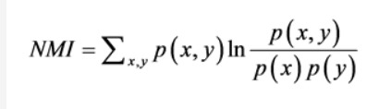
Accuracy Metrics
NMI
It is a measure for determining the quality of clustering.
We have determined NMI without the use labels.
Since it’s normalized, we can measure and compare the NMI between different clustering having different number of clusters.
Technical Presentation

Slide 11
Accuracy metrics
Accuracy Metrics
NMI[Image Results]
It measures the similarity between the true class labels of a dataset and the labels assigned by a clustering algorithm.
NMI is normalized to have a value between 0 and 1.
Technical Presentation

Slide 12
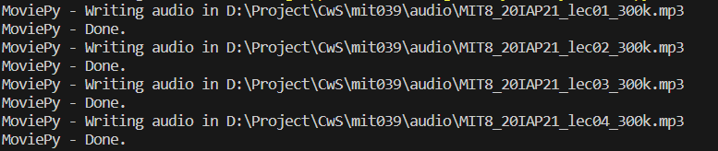
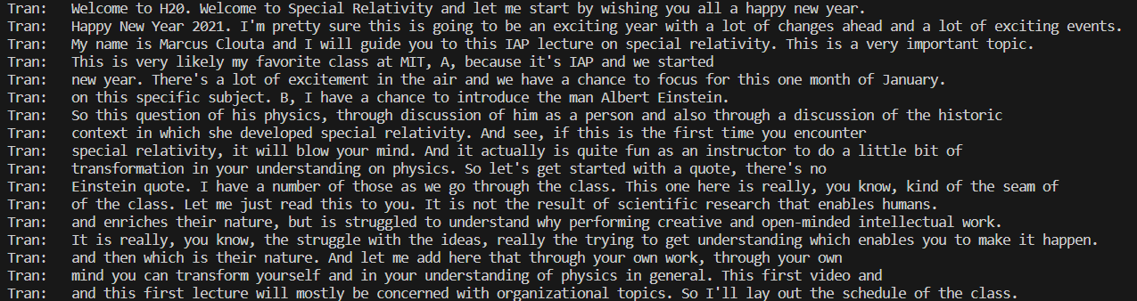
Results
Converting video into audio file
Split the audio file into chunks
Transcripted the audio file into text file.
Technical Presentation

Slide 13
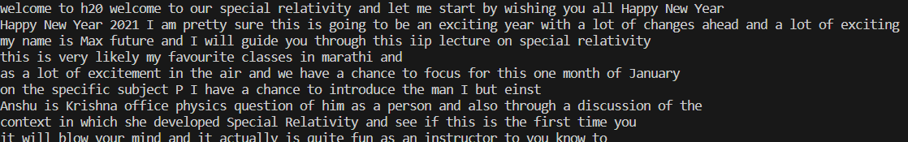
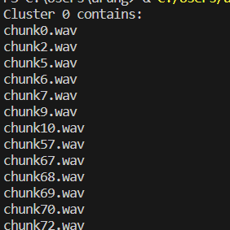
Result of the Progressed work
speech recognition module output
Cluster contents
Technical Presentation

Slide 14
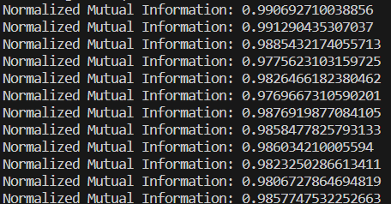
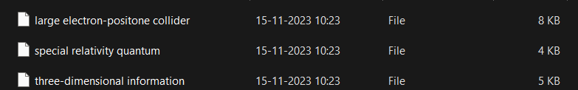
Result of the Progressed work
NMI calculation for 12 Video lectures.
Topic extracted for each cluster
Technical Presentation

Slide 15
Conclusion
Our objective of segmenting audio is a unique and useful venture.
We have developed a unique model by utilizing several libraries, modules and an ASR.
We have accomplished what we have set out to do and look to the road ahead with our plan to further improve our model.
Technical Presentation

Slide 16
Future Works
The future works we will be basing off of our current project will also incorporate a visual element not just an audio element.
This will ensure more dimensionality as the model would be working off two separate criteria's.
This will also provide us with a far more accurate result.
Technical Presentation

Slide 17
Timeline
Mini Project
August 2023 : Topic finalization and literature survey
September 2023 and October 2023 : Implementation of automatic video segmentation model using audio data. We are currently in this stage.
November 2023 : Testing the database using deep learning approaches.
Project
Implement the model such that both audio/visual data can be used in segmentation
Validate and enhance the accuracy and performance of the model.
Technical Presentation

Slide 18
References
Ankit Gandhi, Arijit Biswas, and Om Deshmukh. “Topic Transition in Educational Videos Using Visually Salient Words”. In: Educational Data Mining. 2015. url:https://api.semanticscholar.org/CorpusID:14721646.
Lisa Anne Hendricks et al. “Localizing Moments in Video with Natural Language”. In: 2017. arXiv: 1708.01641 [cs.CV].
Debabrata Mahapatra, Ragunathan Mariappan, and Vaibhav Rajan. “Automatic Hierarchical Table of Contents Generation for Educational Videos”. In: Companion Proceedings of the The Web Conference 2018. Republic and Canton of Geneva, CHE: International World Wide Web Conferences Steering Committee, 2018. isbn: 9781450356404. doi: 10.1145/3184558.3186336. url:https://doi.org/10.1145/3184558.3186336.
Antoine Miech et al. “End-to-End Learning of Visual Representations from Uncurated Instructional Videos”. In: CVPR. 2020.
Darshan Singh S et al. Unsupervised Audio-Visual Lecture Segmentation. 2022. arXiv: 2210.16644 [cs.CV].
Technical Presentation

Slide 19
Thank You !!!
Technical Presentation

