Slide 1

Department Of Computer Science

Slide 2
Software Design Document Xotron ()
Student 1 Name
Arslan Amin SP21-BCT-005.
Student 2 Name
HALEEMA SAADIA SP211-BCT-007
Supervisor:
Tehseen Riaz Abbasi
Department Of Computer Science
Submission Date:02-December-2022

Slide 3
Project Category
.
B- Web ApplicationC- Problem Solving and Artificial Intelligence
E- Smartphone Application
I- Artificial intelligence______________________

Slide 4
Research Based Project
No

Slide 5
Introduction
This chapter provides the Scope of the project, in this chapter we discussed the scope of AI chat bot and its limitations, what we are going to deliver, tool and technologies which we used to build Chatbot.
Additionally, businesses that operate, gather a lot of data, and depend on making quick judgments in real time need to mix AI and intelligent bots. Therefore, a chatbot system will be quite useful in this setting. The ease with which those who dislike chatbots can be connected to actual personnel is one of their best features. The flexibility to switch between assisted and unassisted selling and the choice to engage a human sales assistant when necessary is one of a sales chatbot's most crucial capabilities. The goal of this chatbot system is to lower the work burden on the humans and provide a useful way to the consumers in their daily based task. Also, a check and balance on their health. Everyone needs a personal assistance, so this AI based chatbot is the best system for assessing a user without the interaction of other humans. User work will be easier and efficient.

Slide 6
Tools and Technologies
Tools And Technologies | Tools | Version | Rationale
 | 1.MobileMonkey | 1.1.5 | Virtual chatbot
 | 2.TARS | 1.13.1 | Virtual chatbot
 | 3.BOTSIFY | 1.3 | Virtual chatbot
 | 4.BOTKIT | 4.15.0 | Virtual chatbot
 | 5.Wit.ai | 4.1.2 | Virtual chatbot
 | 6.Replika | 10.2.0 | Virtual chatbot
 | 7.Chatfuel | 1.0.4 | Virtual chatbot
 | 1.AI | 0.0.1 | Programming language
 | 2.NLP | 4.3.0 | Programming language

Slide 7
Scope
The credibility of a business and the quality of its customer service are two essential aspects of a successful business model. To keep up with the ever-changing world, numerous well-known businesses are now employing chatbots powered by artificial intelligence. The goal of this chatbot system is to lower the work burden on the humans and provide a useful way to the consumers in their daily based task. Also, a check and balance on their health. Everyone needs a personal assistance, so this AI based chatbot is the best system for assessing a user without the interaction of other humans. User work will be easier and efficient.
chat bot will listen all the problems, analyze and recognize user problems and will do counselling by giving and suitable suggestions.

Slide 8
Modules
Module 1: Profile management
Module 2: Daily base communication
Module 3: Registered people management
Module 4: Bot training
Module 5: Health care
Module 6: Generals
Module 7:Sentiment Analysis
Module 8:Chatbot analytics
Module 9:Personal assistance
Module 10:Help and support

Slide 9
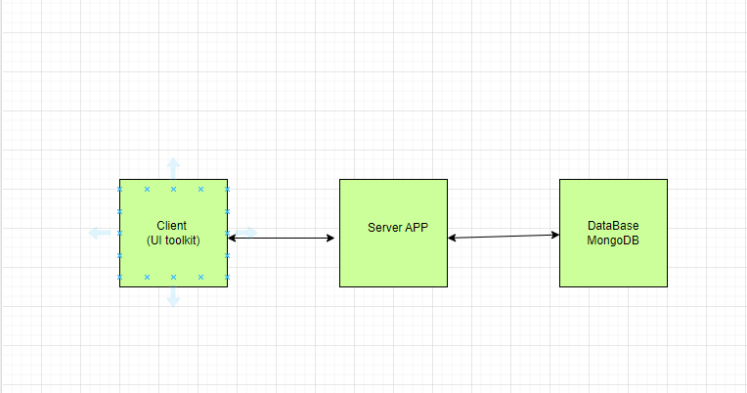
Architecture Diagram of Proposed Project
Figure-2: Architecture Diagram 3 tier.

Slide 10
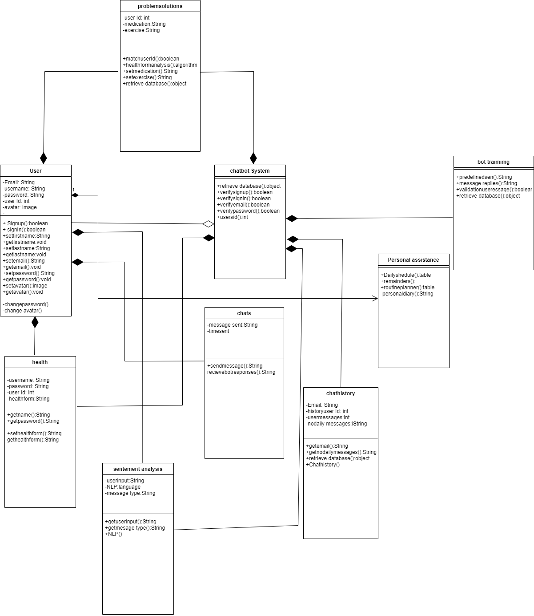
Use Case Diagram

Slide 11
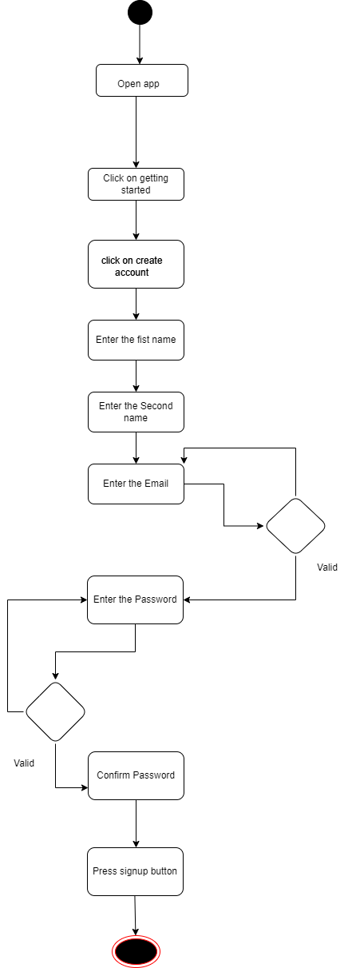
Activity Diagrams

Slide 12
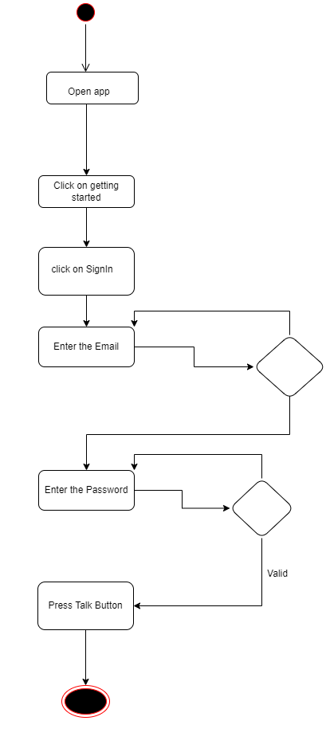

Slide 13
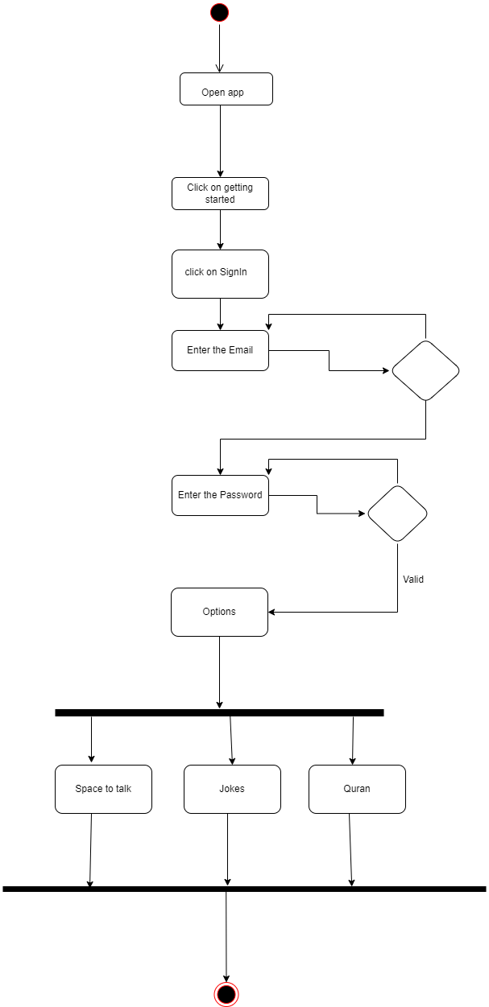

Slide 14
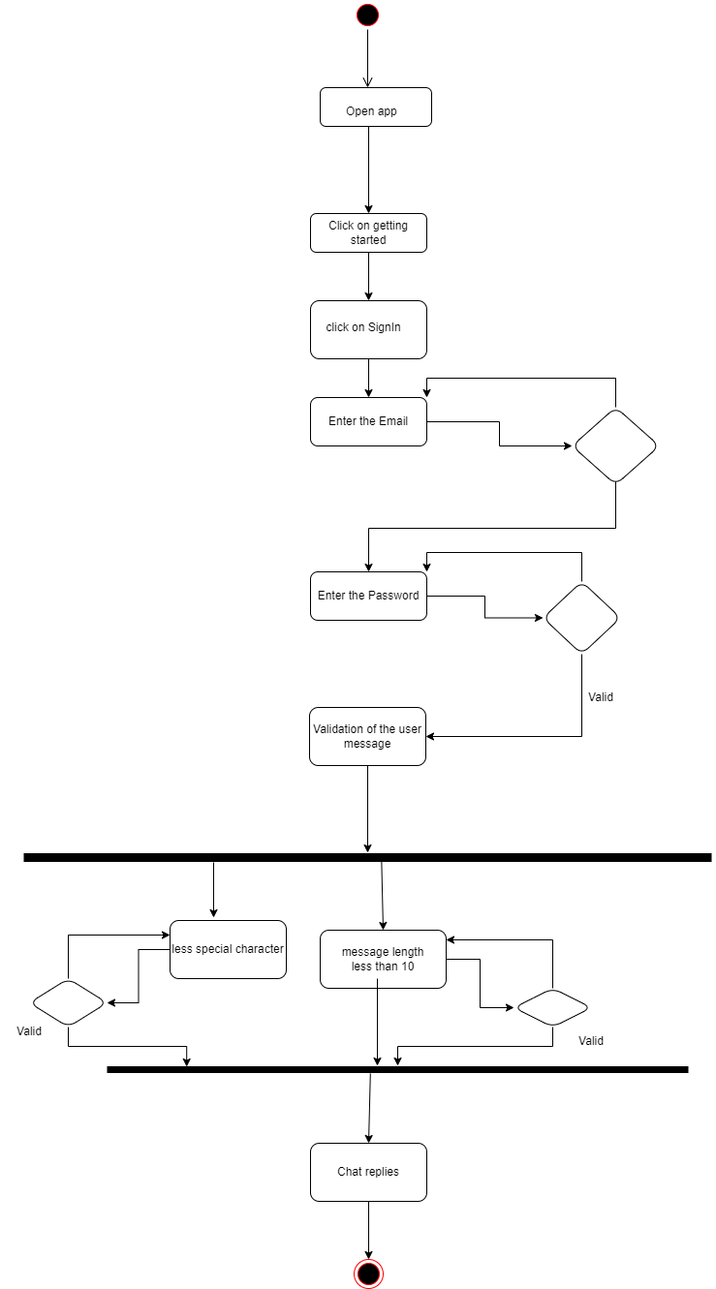

Slide 15
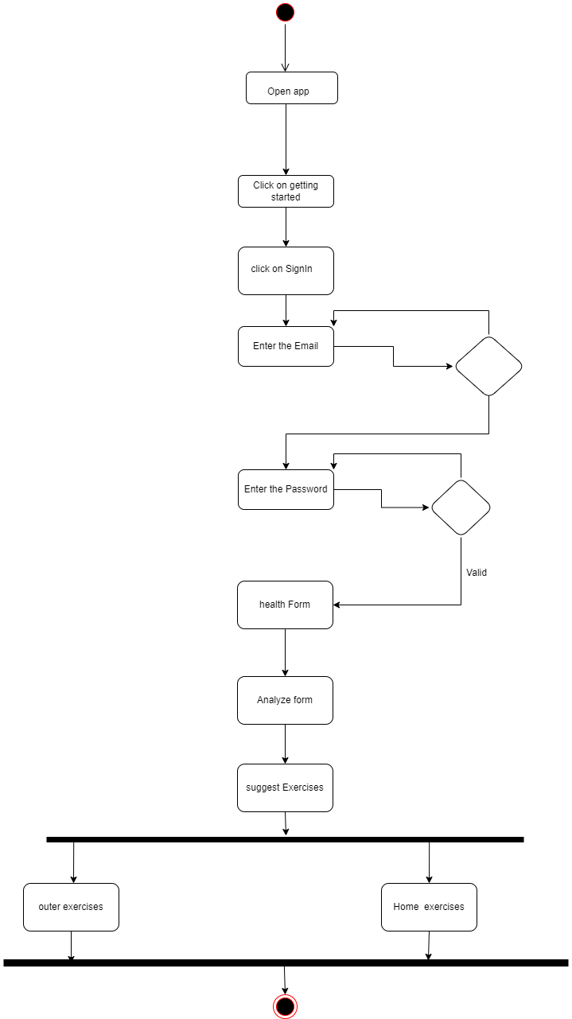

Slide 16
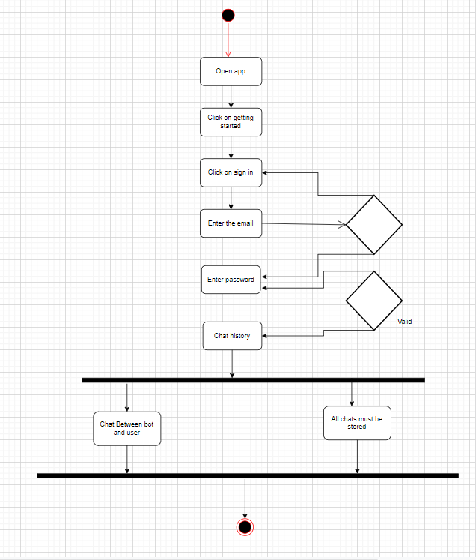

Slide 17
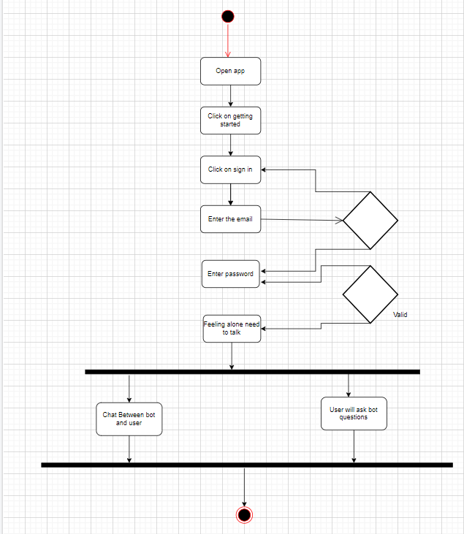

Slide 18
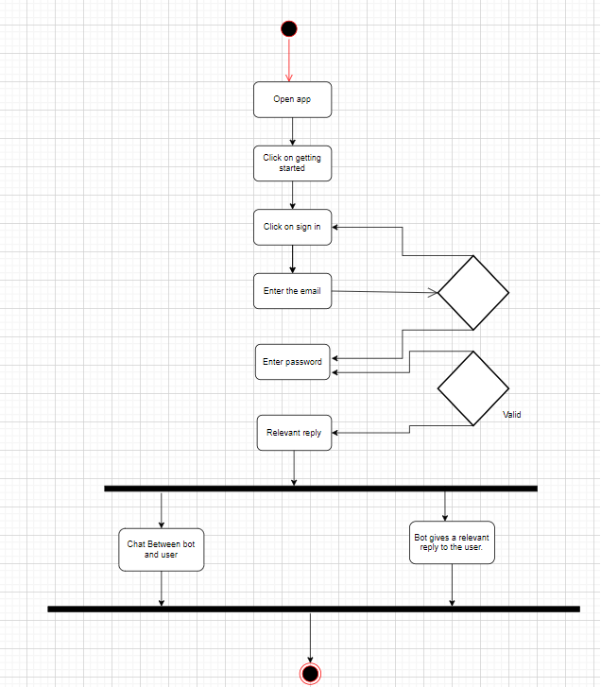

Slide 19
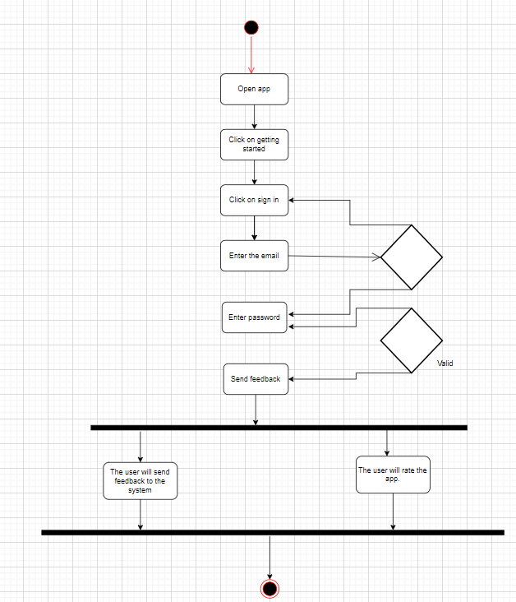

Slide 20
Class Diagram or Data Flow Diagrams
Note: 1 Slide/Per Diagram (Usually 1-2 Slides) -
Based on your project type, discuss the class diagram or Data Flow Diagram.
In case of DFD, discuss level 0, 1 and 2
Create Diagram Using MS VISIO (or any other standard UML supported Tool) as per UML standard notations.
Note: Make sure that diagrams are properly labelled, clear, readable and visible.

Slide 21
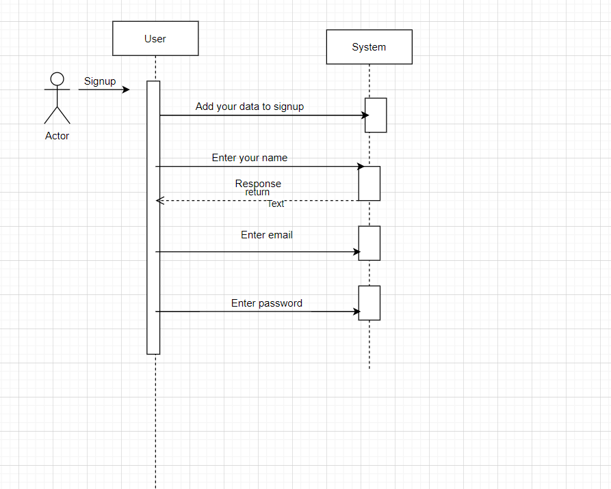
Sequence Diagram

Slide 22
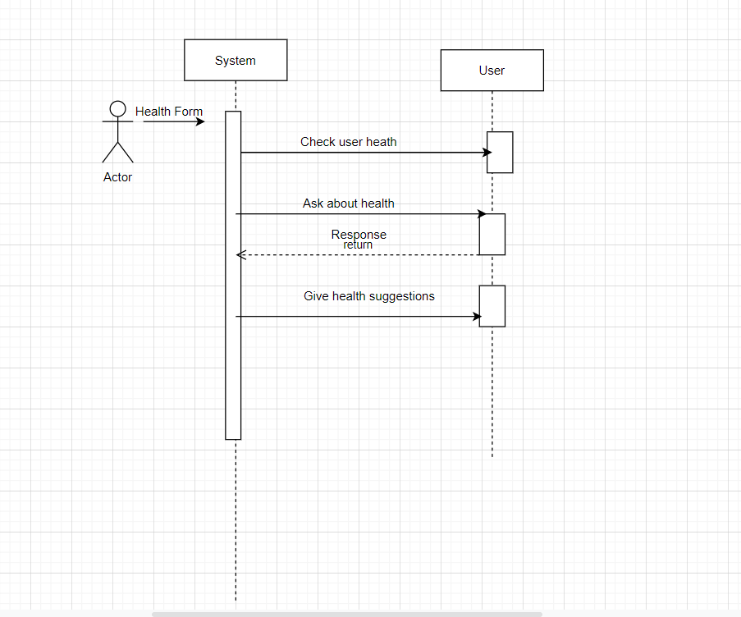

Slide 23
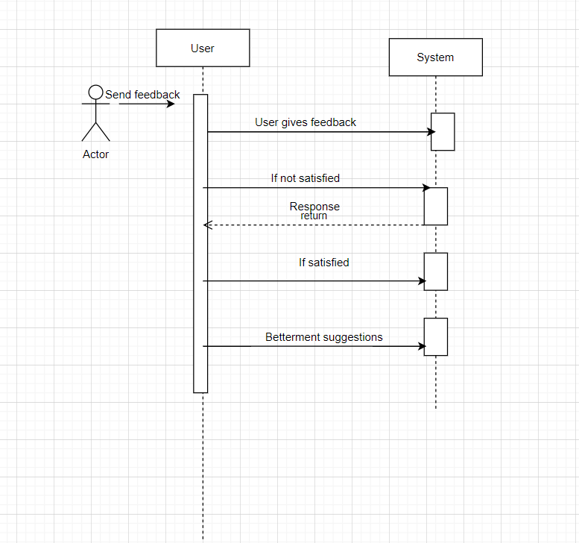

Slide 24
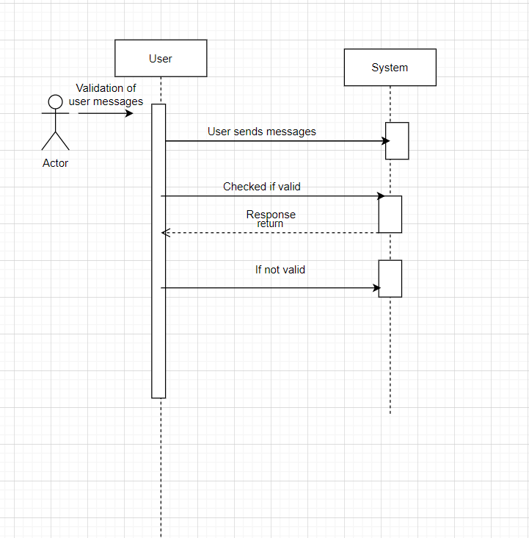

Slide 25
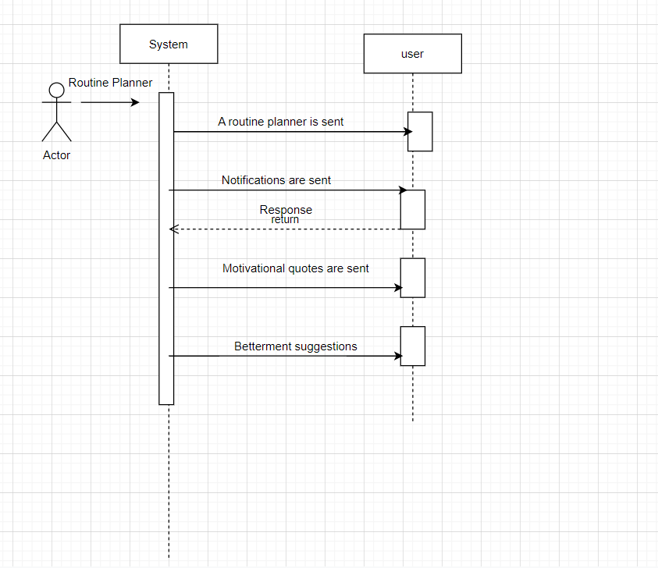

Slide 26
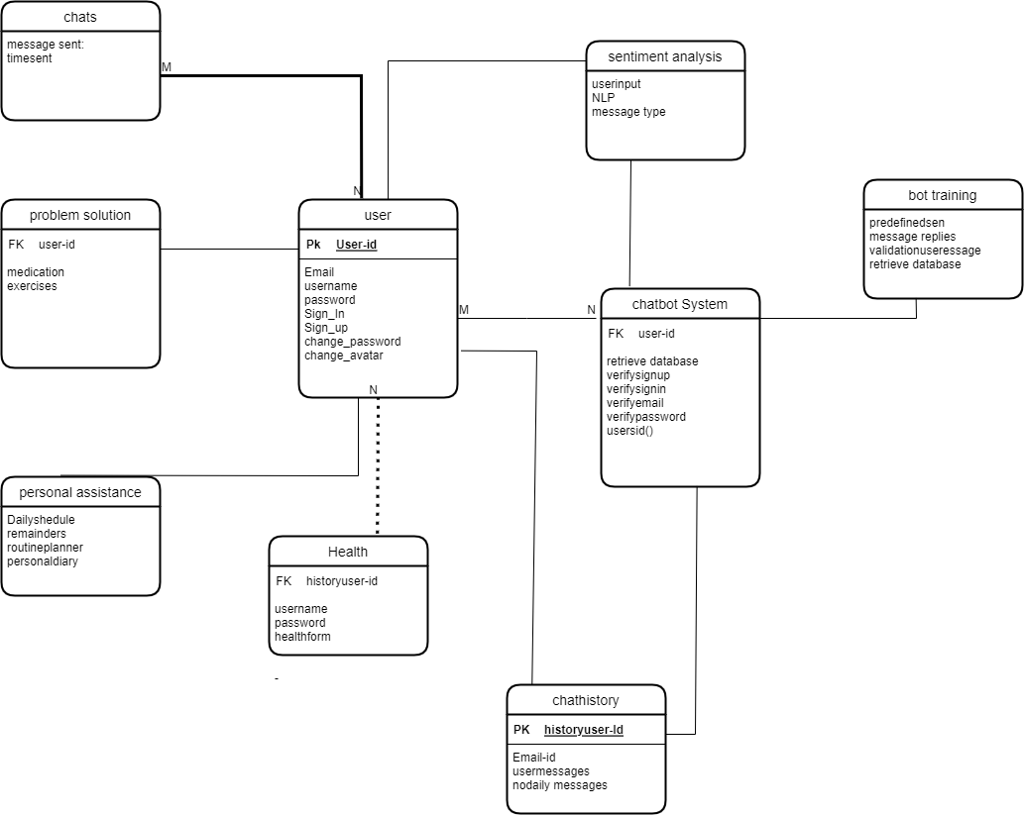
Data Design

Slide 27
Algorithm & Implementation
INPUT email
IF(verifyEmail NOT EQUAL true)
DISPLAY “Invalid Email”
WHILE (verifyEmail EQUAL false)
INPUT password
IF(account NOT found)
DISPLAY “Invalid login credentials! Please try again!”
ELSE
DISPLAY “Successfully logged in!”
GENERATE ads
DISPLAY ads
IF(login)
DO
INPUT message
INPUT receiverID
WHILE(message NOT null OR valid receiverID)
SEND message request to receiver end
ELSE
DISPLAY “Please login”

Slide 28
Conclusion
The system's design is fully described in this document. Additionally provided are the abstract implementation details and the logical flow. The user and system requirements have been met. This document will contain the application's design. How it operates and how it is put into practise. Additionally, the approaches necessary for the application to function correctly will be described.

Slide 29
References
· https://ui8.net/the-madbrains/products/madbrainsui--chatbot--ai-startup-agencyux
· https://www.analyticsvidhya.com/blog/2021/10/complete-guide-to-build-your-ai-chatbot-with-nlp-in-python/
· https://vilmate.com/blog/how-to-develop-a-chatbot/
· https://youtu.be/1XHp8WrZzoc
· https://www.ameyo.com/blog/key-advantages-and-use-cases-of-healthcare-chatbot/
· https://geekflare.com/create-chatbot/
· https://www.tutorialspoint.com/artificial_intelligence/artificial_intelligence_natural_language_procssing.htm

