Slide 1

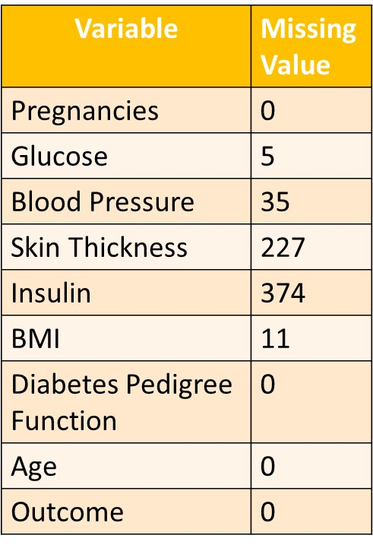
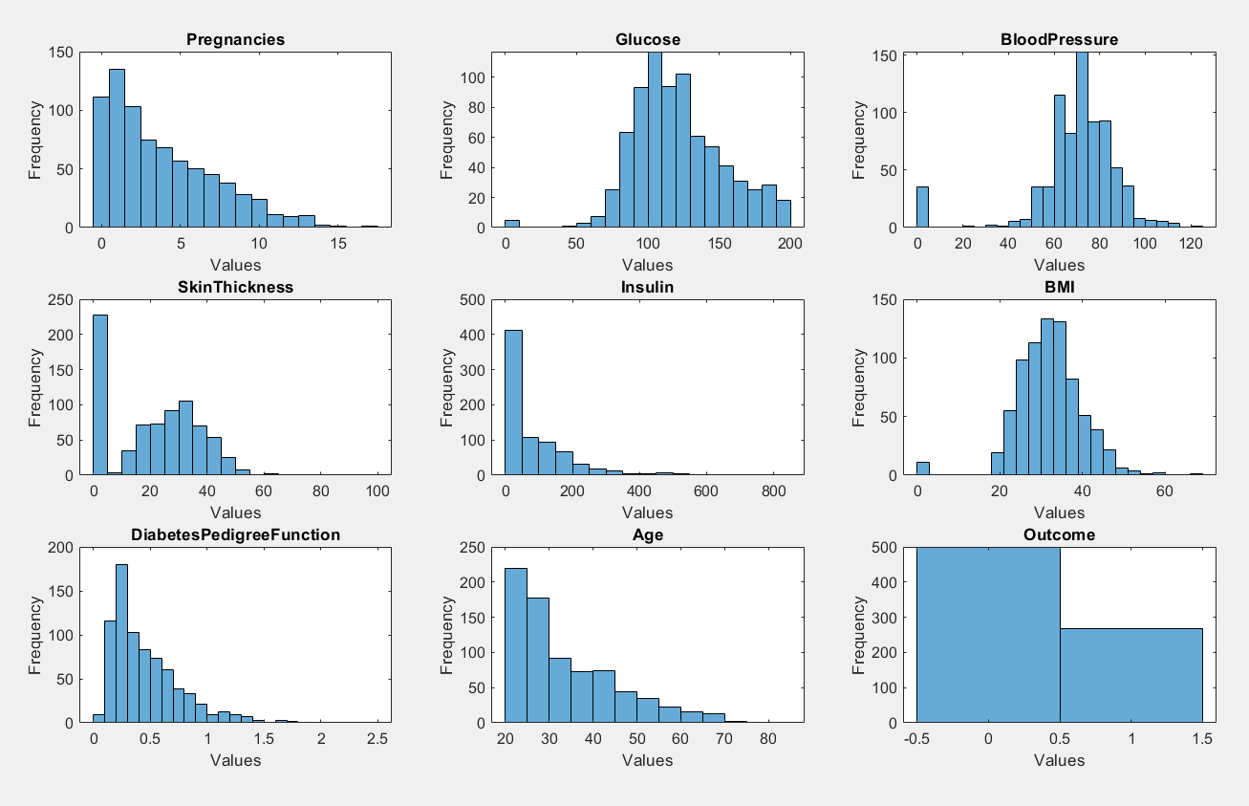
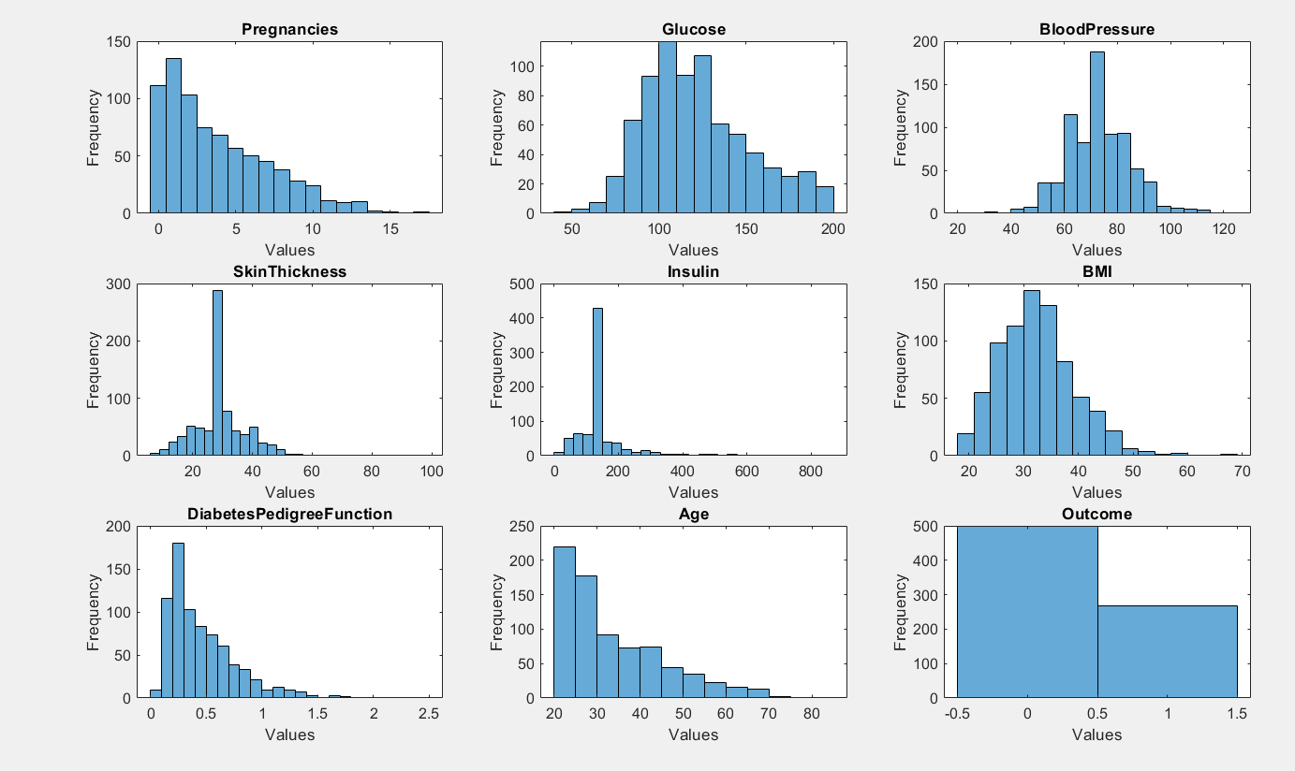
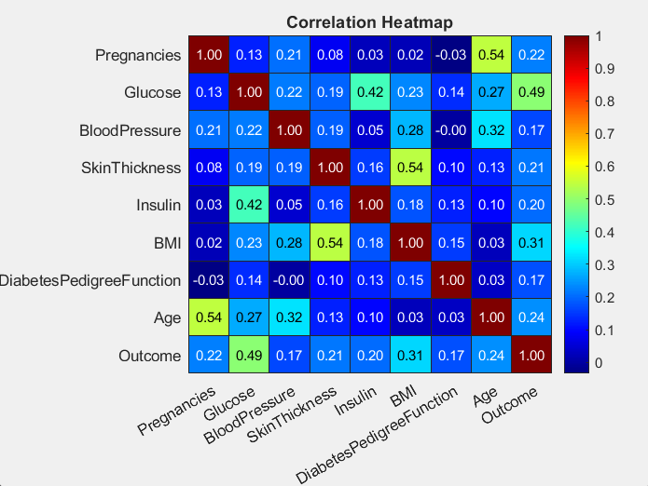
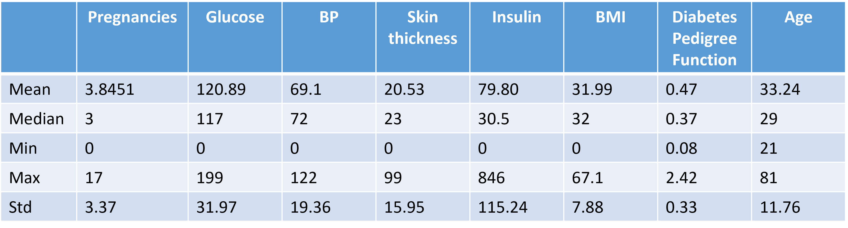
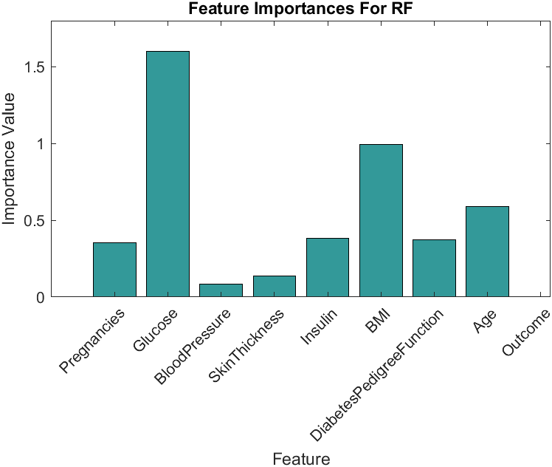
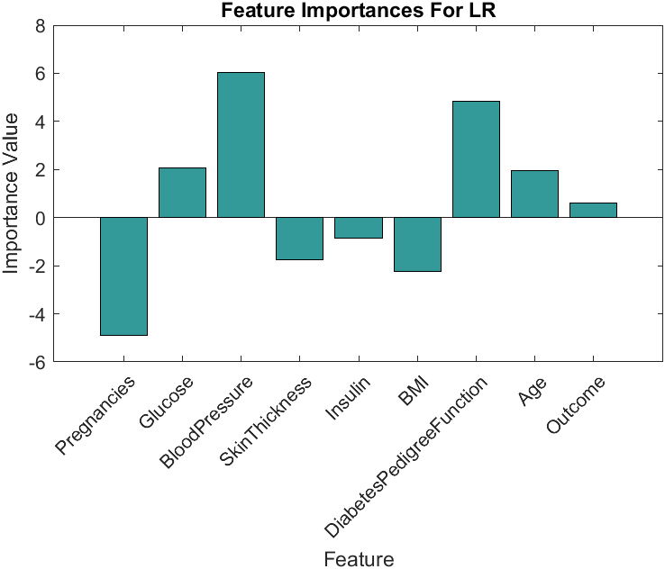
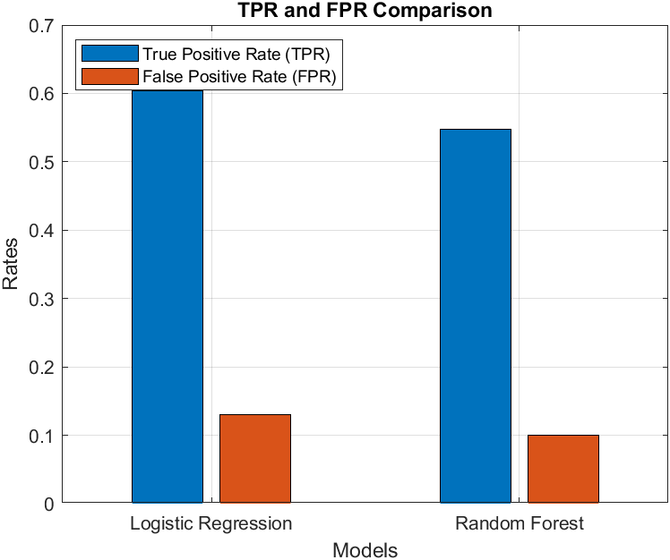
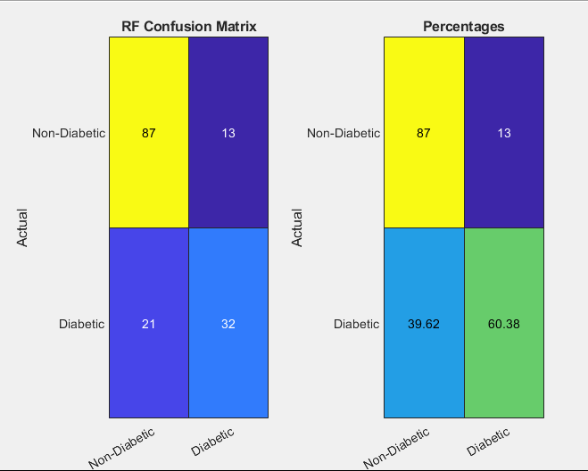
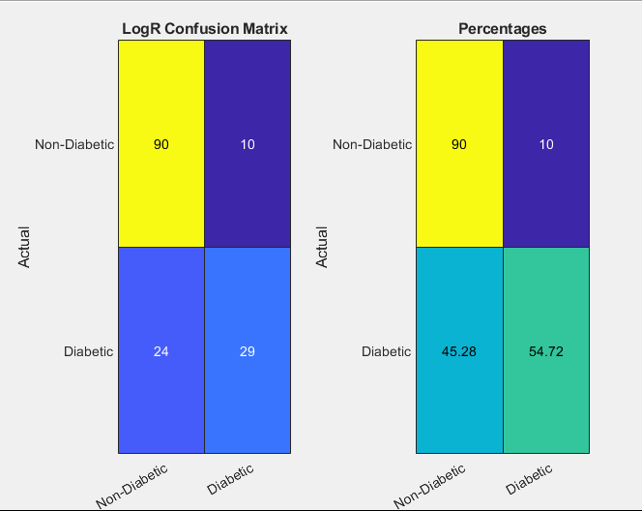
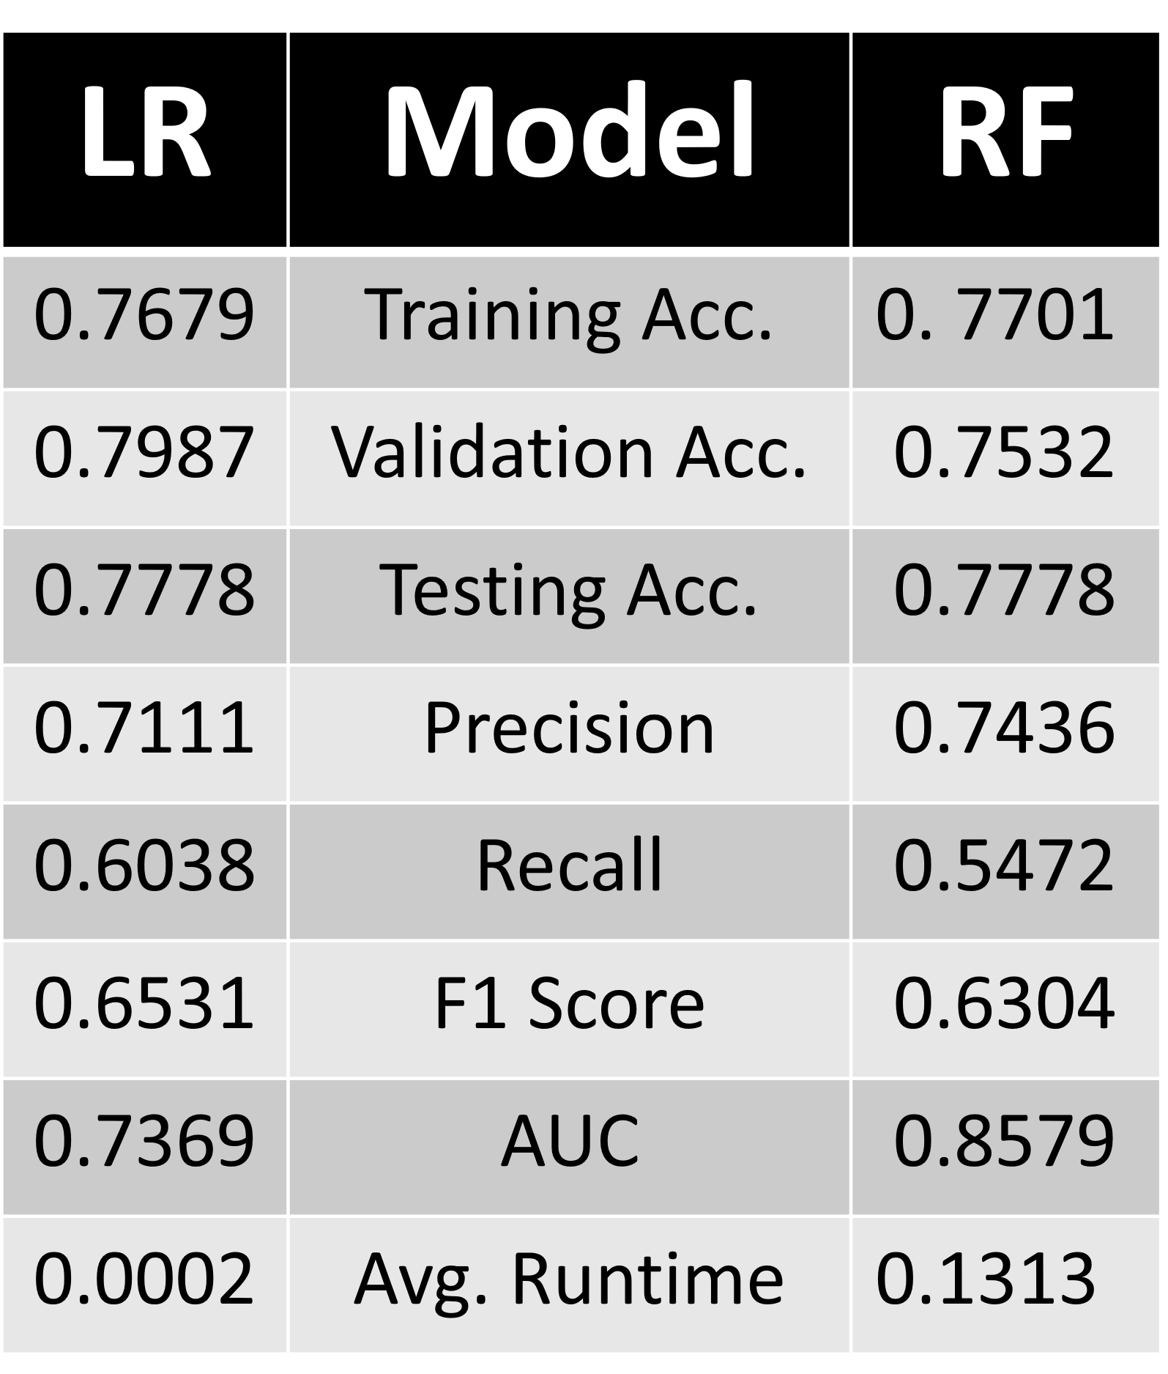
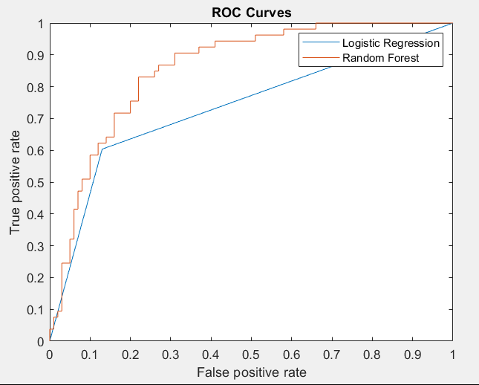
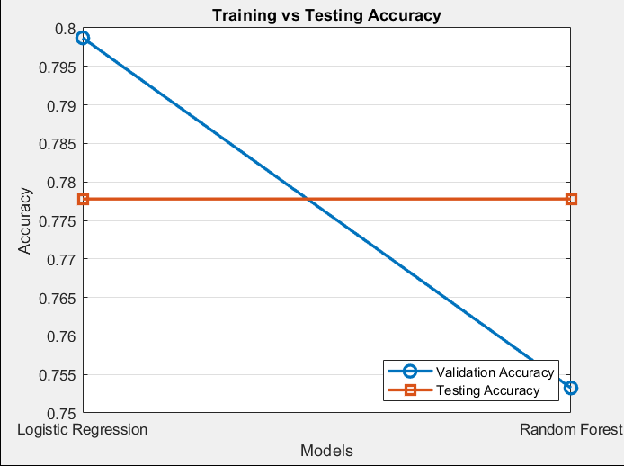
A Comparison of Random Forest and Logistic Regression Applied to Diabetes Dataset
Coursework: INM431 Machine Learning Name: Arsalaan Ahmad Email: Arsalaan.Ahmad@city.ac.uk
Description and Motivation:
Training two models to solve binary classification problem of predicting Diabetes using the medical data available of Women aged 21 and above specifically from Pima Indian heritage. We will compare our results to those obtained by Chang V, Bailey J, Xu QA, Sun Z (2022)¹ for Random Forest, and also apply Logistic Regression to compare with the model performance.
Initial Analysis of Dataset
The dataset is Pima Indians Diabetes Data from Kaggle.
The original dataset has 768 rows and 9 columns. 8 predictors and 1 target (binary) where latter has value 0 or 1 corresponding to the presence or absence of diabetes.
We found that missing values in the data is in the form of 0 values.
Table 1. show information about the missing values in the dataset , in this dataset missing values where in the form of 0. we replaced the missing values in Glucose and Blood Pressure with there mean and missing values in skin thickness, insulin and BMI with there median value.
Figure 1. shows the frequency distribution of dataset before and after we replace 0 values with mean and median value. For the figure its we can also see the frequency of Outcome (target variable).
Figure 2. (correlation heatmap), shows the relation between all the variables, both target and predictors. Glucose seems to be an important factor in determining the presence of Diabetes.
Skin Thickness and BMI , Glucose and Insulin and Age and Pregnancies seems to have a significant positive correlation.
Form table 2. we can see that the range of the predictor variables varies by a lot , so there is a need for normalization for better prediction.
Figure 1. Frequency dist.
Table 1.
Table 2. dataset statistics
Figure 2. Correlation Heatmap
Hypothesis Statement
From literature review², RF exhibited a higher true positive rate, with an increased false positive rate compared to Logistic Regression.
Usually Random Forest perform better³, But the performance difference between RF and Logistic regression is less pronounced in datasets with fewer predictors and observations (1000 or less)^{2 and 4}.
Logistic regression has lower runtime than Random Forest.
Methodology:
Data cleaning: finding missing values (here 0) and replacing them with mean or median values
Normalizing the predictors by using min max method.
Splitting the data into training, validation and test set in 60:20:20 ration respectively.
Using the training data to perform training and 10-fold cross validation to find the general performance and to check for Overfitting.
Using the validation data to perform hyperparameter tuning.
Evaluating the result on every stage with training, validation and testing accuracy together with AUC , precision, recall and F1 scores.
Testing the two chosen models with their best parameters on the testing data and comparing the result.
Figure 3.
Figure 7.
Random Forest
About:
RF is a supervised learning with which can be used for both classification and regression.
Random Forests: ensemble ML method with many decision trees using bagging (probabilistic).(ML lecture 7, Artur S. d’Avila Garcez).
Random Forests are ensemble learning methods that construct multiple decision trees during training to enhance predictive performance. For classification tasks, they output the class selected by the majority of trees, while for regression tasks, they average the predictions of individual trees ⁵
Pros:
Reducing the risk of overfitting by building multiple trees.
Able to maintain accuracy, even though there are a large proportion of missing data (Simplilearn, 2018^{)6.}
Can be used for both regression and categorization.
Cons:
Weaknesses of the RF are feature selection, selecting efficient numbers of classifiers, number of random features for training and in combination steps, resulting in spending a long (Masarat, Sharifian & Taheri, 2016)^{7.}
Slow training and computation speed and high computational expense.
Logistic Regression
About:
It is a traditional statistical method used for binary classification problems.
I logistic function (sigmoid function), transforms the liner model into a probability value between 0 and 1 to perform binary classification.
Pros:
Easy to interpret , the coefficients provide idea about the relation between predictors and the target.
Less computational power consumption and less time taken for training as well as testing compared to RF.
Cons:
Linearity assumption: It require that the relationship between the predictor variables and the log-odds of the outcome is linear.
Sensitive to outliers. Outliers can significantly affect the estimation of coefficients.
ANALYSIS AND CRITICAL EVALUATION OF THE RESULT
Both models performed decently with LR model being easier to work with.
From (figure 3.) we can tell that glucose level has a crucial role in prediction of presence diabetes using RF model followed by BMI. On the other hand, Blood Pressure followed by diabetes pedigree function has the most weightage in prediction of diabetes when using logistic regression.
Pregnancies , BMI, insulin and skin thickness seems to have negative correlation in LR model, so by excluding them from feature on which LR is trained we can increase the accuracy of the model.
The True Positive and False Positive for RF came out to be less than the that of Logistic Regression, thereby contradicting the null hypothesis that True Positive and False Positive for RF tends to be higher.(Figure 7.), it can be cause due to lack of feature selection as we can see in (Figure 3.) most of the features did not have a significant impact when it comes to prediction.
LR seems to generalize better compared to RF. Both LR and RF performed equally well when it comes to Test accuracy. (Table 3.).
Both models where better at predicting absence of diabetes then prediction of diabetes. It was mainly because of lack of data.(Figure 4.)
LR has better recall and RF has better precision. (Table 3.)
RF’s ensemble nature (averaging predictions from many decision trees) allows it to distinguish between classes more effectively, leading to a significantly higher AUC.(figure 5.).
RF likely overfits the training data, leading to reduced performance on the validation set. (Figure 6.)
LR is significantly faster than RF.(Table 3.).
So, there was no significant difference between the accuracy of LR and RF model and the training speed , hyperparameter tuning speed and prediction speed of LR model is much faster and it takes less computing speed as well , therefore it’s seems to be a better choice when it comes to binary categorization of data when the number of predictors are less, and the dataset is small.
Hyperparameter tuning doesn’t give any significant boost to performance to RF model nor the LR model. To bet better results more data is required and also feature selection and feature engineering is required.
The RF model results were not as good as results to those obtained by Chang V, Bailey J, Xu QA, Sun Z (2022). There model was more precise and there model’s F1 score was also better.
Results:
Radom Forest:
Fitting the model by a bagging (or bootstrapping) algorithm with random predictor selections at each split for the initial training of the model.
Used 10-fold cross validation to fine tune hyperparameter by using the in with the best average accuracy. (we use this instead of min OBB error because of computational power and time restrain).
Parameter chosen:
Best Number of Trees for Random Forest: 150
Best Max Number of Splits for Random Forest: 40
Best Minimum Leaf Size for Random Forest: 30
Logistic Regression:
Fitting a Generalized Linear Model(GLM) to training data with distribution set to binomial and a logit link function, which is appropriate for binary classification tasks. (fitglm).
Performed Hyperparameter tuning using Grid search with cross validation.
Selected the lambda hyperparameter of the model with highest mean cross-validation accuracy.
Parameter chosen:
Best Lambda for Logistic Regression: 0.001
Figure 4.
Table 3.
Figure 5.
Figure 6.
LESSONS LEARNED AND FUTURE WORK
Lessons learned:
Must pay more attention to feature selection and lookout for overfitting especially when it comes to RF.
Be careful when tuning Hyperparameter especially in case of RF because there are a lot of choice for methods of implementing which can lead to incorrect method usage.
Using OBB error instead of 10-fold cross validation with accuracy to tune hyperparameter might have been a better choice even at the cost of higher computation and time cost as amount of data was limited and splitting the data into validation set for cross validation reduced it even further.
Future work:
Use feature selection and OOB error for better overfitting prevention and hyperparameter tuning.
Try to compare other algorithms like decision trees and multiple linear regression.
REFERENCES
¹ Chang V, Bailey J, Xu QA, Sun Z. Pima Indians diabetes mellitus classification based on machine learning (ML) algorithms. Neural Comput Appl. 2022 Mar 24:1-17. doi: 10.1007/s00521-022-07049-z. Epub ahead of print. PMID: 35345556; PMCID: PMC8943493.
² Kirasich, Kaitlin; Smith, Trace; and Sadler, Bivin (2018) "Random Forest vs Logistic Regression: Binary Classification for Heterogeneous Datasets," SMU Data Science Review: Vol. 1: No. 3, Article 9. Available at: https://scholar.smu.edu/datasciencereview/vol1/iss3/9
³Couronné, R., Probst, P. & Boulesteix, AL. Random forest versus logistic regression: a large-scale benchmark experiment. BMC Bioinformatics 19, 270 (2018). https://doi.org/10.1186/s12859-018-2264-5
⁴ "Evaluation of Logistic Regression and Random Forest Classification Based on Prediction Accuracy and Metadata Analysis" by Wålinder (2014)
⁵ Random forest, Wikipedia: The Free Encyclopedia, https://en.wikipedia.org/wiki/Random_forest.
⁶Simplilearn. (2018). Random Forest Algorithm - Random Forest Explained | Random Forest in Machine Learning | Simplilearn. In www.youtube.com. https://www.youtube.com/watch?v=eM4uJ6XGnSM/
⁷Masarat S, Sharifian S, Taheri H, 'Modified Parallel Random Forest for Intrusion Detection Systems' (2016) 72 Journal of Supercomputing 2235.

