Slide 1

AIKTC – Anjuman-I-Islam’s Kalsekar Technical Campus. Department of Electronics and Computer Science Engineering
TE Mini Project-2A
Final Presentation
On
“GridLock: Grid Based Multi Factor Authentication System.”
By
Roll No. 23EC23, 23EC14, 23EC57, 23EC59
Name of Students. Kalsekar Abdul Rehman Abdul Alim,
Ansari Mohd Adnan Mohd Ali,
Shaikh Mohd Affan Mohd Umar,
Shaikh Mohd Arsan Abdul Sattar
Guided by
Prof. Muhammed Isamaeel

Slide 2
Outline
Introduction
Literature Survey
Limitations of the existing systems
Problem statement
System Design and Architecture
Proposed Methodology/ Techniques
Implementation Details
Result Analysis
Conclusion
References
A.I. Kalsekar Technical Campus, New Panvel.

Slide 3
Introduction
A.I. Kalsekar Technical Campus, New Panvel.

Slide 4
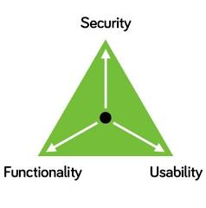
Introduction and Motivation:
Introduction:
With the advent of digitalization, every business needs an online presence. Hence, there is a high need of user authentication and authorization.
Motivation:
However, there have not been any major development in the user authentication and authorization and existing systems have many issues.
Objective:
To create a unique and more robost grid based authentication system
A.I. Kalsekar Technical Campus, New Panvel.

Slide 5
Literature Survey
A.I. Kalsekar Technical Campus, New Panvel.

Slide 6
Literature Survey
Sr. No. | Title, Author & Year | Method / Technique Used | Gap / Potential for Further Work
1 | “Enhancing JWT Authentication and Authorization in Web Applications Based on User Behavior History” – Ahmet Bucko, Kamer Vishi, Bujar Krasniqi, Blerim Rexha (2023) (MDPI) | They use a standard token-based authentication/authorization model (JWT) and enhance it by incorporating user behaviour history (e.g., number of password attempts, IP address consistency, user‐agent type). They compute a weight/percentage reliability score per user and use that to influence trust in the authentication/authorization process. (MDPI) | The behavioural‐score approach may penalise users with legitimate changes (e.g., mobile switching IPs or devices) and may still rely on traditional credentials plus token.
2 | “Innovations in Multi-Factor Authentication: Exploring OAuth for Enhanced Security” – Aravind Ayyagari, Shalu Jain, Anshika Aggarwal (2023) (Innovative Research Thoughts) | Focuses on Multi-Factor Authentication (MFA) in web systems, and how token‐based protocols such as OAuth 2.0 (and by implication SSO) can be leveraged to enhance authentication and authorization. It discusses the benefits, implementation challenges and how MFA combined with OAuth improves security. | While it discusses MFA + OAuth conceptually, real‐world large‐scale empirical results may be limited; also, user experience / usability tradeoffs are less emphasised.
A.I. Kalsekar Technical Campus, New Panvel.

Slide 7
Literature Survey
3 | Exploiting and Securing OAuth 2.0 in Integration Platforms — USENIX / Sec 2024/2025 preprint. (USENIX) | Empirical discovery of cross-app OAuth token/account-linking attacks and a semi-automated scanner for OAuth misconfigurations. | OAuth remains central to SSO; gap: create developer tooling / secure defaults and demonstrate fixes on popular identity providers and website deployments. (USENIX)
4 | Identifying Implementation Flaws of SMS OTP Authentication — IEEE / Computer Society (2025). (IEEE Computer Society) | Studies real apps to surface common implementation mistakes (poor replay protection, exposed endpoints, insecure storage). | Gap: provide a checklist / hardened library and migration plan (SMS → push OTP / authenticator apps / passkeys) and quantify reduction in incidents. (IEEE Computer Society)
5 | A Review of Password-less User Authentication Schemes — arXiv (Dec 2023). (arXiv) | Wide literature survey on passwordless methods (FIDO2/passkeys, OTPless push, device-based, ABE etc.), comparing security & usability. | Survey highlights fragmentation and interoperability issues — gap: experimental comparisons (security + UX + deployment cost) of passkeys vs OTP vs password+2FA across real web apps. (arXiv)
A.I. Kalsekar Technical Campus, New Panvel.

Slide 8
Literature Survey
6 | The utility of behavioral biometrics in user authentication — scoping review (Finnegan et al., 2024). (PMC) | Reviews keystroke dynamics, mouse/gesture, gait and other behavioral biometrics for continuous or step-up authentication. | Behavioral biometrics help continuous/auth risk scoring but raise false-positive/usability & privacy questions — gap: integrate behavioral scoring with OTP/2FA adaptively and measure attacker-resistance and privacy-preserving options. (PMC)
7 | Passwordless Authentication Using a Combination of Cryptography, Steganography & Biometrics — MDPI Sensors/Networks (2024). (MDPI) | Hybrid passwordless scheme combining asymmetric keys, steganographic channels and physiological/behavioural biometrics for web login. | Novel but complex — gap: performance, cross-device portability, accessibility and deployment barriers remain; test integration with WebAuthn/passkeys for realistic web sites. (MDPI)
A.I. Kalsekar Technical Campus, New Panvel.

Slide 9
Limitations
A.I. Kalsekar Technical Campus, New Panvel.

Slide 10

Limitations of Existing System
Weak Passwords
User’s Reuse Passwords
Phishing Attacks
Brute Forcing
Lack of Strong Identiy Verification etc
A.I. Kalsekar Technical Campus, New Panvel.

Slide 11
Problem Statement
A.I. Kalsekar Technical Campus, New Panvel.

Slide 12

Problem Statement
With increasing digitalization, secure user authentication and authorization have become essential. However, existing systems lack major advancements and face vulnerabilities, making them susceptible to security breaches. Gridlock aims to develop a unique and robust grid-based authentication system to address these limitations and enhance user security.
A.I. Kalsekar Technical Campus, New Panvel.

Slide 13
Proposed Methodology
A.I. Kalsekar Technical Campus, New Panvel.

Slide 14
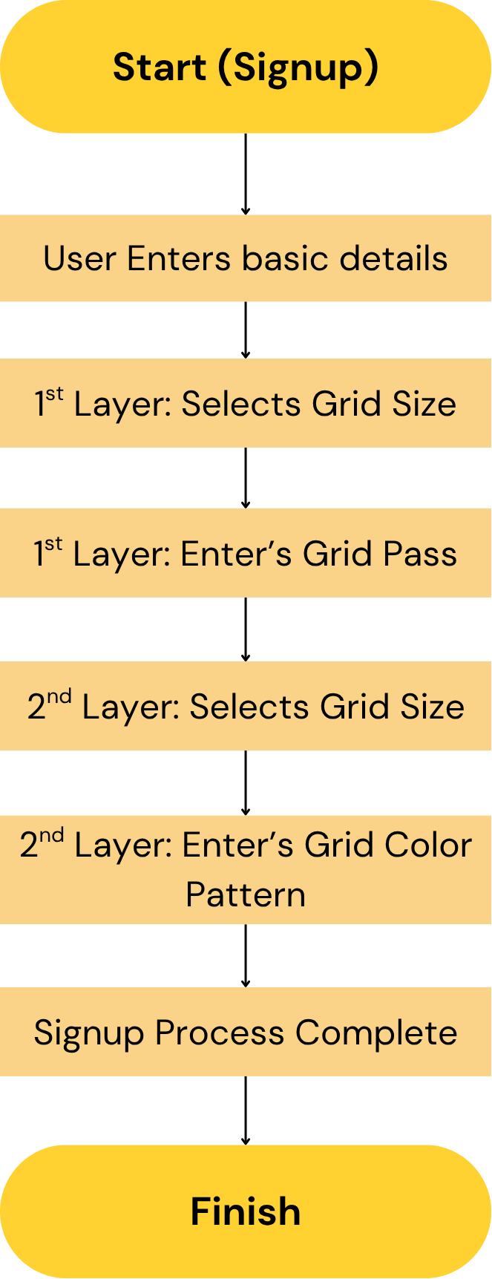
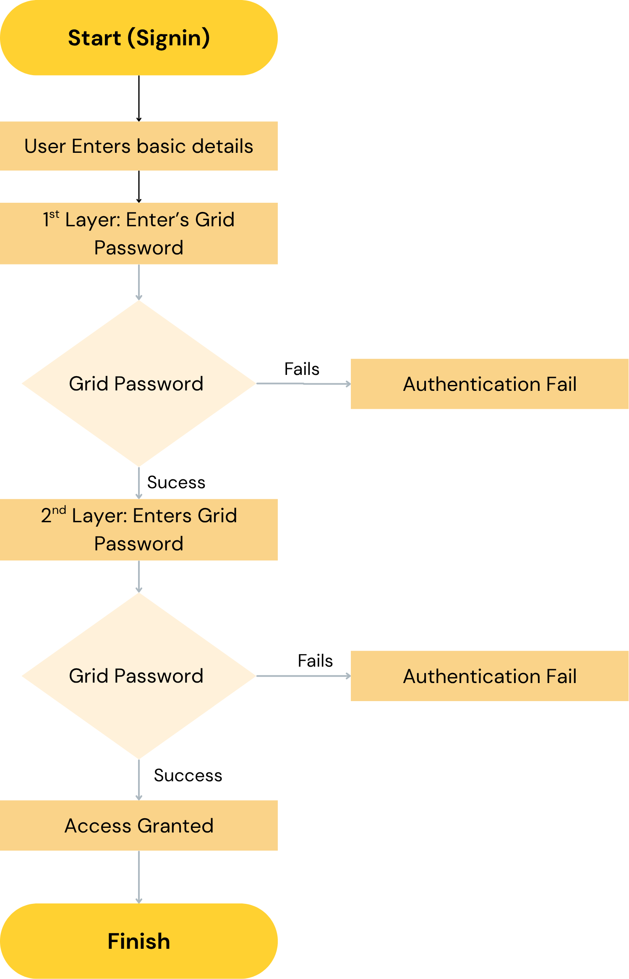

Slide 15
System Design
A.I. Kalsekar Technical Campus, New Panvel.

Slide 16
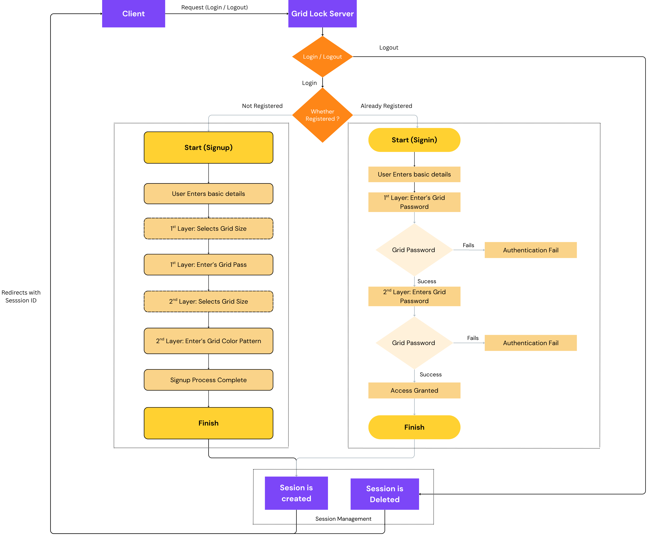
A.I. Kalsekar Technical Campus, New Panvel.

Slide 17
Roadmap
A.I. Kalsekar Technical Campus, New Panvel.

Slide 18
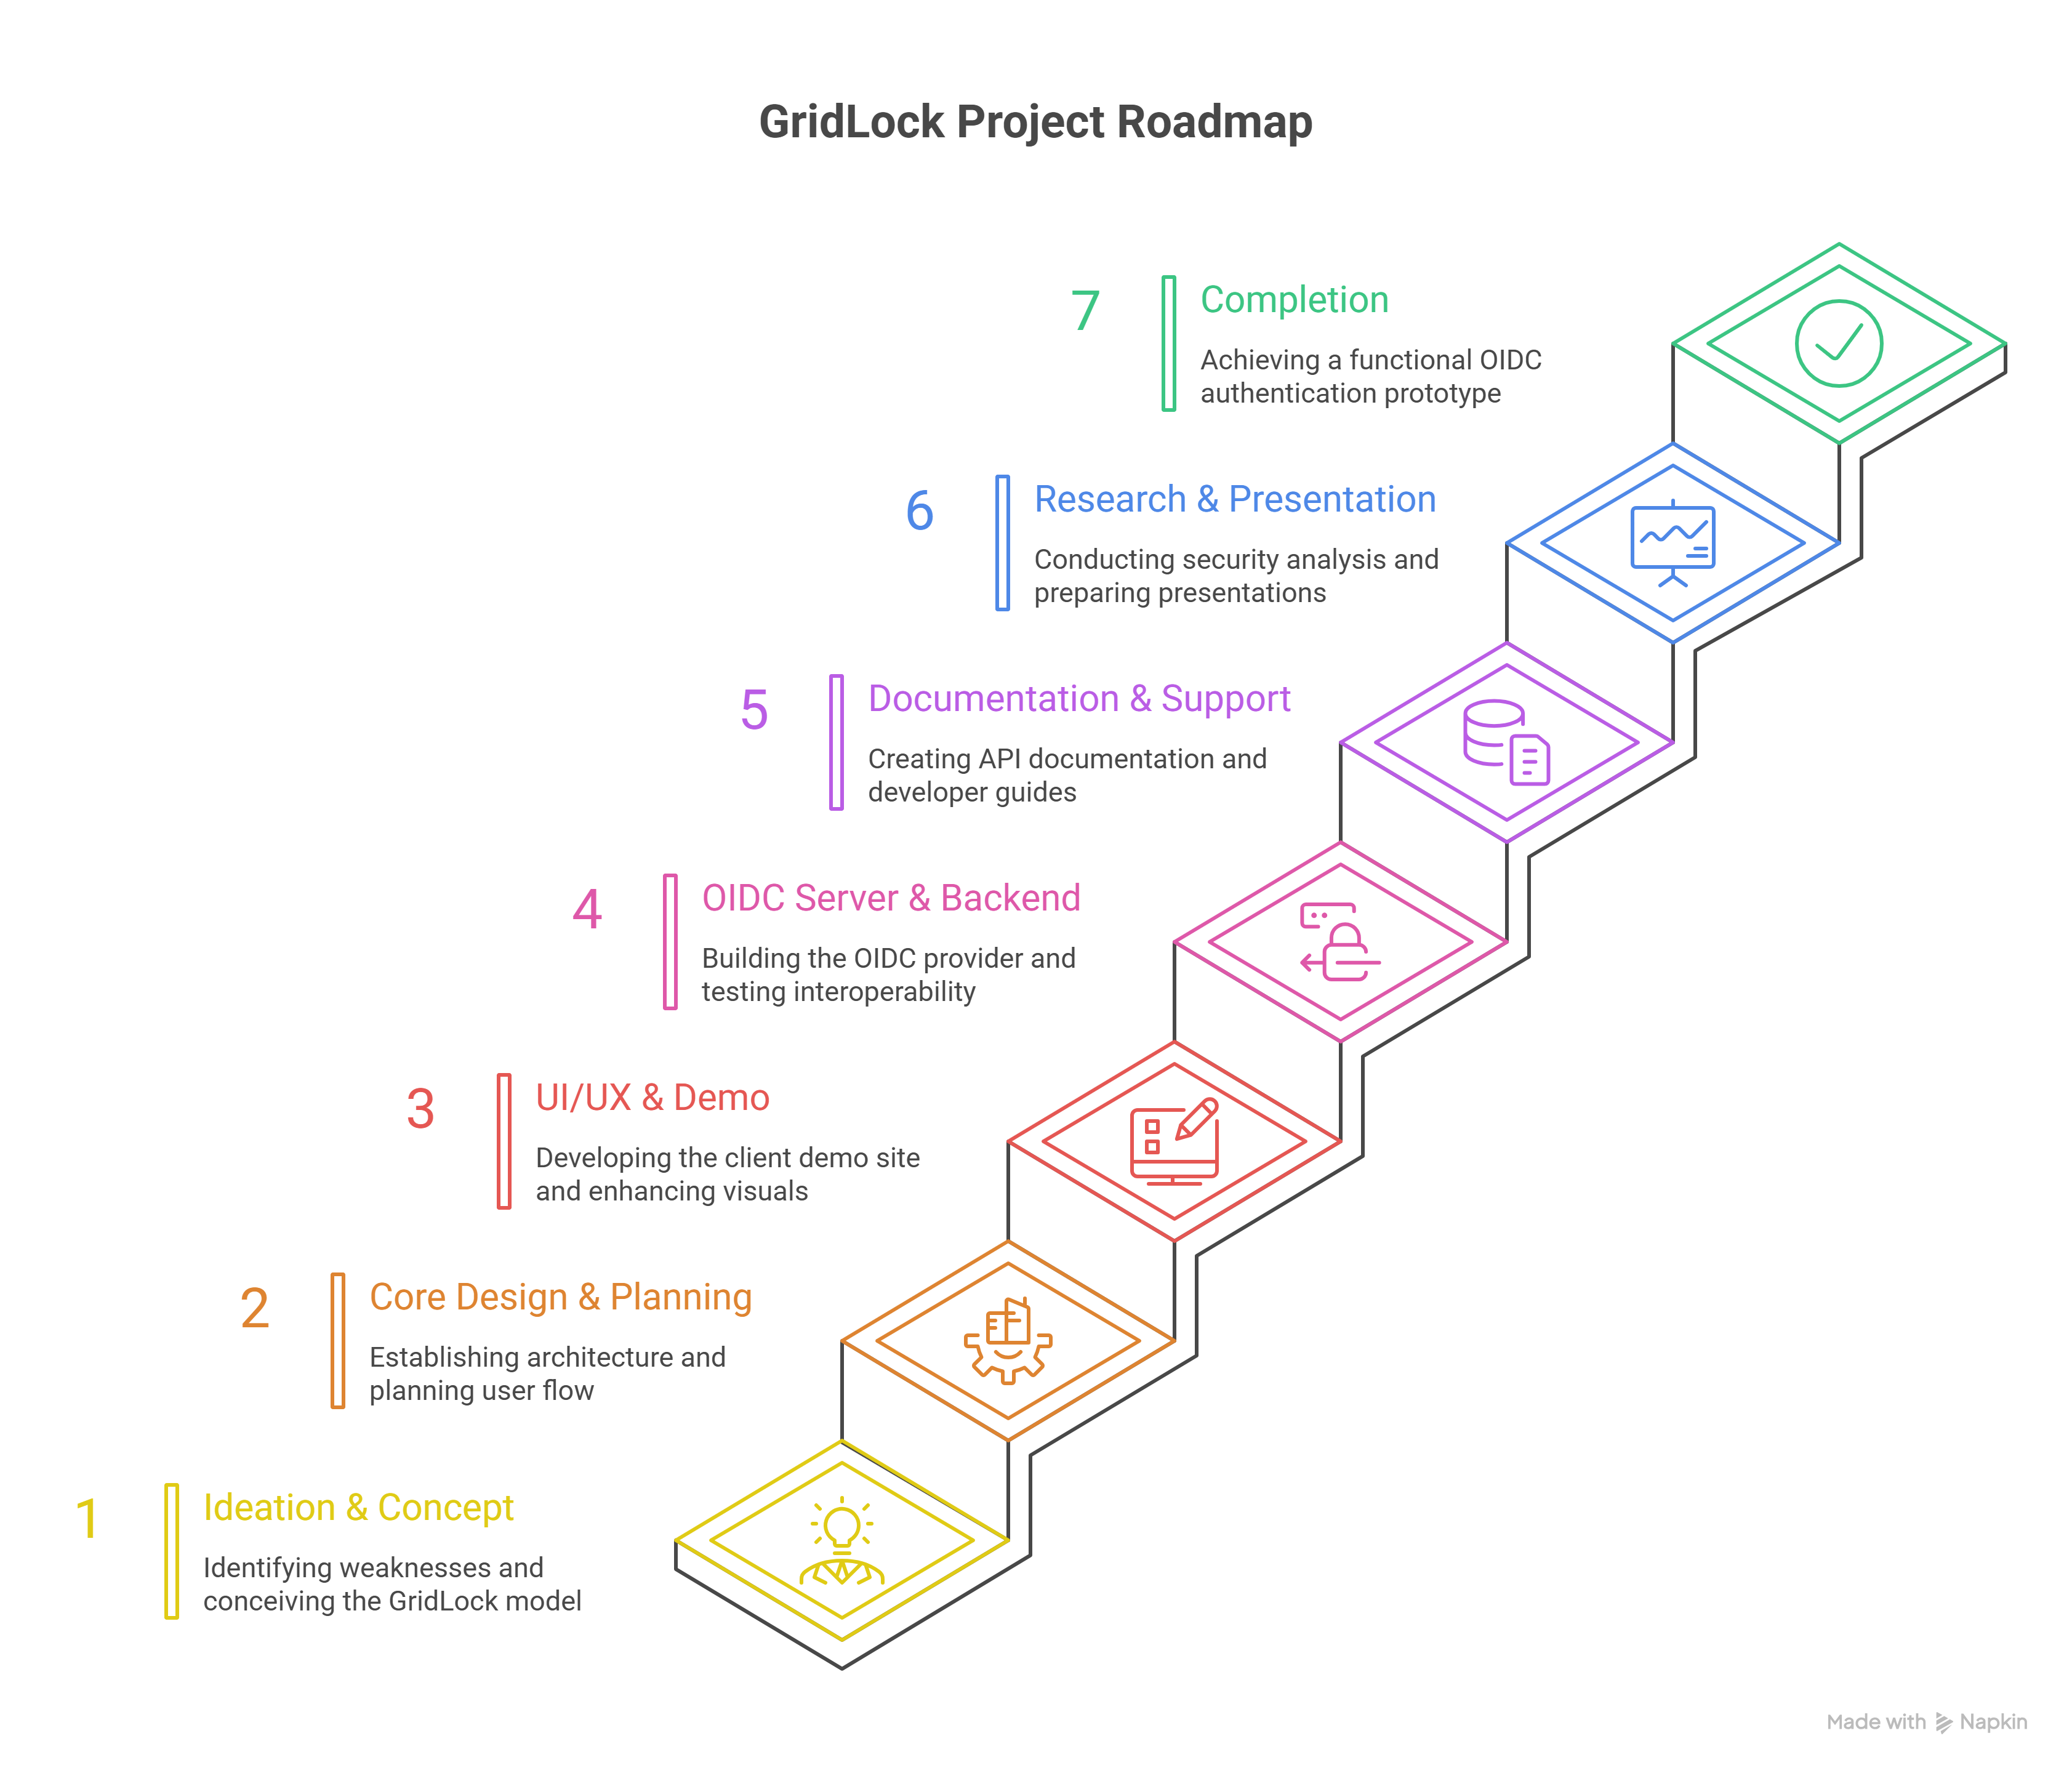
Roadmap
A.I. Kalsekar Technical Campus, New Panvel.

Slide 19
Implementation Details
A.I. Kalsekar Technical Campus, New Panvel.

Slide 20
Implementation Details
Software Tools:
Frontend: HTML, CSS, React (JavaScript) – for designing the user interface.
Backend: Express.js, Supabase for Database.
Database: Supabase, A MySQL based database for storing user information.
IDE: Visual Studio Code – used for coding and development.
LocalHost: Local server for testing React and MySQL integration.
Deployment: Vercel is used for deployment.
Additional Components:
JSON Web Tokens (JWT) for secure data exchange
Email + Phone OTP APIs for recovery
Version control via GitHub
A.I. Kalsekar Technical Campus, New Panvel.

Slide 21
Results
A.I. Kalsekar Technical Campus, New Panvel.

Slide 22
Result Analysis
We have successfully created a grid based authentication having the following features.
Grid based Authentication System
Complete Session Management and Session Persistence
Unique and Robot Password Recovery Mechanism, etc
A.I. Kalsekar Technical Campus, New Panvel.

Slide 23
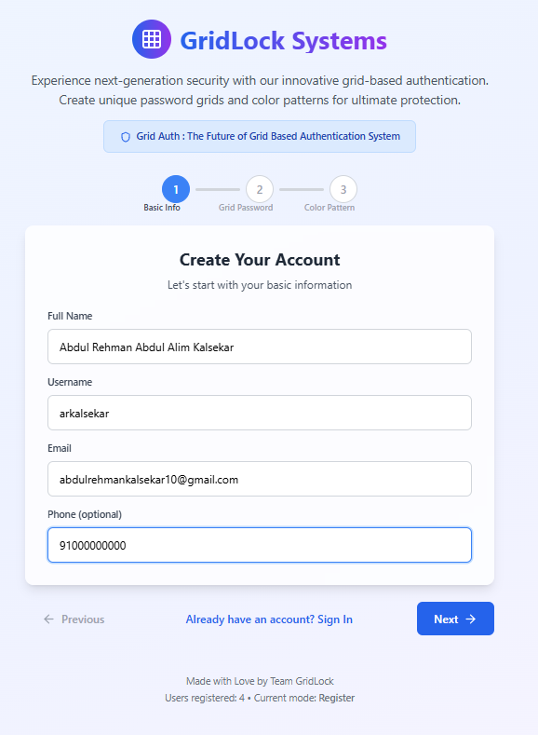
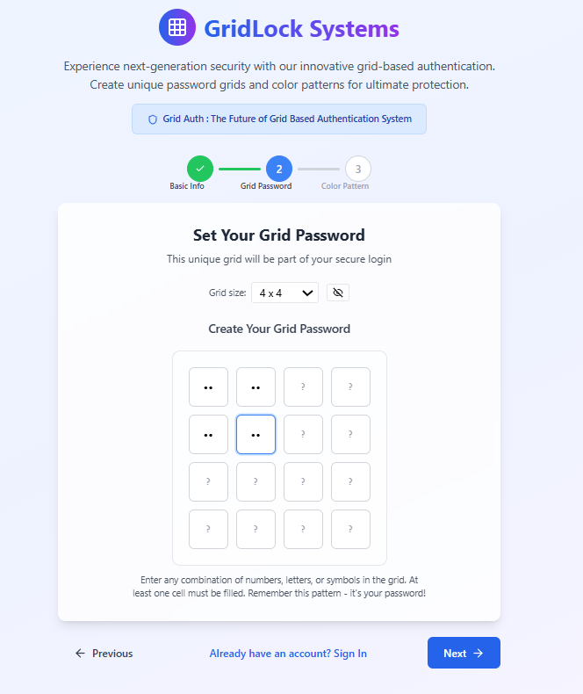
A.I. Kalsekar Technical Campus, New Panvel.

Slide 24
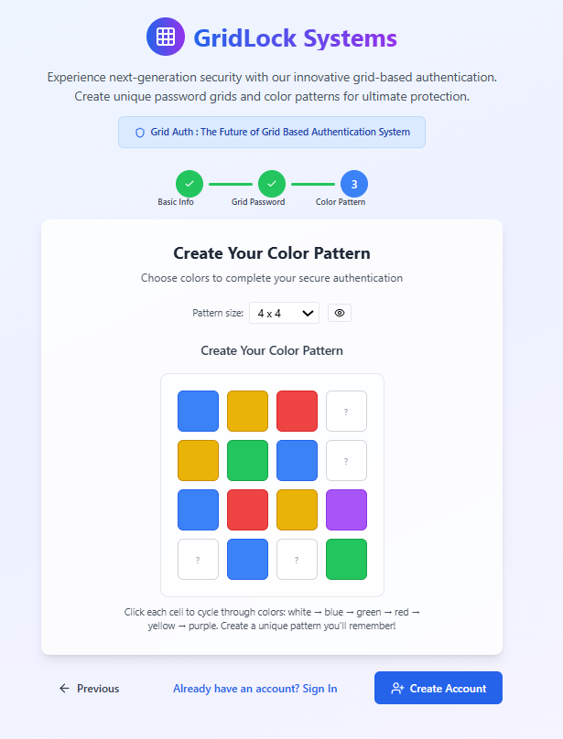
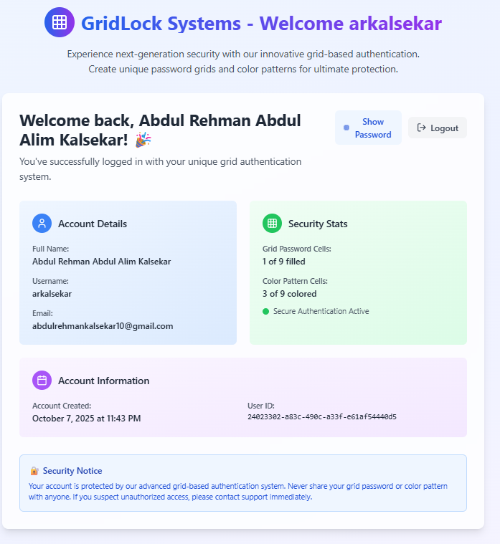
A.I. Kalsekar Technical Campus, New Panvel.

Slide 25
Conclusion and References
A.I. Kalsekar Technical Campus, New Panvel.

Slide 26
Conclusion
GridLock successfully demonstrates a secure, scalable, and user-centric approach to authentication.
By merging visual grid interaction with cryptographic verification and OIDC integration, it bridges the gap between usability and high security.
It represents a major leap toward decentralized and privacy-first identity management, reducing dependency on major providers like Google.
A.I. Kalsekar Technical Campus, New Panvel.

Slide 27
References
All resources used for development are listed. These include websites, articles, and research papers.
“Enhancing JWT Authentication and Authorization in Web Applications Based on User Behavior History” – Ahmet Bucko, Kamer Vishi, Bujar Krasniqi, Blerim Rexha (2023) (MDPI)
“Innovations in Multi-Factor Authentication: Exploring OAuth for Enhanced Security” – Aravind Ayyagari, Shalu Jain, Anshika Aggarwal (2023) (Innovative Research Thoughts)
Exploiting and Securing OAuth 2.0 in Integration Platforms — USENIX / Sec 2024/2025 preprint. (USENIX)
Identifying Implementation Flaws of SMS OTP Authentication — IEEE / Computer Society (2025). (IEEE Computer Society)
A Review of Password-less User Authentication Schemes — arXiv (Dec 2023). (arXiv)
The utilty of behavioral biometrics in user authentication — scoping review (Finnegan et al., 2024). (PMC)
Passwordless Authentication Using a Combination of Cryptography, Steganography & Biometrics — MDPI Sensors/Networks (2024). (MDPI)
A.I. Kalsekar Technical Campus, New Panvel.

Slide 28
Appendix
A.I. Kalsekar Technical Campus, New Panvel.

Slide 29
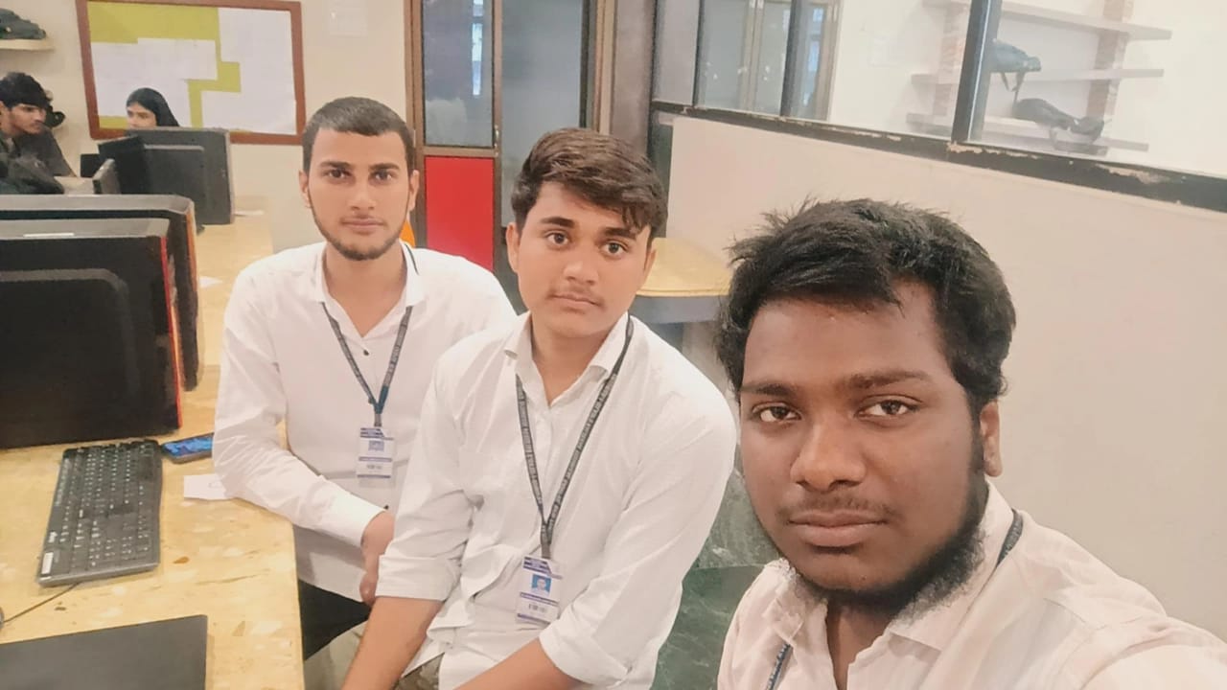
Presented at Axiom – Pillai HOC, New Panvel
A.I. Kalsekar Technical Campus, New Panvel.

Slide 30
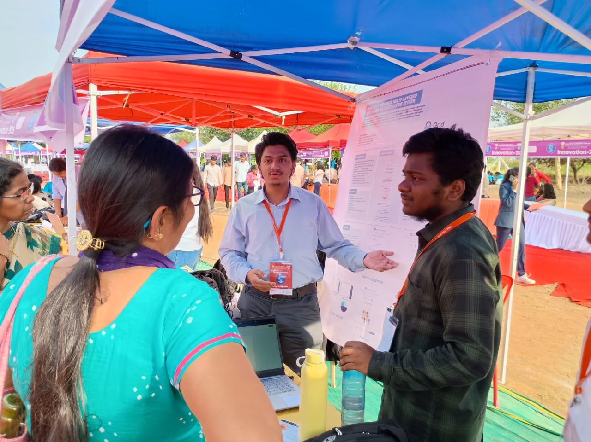
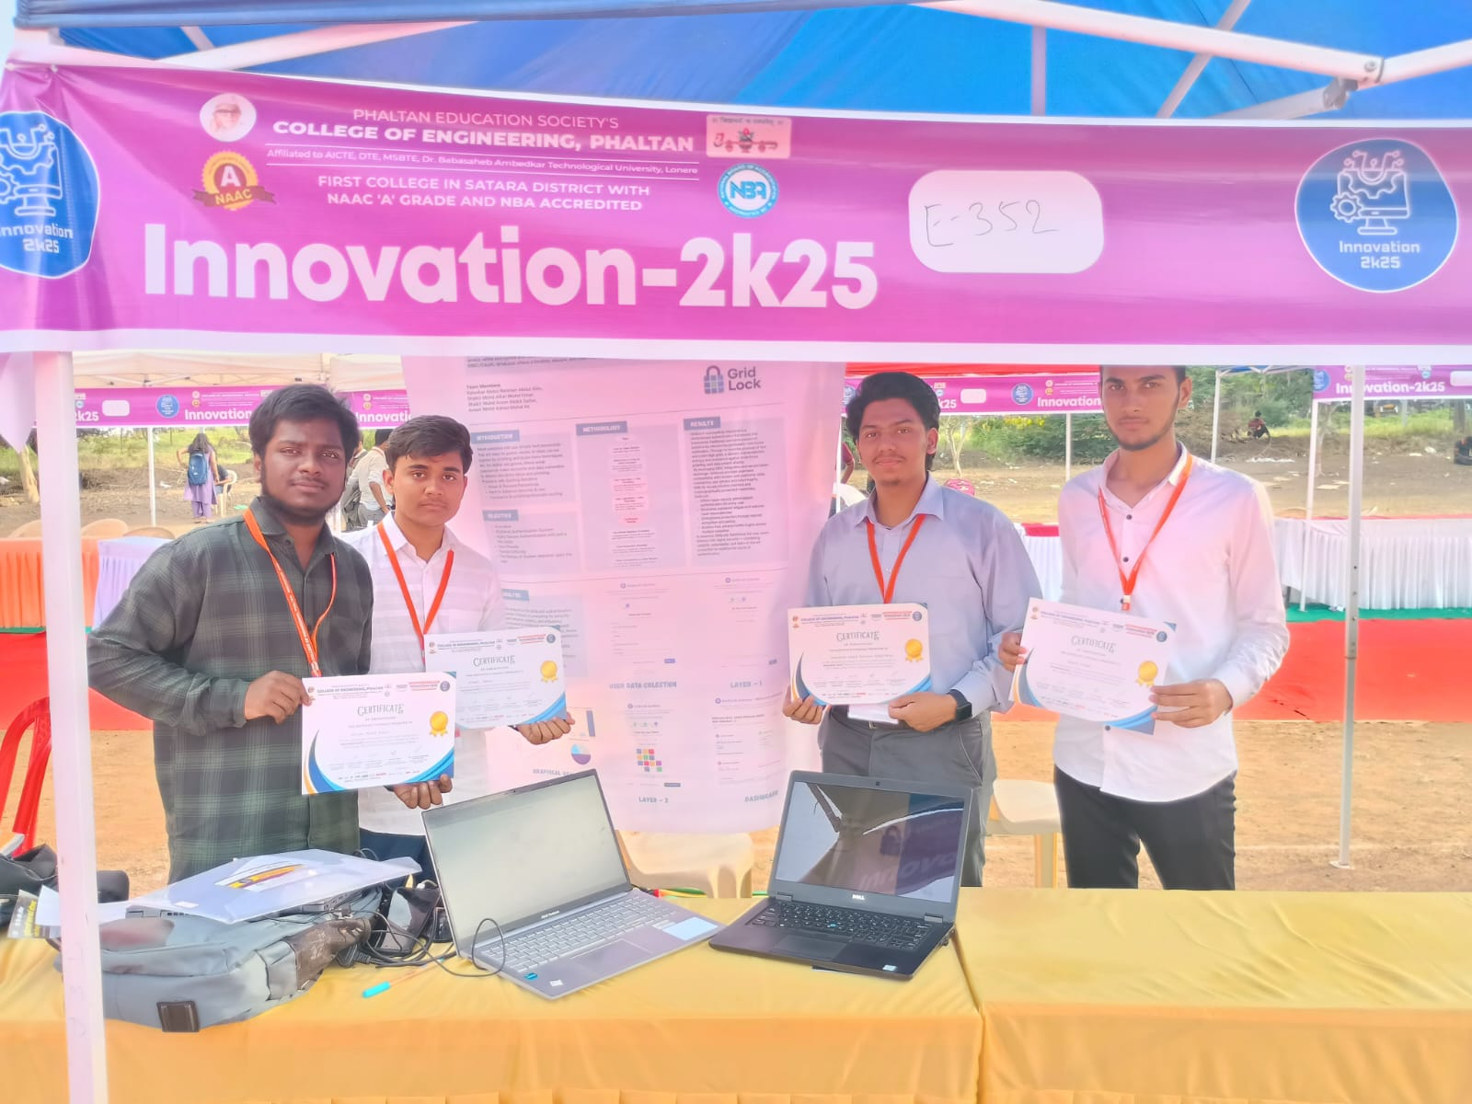
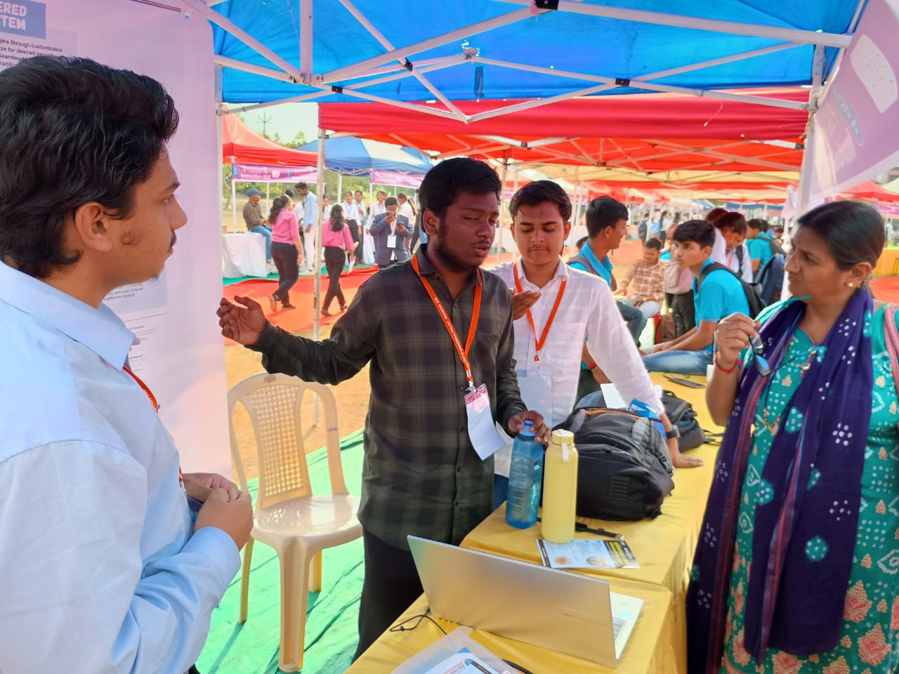
Presented at Innovation2K25, Phaltan College of Engineering, Satara
A.I. Kalsekar Technical Campus, New Panvel.

Slide 31
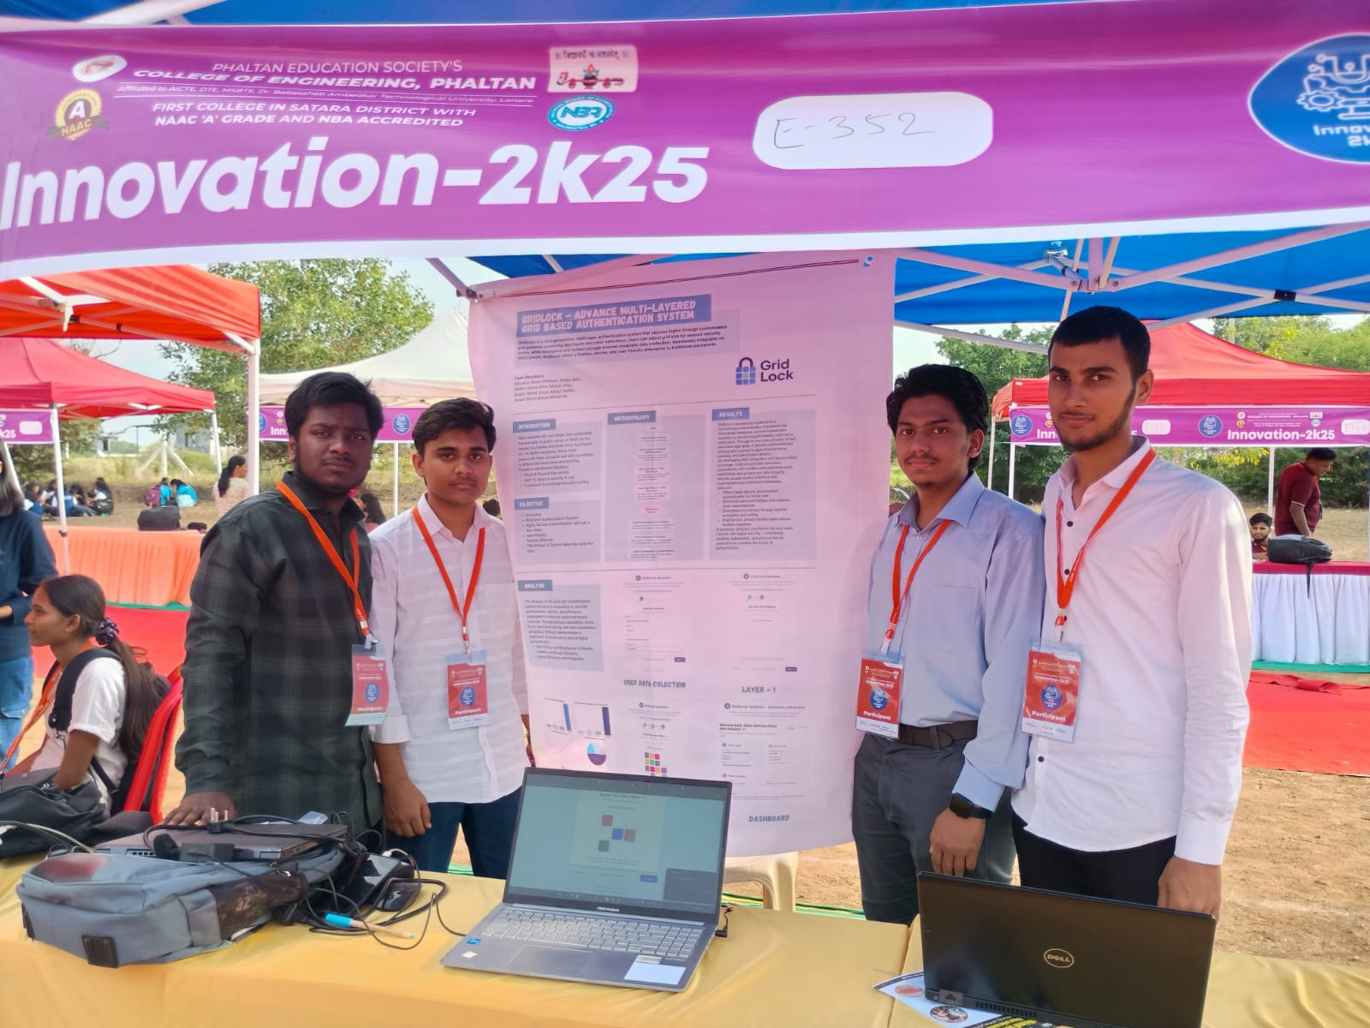
Presented at Innovation2K25, Phaltan College of Engineering, Satara
A.I. Kalsekar Technical Campus, New Panvel.

Slide 32
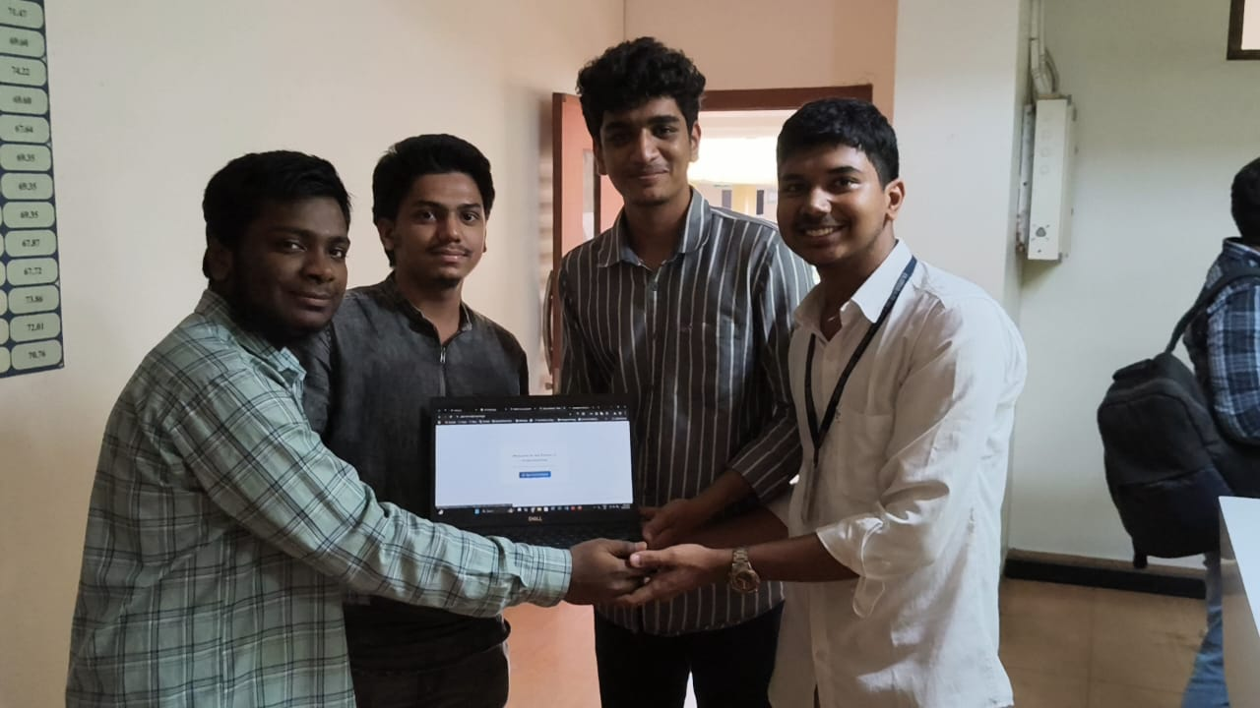
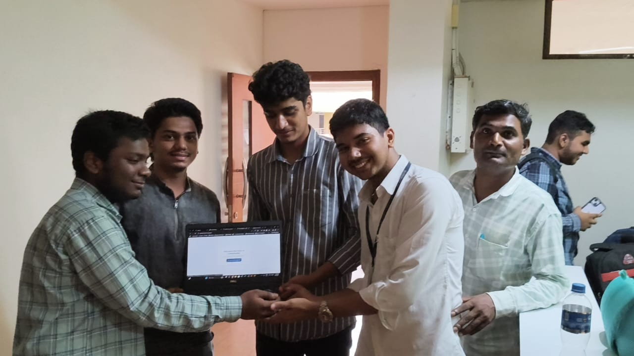
Our Happy Users
A.I. Kalsekar Technical Campus, New Panvel.

Slide 33
Thank You
A.I. Kalsekar Technical Campus, New Panvel.
Notes:
In Slide Show mode, select the arrows to visit links.

