Slide 1

AIKTC – Anjuman-I-Islam’s Kalsekar Technical Campus.
Department of Electronics and Computer Science Engineering
TE Mini Project-2A
Final Presentation
On
“GridLock: Grid Based Two Factor Authentication System.”
By
Roll No. 23EC23, 23EC14, 23EC57, 23EC59
Name of Students. Kalsekar Abdul Rehman Abdul Alim,
Ansari Mohd Adnan Mohd Ali,
Shaikh Mohd Affan Mohd Umar,
Shaikh Mohd Arsan Abdul Sattar
Guided by
Mr. Muhammed Isamaeel

Slide 2
Outline
Introduction
Literature Survey
Limitations of the existing systems
Problem statement
System Design and Architecture
Proposed Methodology/ Techniques
Implementation Details
Result Analysis
Conclusion
References
A.I. Kalsekar Technical Campus, New Panvel.

Slide 3
Introduction
A.I. Kalsekar Technical Campus, New Panvel.

Slide 4

Introduction:
GridLock is a next-generation authentication system that replaces outdated passwords with a multi-layer grid-based security mechanism.
It uses two steps — text grid input and color/digit grid patterns — to ensure authentication is both personalized and highly secure.
GridLock integrates easily with any platform through OIDC (OpenID Connect), functioning as a standalone Identity Provider (IdP) that websites can adopt, just like “Login with Google.”
A.I. Kalsekar Technical Campus, New Panvel.

Slide 5
Literature Survey
A.I. Kalsekar Technical Campus, New Panvel.

Slide 6
Literature Survey
Authentication System | Description | Drawbacks / Limitations
Password-Based Authentication | User enters a username and password stored (hashed) on the server. | - Vulnerable to brute-force and dictionary attacks.- Users often reuse passwords.- Susceptible to phishing.- Forgotten passwords lead to usability issues.
PIN-Based Authentication | Short numeric code (usually 4–6 digits) used for verification. | - Easy to guess if short.- Susceptible to shoulder surfing.- Limited entropy (only numbers).
OTP-Based Authentication | One-time password sent via SMS, email, or app (valid for a short time). | - Requires network connectivity.- Vulnerable to SIM-swapping and phishing.- User inconvenience (time-sensitive).
A.I. Kalsekar Technical Campus, New Panvel.

Slide 7
Literature Survey
Token-Based Authentication (JWT, OAuth) | Uses encrypted tokens instead of passwords for API or session access. | - Tokens can be stolen if not securely handled.- Session revocation is complex.- Token expiry must be managed carefully.
Graphical / Pattern-Based Authentication | User selects or draws a pattern on a grid instead of typing a password. | - Vulnerable to smudge attacks (residual finger traces).- Patterns can be observed (shoulder surfing).- Limited number of unique patterns.
Social Login (OAuth-based) | Login using existing accounts (Google, Facebook, GitHub, etc.). | - Data privacy concerns (third-party tracking).- Dependent on external service availability.- Potential for token misuse.
A.I. Kalsekar Technical Campus, New Panvel.

Slide 8
Limitations
A.I. Kalsekar Technical Campus, New Panvel.

Slide 9
Limitations of Existing System
Category | Limitations / Challenges
1. Password-based Authentication | - Users often create weak or reused passwords.- Susceptible to phishing, credential stuffing, brute-force attacks.- Hard to remember complex credentials.- Frequent password resets reduce usability.
2. OTP / SMS-based Two-Factor (2FA) | - SMS and email channels are vulnerable to SIM swapping, interception, or phishing.- Relies on third-party telecom networks.- Adds friction for users, especially offline.
3. Token-based / Hardware Keys (e.g., RSA, YubiKey) | - Requires users to carry physical devices.- Lost or stolen tokens cause access issues.- High deployment and replacement cost for enterprises.
4. Biometric Systems (Fingerprint, Face, Iris) | - Privacy concerns; biometric data, once stolen, cannot be changed.- Spoofing via high-quality replicas or photos.- Environmental and hardware dependency (lighting, fingerprint quality).
5. Knowledge-based Questions (KBA) | - Answers can be guessed or socially engineered.- Many answers are publicly available or reused.
6. Magic Links / Email Authentication | - Dependent on email account security.- Links can be intercepted if email is compromised.- Latency issues (slow email delivery).
A.I. Kalsekar Technical Campus, New Panvel.

Slide 10
Problem Statement
A.I. Kalsekar Technical Campus, New Panvel.

Slide 11
Problem Statement
To develop a secure, customizable, and user-friendly authentication system that
Eliminates password vulnerabilities and phishing risks.
Offers multi-factor protection using grid-based personalization. Supports cross-platform login using modern web standards (OIDC).
Provides personalized authentication while maintaining scalability, flexibility, and user privacy.
A.I. Kalsekar Technical Campus, New Panvel.

Slide 12
System Design
A.I. Kalsekar Technical Campus, New Panvel.

Slide 13
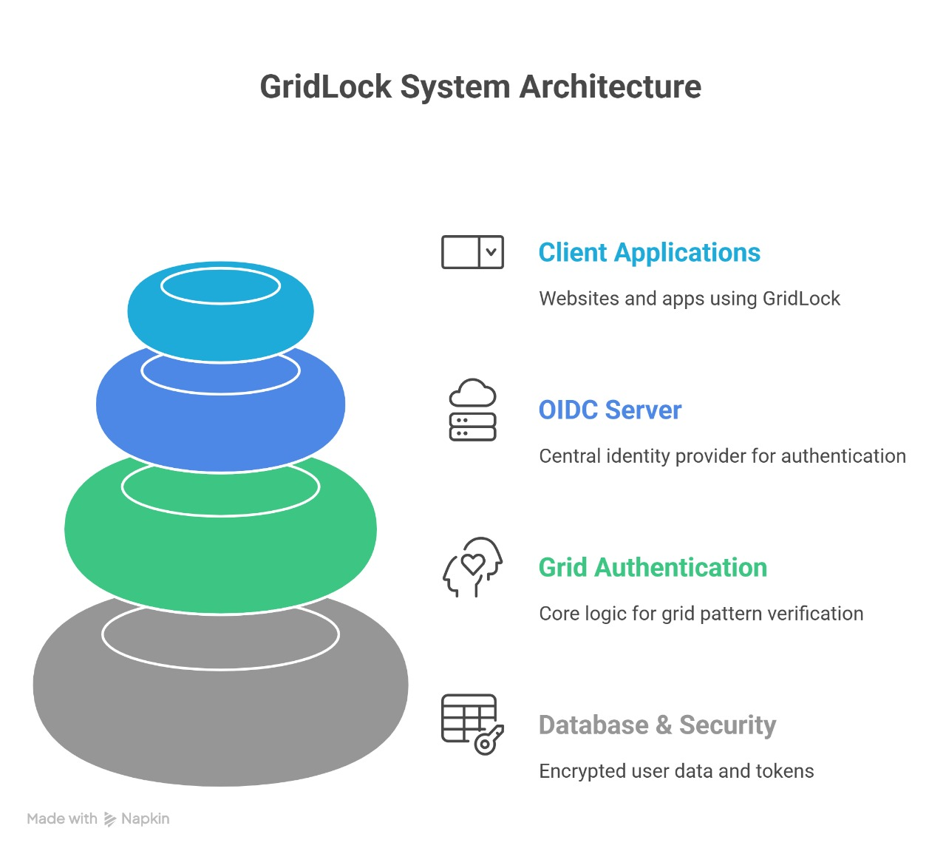
System Design and Architecture
User Registration: Users select grid size (3×3–10×10), enter text in chosen cells, and select a color or digit pattern.
Data Storage: Inputs are hashed, salted, and securely stored in an encrypted database.
Authentication: During login, users reproduce their text and color pattern. The system verifies against stored hashes.OIDC
Flow: Acts as an Identity Provider, issuing JWT tokens to third-party websites upon successful authentication.
Recovery Mechanism: Multi-OTP verification (email & phone) for account recovery in case of failed grid recall.Accessibility: Color-blind mode toggles digits instead of colors.
A.I. Kalsekar Technical Campus, New Panvel.

Slide 14
Proposed Methodology
A.I. Kalsekar Technical Campus, New Panvel.

Slide 15
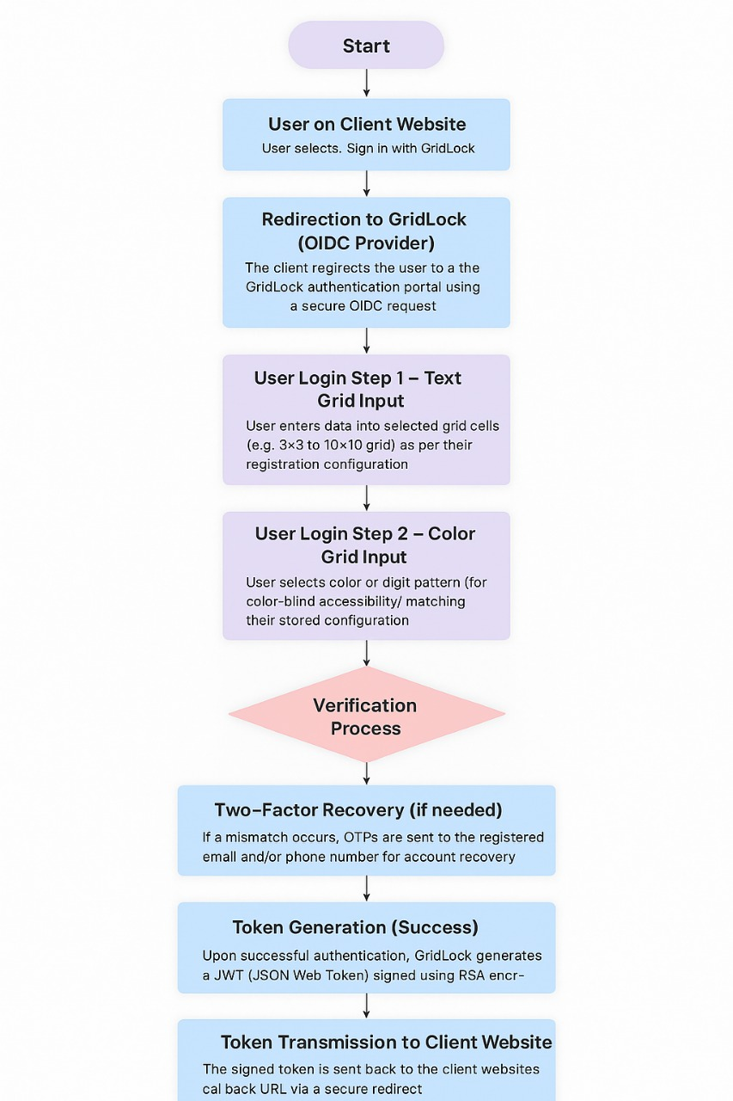
Proposed Methodology /Techniques
Flow Summary:
User on Client Website → Clicks “Sign in with GridLock.”
OIDC Request → Client sends response_type=code, client_id, redirect_uri, scope=openid, state, nonce, code_challenge → redirect to GridLock (HTTPS).
Login Step 1: Text Grid Input → User enters characters in registered grid cells.
Login Step 2: Color / Pattern Input → Selects color or symbol pattern (with accessibility options).
Verification Process → GridLock validates hashed inputs, state, nonce, IP/device.
Token Generation → GridLock issues signed JWT (ID Token + optional Access/Refresh) with claim grid_auth=true.
Token Transmission → Redirect back to client; client exchanges code + verifier for tokens over TLS.
Session Establishment → Client validates token, creates secure session (HttpOnly + Secure cookies), optionally fetches profile via userinfo.
A.I. Kalsekar Technical Campus, New Panvel.

Slide 16
Roadmap
A.I. Kalsekar Technical Campus, New Panvel.

Slide 17
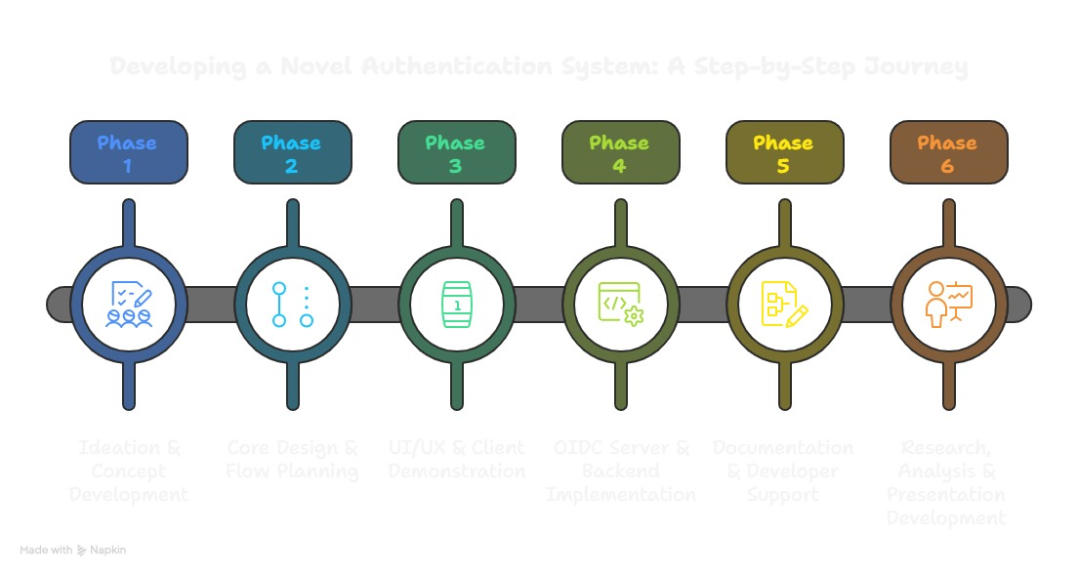
Roadmap
A.I. Kalsekar Technical Campus, New Panvel.

Slide 18
Implementation Details
A.I. Kalsekar Technical Campus, New Panvel.

Slide 19
Implementation Details
Software Tools:
Frontend: HTML, CSS, React (JavaScript) – for designing the user interface.
Backend: Express.js, Supabase for Database.
Database: Supabase, A MySQL based database for storing user information.
IDE: Visual Studio Code – used for coding and development.
LocalHost: Local server for testing React and MySQL integration.
Deployment: Vercel is used for deployment.
Additional Components:
JSON Web Tokens (JWT) for secure data exchange
Email + Phone OTP APIs for recovery
Version control via GitHub
A.I. Kalsekar Technical Campus, New Panvel.

Slide 20
Results
A.I. Kalsekar Technical Campus, New Panvel.

Slide 21
Result Analysis
GridLock achieved the following key outcomes:
Successful OIDC-based login flow between client and server.
Dynamic grid-based registration and login functionality.
Encrypted credential storage and token-based verification.
Tested interoperability with multiple client frameworks (React, Django, Flask).
High entropy rate (over 590 bits) for 10×10 grid configurations, making brute-force practically impossible.(Attach screenshots of working login, dashboard, and demo site integration.)
A.I. Kalsekar Technical Campus, New Panvel.

Slide 22
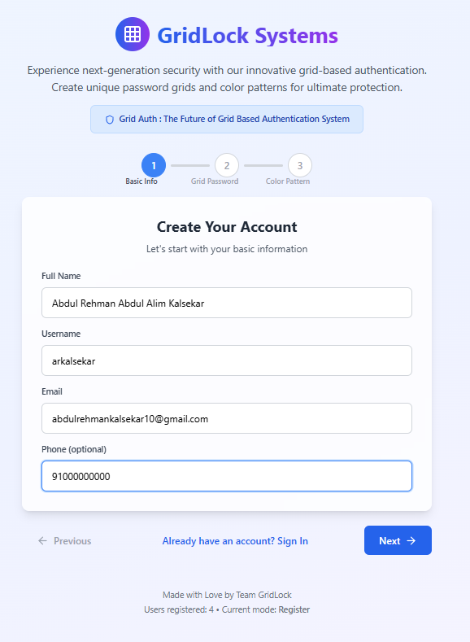
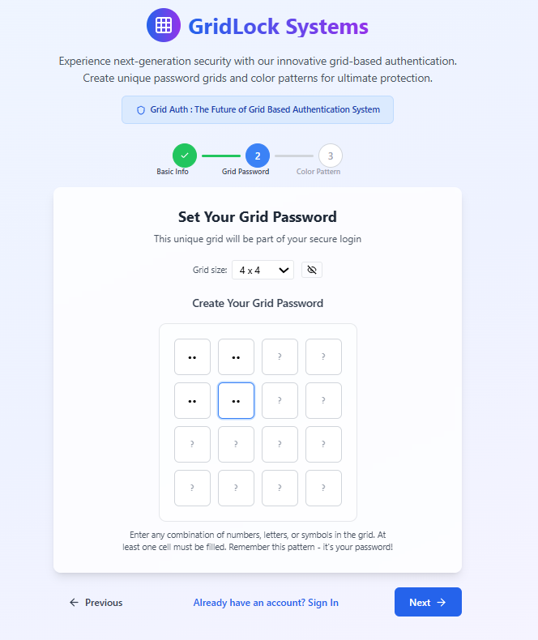
A.I. Kalsekar Technical Campus, New Panvel.

Slide 23
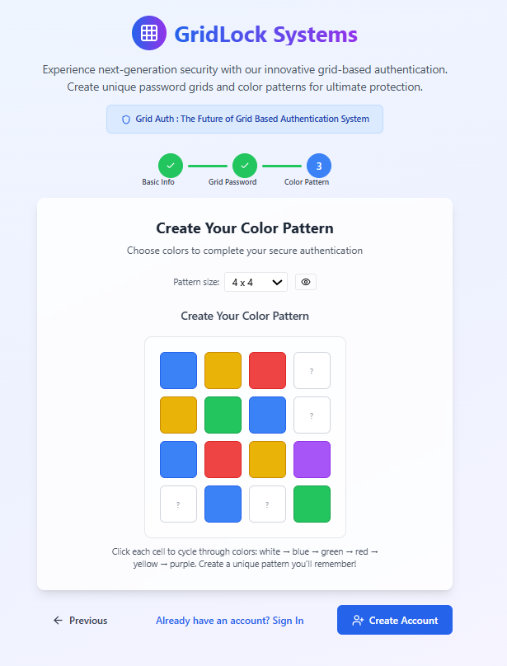
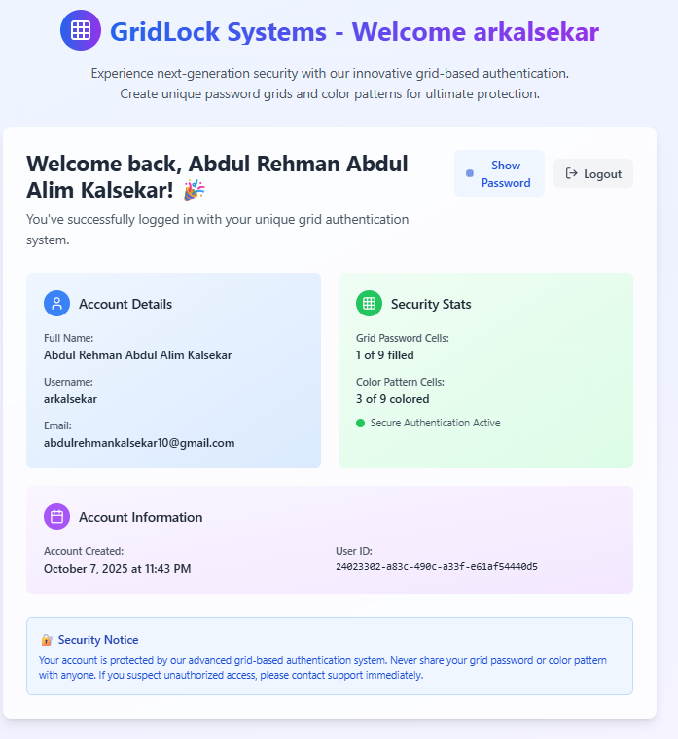
A.I. Kalsekar Technical Campus, New Panvel.

Slide 24
Conclusion and References
A.I. Kalsekar Technical Campus, New Panvel.

Slide 25
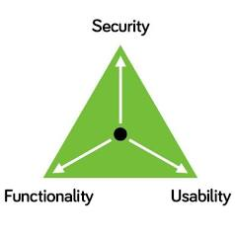
Conclusion
GridLock successfully demonstrates a secure, scalable, and user-centric approach to authentication.
By merging visual grid interaction with cryptographic verification and OIDC integration, it bridges the gap between usability and high security.
It represents a major leap toward decentralized and privacy-first identity management, reducing dependency on major providers like Google.
A.I. Kalsekar Technical Campus, New Panvel.

Slide 26
References
All resources used for development are listed. These include websites, articles, and research papers.
RFC 6749: OAuth 2.0 Authorization Framework – IETF
OpenID Connect Core Specification – OpenID FoundationSupabase
Documentation – PostgreSQL Integration
Bcrypt and Argon2 Cryptographic Hashing Papers
Research on Graphical Password Authentication Models (IEEE, 2020–2023)
OWASP Authentication Guidelines
A.I. Kalsekar Technical Campus, New Panvel.

Slide 27
Thank You
A.I. Kalsekar Technical Campus, New Panvel.
Notes:
In Slide Show mode, select the arrows to visit links.

