Slide 1

AIKTC – Anjuman-I-Islam’s Kalsekar Technical Campus. Department of Electronics and Computer Science Engineering
TE Mini Project-2B
Final Presentation
On
“Biometric Enabled Decentralized Voting System”
By
Roll No. 23EC23, 23EC14, 23EC57, 23EC59
Name of Students. Kalsekar Abdul Rehman Abdul Alim,
Ansari Mohd Adnan Mohd Ali,
Shaikh Mohd Affan Mohd Umar,
Shaikh Mohd Arsan Abdul Sattar
Guided by
Prof. Ismaeel Shaikh

Slide 2
Outline
Introduction
Literature Survey
Limitations of the existing systems
Problem statement
Proposed Methodology/ Techniques
System Design and Architecture
Implementation Details / Tools & Technologies Used
Result Analysis / Output Screenshots
Roadmap
Advantages & Limitations
Conclusion
Future Scope
References
A.I. Kalsekar Technical Campus, New Panvel.

Slide 3
Introduction

Slide 4
Introduction
1. This project proposes a Biometric-Enabled Blockchain-Based Decentralized Voting System designed to improve transparency, security, and trust in digital elections.
2. The system uses Aadhaar-based identity verification combined with biometric authentication (fingerprint scanner) to ensure that only legitimate voters can cast votes.
3. Voter authentication is performed off-chain, ensuring sensitive biometric data is never stored publicly, thereby protecting privacy.
4. After successful biometric verification, the voter is presented with a secure polling interface displaying voter details and party options.
5. Before final vote submission, the system performs second-level biometric confirmation, ensuring strong identity validation and preventing unauthorized voting.
6. Only essential voting data (voter identifier and selected party reference) is stored on-chain, enabling immutability, auditability, and transparency.
7. Blockchain technology prevents vote tampering, double voting, and unauthorized data modification by using decentralized consensus mechanisms.
8. The system integrates modern web technologies (React, TypeScript, JavaScript) with biometric hardware (SecuGen scanner) for practical implementation.
9. The proposed architecture separates authentication and vote storage to balance privacy, scalability, and trust.
A.I. Kalsekar Technical Campus, New Panvel.

Slide 5
Introduction
Objectives:
1. To design a secure decentralized voting framework using blockchain technology.
2. To integrate biometric authentication for strong voter identity verification.
3. To implement off-chain biometric verification for privacy protection and reduced blockchain overhead.
4. To prevent electoral fraud such as impersonation, duplicate voting, or unauthorized access.
5. To provide transparent and immutable vote storage using blockchain smart contracts.
6. To ensure voter confidence through verifiable and tamper-proof election records.
7. To create a scalable architecture suitable for real-world deployment in large democracies.
8. To explore integration between national identity systems (e.g., Aadhaar-like frameworks) and secure digital governance.
A.I. Kalsekar Technical Campus, New Panvel.

Slide 6
Literature Survey

Slide 7
Literature Survey
SR. NO. | TITLE AUTHOR & YEAR | METHOD / TECHNIQUE USED | GAP
1 | Faruk, M. J. H., Alam, F., Islam, M., et al. (2024). Transforming online voting: a novel system utilizing blockchain and biometric verification for enhanced security, privacy, and transparency. Cluster Computing. | Uses Hyperledger Fabric blockchain with biometric verification (fingerprint/face recognition). Identity is verified before vote casting and vote records are stored immutably on blockchain. | Does not clearly separate off-chain authentication and on-chain voting; no Aadhaar/national-ID integration; lacks double biometric confirmation before vote commit.
2 | Peace engineering: The contribution of blockchain systems to the e-voting process (2021). Technological Forecasting & Social Change. | Conceptual analysis of how blockchain improves transparency, trust, and election security. | Theoretical work only; lacks implementation details, biometric integration, and authentication workflow.
A.I. Kalsekar Technical Campus, New Panvel.

Slide 8
Literature Survey
SR. NO. | TITLE AUTHOR & YEAR | METHOD / TECHNIQUE USED | GAP
3 | E-voting system using cloud-based hybrid blockchain technology (2024). Journal of Network and Systems Security Research. | Uses hybrid blockchain architecture with digital signatures and cloud-based infrastructure for scalable voting. | Authentication relies on digital signatures; no biometric hardware integration or off-chain identity verification.
4 | A Blockchain-Based E-Voting System for India: Addressing Security Challenges with Aadhaar Card Authentication (IEEE Conference). | Integrates Aadhaar-based identity verification with blockchain voting framework for Indian election context. | Aadhaar mostly used at registration stage; no repeated biometric verification or explicit off-chain authentication model.
A.I. Kalsekar Technical Campus, New Panvel.

Slide 9
Literature Survey
SR. NO. | TITLE AUTHOR & YEAR | METHOD / TECHNIQUE USED | GAP
5 | BlockVOTE: An Architecture of a Blockchain-based Electronic Voting System (IEEE). | Provides blockchain architecture emphasizing immutability, auditability, and smart-contract-driven voting. | Focuses on blockchain layer only; does not solve voter authentication or biometric validation.
6 | Secure E-Voting System using Blockchain Technology and Authentication via Face Recognition and Mobile OTP (IEEE). | Uses face recognition and OTP-based authentication before vote submission to blockchain. | Software-based authentication only; no hardware biometrics, Aadhaar integration, or off-chain privacy-preserving verification.
A.I. Kalsekar Technical Campus, New Panvel.

Slide 10
Limitations of Existing System

Slide 11
Limitations of Existing System
Does not clearly separate off-chain authentication and on-chain voting; no Aadhaar/national-ID integration; lacks double biometric confirmation before vote commit.
Theoretical work only; lacks implementation details, biometric integration, and authentication workflow.
Authentication relies on digital signatures; no biometric hardware integration or off-chain identity verification.
Aadhaar mostly used at registration stage; no repeated biometric verification or explicit off-chain authentication model.
Focuses on blockchain layer only; does not solve voter authentication or biometric validation.
Software-based authentication only; no hardware biometrics, Aadhaar integration, or off-chain privacy-preserving verification.
A.I. Kalsekar Technical Campus, New Panvel.

Slide 12
Problem Statement

Slide 13
Problem Statement
Biometric Enabled Decentralized Voting System.
A.I. Kalsekar Technical Campus, New Panvel.

Slide 14
Proposed Methodology / Techniques

Slide 15
Proposed Methodology /Techniques
All techniques / methods / algorithms along with their technical details need to be explained in detail.
A.I. Kalsekar Technical Campus, New Panvel.

Slide 16
System Design and Architecture

Slide 17
System Design and Architecture
Provide and explain general architecture diagram / abstract diagram / modular diagram
Provide details about the major components or modules and their functions.
A.I. Kalsekar Technical Campus, New Panvel.

Slide 18
Implementation Details / Tools & Technologies Used

Slide 19
Implementation Details / Tools & Technologies Used
Describe the Technologies and Tools along with
Software Tools: List the development tools, integrated development environments (IDEs), and software libraries used.
Hardware Components: If applicable, describe any specific hardware used (e.g., sensors, processors).
A.I. Kalsekar Technical Campus, New Panvel.

Slide 20
Result Analysis / Output Screenshots

Slide 21
Result Analysis / Output Screenshots
Outcomes: Present the results of your project.
Demonstration: Provide a demo or screenshots of your project in action.
A.I. Kalsekar Technical Campus, New Panvel.

Slide 22
Road Map

Slide 23
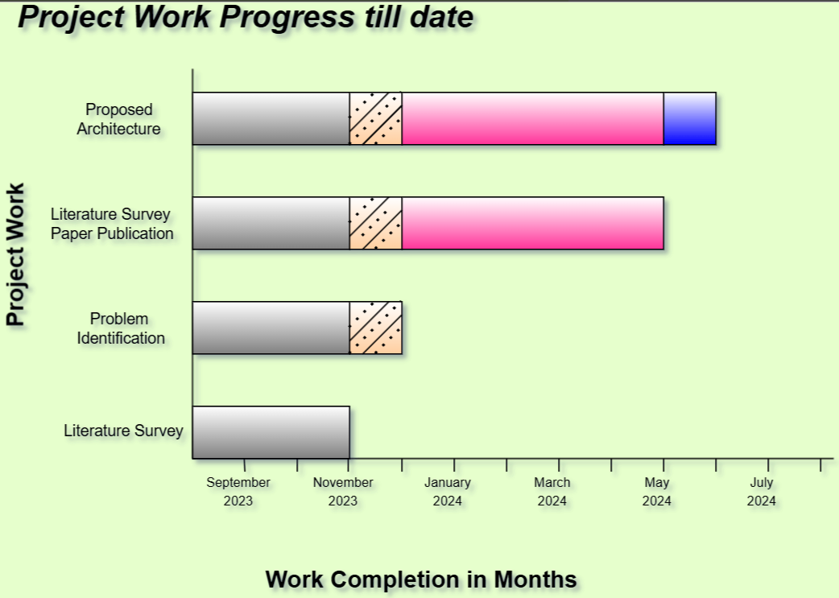
Road Map
https://app.diagrams.net/
For reference only. You can also use Canva, etc.
A.I. Kalsekar Technical Campus, New Panvel.

Slide 24
Advantages & Limitations

Slide 25
Advantages & Limitations
Advantages – Highlights the strengths and benefits of the proposed system.
Limitations – Points out the challenges and constraints faced in the system.
A.I. Kalsekar Technical Campus, New Panvel.

Slide 26
Conclusion

Slide 27
Conclusion
Summarize the main findings and contributions of the project.
A.I. Kalsekar Technical Campus, New Panvel.

Slide 28
Future Scope

Slide 29
Future Scope
Future Scope – Explores possible enhancements and extensions to improve the system further.
A.I. Kalsekar Technical Campus, New Panvel.

Slide 30
References

Slide 31
References
All references should be arranged based on the year of publications. With latest year on top.
References can include books/ research papers/white papers/websites/casestudies etc..
Sample :
[1] Rodríguez, Germán E., et al. "Cross-site scripting (XSS) attacks and mitigation: A survey." Computer Networks 166 (2025): 106960.
[2] Jemal, Ines, et al. "Sql injection attack detection and prevention techniques using machine learning." International Journal of Applied Engineering Research 15.6 (2025): 569-580.
[3] Karacan, Hacer, and Mehmet Sevri. "A novel data augmentation technique and deep learning model for web application security." IEEE Access 9 (2024): 150781-150797.
[4] Alazmi, Suliman, and Daniel Conte De Leon. "A systematic literature review on the characteristics and effectiveness of web application vulnerability scanners." IEEE Access 10 (2023): 33200-33219.
[5] Aung, Thinzar, and Zin Thu Thu Myint. "Effective Web Application Vulnerability Testing System Using Proposed XSS_SQL_Scanning_Algorithm." 2023 IEEE Conference on Computer Applications (ICCA). IEEE, 2023.
[6] Aljabri, Malak, et al. "Testing and Exploiting Tools to Improve OWASP Top Ten Security Vulnerabilities Detection." 2022 14th International Conference on Computational Intelligence and Communication Networks (CICN). IEEE, 2022.
A.I. Kalsekar Technical Campus, New Panvel.

Slide 32
Thank You
A.I. Kalsekar Technical Campus, New Panvel.
Notes:
In Slide Show mode, select the arrows to visit links.

