Slide 1
Final Project (Heart Monitor)
Embedded Systems
Arsani Sinout - 900143721

Slide 2
Project Description
The project requires developing an application that implements an embedded system that uses the STM32 module (connected with USB link) and connected to the ECG sensor module. The application should be running on the PC and should measure the heartbeat rate for 1-minute after the user sets the sampling rate, and show the output in a graphical way.

Slide 3
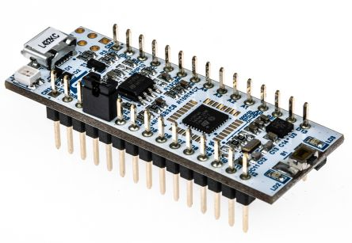
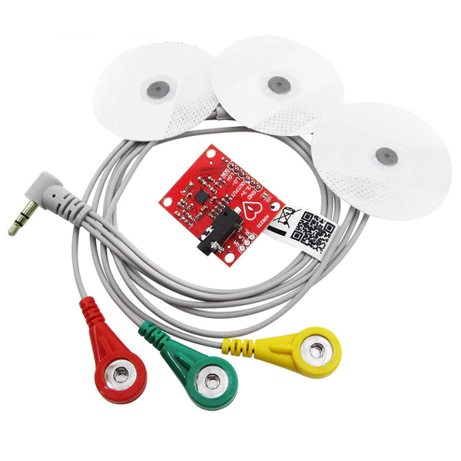
Project Components
STM32L432: Nucleo-32
AD8232: ECG Module

Slide 4
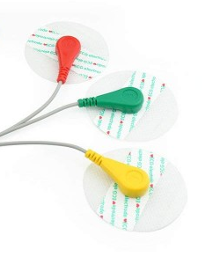
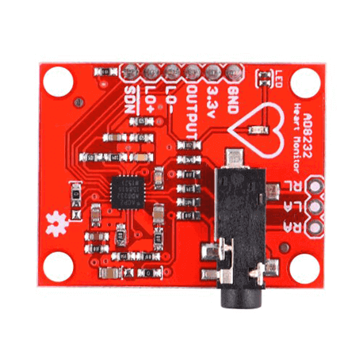
Flow Of Data
Heart Beat Sensor
ECG Module
ADC (STM32)
UART
Output / Storage
Output Processing
Graphical Output

Slide 5
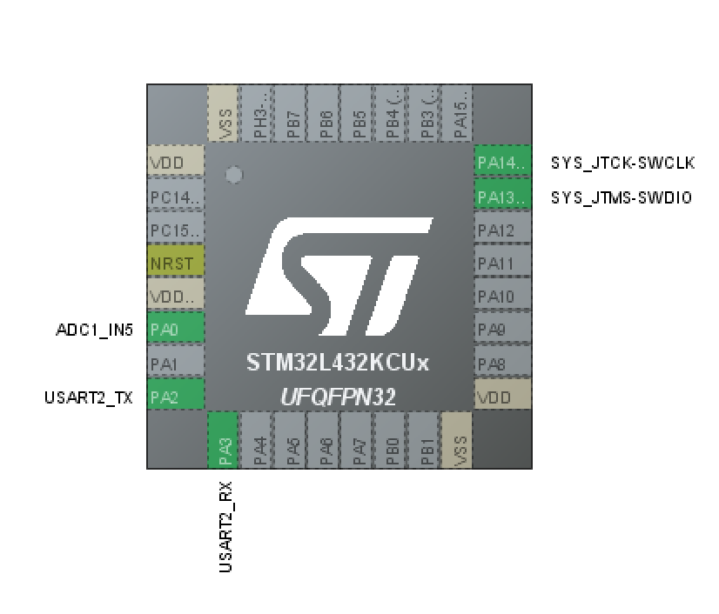
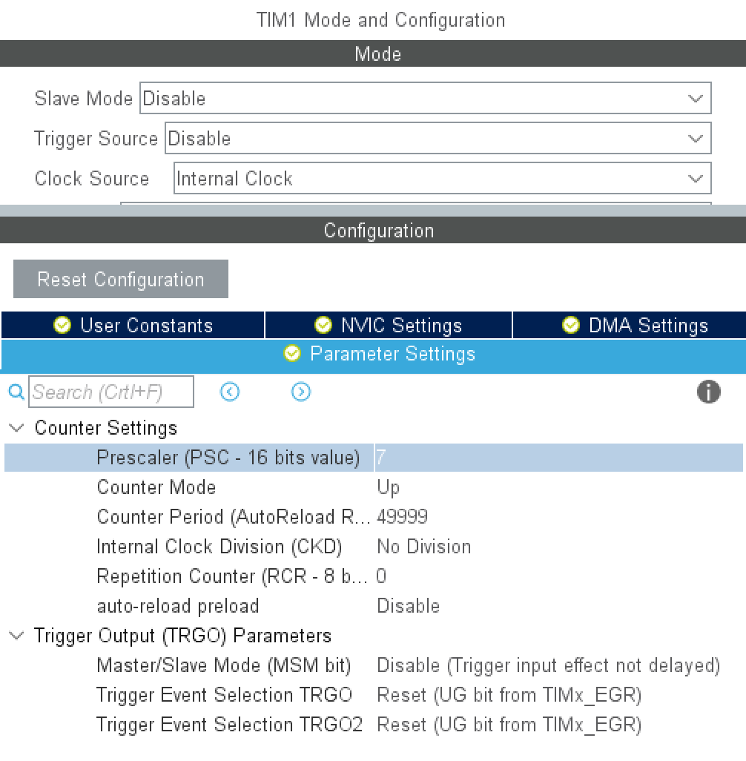
STM32 Configuration

Slide 6
Code (C)
int trans_rec = 0;
int srate = 0;
while (1)
{
if (trans_rec == 0)
{
HAL_UART_Receive_IT(&huart2 , (uint8_t *) srate, sizeof(srate));
if (srate > 0)
{
trans_rec = 1;
}

Slide 7
Code (C)
else
{
HAL_ADC_Start(&hadc1);
res = HAL_ADC_GetValue(&hadc1);
sprintf(out, "%d\r\n", res);
HAL_UART_Transmit(&huart2, (uint8_t*)out, sizeof(out),200);
__HAL_TIM_SET_COUNTER(&htim1,0);
while (__HAL_TIM_GET_COUNTER(&htim1) < 100000 / srate);
}

Slide 8
Code (Python)
def read():
a=''
while True:
if ser is None:
continue
try:
val = ser.readline().decode("utf-8")
return val
except:
print(" ")

Slide 9
Code (Python)
ser.port = port
ser.baudrate = int(brate)
ser.bytesize = serial.EIGHTBITS
ser.partiy = serial.PARITY_NONE
ser.timeout = 2
ser.open()
ser.write(srate.encode())
ani = animation.FuncAnimation(fig, animate, fargs=(xs, ys), interval=50)
plt.show()

Slide 10
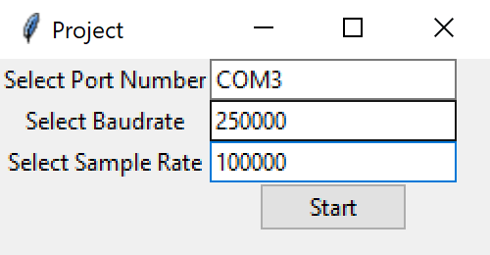
UI

Slide 11
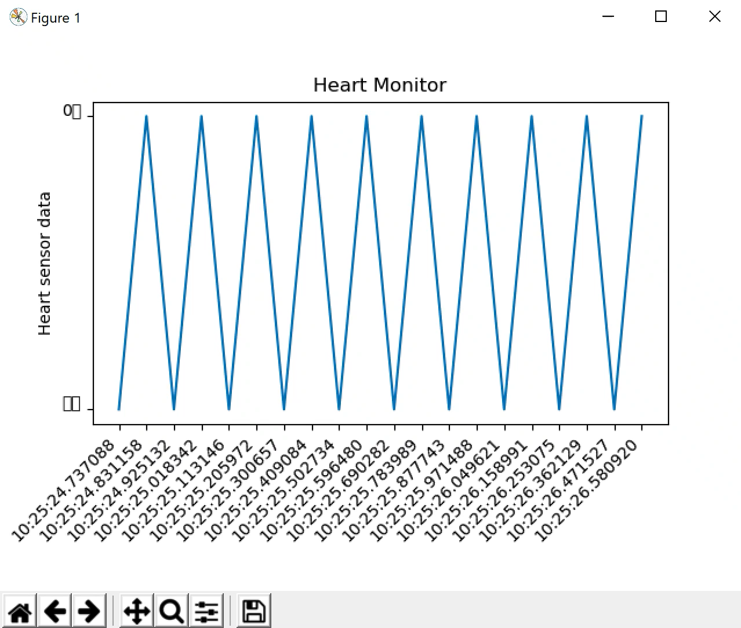
Output

Slide 12
Thank You

