Slide 1


LDO Regulator
Project Name: Digital High Frequency Chip – Linear Low Dropout Voltage Regulator
Project Number: 3097
Students:
Name: Arsen Arutyunov ID:
Name: Or Fahima ID:
Project Instructor:
Name: Tal Elazar
Project carried out at: University
Instructor’s Signature: ____Tal Elazar____

Slide 2
Abstract and Introduction
The project’s objective is to design an LDO for a DPLL.
DPLLs require a highly stable voltage input for proper operation.
Variations in supply voltage, temperature, and load current can degrade performance.
The LDO is necessary to maintain a constant input voltage despite these variations.
A well-designed bandgap reference circuit and a high-gain stable OTA are essential for the LDO’s design.

Slide 3
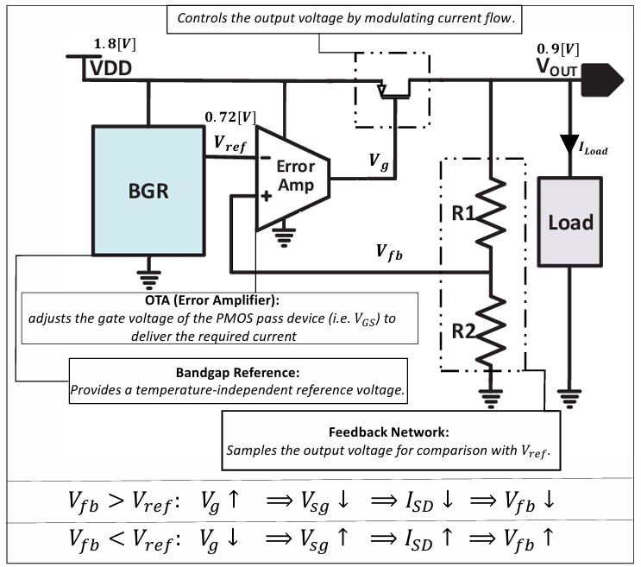
LDO Operating Principle

Slide 4
Engineering Motivation
🟦 What is a DPLL?
A Digital Phase-Locked Loop (DPLL) is a closed-loop system that synchronizes an internal oscillator to a reference clock.
It is commonly used in clock generation, frequency synthesis, and data recovery in modern SoCs.
The reference clock is typically generated by a quartz crystal oscillator, which provides a precise but low-frequency signal.
The DPLL uses this reference to generate a higher-frequency, low-jitter clock by continuously adjusting its internal oscillator (VCO) through feedback.

Slide 5
Engineering Motivation
🟦 Why Clean Supply Matters: VCO & TDC
VCO (Voltage-Controlled Oscillator) generates a clock signal whose frequency depends on voltage. → Supply noise causes jitter and frequency errors.
TDC (Time-to-Digital Converter) measures time differences with picosecond accuracy. → Voltage fluctuations lead to timing inaccuracy.
🔌 Both blocks are highly sensitive to power supply variations. 🔒 A stable and low-noise LDO is essential to maintain DPLL performance.

Slide 6
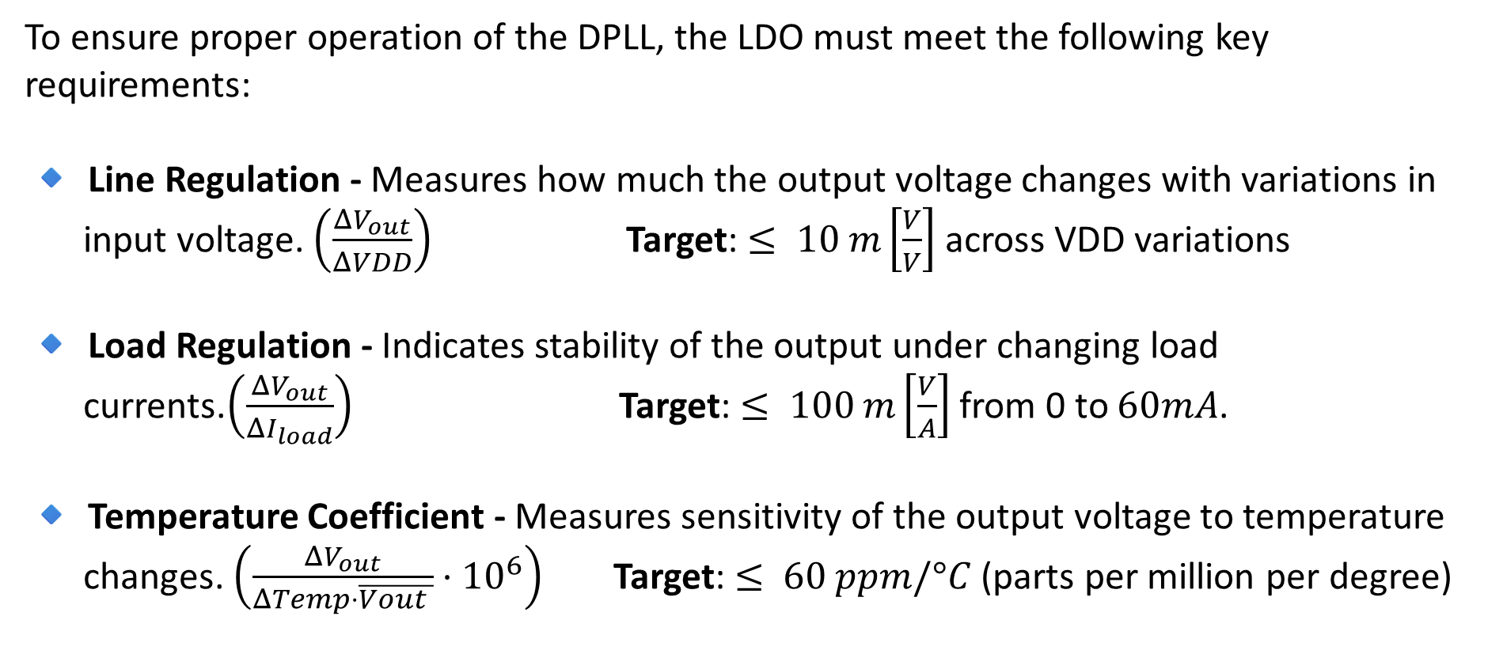
Target Specifications
To ensure proper operation of the DPLL, the LDO must meet the following key requirements:
🔹 Line Regulation - Measures how much the output voltage changes with variations in input voltage. $\left(\frac{ΔV_{out}}{ΔVDD}\right)$ Target: $≤ 10 m\left[\frac{V}{V}\right]$across VDD variations
🔹 Load Regulation - Indicates stability of the output under changing load currents.$\left(\frac{ΔV_{out}}{ΔI_{load}}\right)$ Target: $≤ 100 m\left[\frac{V}{A}\right]$from 0 to $60mA$.
🔹 Temperature Coefficient - Measures sensitivity of the output voltage to temperature changes. $\left(\frac{ΔV_{out}}{ΔTemp⋅\overline{Vout }}⋅{10}^{6}\right)$ Target: $≤ 60 ppm/°C$(parts per million per degree)

Slide 7
Design Approach – Meeting the Spec
To meet the key performance requirements, the following design strategies were applied:
🔹 Line Regulation/PSRR → Use a high-gain error amplifier to maintain a stable output under VDD variations
🔹 Load Regulation → Design a strong pass transistor capable of sourcing the maximum load current
🔹 Temperature Coefficient → Integrate a precise Bandgap Reference (BGR) → The BGR includes its own high-gain error amplifier to ensure thermal stability

Slide 8
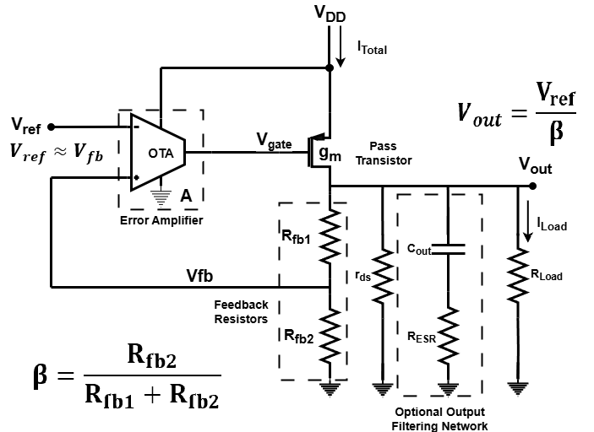
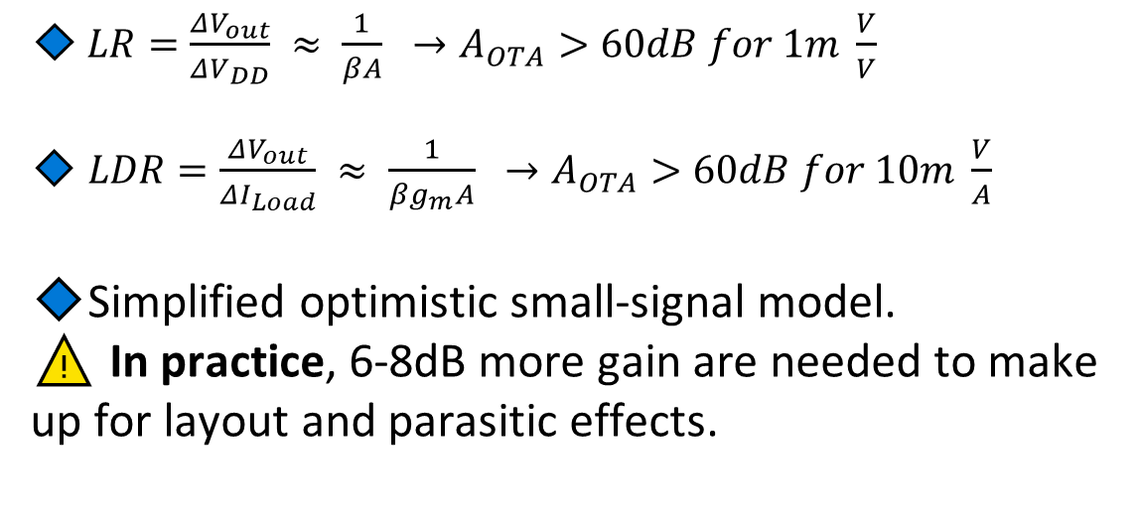
Required OTA Gain
🔹 $LR=\frac{ΔV_{out}}{ΔV_{DD}} ≈ \frac{1}{βA} →A_{OTA}>60dB for 1m \frac{V}{V}$
🔹 $LDR=\frac{ΔV_{out}}{ΔI_{Load}} ≈ \frac{1}{βg_{m}A} →A_{OTA}>60dB for 10m \frac{V}{A}$
🔹Simplified optimistic small-signal model.
⚠️ In practice, 6-8dB more gain are needed to make up for layout and parasitic effects.

Slide 9
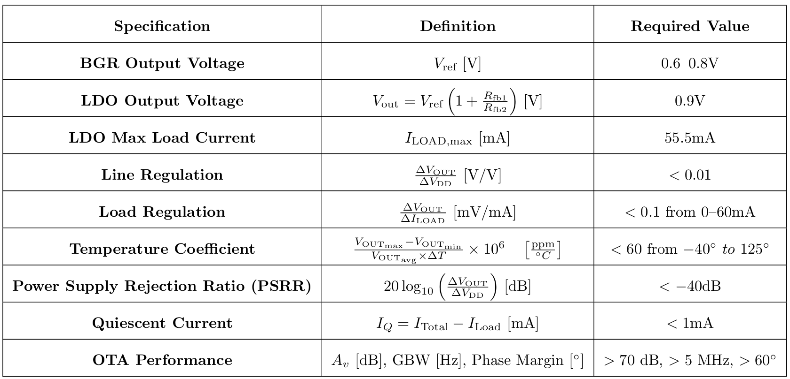
Full Project Requirements

Slide 10

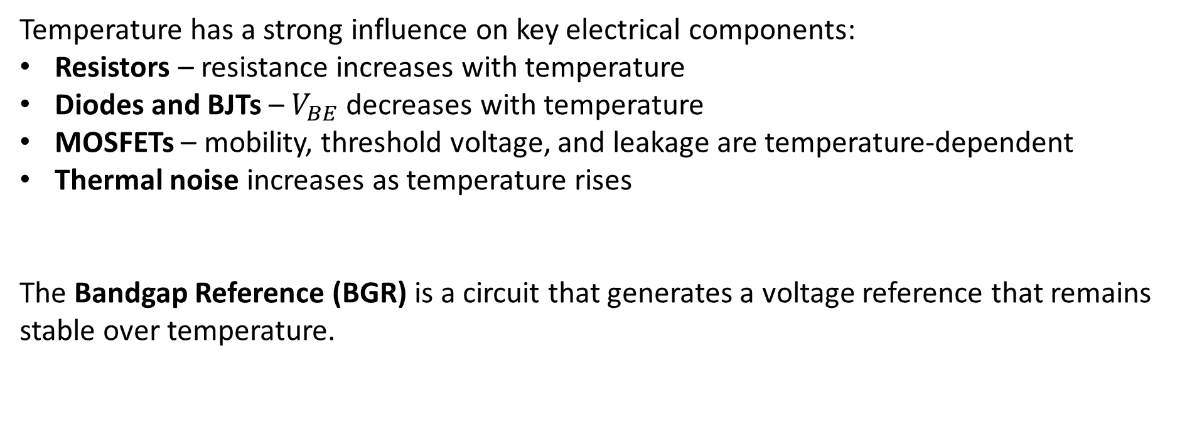
Why Temperature Matters in Analog Circuits
Temperature has a strong influence on key electrical components:
Resistors – resistance increases with temperature
Diodes and BJTs – $V_{BE}$ decreases with temperature
MOSFETs – mobility, threshold voltage, and leakage are temperature-dependent
Thermal noise increases as temperature rises
The Bandgap Reference (BGR) is a circuit that generates a voltage reference that remains stable over temperature.

Slide 11
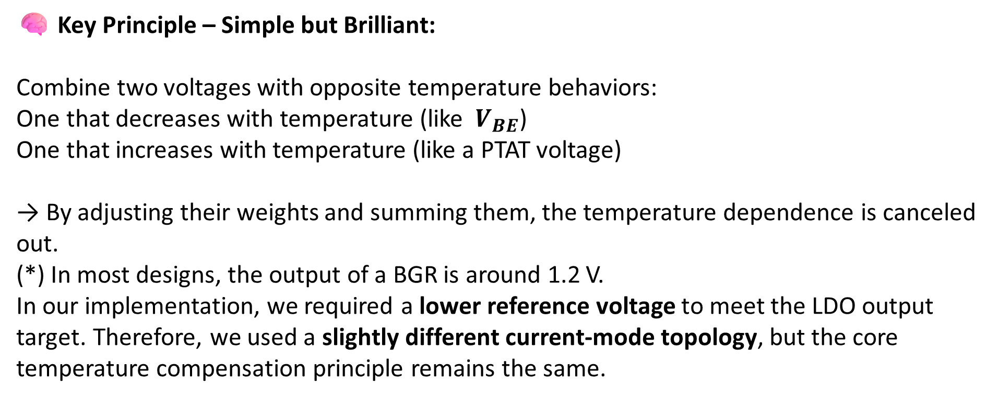
BGR – Operating Principle
🧠 Key Principle – Simple but Brilliant:
Combine two voltages with opposite temperature behaviors:
One that decreases with temperature (like $V_{BE}$)
One that increases with temperature (like a PTAT voltage)
→ By adjusting their weights and summing them, the temperature dependence is canceled out.
(*) In most designs, the output of a BGR is around 1.2 V. In our implementation, we required a lower reference voltage to meet the LDO output target. Therefore, we used a slightly different current-mode topology, but the core temperature compensation principle remains the same.

Slide 12
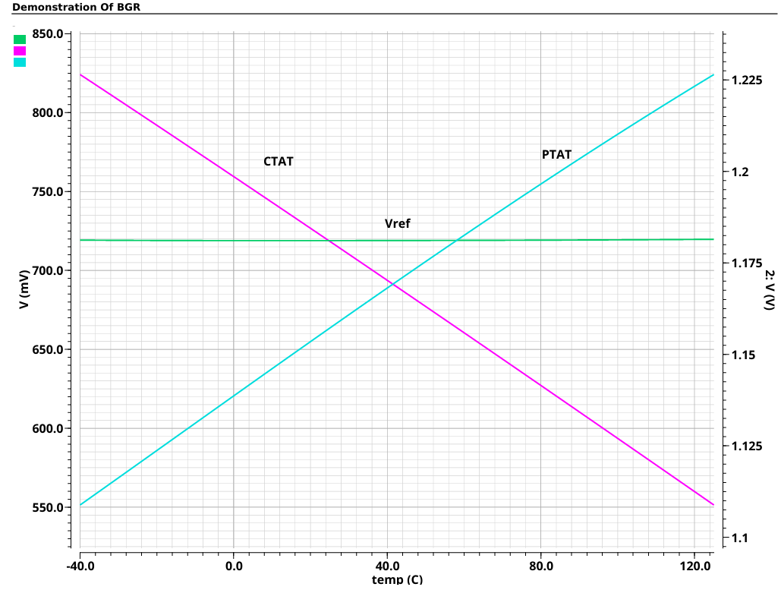


BGR – Operating Principle

Slide 13
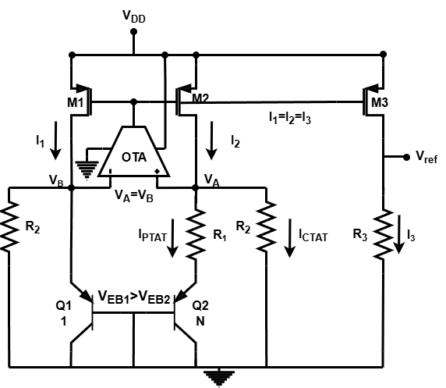
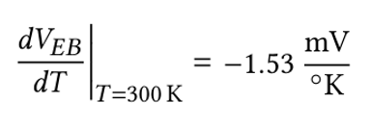
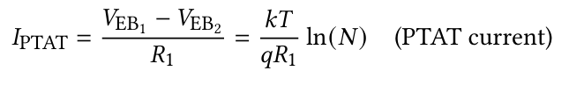

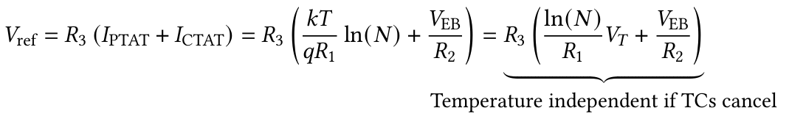
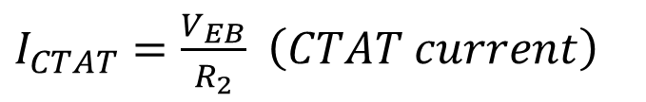
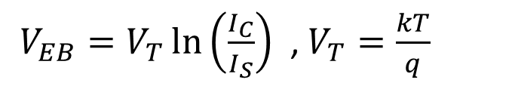
BGR Operating Principle
$V_{EB}=V_{T}\ln\left(\frac{I_{C}}{I_{S}}\right)$ , $V_{T}=\frac{kT}{q}$
$I_{CTAT}=\frac{V_{EB}}{R_{2}}$ $\left(CTAT current\right)$

Slide 14
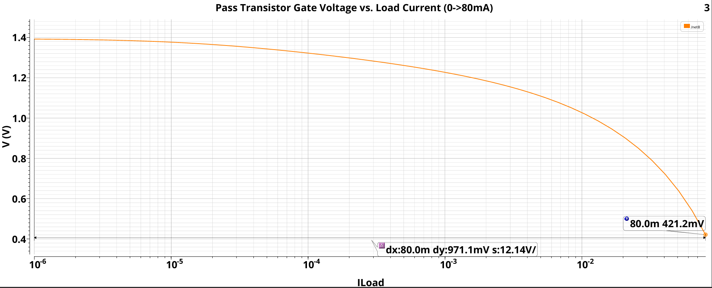
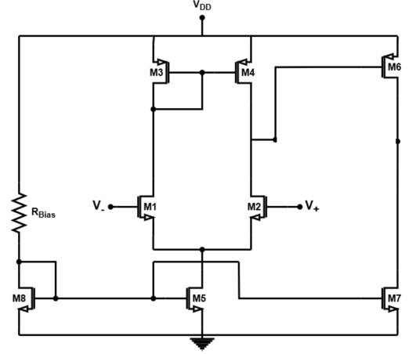
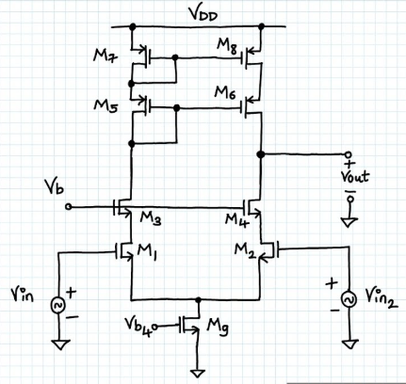
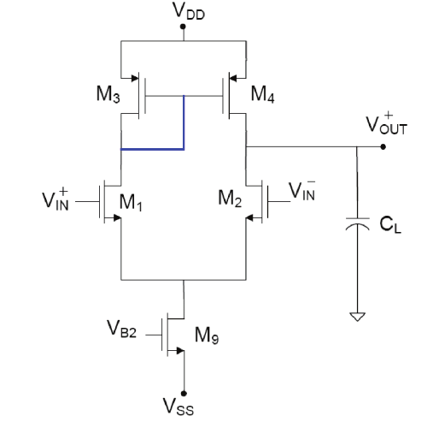
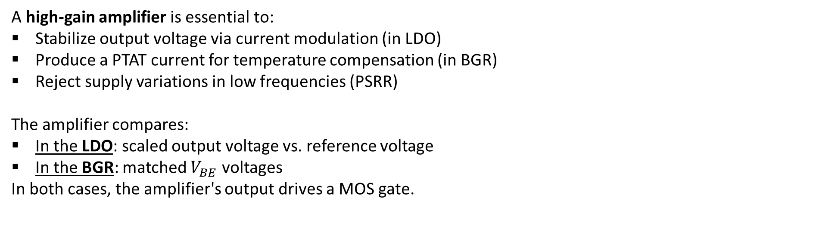
The Role of the OTA in Our Design
A high-gain amplifier is essential to:
Stabilize output voltage via current modulation (in LDO)
Produce a PTAT current for temperature compensation (in BGR)
Reject supply variations in low frequencies (PSRR)
The amplifier compares:
In the LDO: scaled output voltage vs. reference voltage
In the BGR: matched $V_{BE}$voltages
In both cases, the amplifier's output drives a MOS gate.
Why the two-stage Miller OTA topology?
High DC gain required (>70dB) – single-stage OTA insufficient.
Large output swing needed – telescopic cascode unsuitable.
No longer one-pole system, compensation is essential for stability.

Slide 15
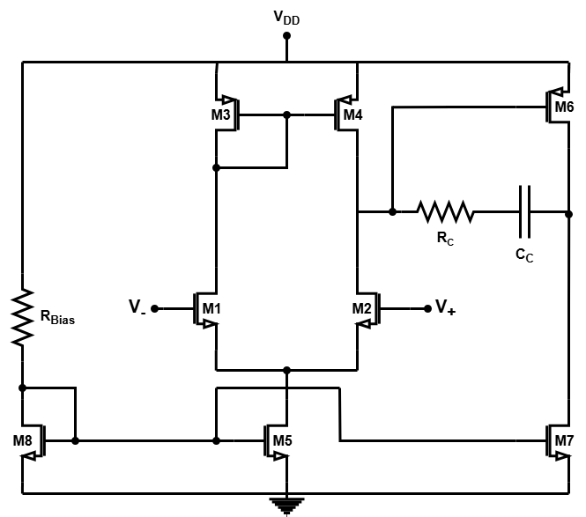


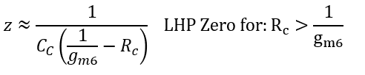

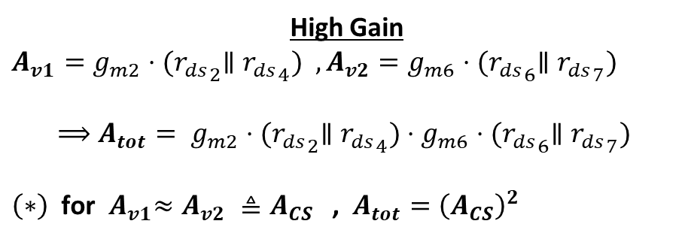

Two-Stage Miller OTA
High Gain $$A_{v1}=g_{m2}⋅{{(r}_{ds}}_{2}∥{r_{ds}}_{4}) ,A_{v2}=g_{m6}⋅{{(r}_{ds}}_{6}∥{r_{ds}}_{7})$$
$$⟹A_{tot}= g_{m2}⋅{{(r}_{ds}}_{2}∥{r_{ds}}_{4})⋅g_{m6}⋅{{(r}_{ds}}_{6}∥{r_{ds}}_{7})$$
$\left(∗\right)$for${ A}_{v1}≈A_{v2} ≜A_{CS}$ , $A_{tot}={\left(A_{CS}\right)}^{2}$
Frequency compensation and stability
$$p_{1}≈\frac{1}{R_{out1}A_{tot}⋅C_{c}}⇒GBW=A_{DC}×p_{1}=\frac{g_{m1}}{C_{C}}$$
$p_{2}≈\frac{g_{m_{6} }}{C_{L}}$
$$z≈\frac{g_{m_{6} }}{C_{C}}$$

Slide 16
From Schematic to Layout
Once the schematic design was finalized and verified through simulations, the circuit was implemented in physical layout using TSMC 28nm CMOS technology.
Layout quality directly affects:
✅ Performance (gain, matching, parasitics)
✅ Area and density
✅ Noise and stability
Special attention was given to:
Symmetry in analog blocks (e.g., OTA differential pair)
Matching techniques for current mirrors and resistors
Routing of sensitive nodes (e.g., BGR core, OTA outputs)
Minimization of IR drop through metal stacking

Slide 17
Layout – It’s All About Matching
In analog layout, perfect interconnects don't exist — Parasitic capacitances&resistances will always be there.
The key idea behind matching is not to eliminate these effects, but to ensure they impact all matched devices equally.
Techniques we applied:
✅ Common-centroid layout for critical pairs
✅ Dummy devices to minimize edge mismatches
✅ Guard rings around sensitive transistor clusters to isolate substrate noise
✅ Symmetric routing to balance parasitics

Slide 18
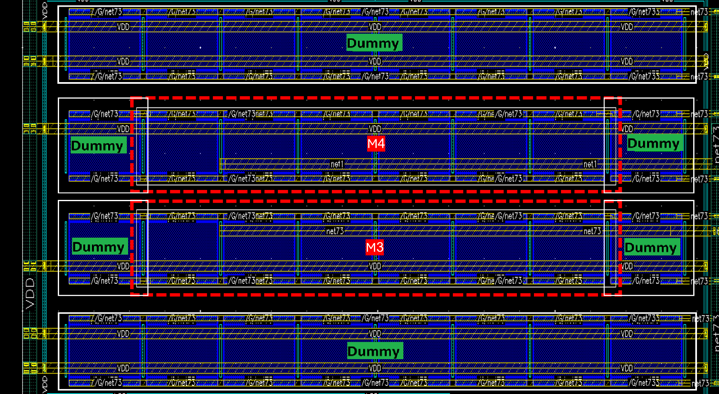
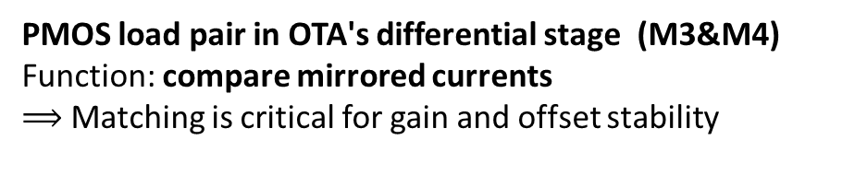
For Example 1
Dummy devices to minimize edge mismatches
PMOS load pair in OTA's differential stage (M3&M4)
Function: compare mirrored currents
$⟹$ Matching is critical for gain and offset stability
Symmetric Routing&Placment

Slide 19
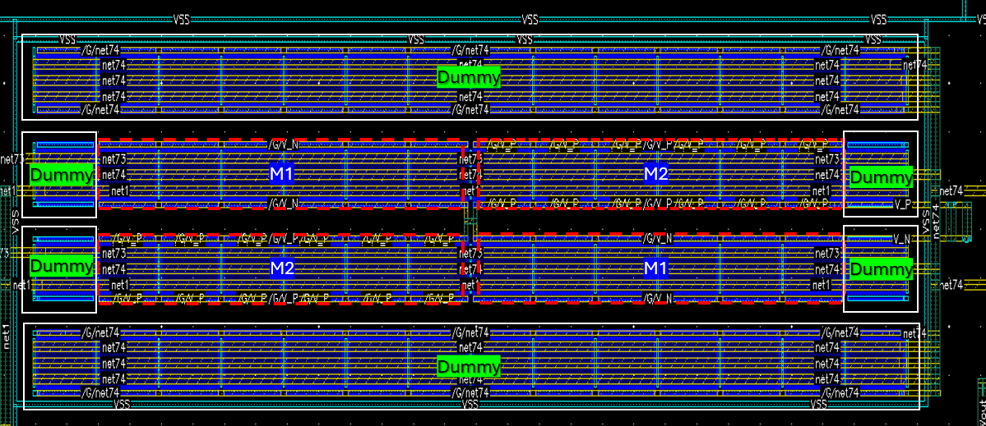
For Example 2
High Symmetry routing between the devices
High Symmetry routing between the devices
Differential Pair (M1 & M2)
Core of the OTA – compares input voltages
Requires excellent symmetry to avoid offset
Implemented using Common-Centroid layout:
→ Transistors are placed symmetrically around a center to cancel process gradients
Common Center for both Transistors

Slide 20
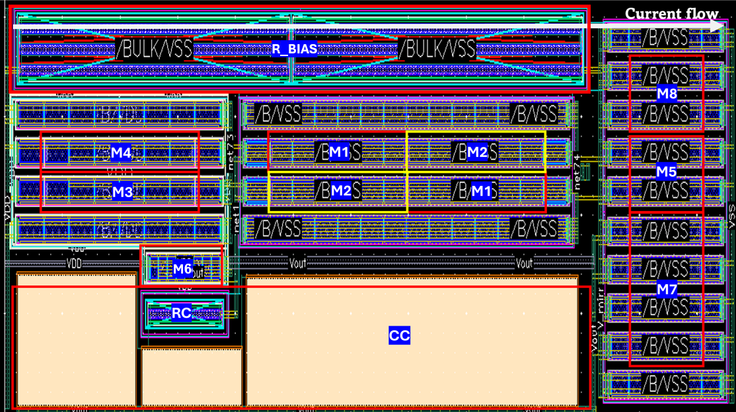
Final OTA Layout

Slide 21
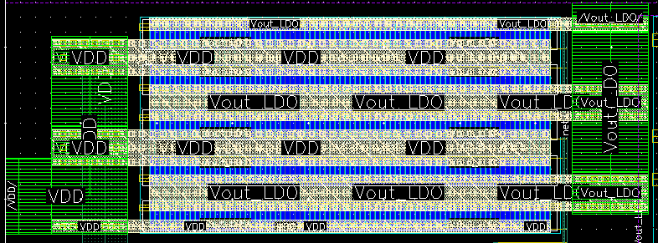
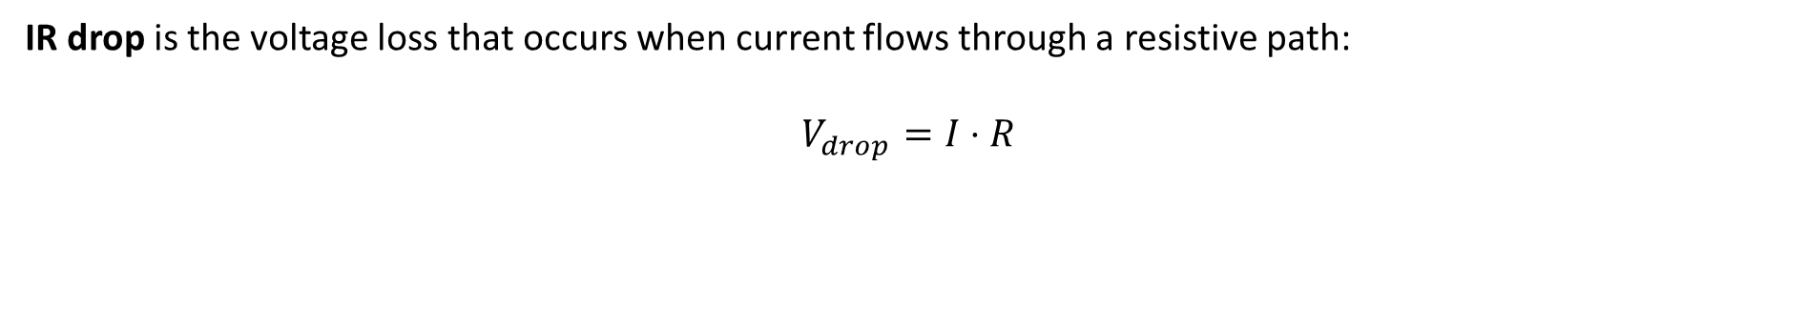
A Bit About IR Drop
IR drop is the voltage loss that occurs when current flows through a resistive path:
$$V_{drop}=I⋅R$$
This affects the actual voltage delivered to the load, especially in analog blocks.
To ensure proper LDO operation at 60 mA load, careful layout planning was required:
📏 Wire width and spacing calculated according to PDK to pass DRC
🧱 Multiple metal layers selected based on current density
🪜 Metal stacking used to distribute current across layers to further minimize resistance
🔗 Segmented connections made to match physical transistor layout

Slide 22
Final Layout

Slide 23
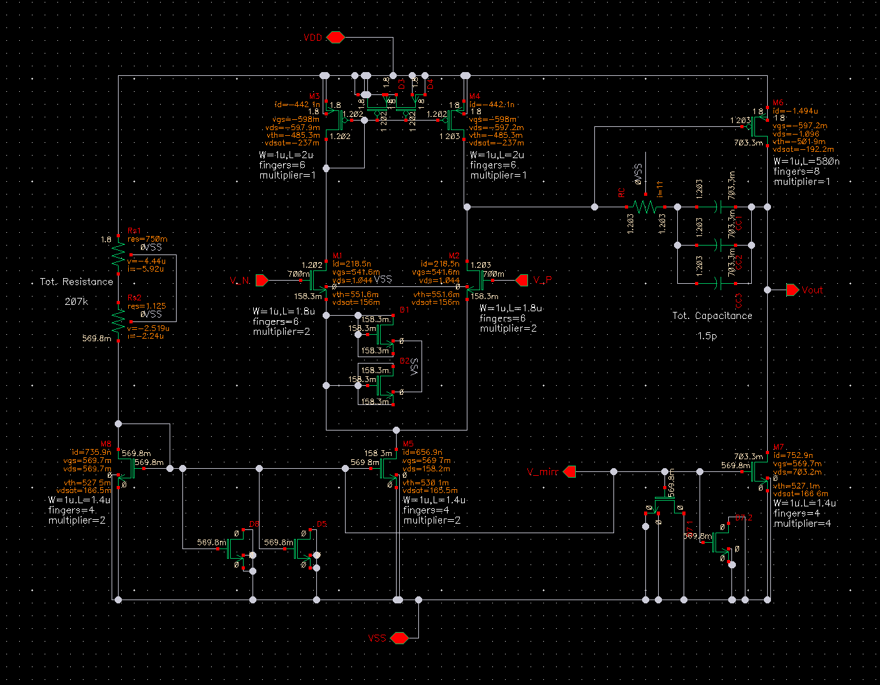
OTA - Schematic

Slide 24
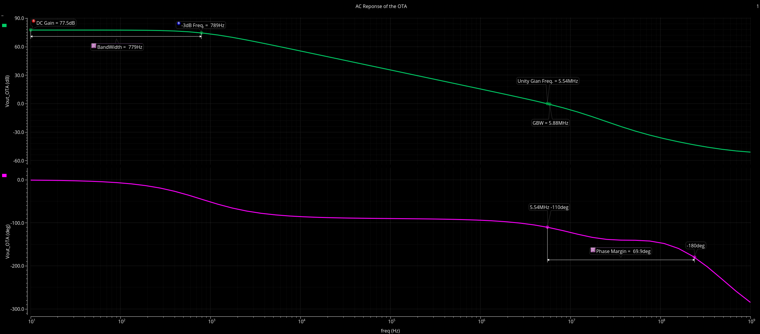


OTA – Frequency Response (Post Layout)
Common Trade-off $$Gain ⟷B.W.$$
Common Trade-off $$Gain ⟷B.W.$$
High Gain Amp. To meet the specs
High Gain Amp. To meet the specs
Close GBW and UGF →
well-separated poles, ensuring stable operation
Close GBW and UGF →
well-separated poles, ensuring stable operation
High Phase Margin To Ensure Stability

Slide 25
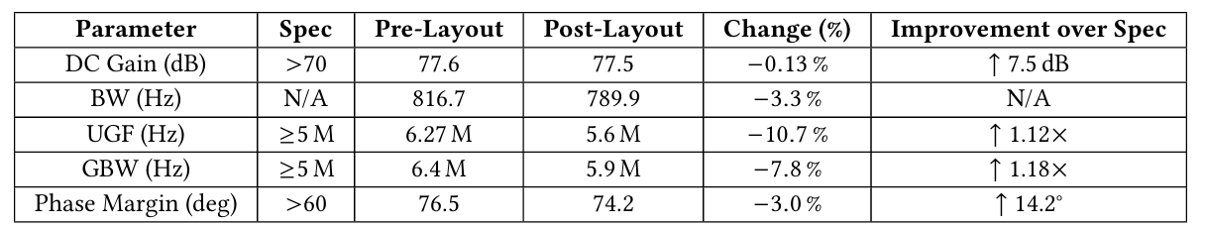
OTA – Frequency Response (Post Layout)
UGF and GBW are close – indicating good pole separation and stable OTA behavior. Main shift expected post-layout is in the first pole, due to parasitic R and C from routing.

Slide 26
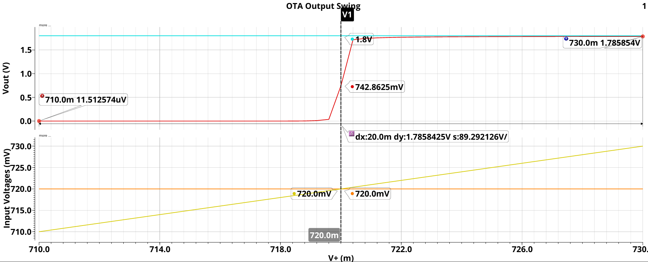
OTA – Output Swing

Slide 27
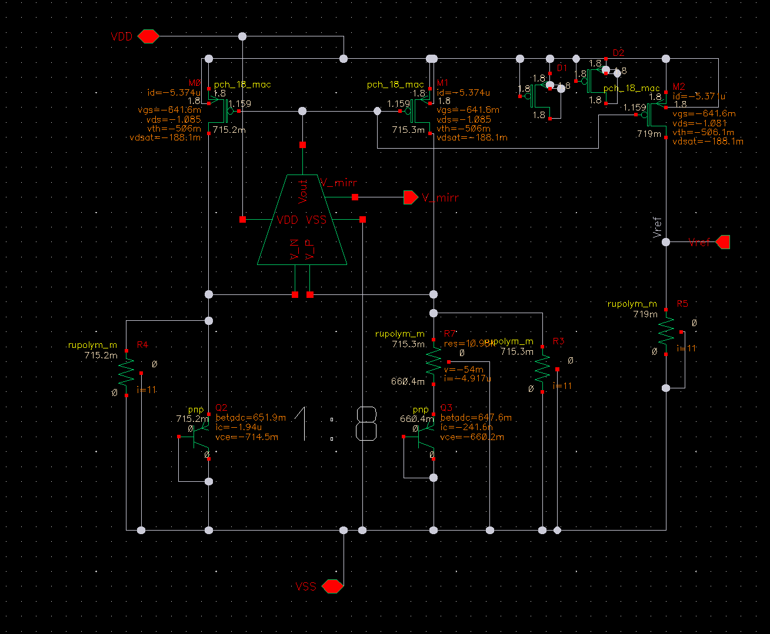
BGR - Schematic

Slide 28
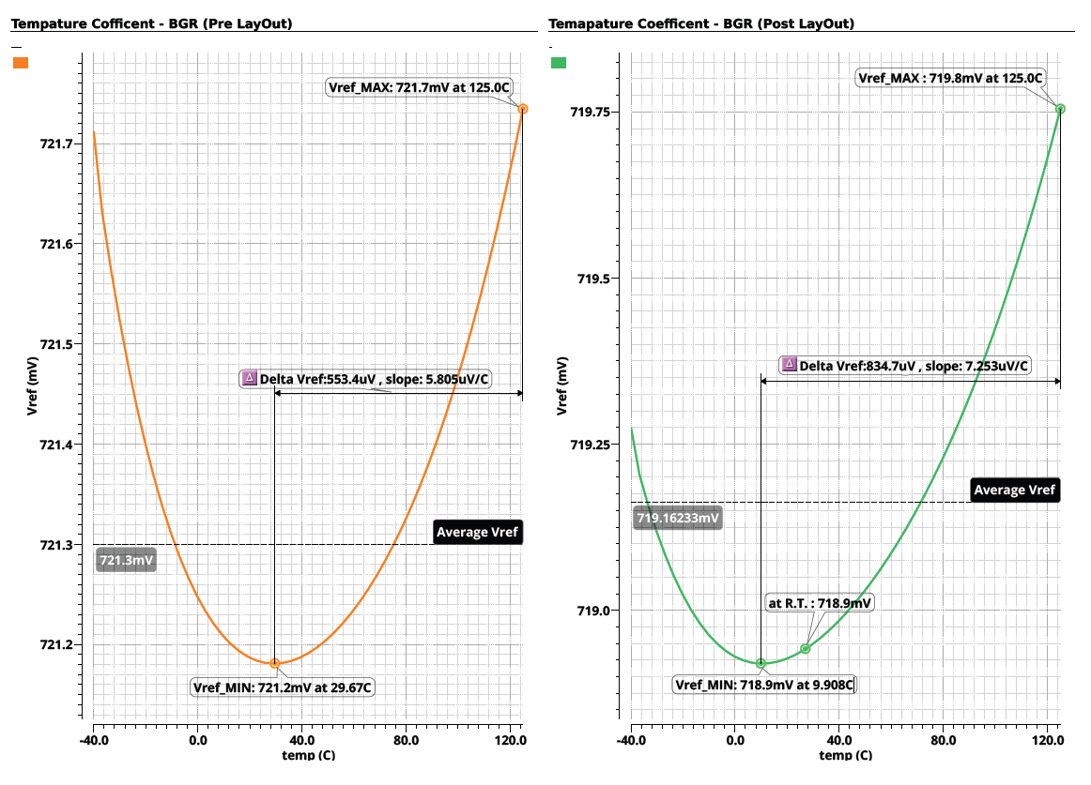
BGR – Temperature Stability
Temp Sweep : -40 - 125 [C]

Slide 29
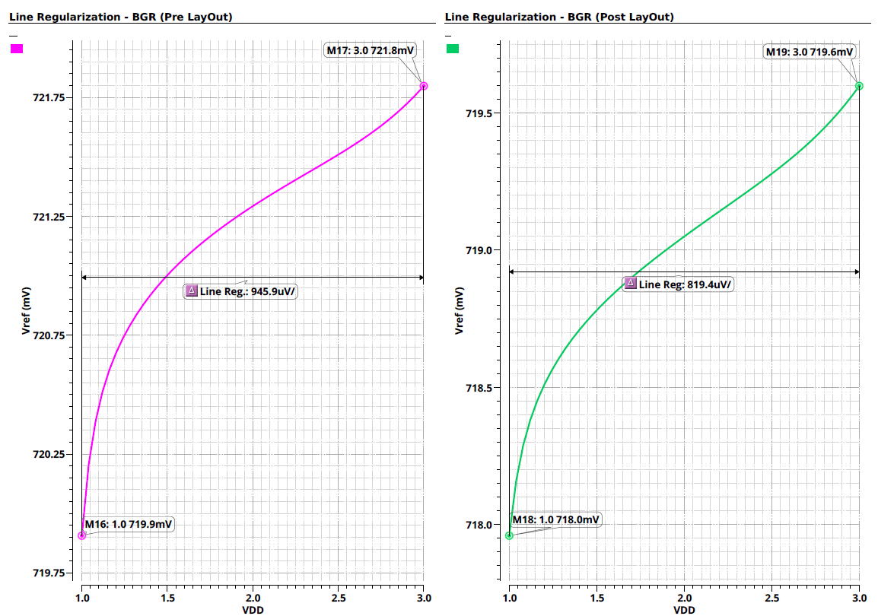
BGR – Line Regulation
VDD Sweep : 1-3 [V]

Slide 30
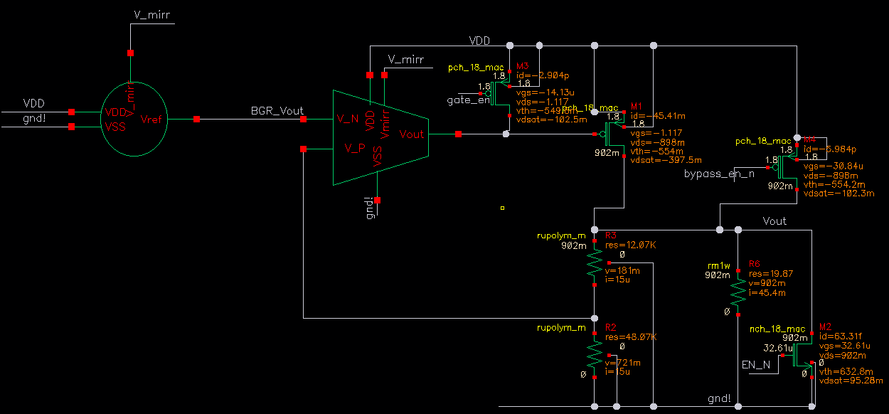
LDO - Schematic

Slide 31
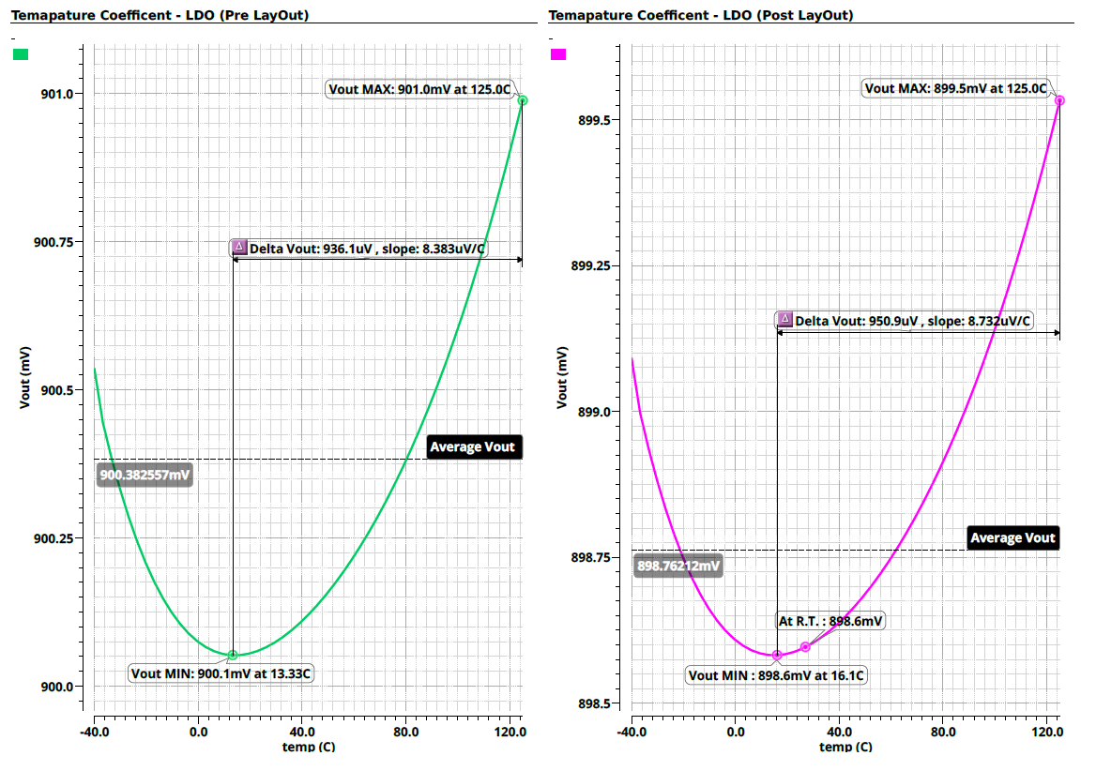
LDO – Temperature Stability
Temp Sweep : $−40 − 125 \left[C\right],I_{load} = 55[mA]$

Slide 32
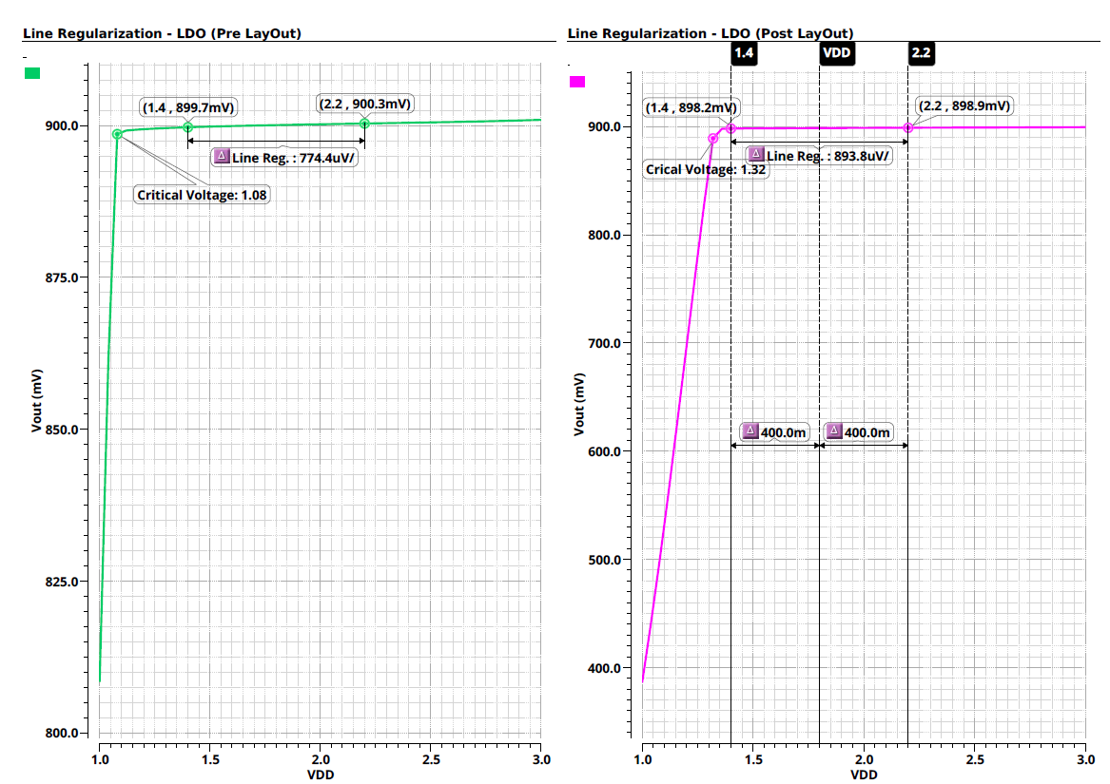

LDO – Line Regulation
VDD Sweep : $1.4 – 2.2 [V]$, $I_{load} = 55[mA]$

Slide 33
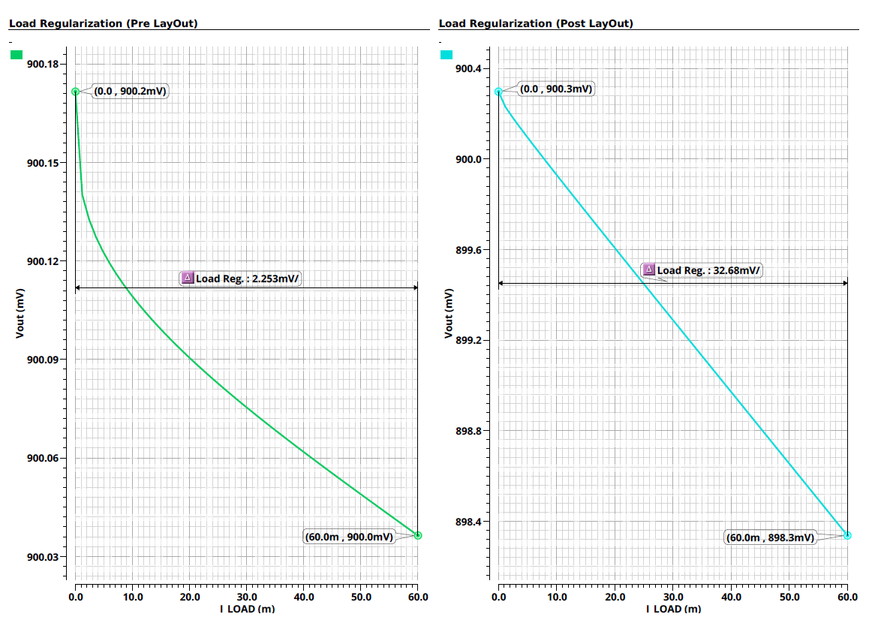
LDO – Load Regulation
$$I_{load} Sweep=0−60[mA]$$

Slide 34
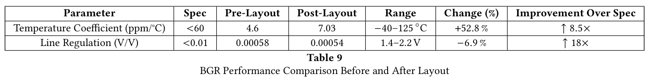
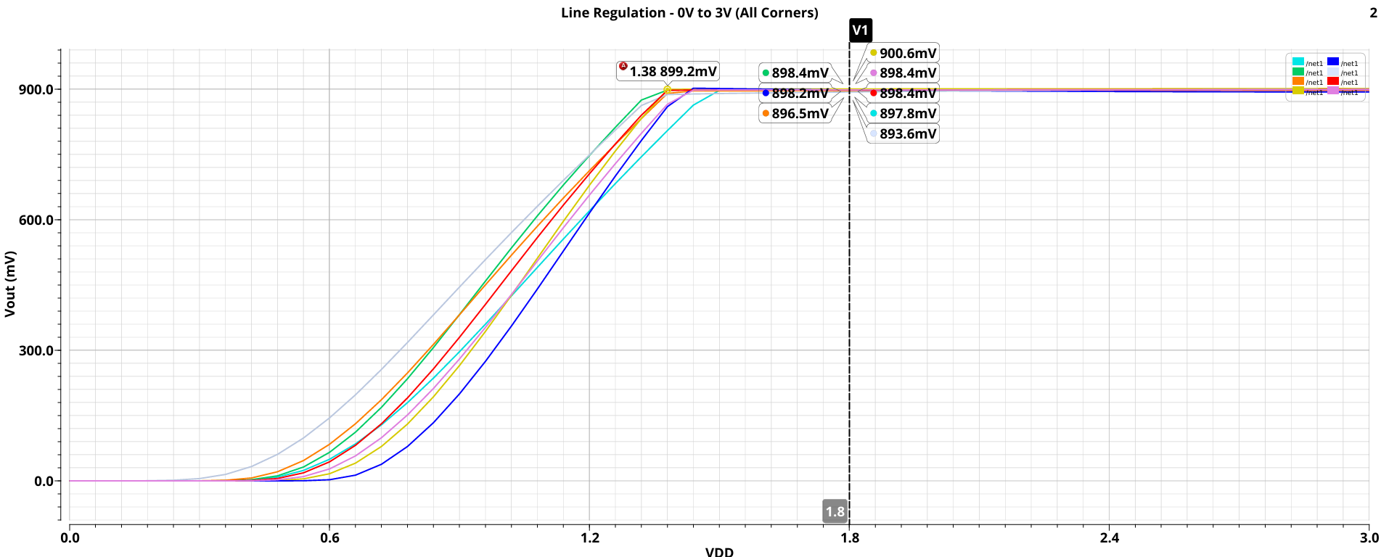
LDO – Line Regulation across Corners
TT @27
FF @27, FF @125
SS @27, SS @-40
FS @27
SF @27

Slide 35
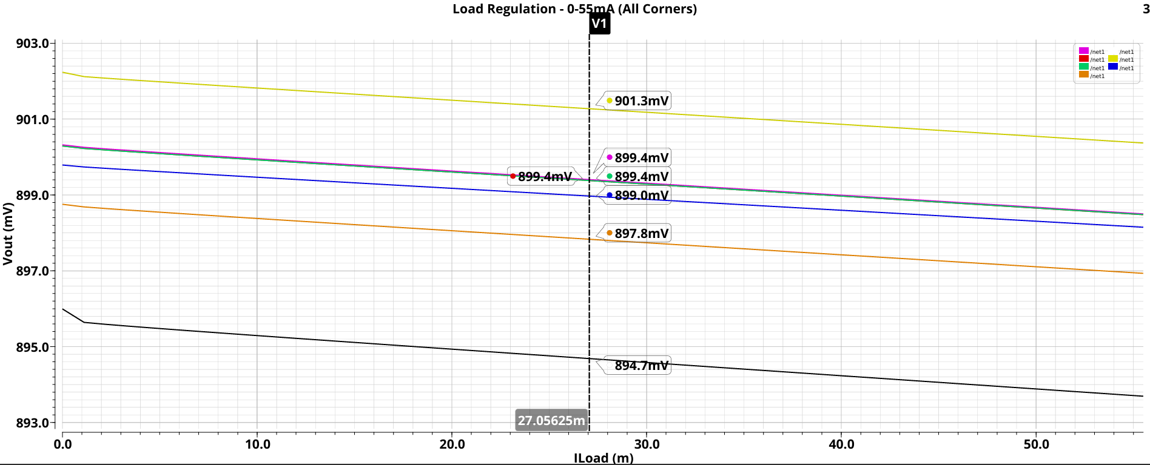
LDO – Load Regulation across Corners
TT @27
FF @27, FF @125
SS @27, SS @-40
FS @27
SF @27

Slide 36
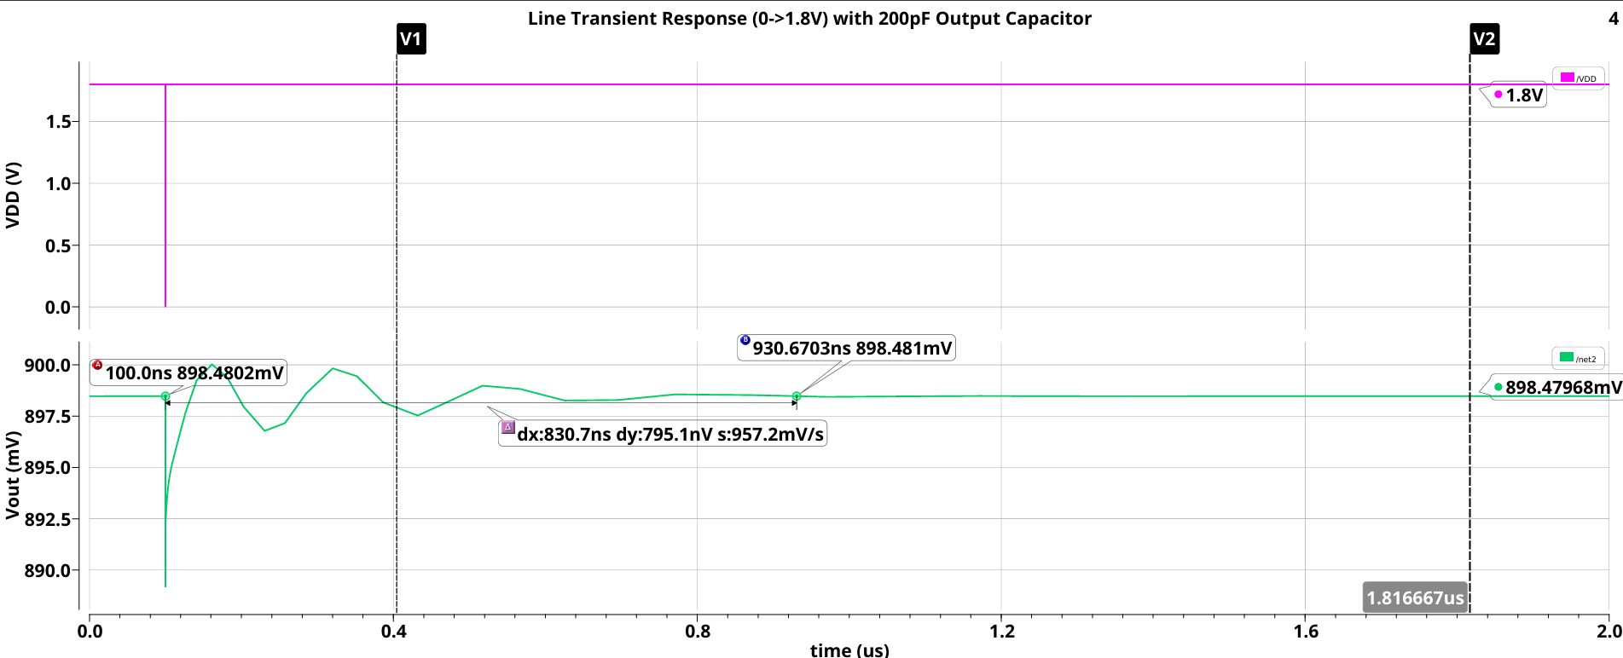

LDO – Line Transient to 10ps Disturbance

Slide 37
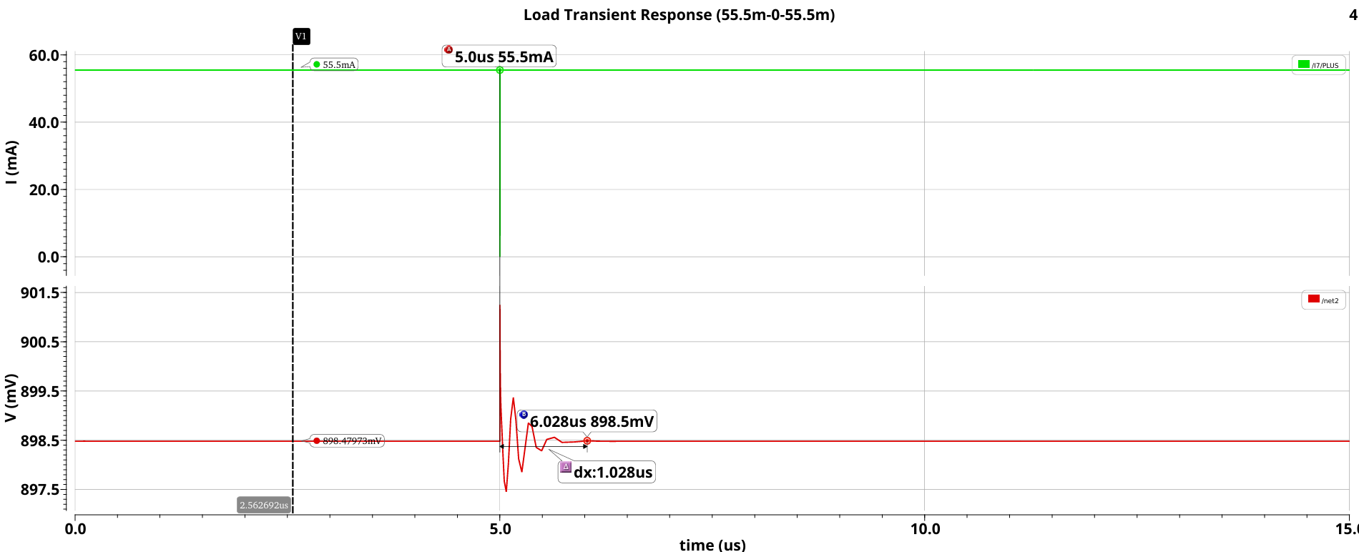
LDO – Load Transient to 10ps Disturbance

Slide 38
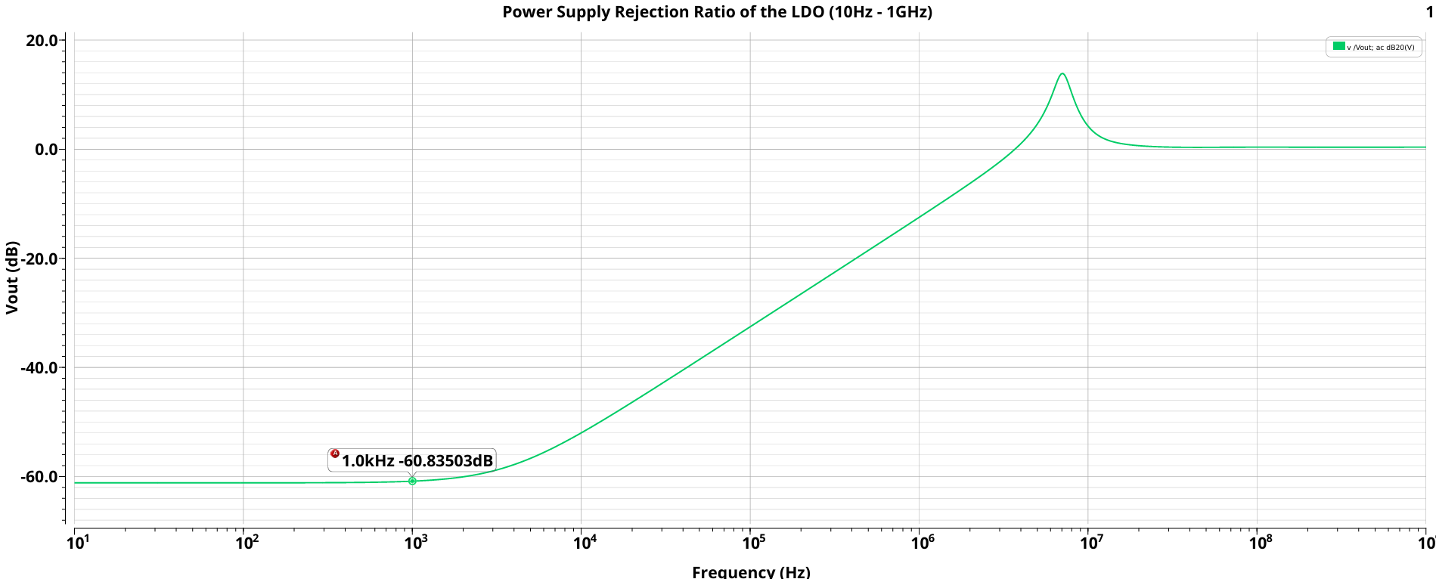
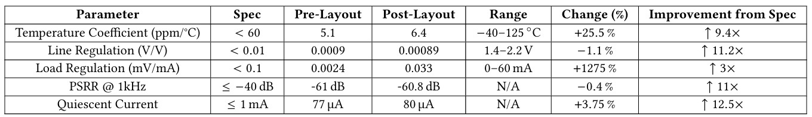
LDO – Power Supply Rejection Ratio

Slide 39
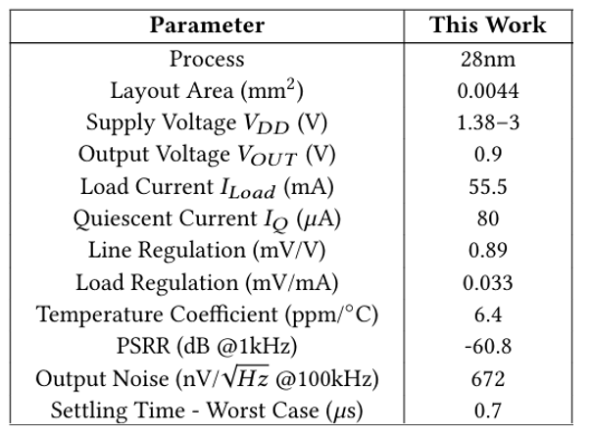
Full Post-Layout Results

Slide 40
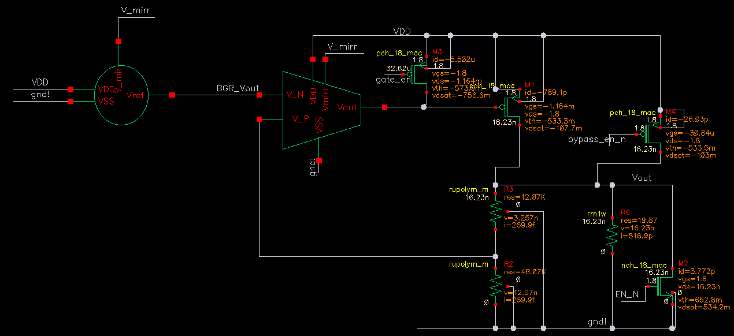
LDO – Disabled Mode

Slide 41
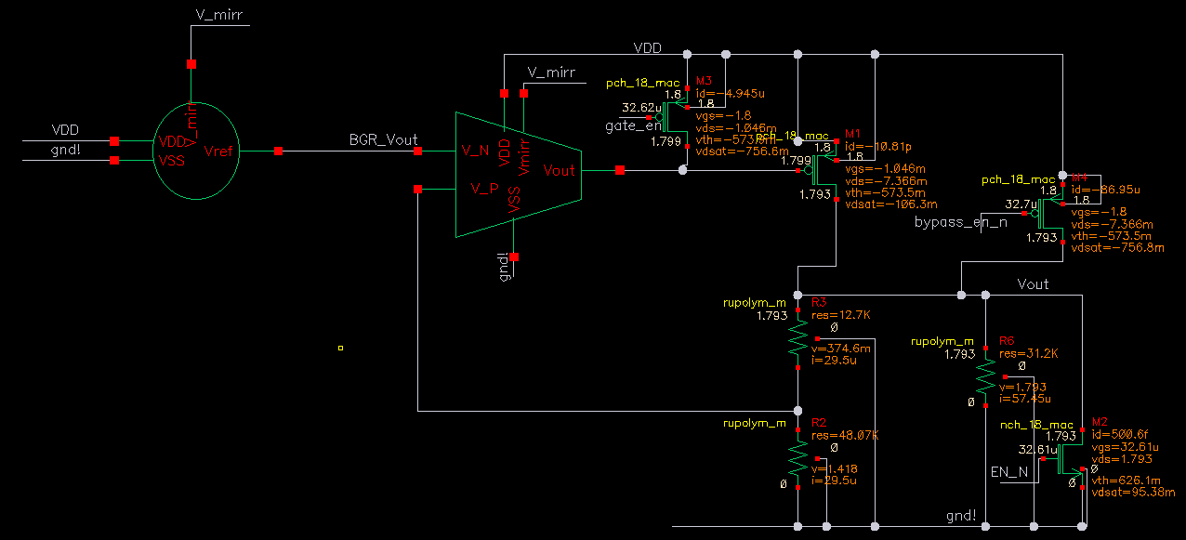
LDO – Bypass Mode

Slide 42
Conclusions
A 0.9V LDO regulator was successfully implemented in 28nm CMOS for integration within a DPLL system-on-chip.
The design met key specifications including line/load regulation, temperature stability, PSRR, transient response, area and, power constraints, demonstrating reliable performance across all PVT corners and scenarios.
Major design challenges, such as balancing stability, gain, bandwidth, area, and power consumption tradeoffs, along with layout optimizations to improve matching and minimize IR drop, were effectively addressed through iterative refinement.
Post-layout results showed only minor degradation, validating the effectiveness of early floorplanning and adherence to industry-standard layout practices.

Slide 43
Further Work
EA Gain and BW Improvement:
Use gain-boosted cascode or telescopic topologies (>100 dB gain) to enhance regulation and PSRR.
Tradeoffs: Increased complexity, reduced output swing, and higher power.
BGR Performance Enhancement:
Implement second-order curvature correction and cascode current mirrors for sub-1 ppm/°C temperature coefficient and improved PSRR.
Tradeoffs: Higher power and design complexity.
Pass Device Optimization:
Widen pass transistor for better load regulation.
Tradeoffs: Raises gate capacitance, reducing bandwidth and stability. Can be mitigated with a buffer stage.
Advanced LDO Control Features:
Add low-power modes and digitally tunable output voltage through feedback resistor ladder.
Tradeoffs: More area and logic, requires early top-level integration.
Output Noise Reduction:
Employ low-noise OTA topologies or RC filtering on the BGR output to reduce low-frequency noise.
Tradeoffs: Large passive RC filters impractical on chip. Other methods add complexity.

Slide 44





Project Documentation
DPLL-LDO

