Slide 1

Michael Donnelly – 3rd Year Project

Slide 2
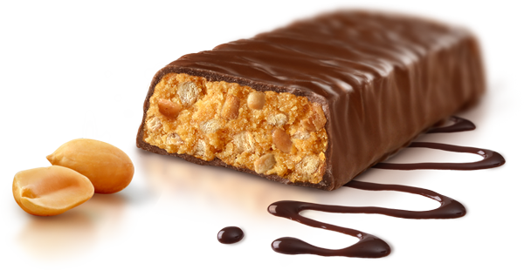
What's the idea?
Protein / Health bar E-Commerce site.
Hosting four to six different brands
Two variations per brand.

Slide 3
What's the twist?
Existing sites restrict customers.
24x of same type
Customisable box sizes.
5x, 7x, 10x
Set prices per box size.

Slide 4

Development Goals
Display products directly from a DB.
Consistent and practical design.
Shopping cart functionality.

Slide 5

Front-end Technology
HTML5
CSS3
JavaScript

Slide 6

Back-end Technology
PHP
MySQL
phpMyAdmin

Slide 7
What has been completed?
Database
Basic layout

Slide 8
What's left to be completed?
Shopping cart functionality
Payment functionality

Slide 9

Conclusion
Meet set deadlines.
Deliver a complete E-Commerce site.

Slide 10

Any Questions?

