Slide 1

Ride Sharing App
Ndacyayisenga Shema Arsene

Slide 2

Agenda
3 | Project statement & objectives
5 | ER diagram
6 | BUsiness Process
7 | Procedures,Function,Triggers
9 | Result & conclusion

Slide 3

Project Statement
This project aims to reduce the cost of taxi and cab transportation in Rwanda by allowing multiple passengers traveling in the same direction to share a ride and split the fare.
By implementing a ride-sharing system similar to Uber Pool, the platform promotes affordable and efficient transportation.

Slide 4
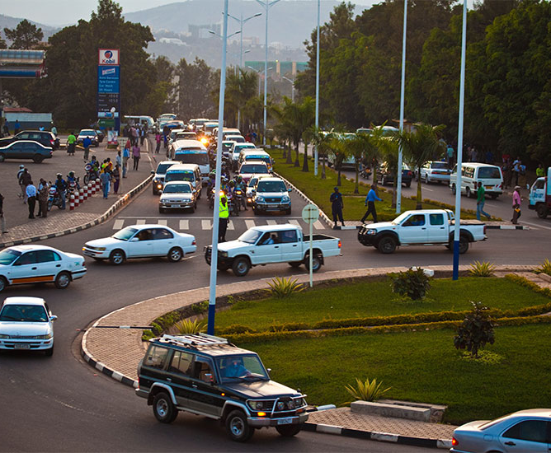
Objectives
To provide an affordable ride-sharing solution tailored to the Rwandan market
To enable passengers to book shared rides and split costs based on location and timing
To optimize vehicle usage and increase driver earnings through pooled rides
To implement secure, efficient backend logic using Oracle PL/SQL
To track and audit user activity for accountability and transparency

Slide 5
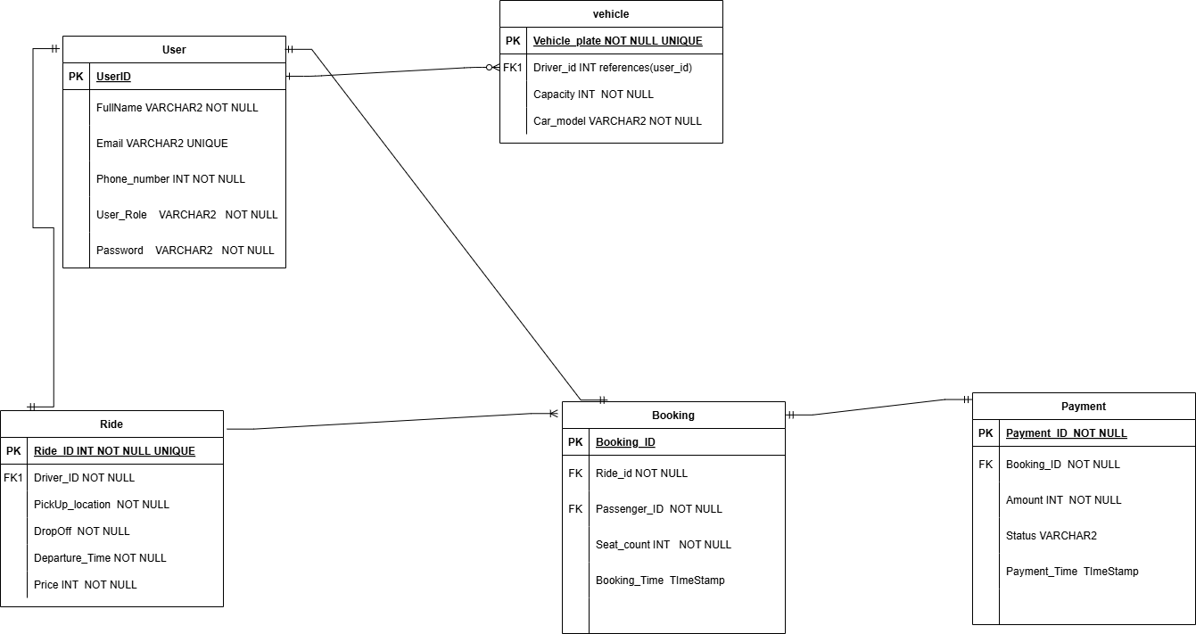
ER DIAGRAM

Slide 6
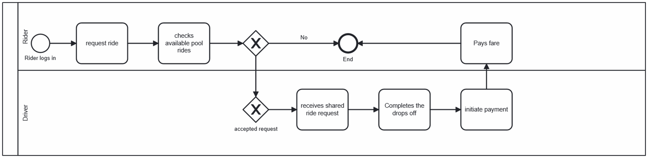
Business process

Slide 7
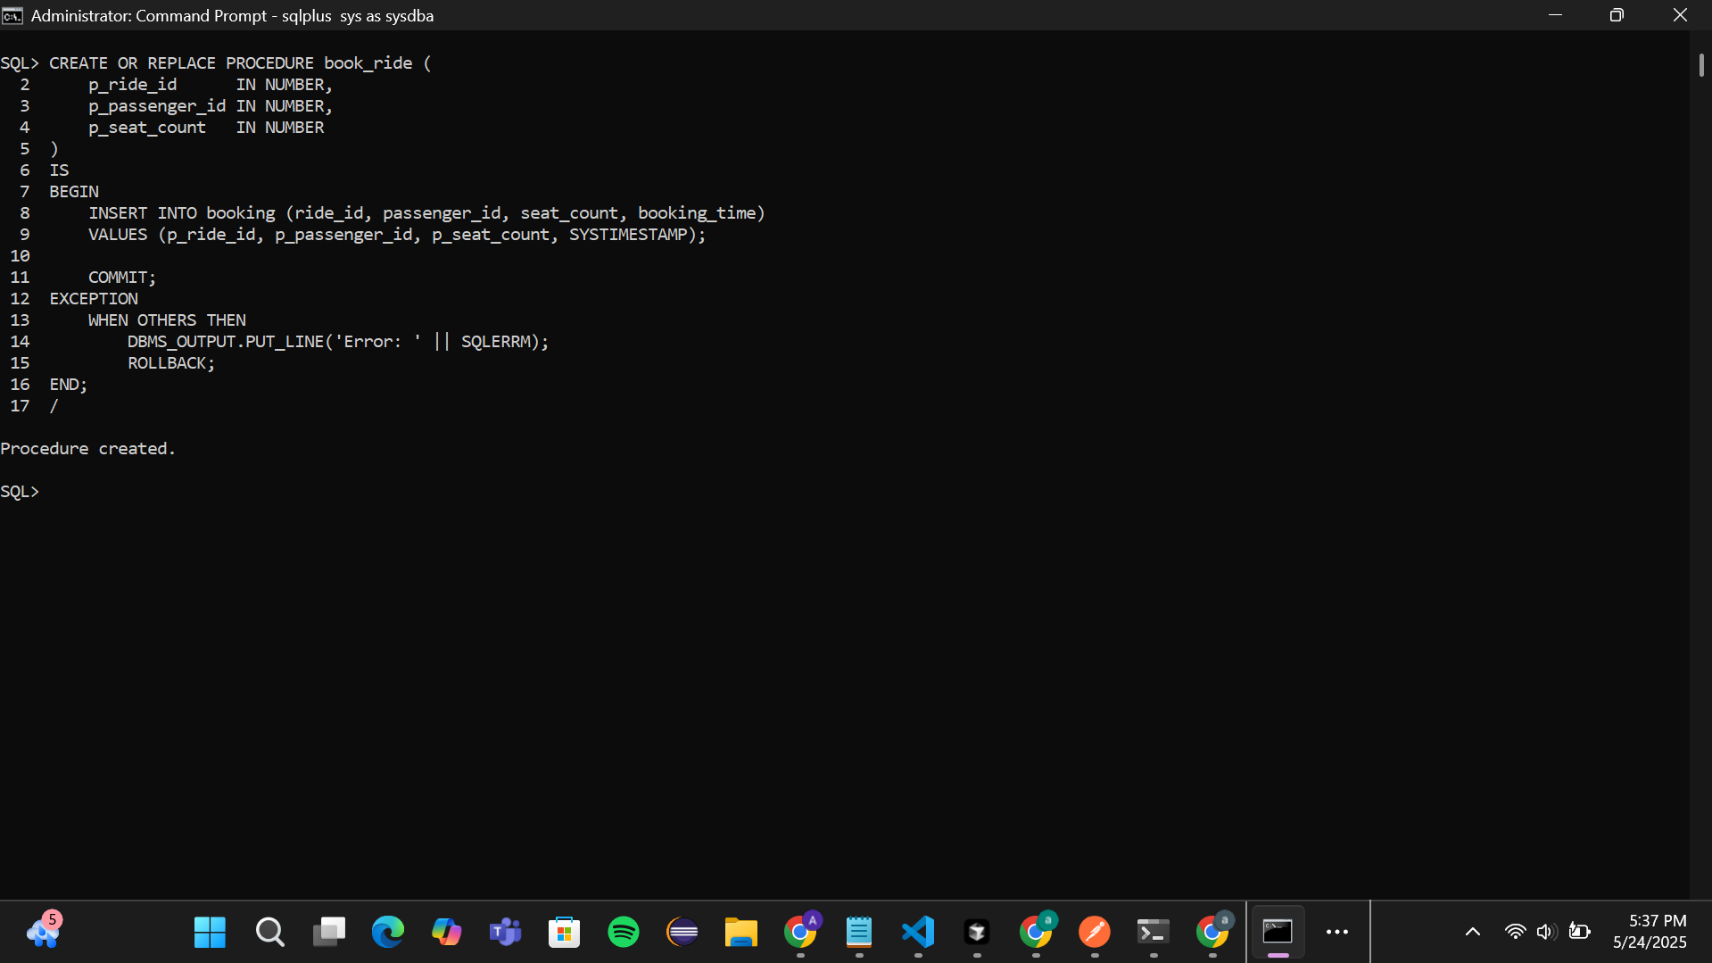
Procedure

Slide 8
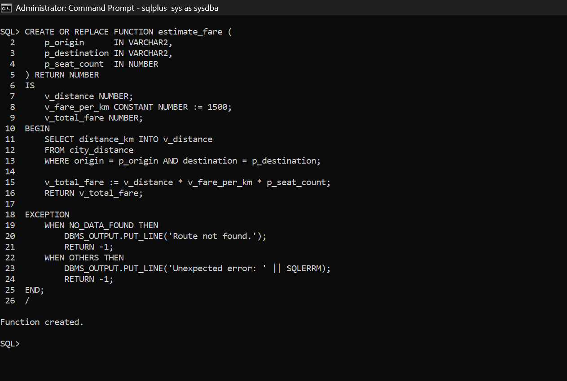
Function

Slide 9
Results and Achievement
Successfully implemented a PL/SQL-based ride-sharing database system
Enabled key features: user registration, ride creation, seat booking, and payments
Automated Price estimation using distance and seat count
Enforced business rules with triggers to block bookings on weekdays and holidays
Logged user actions for accountability through an audit trail

