Slide 1
Principle Component Analysis
Chih-Sheng Huang

Slide 2
Principle Component Analysis
Principle Component Analysis (PCA) is a statistical approach to convert a set of observations of possibly correlated variables into a set of values of linear uncorrelated variables.
The aim of PCA is to find the orthogonal linear transformation matrix to transfer the data to new coordinate system that the first coordinate (first PC) has the largest variance, the second coordinate has the second largest variance, and so on.

Slide 3
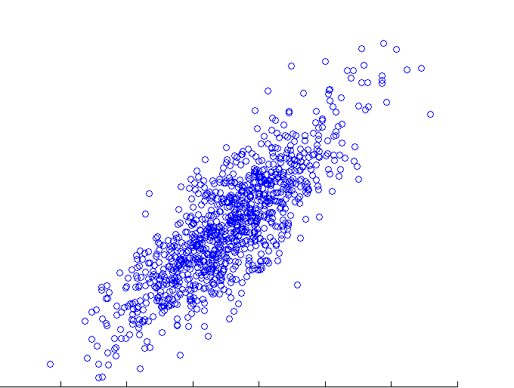
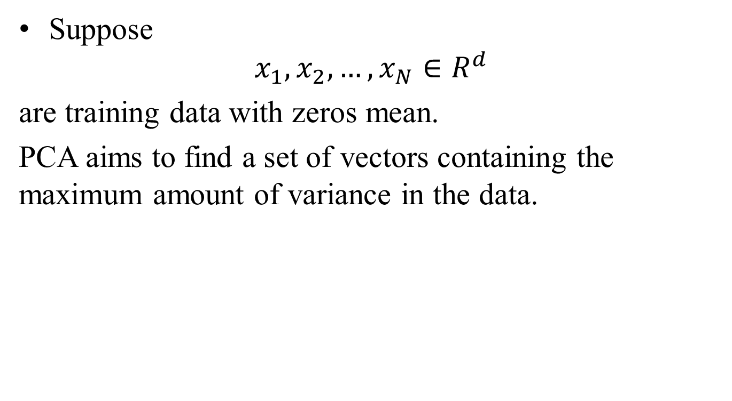
Principle Component Analysis
Suppose
$$x_{1},x_{2},…,x_{N}∈R^{d}$$
are training data with zeros mean.
PCA aims to find a set of vectors containing the maximum amount of variance in the data.
?

Slide 4




Principle Component Analysis
$$x_{i}$$
$$v$$
$$θ$$
If $\left\|v\right\|$ is unit, then
Notes:
<x,v>>=0 if 0<=theta<pi/2
<x,v> <0 if pi/2<theta<=pi

Slide 5














Principle Component Analysis
$$x_{6}$$
$$x_{5}$$
$$x_{2}$$
$$x_{4}$$
$$v$$
$$x_{3}$$
$${v_{}^{T}x}_{6}$$
$${v_{}^{T}x}_{5}$$
$$x_{1}$$
$${v_{}^{T}x}_{4}$$
$$0$$
$${v_{}^{T}x}_{3}$$
$${v_{}^{T}x}_{2}$$
$${v_{}^{T}x}_{1}$$

Slide 6

Principle Component Analysis
$$\acute{v}$$
$$x_{6}$$
$$x_{5}$$
$$x_{2}$$
$$x_{4}$$
$$v$$
$$x_{3}$$
$$x_{1}$$
$$0$$

Slide 7
Principle Component Analysis
$$\acute{v}$$
$$x_{6}$$
$$x_{5}$$
$$x_{2}$$
$$x_{4}$$
$$v$$
$$x_{3}$$
$$x_{1}$$
small variance
$$0$$
Large variance

Slide 8

Principle Component Analysis
The projections of the all points $x_{i}$ into the direction $v$are
$$v^{T}x_{1},v^{T}x_{2},…,{v^{T}x}_{N}$$
The variance of the projections is
C covariance matrix

Slide 9
Principle Component Analysis
The first principal vector can be found by the following equation:

Slide 10
Principle Component Analysis
Lagrange function:

Slide 11
Principle Component Analysis
The first principal vector can be found by the following equation:
This is equivalent to find the largest eigenvalue of the following eigenvalue problem:

Slide 12
Principle Component Analysis
Eigenvalue vector is the corresponding variance vector.

Slide 13
Exercise
Generate one dataset (1000 samples for two class)
Plot the generated samples.
Apply PCA, plot the PC projection axis and the projected data.

Slide 14
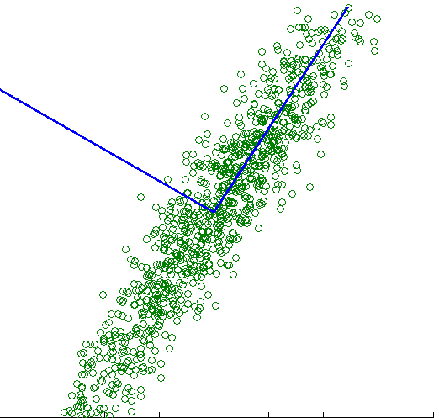
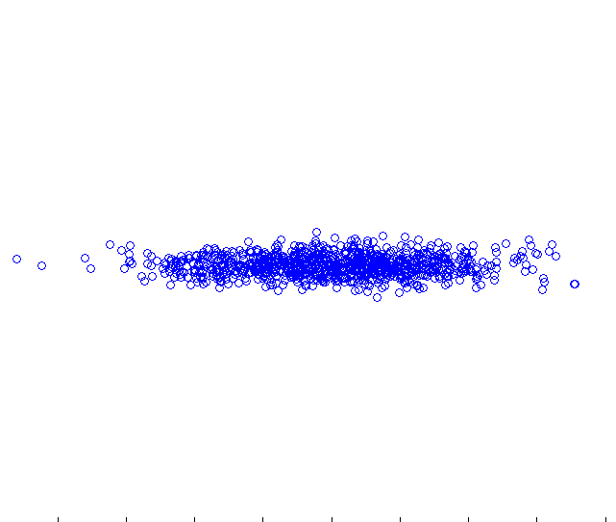
Exercise
Original feature space
PC space
x2
PC 2
x1
PC 1

