Slide 1
Correlations and Regression
Chih-Sheng Huang

Slide 2
什麼是相關性
兩個變數之間(或多變數)的關係?
線性or非線性
為了讓大家都能清楚理解，後續介紹皆以線性為主。
所以為探討兩個變數(或多變數)間是否存在直線關係: Correlation
並且將線性關係以方程式表示: Linear Regression
Notes:
Explore the relation between two variables.

Slide 3
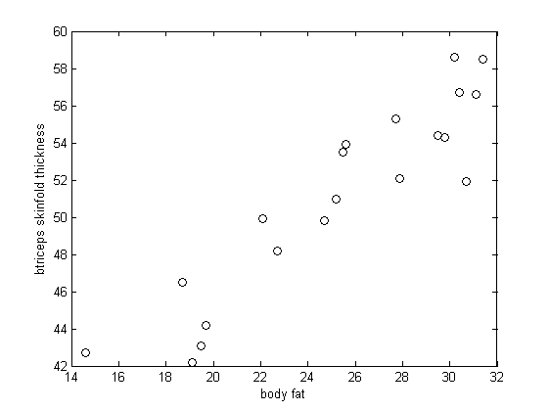
Example: 線性關係
Notes:
% http://calcnet.mth.cmich.edu/org/spss/Prj_body_fat_data.htm
% The data consists of 20 females whose age are between 25 and 30 years old.

Slide 4
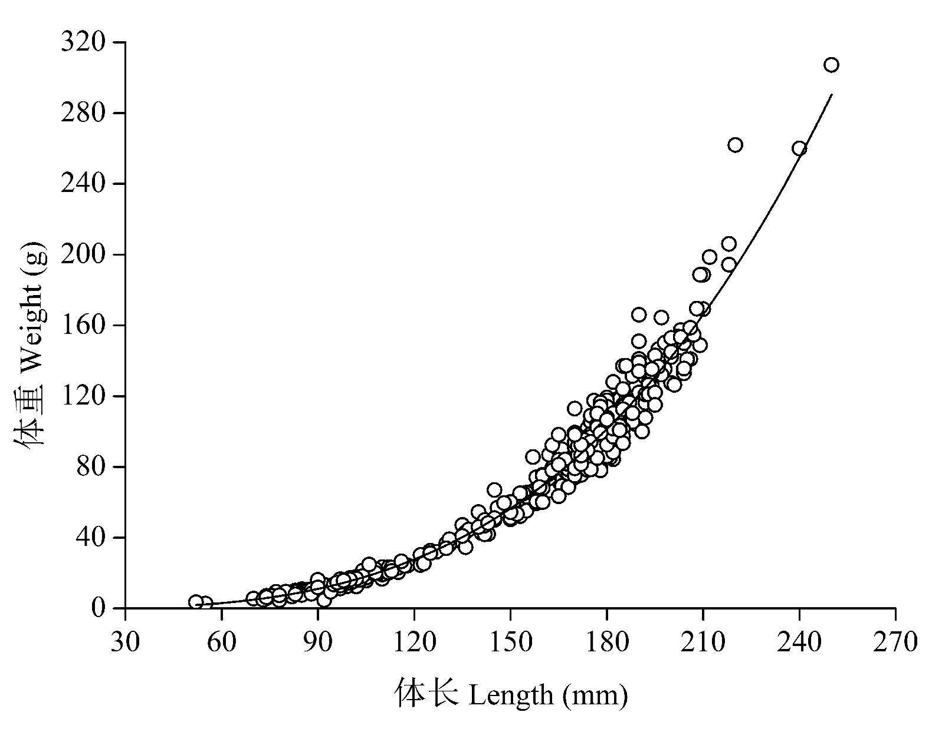
Example: 非線性關係
圖片來源:http://www.biodiversity-science.net/article/2016/1005-0094-24-3-304.html
Notes:
图3 长江上游长鳍吻鮈体长-体重关系Fig. 3 Length-weight relationship of Rhinogobio ventralis in the upper Yangtze River

Slide 5
The Relation between variables
Assumptions:
The pair of data is independent.
Normal distribution
Same variance
Linear relation between variables.

Slide 6
Pearson Correlation Coefficient
Suppose there are two variables (x_{i}, y_{i}), i=1,…,n , the correlation coefficient is defined as

Slide 7
Positive relation correlation
Negative relation correlation
y
y
x
x
Non-relation correlation
Non-linear relation
y
y
x
x

Slide 8
Hypothesis Test
Correlation Coefficient
H₀：ρ= 0 v.s. H_{a}：ρ≠ 0
顯著水準：α
檢定統計值：
If｜T｜>t _{α/2},_{n-2} Reject H₀

Slide 9
簡單直線回歸(Simple Linear Regression)
體脂肪期望值E(y)與三頭肌皮褶厚度(x)可以用直線關係描述
E(y_{i}) =β₀+β₁x_{i}，i=1, …,n
y_{i}：依變數(Dependent variable)
x_{i}：獨立(自)變數(Independent variable)
β₀：截距(Intercept) x=0時y的值
β₁：斜率(Slope) x變動一個單位y變動的量
但實際觀測值與直線E(y) =β₀+β₁x有差距
原因：環境、實驗誤差、量測誤差及其他原因
y_{i} =β₀+β₁x_{i} +ε_{i}，i=1, …,n
ε_{i}：誤差(Error)

Slide 10
簡單直線回歸(Simple Linear Regression)
y
y=β₀+βx
Error term
β₀
Slope = β
y-intercept
0
x
x₀

Slide 11
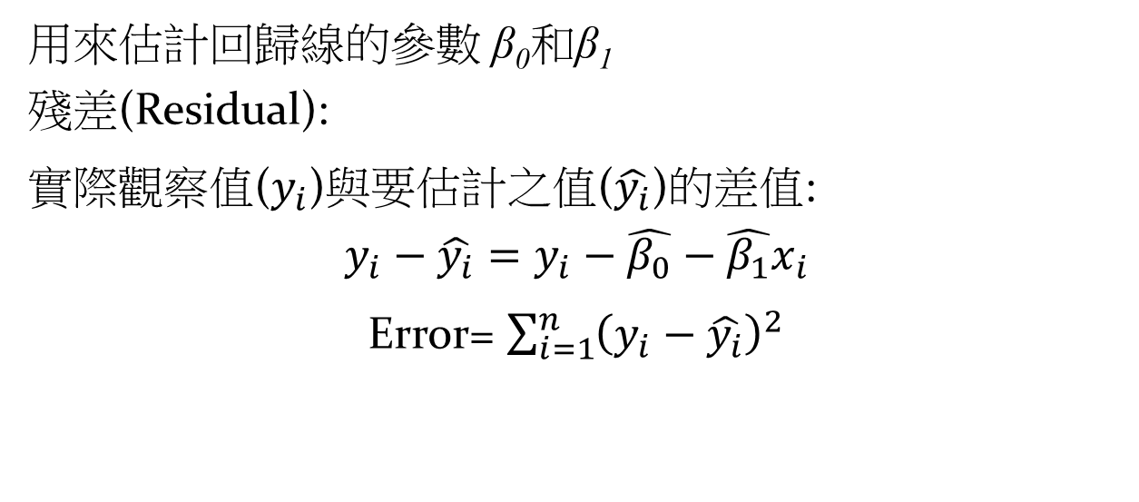
最小平方法(Least Squares Method)
用來估計回歸線的參數 β₀和β₁
殘差(Residual):
實際觀察值($y_{i}$)與要估計之值($\hat{y_{i}}$)的差值:
$$y_{i}−\hat{y_{i}}=y_{i}−\hat{β_{0}}−\hat{β_{1}}x_{i}$$
Error= $\sum_{i=1}^{n}{{\left(y_{i}−\hat{y_{i}}\right)}^{2}}$

