Slide 1
Fuzzy Logic
By Arseni Pertzovskiy

Slide 2
What is Fuzzy Logic System?
Generally, we want a method of reasoning, that resembles type of human reasoning. This involve all intermediate possibilities between discrete values YES and NO.
This model must be built so that it is capable of dealing with vague information.
Fuzzy logic-based systems do precisely that; they excel where systems are particularly complex and have been used successfully in many applications ranging from voice and handwriting recognition to subway train speed control. Fuzzy Logic System was invented by Lotfi Zadeh.

Slide 3
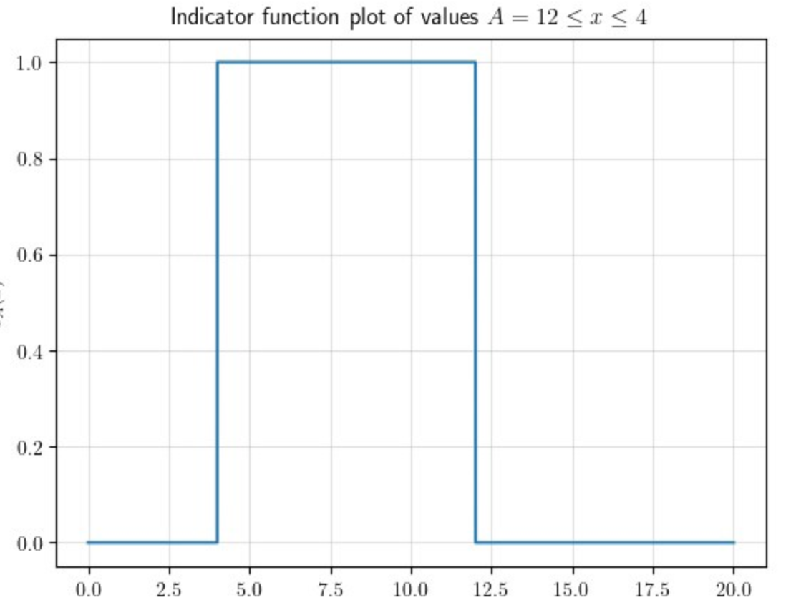
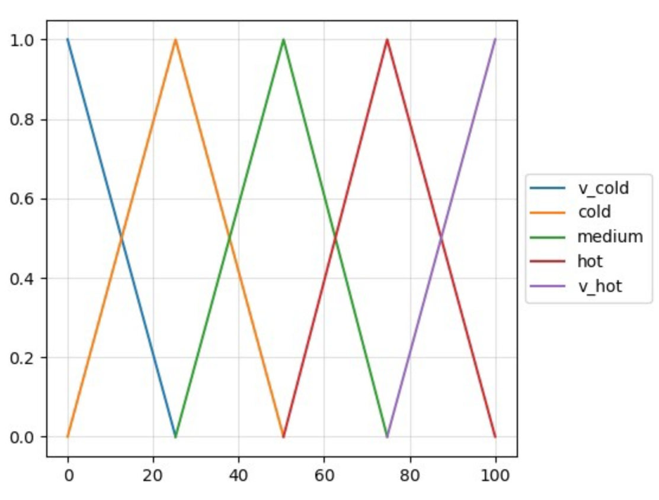

Crisp sets vs Fuzzy sets
Classical logic is based on the crisp set, where a group of distinct objects are considered as a collection.
Unlike crisp sets, a fuzzy set allows partial belonging to a set, that is defined by a degree of membership, denoted by µ, that can take any value from 0 (element does not belong at all in the set) to 1 (element belongs fully to the set).
$$T=\{cold, not cold\}$$
$$T=\{very cold, cold, medium, hot, very hot\}$$

Slide 4
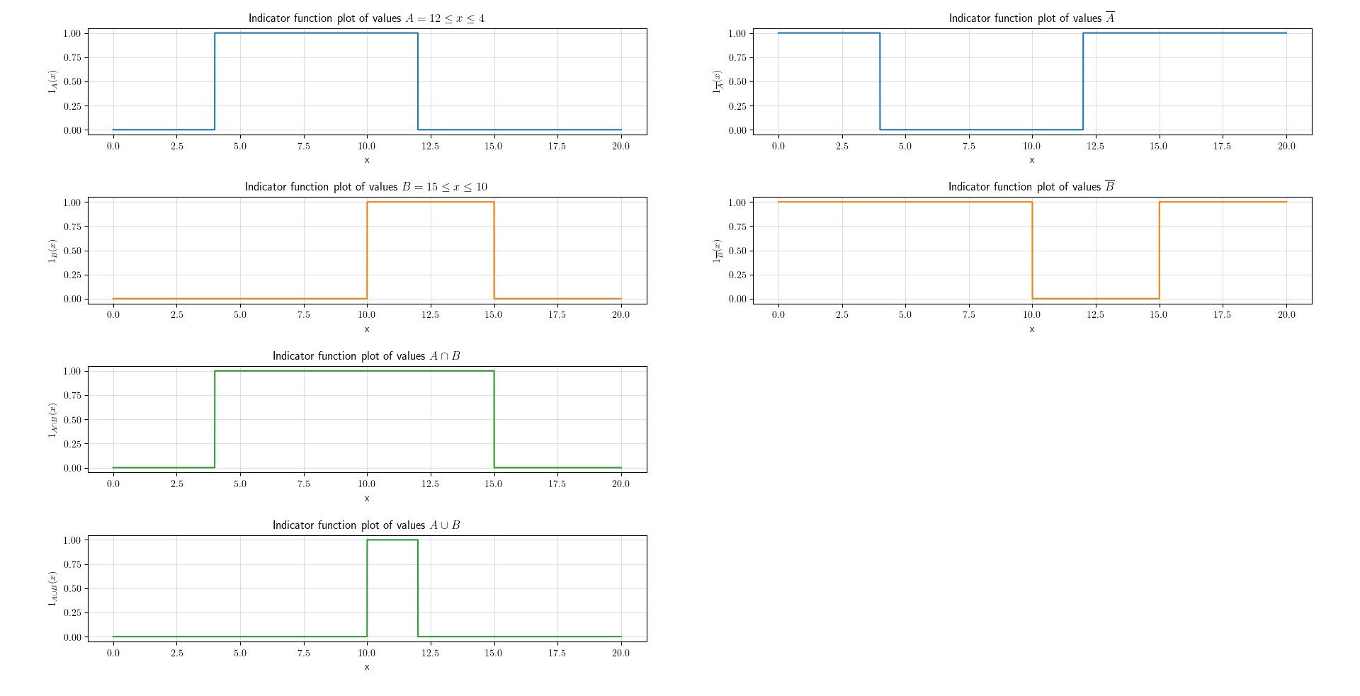
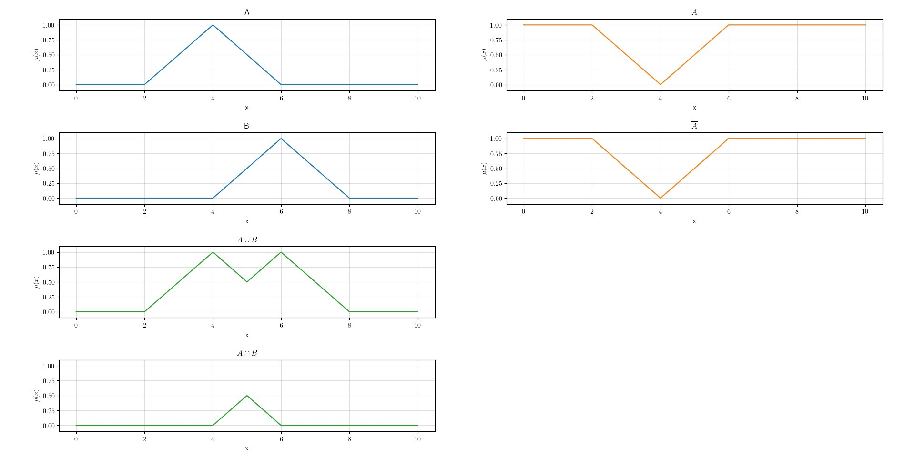
Logic operations Crisp sets vs Fuzzy sets

Slide 5
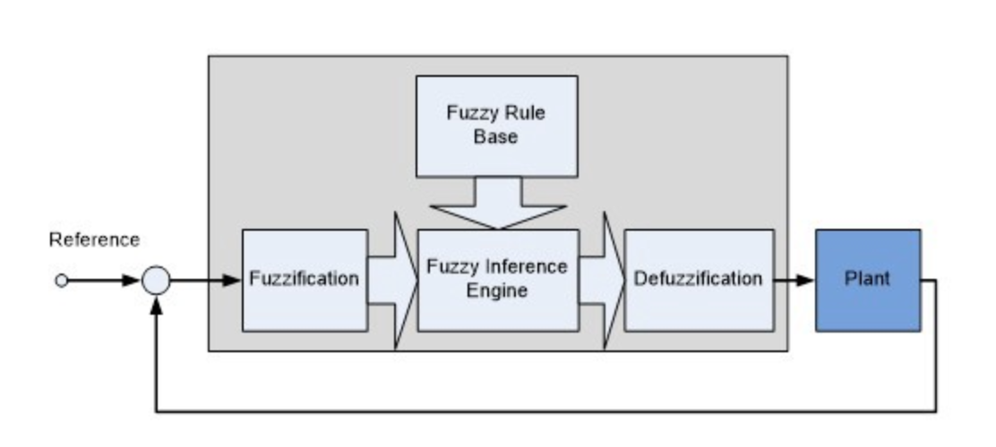
The Basic Configuration of a Fuzzy System
CRISP INPUT
CRISP OUTPUT

Slide 6
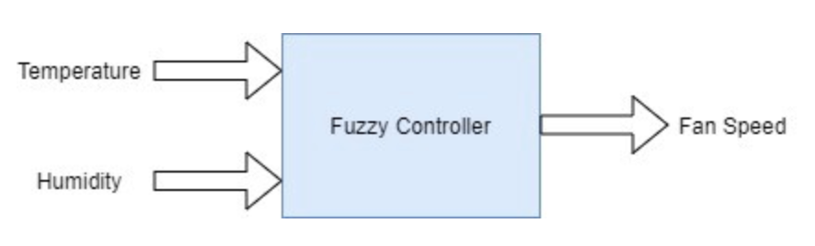
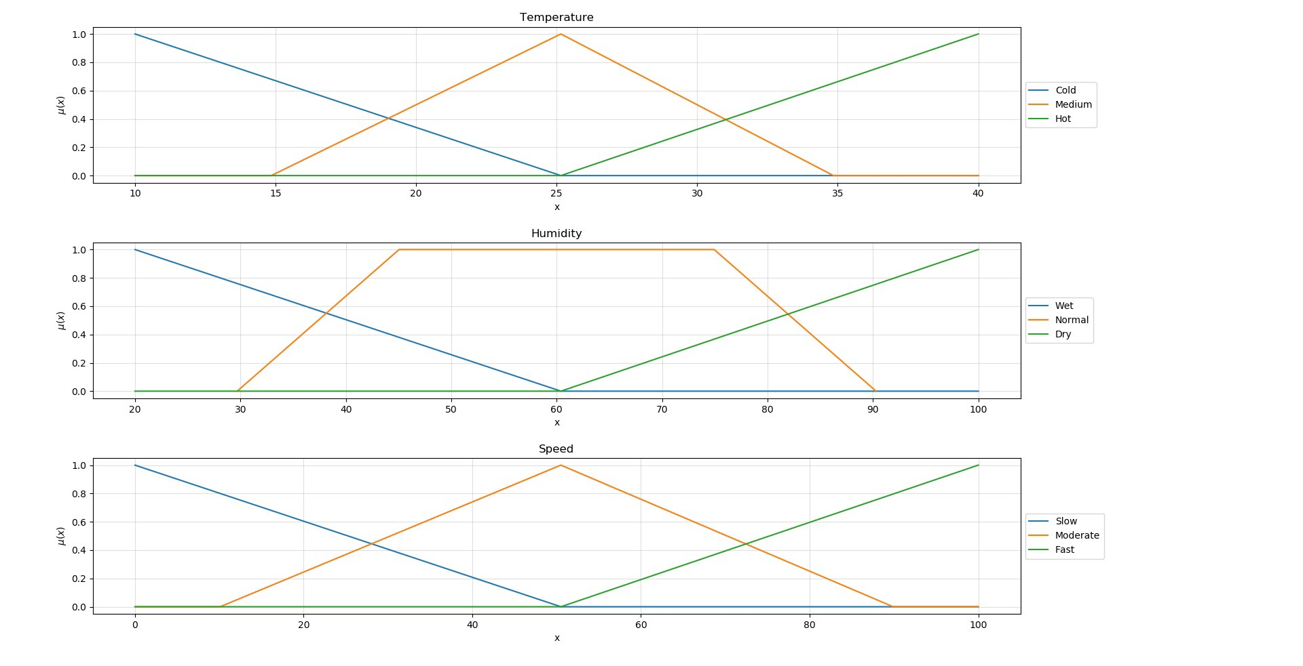
Simple Example

Slide 7
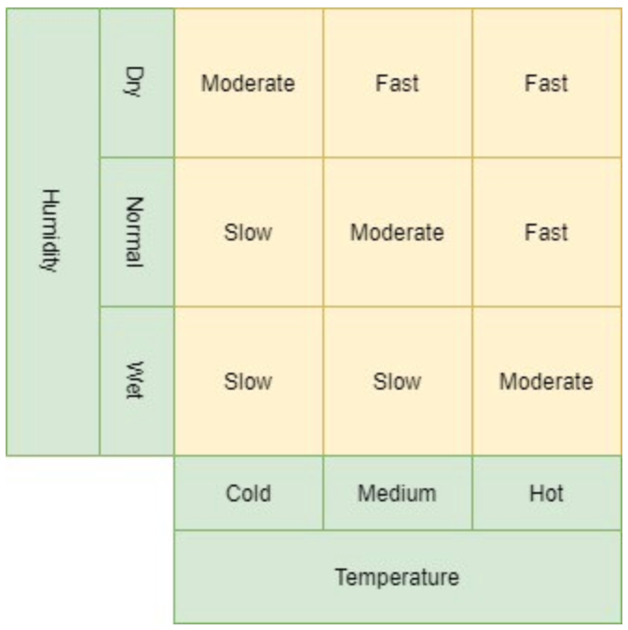
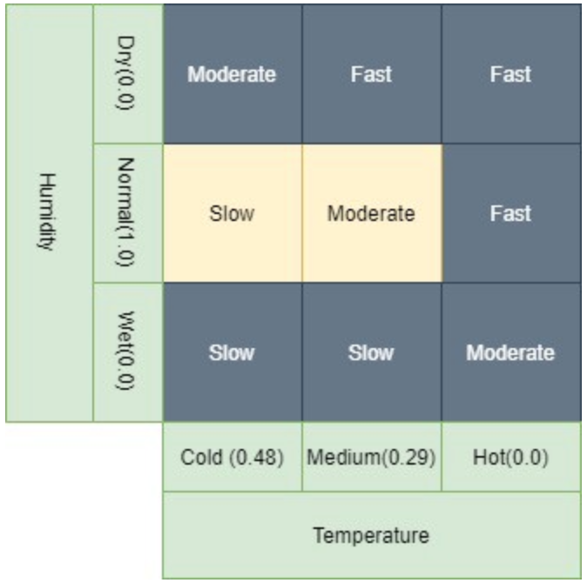
INPUT: temperature of 18 degrees and humidity of 60%
A temperature of 18 degrees is:
0.48 Cold 0.29 Medium 0.00 Hot
And humidity of 60% is:
0.0 Wet 1.0 Normal 0.0 Dry

Slide 8
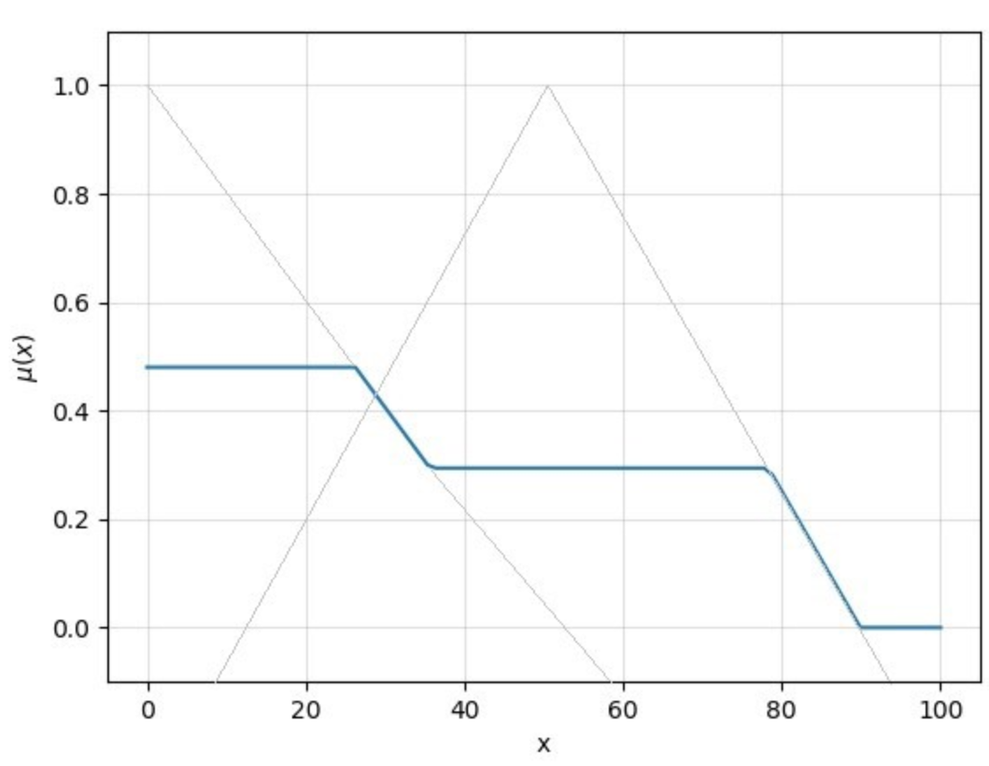


Fuzzy Output
Slow
Moderate
The output set is finally defuzzified using centre-of-gravity defuzzification and a crisp value of 36.814 is obtained to drive the fan.

Slide 9
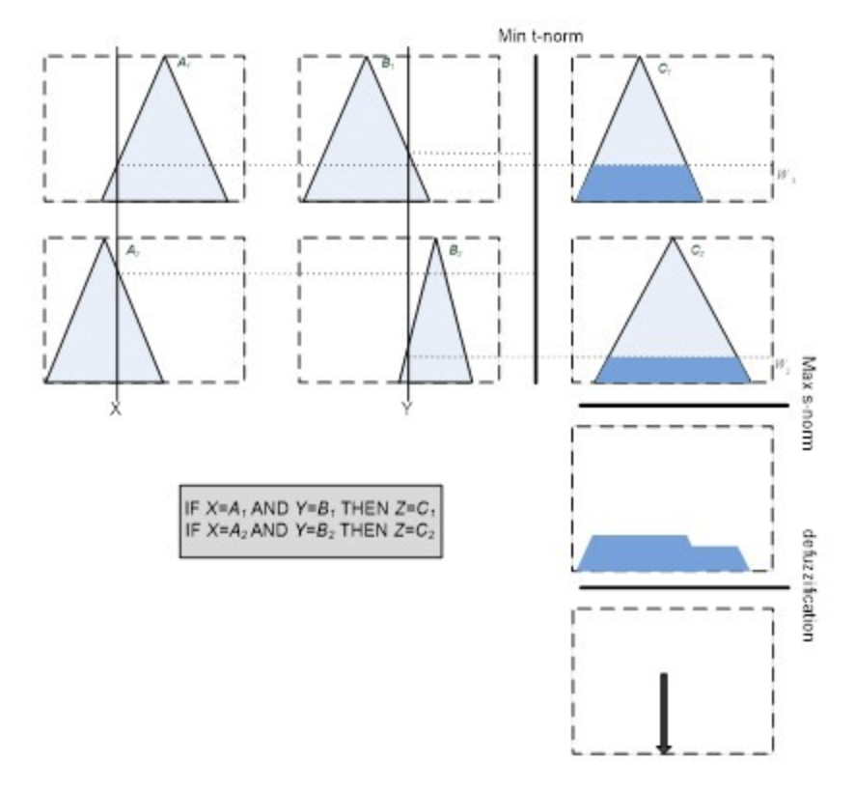
A Graphical Representation of This Process
Medium
Wet
Slow
Cold
Normal
Medium
Temperature
Humidity

Slide 10

Advantages
Generally, in this system, we can take imprecise, distorted, noisy input information
These logics are easy to construct and understand
Due to the flexibility of fuzzy logic, we can add and delete rules in the FLS system
Suitable to problems which do not have high accuracy.

Slide 11
Links to sources
https://www.youtube.com/watch?v=TReelsVxWxg&t=3s
https://towardsdatascience.com/a-very-brief-introduction-to-fuzzy-logic-and-fuzzy-systems-d68d14b3a3b8
https://medium.com/simplex-internet-blog/introduction-to-fuzzy-logic-3664c610d98c
https://medium.com/verifyas/fuzzy-logic-explained-67c075c2b228
https://www.massey.ac.nz/~nhreyes/MASSEY/159741/Lectures/Lec2012-3-159741-FuzzyLogic-v.2.pdf

