Slide 1

Reactive programming
Reactive programming is programming with asynchronous data streams
Rx is a library for composing asynchronous and event based programs using observable collections.
Rx uses LINQ query on the observable collections.
"Rx = Observables + LINQ + Schedulers"

Slide 2
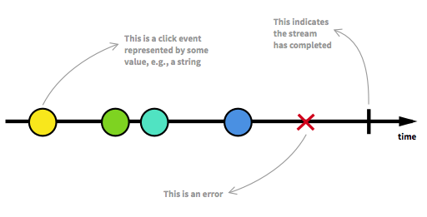
Stream
Stream is a sequence of ongoing events ordered in time. It can emit three different things:
value (of some type)
an error
"completed" signal

Slide 3
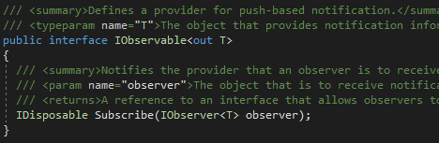
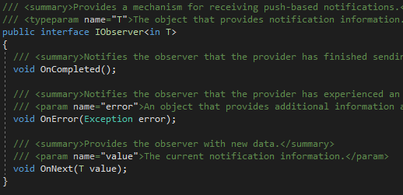
IEnumerables are one of the most widely used Pull Based collection which is synchronous in nature. And let us suppose due to any reason, your datasource went down for some time, then what will happen? It will keep waiting until database comes online. However, you can convert the same Pull based interface to Push based interface.
Rx have the concept of forward streaming (push), disposing (closing) and completing (eof).
You should be able to think of anything that implements IObservable<T> as a streaming sequence of T objects.
So if a method returned an IObservable<Price> I could think of it as a stream of Prices. IObservable<T> is meant to be the
"functional dual of IEnumerable<T>".
Subscribe() – subscribe observer to receive notifications.
OnNext() – An Observable calls this method whenever the Observable emits an item. This method takes as a parameter the item emitted by the Observable.
OnError() - An Observable calls this method to indicate that it has failed to generate the expected data or has encountered some other error.
It will not make further calls to OnNext() or OnCompleted(). This method takes as its parameter an indication of what caused the error.
OnCompleted() - An Observable calls this method after it has called OnNext() for the final time, if it has not encountered any errors.

Slide 4
Observable: Observable are nothing but the data streams. Observable packs the data that can be passed around from one thread to another thread. They basically emit the data periodically or only once in their life cycle based on their configurations.
Observers: Observers consumes the data stream emitted by the observable. Observers subscribe to the observable using Subscribe()method to receive the data emitted by the observable. Whenever the observable emits the data all the registered observer receives the data in OnNext() callback. Here they can perform various operations like parsing the JSON response or updating the UI. If there is an error thrown from observable, the observer will receive it in OnError().
Schedulers: Remember that Rx is for asynchronous programming and we need a thread management. There is where schedules come into the picture. Schedulers are the component in Rx that tells observable and observers, on which thread they should run. You can use ObserveOn()method to tell observers, on which thread you should observe.

Slide 5
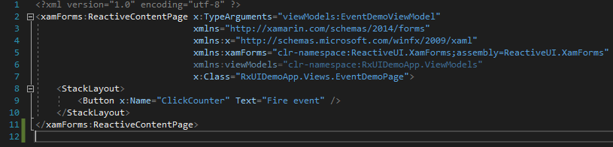
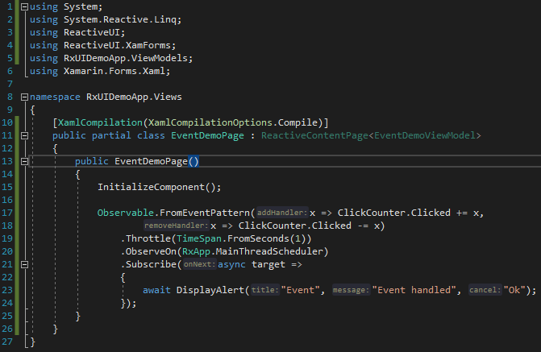
Stream
Step-1 Create observable that emits the data
Step -2 Create observer that consumes data
Step-3 Manage concurrency
You are able to create data streams of anything
A stream can be used as an input to another one.
You can merge/map/filter streams

Slide 6
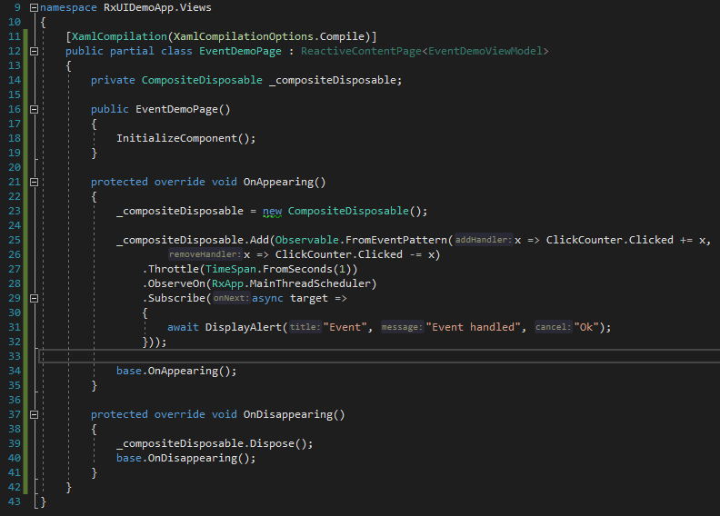
Managing subscription
Rx Api provide CompositeDisposable class which can store subscriptions. Subscribe() returns IDisposable.
Managing subscriptions
Rx Api provide CompositeDisposable class which can store subscriptions.

Slide 7

ReactiveUI in Xamarin Forms
- MVVM framework
ReactiveUI allows you to combine the MVVM pattern with Reactive Programming using such features, as WhenAny, ReactiveCommand, ObservableAsPropertyHelper, Binding and
WhenActivated.

Slide 8
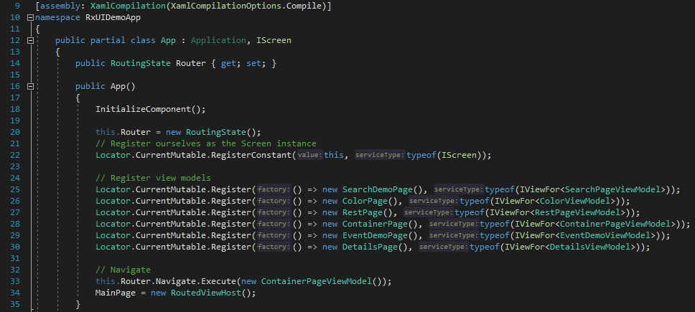
Install nuget packages in dotnet standard library:
ReactiveUI, ReactiveUI.Events.XamForms, ReactiveUI.XamForms
Setup App.xaml.cs:
IScreen: represents any object that is hosting its own routing
RoutingState: manages the ViewModel Stack and allows ViewModels to navigate to other ViewModels.
Locator: host the container for DI-based operations.

Slide 9
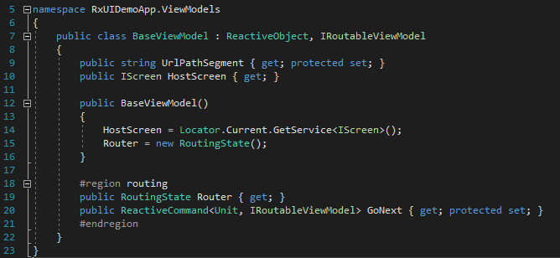
ViewModel
Should inherit ReactiveObject or IReactiveObject (implement INotifyPropertyChanged). In addition, ReactiveObject provides Changing and Changed Observables to monitor object changes.
To use Navigation ViewModel should inherit IRoutableViewModel.
UrlPathSegment – string token represents the current ViewModel
HostScreen – IScreen that this ViewModel is currently being shown in. This is usually passed into the ViewModel in the constructor and saved as a read-only property.

Slide 10

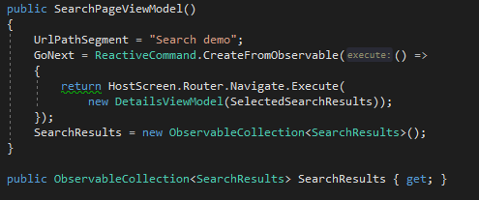
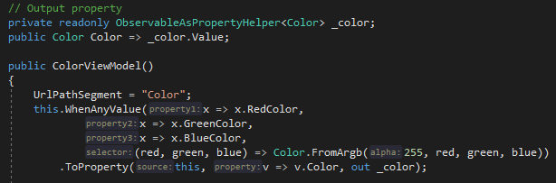
Read-write properties
Note, that unlike in other frameworks, properties are always written this way, using the exact same boilerplate code. If you are attempting to put anything in the setter, you are almost certainly Doing It Wrong, and instead should be using WhenAnyValue and ToProperty instead.
Read-only properties
Output properties
Properties that are only initialized in the constructor and don’t ever change, don’t need to be written via RaiseAndSetIfChanged, they can be declared as normal properties
Output properties are a way to take Observables and convert them into ViewModel Properties. We'll often use them with the opposite method, which turns ViewModel Properties into Observables, WhenAnyValue.

Slide 11
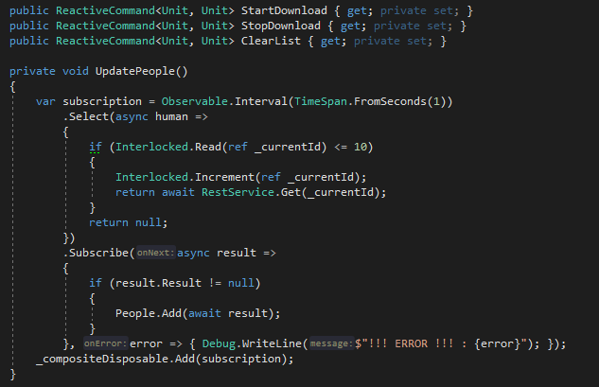
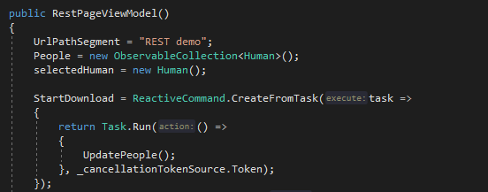
Commands
Creating commands:
CreateFromObservable() - Execute the logic using an IObservable.
CreateFromTask() - Execute a C# Task Parallel Library (TPL) Task. This allows use also of the C# async/await operators.
Create() - Execute a synchronous Func or Action.
CreateCombined() - Execute one or more commands.

Slide 12
Bindings
- Reactive command can be added to View by either using XAML binding supported platforms, or using the inbuilt ReactiveUI bindings method BindCommand.
- Always dispose bindings via WhenActivated or else bindings leak memory.
- Remember to place a call to WhenActivated to code-behind of the view, otherwise your view model’s WhenActivated block won’t get called.
Dispose your subscription
If you do WhenAny on anything other than this, you need to put it inside a WhenActivated block and add a call to DisposeWith
- Not all subscriptions need to be disposed. It's like events. If a component exposes an event and also subscribes to it itself, it doesn't need to unsubscribe. That's because the subscription is manifested as the component having a reference to itself. Same is true with Rx. If you're a VM and you e.g. WhenAnyValue against your own property, there's no need to clean that up because that is manifested as the VM having a reference to itself.

