Slide 1
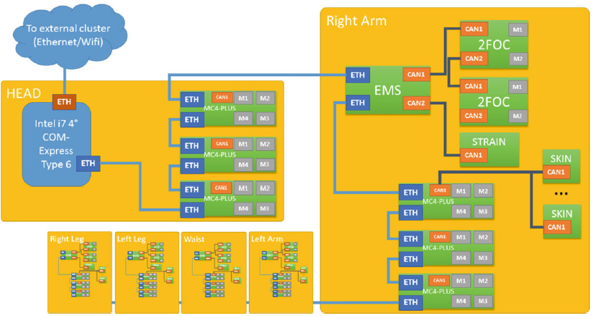
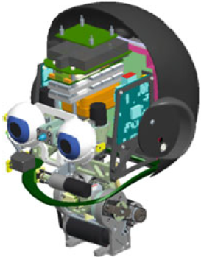
System HW
💻
💻
🖥
1 Gbps

Slide 2

System SW
💻
💻
🖥
commands
feedback
yarprobotinterface

Slide 3
Data Logging: Presently
log
yarpdatadumper
💻
💻
🖥
yarpdatadumper
log
.
.
.
yarpdatadumper
log
commands
feedback
yarprobotinterface

Slide 4
Time Sync
log
yarpdatadumper
🕒
🖥
💻
💻
🕒
🕒
yarpdatadumper
log
.
.
.
yarpdatadumper
log
sync via ntp
sync via DD broadcast
🕒
yarprobotinterface
DiagnosticDaemon
🕒
🕒
🕒
🕒
🕒

Slide 5
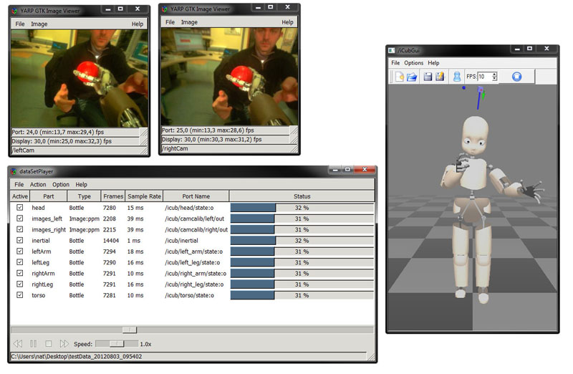
Data Replaying: Presently
yarpdataplayer

Slide 6
Data Logging: Present Downsides
Cumbersome (manual) handling of bank of yarpdatadumpers
Logging commands can be relevant, but it is currently problematic:
Unable to deal w/ RPC
No timestamp available
Many /command:o to single /command:i Multiple endpoints to attach to
No integrated solution (like webviz, openmct…)for aggregate visualization of: robot avatar, time plots, external sync-ed sources (e.g. video)

Slide 7
Full Telemetry System
A full telemetry system should allow for:
Choosing data to be streamed out: anything from anywhere
Configuring logging properties: rate, compression
Checking automatically bandwidth/logging-tables budget
CPU
Logging Table
Vars Indexes
configure
🔂
data stream

