Slide 1

app-logger: Component (C++ Library)
Startup configuration JSON
Internal Circular Buffer
App 1
API::write
Logger
Log File
Network
in the future
Thread
1
API::write
Thread
N
Thread
2
API::write
Similar components:
https://github.com/ADVRHumanoids/MatLogger2
https://github.com/gabime/spdlog

Slide 2
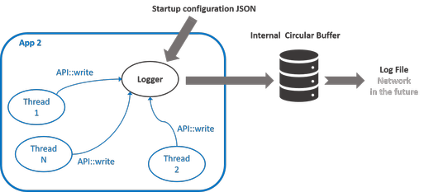
app-logger: Component (C++ Library)
Startup configuration JSON
Internal Circular Buffer
App 1
API::write
Logger
Log File
Network
in the future
Thread
1
API::write
Thread
N
Thread
2
API::write
Any App program
behaves similarly

Slide 3
API (TBD)
App1::configure() {
//…
logger->configure(“config.json”);
}
config.json shall contain:
Which ids to log
Each id w/ [compression, async, sync]
Size of file log
Writing modes:
Last # secs or # bytes
Everything
App1::Thread1::run() {
//…
logger->add(var11, std::hash<std::string>(“app1/thread1/var11”));
logger->add(var12, std::hash<std::string>(“app1/thread1/var12”));
}
Method add() logs content of vars + globally synced timestamp
Method add() always in codebase
Polymorphism to specialize add()
Log also YARP datatypes
Hash (?) to generate ids
API can be made more modern
Freedom to put add() anywhere
App1::Thread2::run() {
//…
logger->add(var21, std::hash<std::string>(“app1/thread2/var21”));
logger->add(var22, std::hash<std::string>(“app1/thread2/var22”));
}

Slide 4
Log File Structure (TBD)
MATIO compatibility (w/ nice C++ wrapper like in: https://github.com/dic-iit/matio-cpp)
Initial header to define the payload
…

