Slide 1
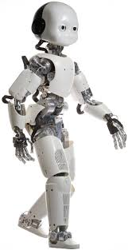

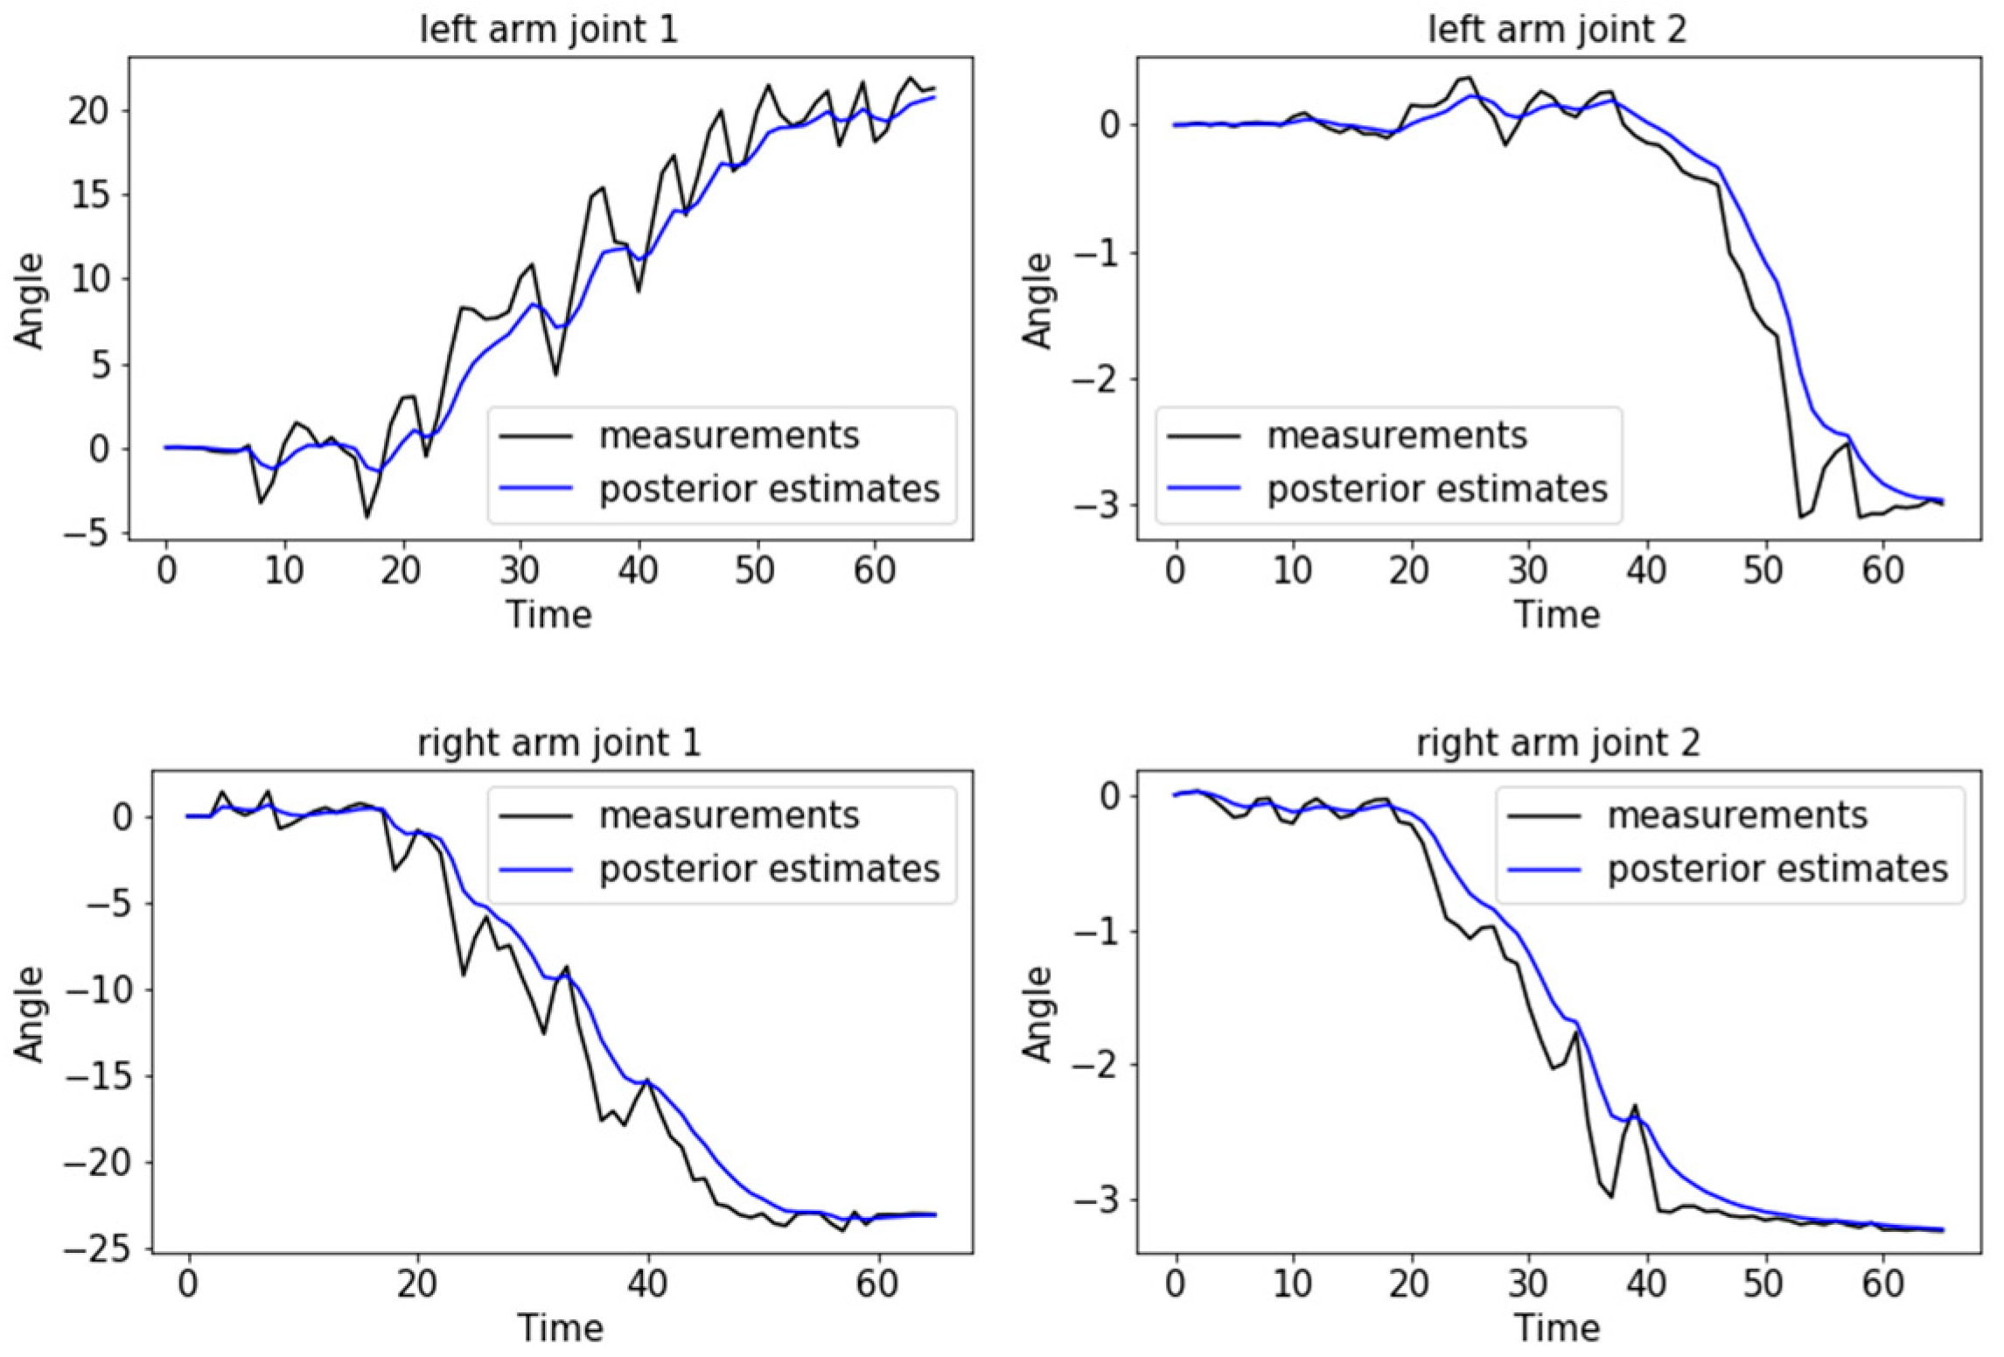
During the experiment…
Logs the data
Saves all data to .mat files
After the experiment…
We can load the .mat files and analyze the experiment;
If there was an error, we can check through the logs to find out what caused it;

