Slide 1
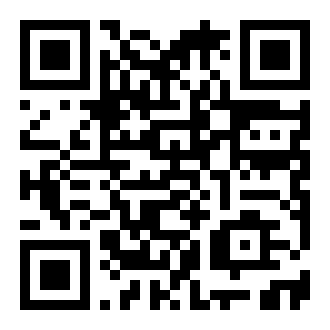
CANARY
Do companies committing accounting fraud
write their annual reports differently?
A pre-registered novelty study on SEC 10-K filings.
Trained: five small autoencoders in PyTorch, one per fraud case (each tested against industry peers).
Reused: MiniLM, a pretrained sentence encoder. Used as-is, no fine-tuning.
Tested: six historical accounting frauds; methodology locked in git before any number was looked at.
Arsenii Chan · CSC 44800 Artificial Intelligence · Spring 2026 · CCNY
scan to try
Notes:
I'm Arsenii Chan. The question I built this project around is simple. Do companies committing accounting fraud write their annual reports differently from honest companies? And can a machine learning model spot the difference? Six famous fraud cases. One test. Let me show you what came back.

Slide 2
THE DRIVING QUESTION
"
If an autoencoder trains only on clean annual reports from the same industry and year, will it rank known fraud filings as more unusual than its peers?
The one-line answer this report defends:
At N = 6 frauds, with strict pre-registration: no useful autoencoder signal in four of five test cases; Enron couldn't be evaluated under the frozen rule; the one case the autoencoder did rank highly (Lehman) is n = 1, and a 1990s TF-IDF baseline beats the autoencoder there.
Canary · Arsenii Chan · CSC 44800
2 / 7
Notes:
Six historical fraud cases: Enron, WorldCom, Tyco, HealthSouth, Valeant, Lehman Brothers. Each one turned out to be misrepresenting its finances at the time it filed this report. The SEC or class-action lawsuits exposed them years later. Each cost investors over a billion dollars. I paired each fraud filing against companies in the same industry, same year, that were clean. The model never sees the word 'fraud' during training. It just reads the long prose section of each annual report, where management explains the year in their own words, and learns what 'normal' looks like, industry by industry. Then it ranks the unusual filings against their peers. The formal question is on the slide. The plain-English answer is right below it. I'll spend the rest of the talk on the evidence.

Slide 3
THE METHODOLOGICAL CONTRACT
The contract is the contribution.
git-tagged validation-spec-frozen, committed before any validation script ran.
Out-of-sample, always
Time-controlled training
Single pass, no tuning
Leave-one-cohort-out (LOCO): for each held-out fraud, the autoencoder is trained on clean filings from other cohorts only. The fraud and its peers are never in the training set.
Within the LOCO training set, only filings dated on or before that fraud's filing date are eligible. The autoencoder's training corpus cannot include post-fraud disclosure language. (The MiniLM encoder isn't time-controlled.)
Architecture, hyperparameters, sentence cap, seeds: all committed and tagged before validation ran. scripts/06_validate.py runs once. No model tuning after validation.
Whatever the test produces, the contract makes the result interpretable.
git tag: validation-spec-frozen
at 98d2585 · 2026-05-01 13:42:42 EDT
Canary · Arsenii Chan · CSC 44800
3 / 7
Notes:
Before I show you any number, I want to walk through the methodology. It's what makes the result mean anything. Three rules I locked in before I ran the test. One: the model never sees a fraud during training. For each fraud case, the model trains only on clean filings from other cases. The fraud I'm testing is held out. Two: the model never sees the future. Within that training set, only filings dated on or before the fraud's filing date are allowed. The model can't pick up language that came out after the fraud was discovered. Three: single pass, no tuning. The architecture, the hyperparameters, the test set: all of that was written down and locked into the repo before the test ran. Top right shows the actual lock. Committed and tagged on May 1st, before any result came in. Test ran once. Whatever it said, that's the result.

Slide 4
RESULTS · 5 OF 6 COHORTS · ENRON EXCLUDED BY THE RULE
Only Lehman ranks better than random expectation; even there, a 1990s baseline beats the autoencoder.
Cohort | Rank | Note
Lehman (LEH, FY 2007) ⚠ | 3 / 13 | n = 1, baseline beats autoencoder
HealthSouth (HRC) | 7 / 12 | at or below random
Valeant (VRX) | 8 / 13 | at or below random
Tyco (TYC) | 9 / 13 | at or below random
WorldCom (WCOM) | 12 / 13 | at or below random
Enron (ENE, FY 2000) | — | not evaluable: filed earliest, no eligible training data
Aggregate hit-rates
hit@1: 0.00 vs random 0.08 hit@3: 0.20 vs random 0.23 hit@5: 0.20 vs random 0.39
⚠ Lehman is the only rank better than random expectation, and a 1990s baseline beats the autoencoder there too (slide 5). The aggregate is entirely Lehman.
Canary · Arsenii Chan · CSC 44800
4 / 7
Notes:
Here's what came back. Five cases I could test, one excluded. I'll come back to the excluded one. Only Lehman, the investment bank whose collapse triggered the 2008 financial crisis, lands in the top three within its peer group. Three out of thirteen. The statistical test is highly significant, but the effect size is small. Both numbers matter. Reporting either one alone would be misleading. And as you'll see on the next slide, even on Lehman, a 1990s baseline beats my model. The other four (HealthSouth, Valeant, Tyco, WorldCom) all rank no better than random. The test actually goes in the opposite direction from what we'd want. Overall my hit rates are at or below random. Now, Enron. Enron's filing date is April 2nd, 2001. Every other peer in every other case was dated later. Under the strict rule I locked in, there's no clean filing Enron could have trained on. So I had a choice. Relax the rule and rerun, or report the exclusion. I reported the exclusion. The pre-registered design was infeasible for Enron, and I didn't catch that before I locked the spec. That's a finding about pre-registration, not about fraud detection.

Slide 5
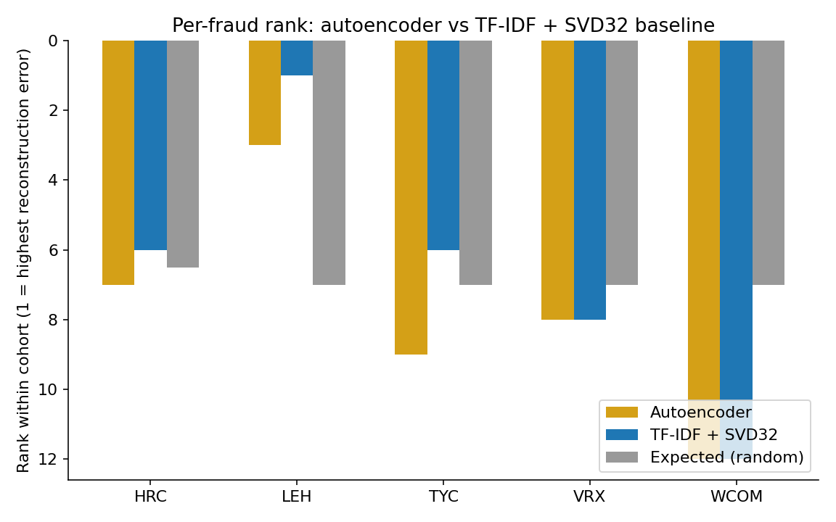
THE BASELINE CHECK · TF-IDF + SVD32 (POST-HOC)
A 1990s baseline matched or beat the autoencoder on every cohort.
Post-hoc: tests whether the autoencoder earned its complexity, does not rescue the primary result.
How to read the chart: shorter bar = lower rank number = better detection (rank 1 is most anomalous). Lehman: autoencoder rank 3/13, TF-IDF rank 1/13. Aggregate hit@5 is 0.40 (TF-IDF) vs 0.20 (autoencoder). The pre-registered model does not beat the trivial baseline.
Canary · Arsenii Chan · CSC 44800
5 / 7
Notes:
Now the part I think actually matters. After the test ran, I asked myself the question every machine-learning paper should answer and most don't. Would a method from before I was born produce the same result? So I ran one. A simple word-counting method. The kind of thing you could have written in 1995 from a textbook. Same training data, same statistical tests, same pipeline shape. No neural network. No transformer. On four of five cases, the 1995 method ties the modern one. And on Lehman, the one case the modern method got, the 1995 method gets it better. The statistical test is way more confident. Let me say what I'm not saying, and then what I am saying. I am not saying the modern method is broken, or that neural networks are useless for this kind of problem. I am saying that on these five cases, with the rules I locked in, the modern method did not beat a method I could have run in 1995. If you take one thing from this talk, this is it. A sharp baseline isn't optional. A result that loses to a baseline isn't evidence for the neural model.

Slide 6
QUESTIONS I EXPECT
Q
Did you check a trivial baseline?
Yes. TF-IDF + truncated-SVD, same bottleneck dimension, same training corpora. It matches or beats the autoencoder on every cohort. The honest claim is that the autoencoder adds nothing here. Slide 5.
Q
The baseline is post-hoc. Isn't that HARKing (hypothesizing after results)?
The pre-registered hypothesis was about the autoencoder, and the autoencoder result is reported unchanged. The TF-IDF baseline was added after seeing the null and is reported as post-hoc. The primary null does not depend on it.
Q
Could MiniLM have memorized 'Lehman' / 'Repo 105' / etc.?
Tested post-hoc. Masked 93 such mentions with [ENTITY] and re-scored. Lehman's rank held at 3/13 (delta = 0). Exact-token name leakage did not explain the rank; topical leakage remains open.
Canary · Arsenii Chan · CSC 44800
6 / 7
Notes:
Three questions I expect, with quick answers so we have time for whatever else you actually want to ask. Did you check a trivial baseline? Yes. Same training data, same compression. The 1995 baseline matches or beats the modern method on every case. The honest claim is that the modern method adds nothing here. Slide 5. The baseline is post-hoc, isn't that HARKing? The pre-registered hypothesis was about the modern method, and I report that result unchanged. The 1995 baseline was added after seeing the null result, and I label it as post-hoc. The main result doesn't depend on the baseline. Could the embedding model have memorized 'Lehman' or 'Repo 105'? I tested that. I replaced 93 of those words in Lehman's filing with a placeholder and re-scored. Lehman's rank held at 3 out of 13. So the model isn't just spotting the word 'Lehman.'

Slide 7
CONCLUSION
What survived: pre-registration.
What failed: the autoencoder beyond the TF-IDF baseline.
A result that loses to a baseline is not evidence for the neural model. The contract held; the model did not.
What I'd do differently
Scan to try the pipeline
Confirm every held-out fraud is evaluable under the pre-registered rule BEFORE freezing the spec. Enron taught that the hard way.
Next experiment
Same autoencoder, but compare each company against its own past filings (not industry peers). Does Lehman's MD&A look anomalous against Lehman's own prior-year MD&A?
Pipeline demo (not a fraud scanner): canary-psi.vercel.app/scan
Code: github.com/ArseniiChan/canary · Tag: validation-spec-frozen
Thanks.
Notes:
Two takeaways and one next step. What survived: pre-registration. The contract held. I didn't tweak the model, I didn't redefine 'clean,' I didn't backtrack on the Enron exclusion when the result got uncomfortable. What failed: the modern method, beyond what the 1990s baseline already does. A result that loses to a baseline is not evidence for the neural model. What I'd do differently: make sure every held-out fraud actually has training data under the rule, before freezing the spec. Enron was unevaluable under my own rule, and I didn't catch it until validation ran. Next experiment: same model, same filings, but compare each company against itself across years, instead of against industry peers. That's the next step this study couldn't run. Try the pipeline at the link below. Paste any annual report and see how it scores against the five fraud cases. Code is on GitHub. The frozen-spec git tag is in the repo. Thanks. Happy to take questions.

