Slide 1


BoostARoota
A Fast Feature Selection Algorithm
Chase DeHan, PhD
Data Scientist
Progressive Leasing
San Francisco | November 2nd - 4th 2017
@ODSC

Slide 2
Executive Summary
Needed a better method for feature selection
There is Boruta, LASSO, PCA, etc
But, they don’t work well on boosted trees
So built my own in the spirit of Boruta
Results in:
A generalizable feature selection model with high performance

Slide 3
About Me
Chase DeHan
Current Data Scientist at Progressive Leasing
Former Finance Professor at University of South Carolina Upstate
PhD in Economics from University of Utah
Interests are in building automated machine learning systems

Slide 4
Progressive Leasing
My employer and sponsored this research.
Subsidiary of Aaron’s (NYSE:AAN, Mkt Cap ~2.6B)
Leader in virtual lease-to-own
Over 20,000 retail partners across US
Team of Data Scientists and Engineers:
Credit Risk Modeling
Collections Optimization
Sales Optimization

Slide 5
Motivation
Credit Risk Modeling
Working with high dimensions, needed a better process for reduction
Wanted a wrapper method specifically tuned towards XGBoost
Used other methods, but weren’t giving desired results

Slide 6


Slide 7
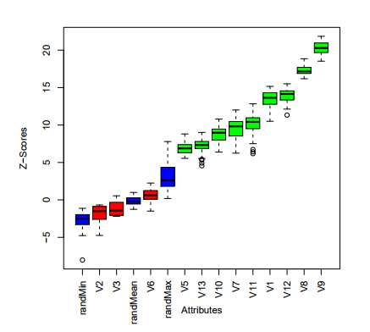
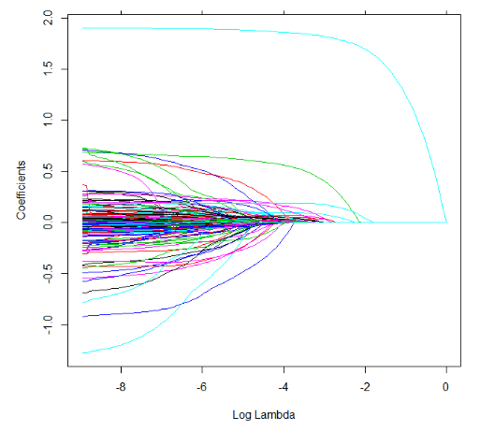
There are MANY Other Methods
But,
- most aren’t able to capture the non-linearities of boosted trees.
- or, run super slow
Popular methods include:
Boruta LASSO
Kursa and Rudnicki (2010)
Rickert (2013)

Slide 8
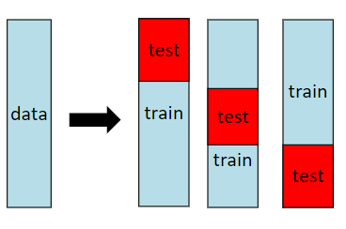


Common Approach to Feature Selection
Step 1:
Run Algorithm (Boruta) on 100% training data
Step 2:
Cross Validate on the reduced subset
Evaluate on the holdouts
Reduce Features

Slide 9
Common Approach to Feature Selection
But this is wrong!
Why?
Step 1:
Run Algorithm (Boruta) on 100% training data
Step 2:
Cross Validate on the
Reduce Features

Slide 10


Slide 11
Why can this overfit?
Reduce Features
Because the CV data was already seen in the feature selection process!

Slide 12
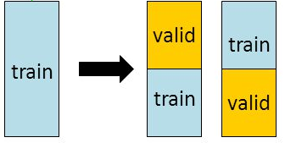
The Right Way – Nested Cross-Validation
Outer Loop
Inner Loop
Obtain parameters on Inner Loop
Then use those on the Outer Loop
The inner loop has no ability to snoop on the outer loop

Slide 13
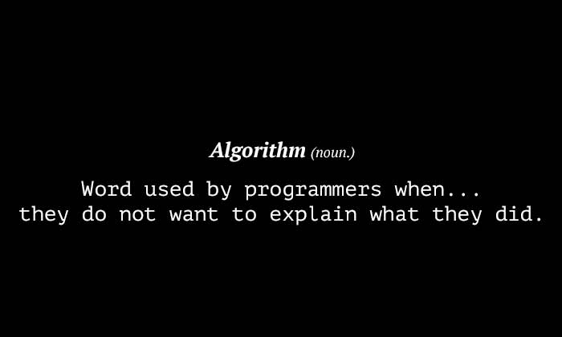

Slide 14
How the algorithm works
Double width of the data set, making a copy of all features in original dataset
Randomly shuffle the new features created in (1). These duplicated and shuffled features are referred to as "shadow features"
Run XGBoost classifier on the entire data set ten times. Running it ten times allows for random noise to be smoothed, resulting in more robust estimates of importance.
Obtain importance values for each feature. This is a simple importance metric that sums up how many times the particular feature was split on in the XGBoost algorithm.
Compute "cutoff": the average feature importance value for all shadow features and divide by four.
Remove features with average importance across the ten iterations that is less than the cutoff specified in (5)
Go back to (1) until the number of features removed is less than ten percent of the total.
Method returns the features remaining once completed.

Slide 15
OHE Dataframe
Shuffled “Shadow” Features
Var | Var_Imp
V1 | 0
V2 | 1.2
V3 | 12
Vn | 7
ID | V1 | V2 | V3 | .. | Vn
1 | 12 | 0.1 | 1 | .. | 0
2 | 68 | 0.2 | 0 | .. | 0
3 | 21 | 0.1 | 1 | .. | 1
.. | .. | .. | .. | .. | ..
N | 36 | 0.3 | 0 | .. | 1
S1 | S2 | S3 | .. | Sn
36 | 0.3 | 0 | .. | 1
68 | 0.2 | 0 | .. | 0
12 | 0.1 | 1 | .. | 0
.. | .. | .. | .. | ..
21 | 0.1 | 1 | .. | 1
Var_Imp > 0.5 ?
Remove V1
Combine into 1 DF
Var | Var_Imp
V2 | 1.2
V3 | 12
Vn | 7
ID | V1 | V2 | V3 | .. | Vn
1 | 12 | 0.1 | 1 | .. | 0
2 | 68 | 0.2 | 0 | .. | 0
3 | 21 | 0.1 | 1 | .. | 1
.. | .. | .. | .. | .. | ..
N | 36 | 0.3 | 0 | .. | 1
S1 | S2 | S3 | .. | Sn
36 | 0.3 | 0 | .. | 1
68 | 0.2 | 0 | .. | 0
12 | 0.1 | 1 | .. | 0
.. | .. | .. | .. | ..
21 | 0.1 | 1 | .. | 1
Run XGBoost
10 iterations
Did we remove 10%?
Var | Var_Imp
V1 | 0
V2 | 1.2
V3 | 12
Vn | 7
Var | Var_Imp
S1 | 5
S2 | 0
S3 | 0
Sn | 3
Yes
No
Average Imp / 4
8 / 4 / 4 = 0.5
Repeat
Return Variables
Set cutoff at 0.5
Keep if:
Var_Imp > cutoff

Slide 16


Slide 17
Results - Testing Methodology
5 fold CV, predicted on out of fold
Repeated 5 Times
Many different datasets (0/1 and regression)
1)Feature selection
2)Train Model
Aggregate cross validated predictions
Evaluate results
3)Score test set

Slide 18
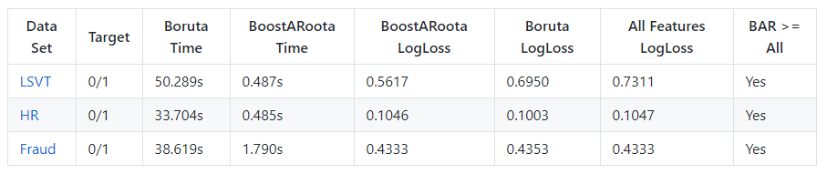
Results
Outperforms - All Features from original set
Faster than Boruta, and outperforms often

Slide 19

Installing BoostARoota
Yes, that is python only. The R package is in the works.

Slide 20
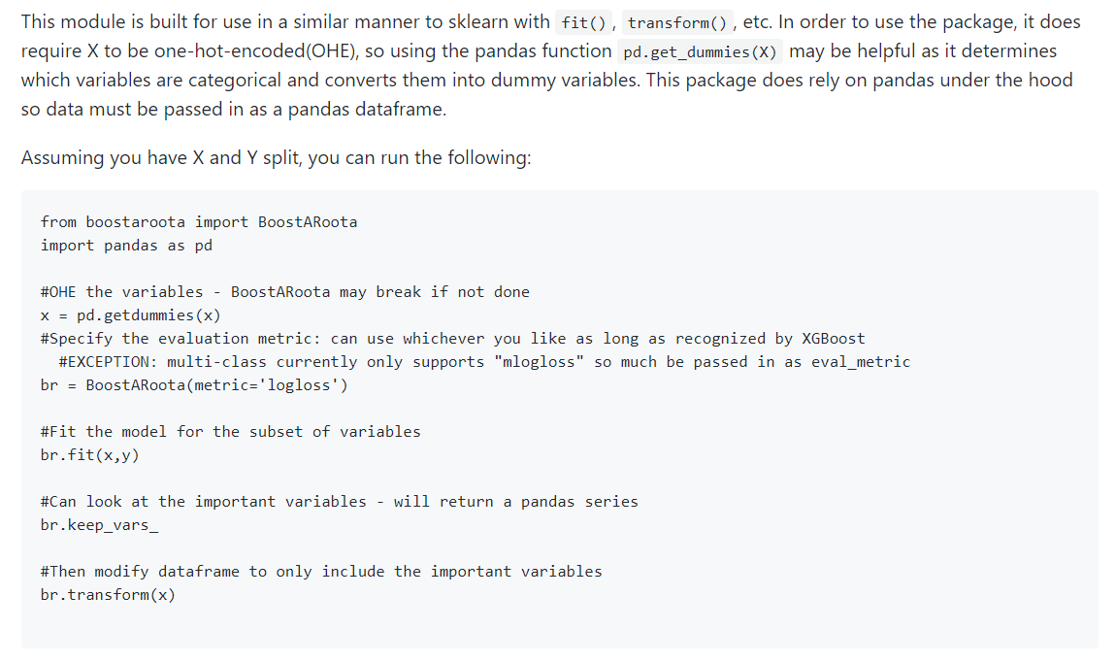
Using the Package

Slide 21
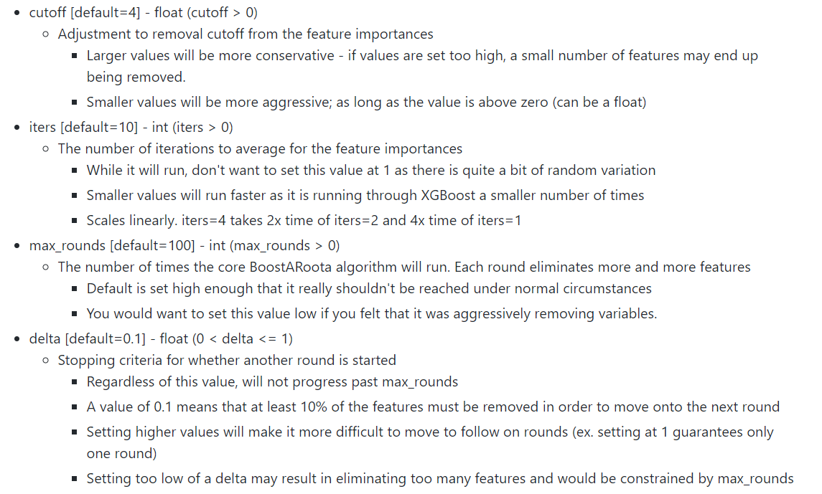
Tuning Parameters

Slide 22
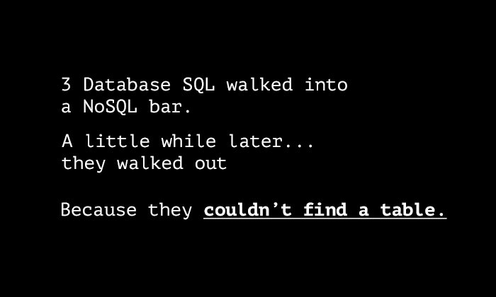
Show me the demo!

Slide 23
Steps in the future
What am I planning on adding in the future?
R package
XGBoost on GPU
XGBoost on Spark
Running other algorithms (i.e. LightGBM)

Slide 24
Thanks!
Use it and give me some feedback!
Star the project at: github.com/chasedehan/BoostARoota
Chase DeHan, PhD
chasedehan@yahoo.com
chase.dehan@progleasing.com

