Slide 1
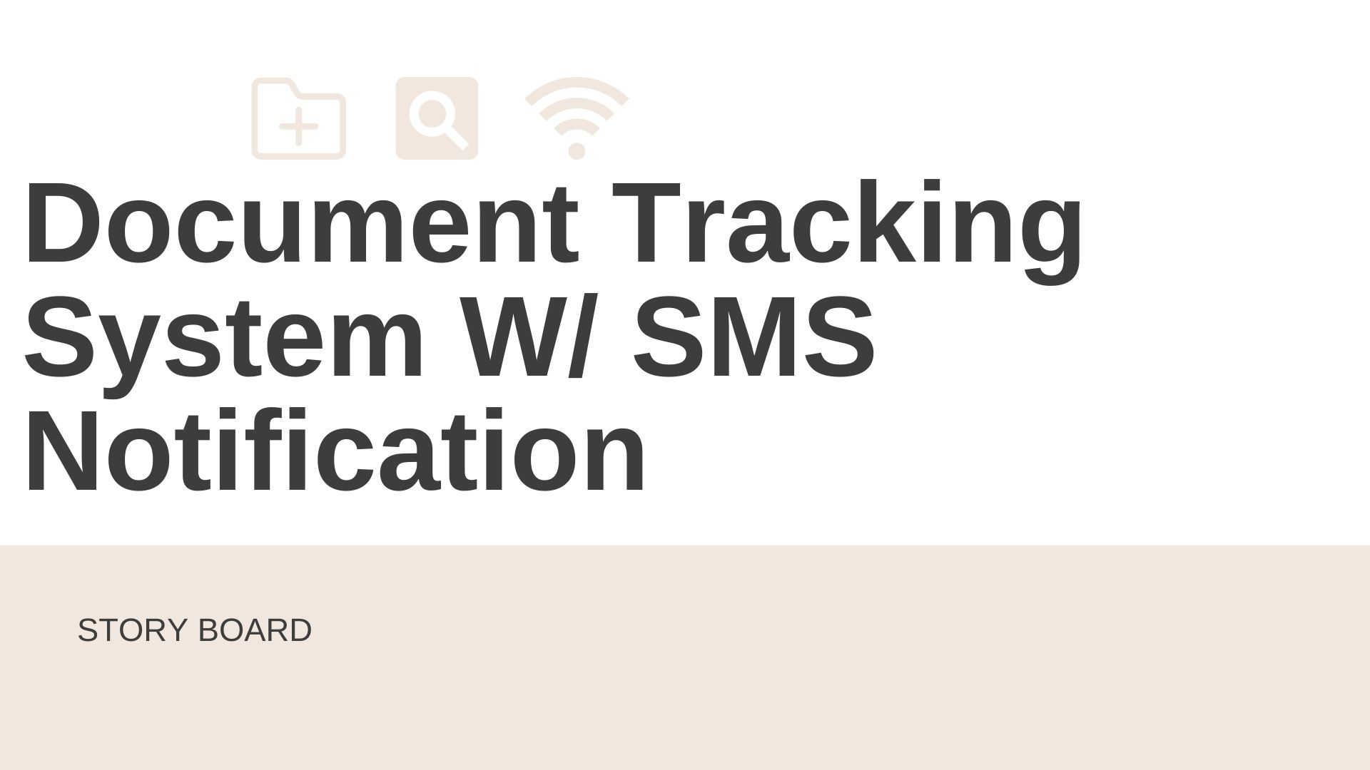

Slide 2





SYSTEM LOGIN
WELCOME PAGE
HOME PAGE
The user will login first to the system using their DTS username and password.
The welcome page will appear after the user has successfully logged in to the system
On the system's homepage, it has the following modules: Documents and Campaign.
MY DOCUMENT
ADD DOCUMENT
DOCUMENT MODULE
The user can access his/her personal document files through this interface.
The user can create or open a document file and add it to the system. The user must fill out the following fields: File name, File description, Sender's name, Document type, and Office department.
This module enables the workflow of with review and approval processes, full control over revisions, elimination of file stores, and the discovery of all documents with a single search term.

Slide 3

OFFICE DOCUMENTS
RECEIVED & PENDING FOR RELEASED
CAMPAIGN
This will store all office related documents sent by the other staffs. The user can also search all previous and current document files sent by other departments.
This contains all the received documents sent by the other departments. The user can also see if the sent file is pending or approved.
A SMS Campaign is an automated text message sent to the recipients in order to provide a notification.
LOGOUT

