Slide 1
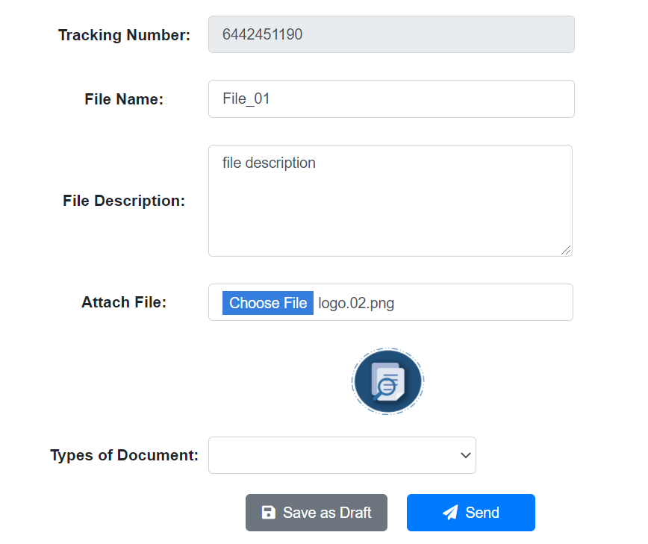
Sending Process
ADMIN
Ma access ni admin itong module ng documents
Documents
Add New Document
Received Document
Lahat ng input datas dito, ito yung dapat na ma send and ma receive din ng receiving officers
May mag appear na modal pag na clicked

Slide 2
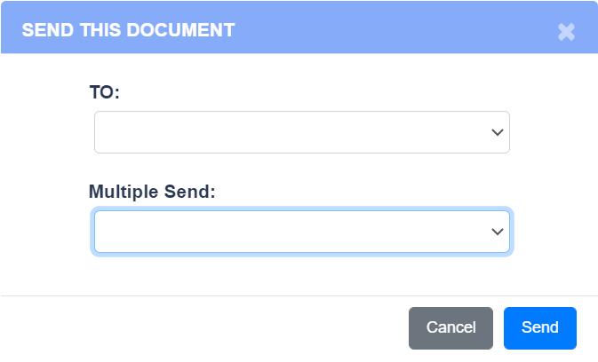
Sending Process
ADMIN
Ma access ni admin itong module ng documents
Documents
Can send and receive document
Add New Document
TO:
Names of receiving officers of each department
Dito mag appear lahat ng receiving officer ng bawat departments. Yung designation process si head ang mag se-set up kung sino ang in-assign nya as receiving officer ng department nila
Received Document
Hindi dapat ma tawag ang ibang users tulad ng head, employee and releasing officer sa selection box kasi di po sila authorized sa receiving of documents.
After ma select yung name na sesendan ni admin, mag direct na ito sya duon.

Slide 3
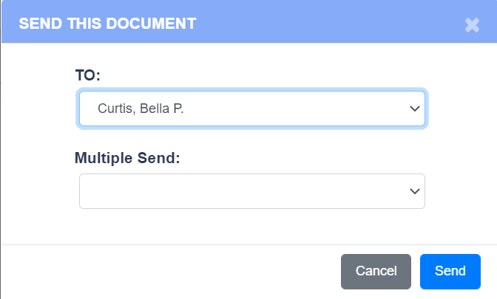
Sending Process
ADMIN
Ma access ni admin itong module ng documents
Documents
Add New Document
Received Document
Success Message: Sent Successfully

Slide 4
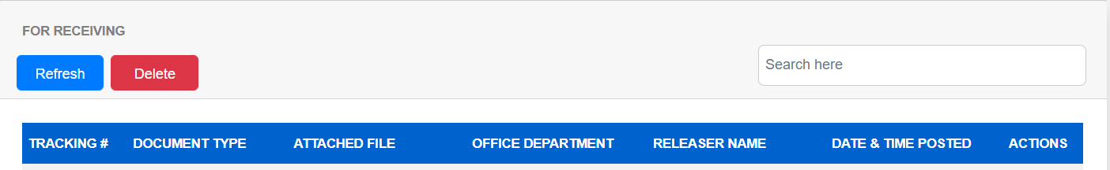

Receiving Process
( RECEIVING OFFICER ICT DEPARTMENT )
Ma access ni receiving officer itong module ng documents
64424511 Unclassified logo.02.png ADMIN Juan Delacruz 10/22/2021
Documents
Lahat ng ma receive na documents galling sa admin and releasing officer, dito lahat mag direct.
Can receive document only
Received Documents
Ma display nya dapat yung info’s na nakuha during adding of new documents

Slide 5
Receiving Process
( RECEIVING OFFICER ICT DEPARTMENT )
Ma access ni receiving officer itong module ng documents
64424511 Unclassified logo.02.png ADMIN Juan Delacruz 10/22/2021
Documents
Pag na click nya yung receive, mag appear duon sa admin sender na received na ni receiving officer ang document nya
Received Documents
Kulang po ata ako ng lagay, dapat sa bawat table may naka lagay po na STATUS sa Head Table para malaman kung ano na yung status ng documents na ni sent nila
Bale same process lang din po ng pag receive ng docu kay admin tulad po dito

Slide 6
Sending Process
(DEPARTMENT HEAD/ EMPLOYEE USERS
Documents
TO:
Name of their department’s releaser only
Can send document only
Add New Document
Isa lang po ang mag appear na releasing officer kasi per department may 1 releaser and 1 receiver sila
Si head at normal employee user makapag send lang ng document pero di maka receive. Di rin sila pwedeng maka send directly ng document sa ibang department kasi they are not authorized personnel
Meaning dadaan muna lahat sa releasing officer ang lahat ng document na i-sesend nila at ang releaser ang bahala na mag send papuntasa ibang department

Slide 7
Sending Process
(DEPARTMENT HEAD/ EMPLOYEE USERS
Documents
( Releasing Officer )
Can send document only
Add New Document
Success Message: Sent Successfully

Slide 8
Sending Process
( RELEASING OFFICER )
64424511 Unclassified logo.02.png ICT Department Head 10/22/2021
Release
Documents
Dito lahat mag direct ang mga sinend sakanya na document galling sa mga kasamahan nya sa iisang department.
Pag na click nya na yung release may modal na lalabas
Can send and release only
Add New Document
Pending for Release

Slide 9
Releasing Process
( RELEASING OFFICER )
Documents
Can send and release only
TO:
Name of their department’s releaser only
Add New Document
Lahat ng makikita dapat dito sa dropdown selection ay mga receiving officer ng bawat department at si admin
Di nya dapat Makita ang ibang releasing officer and department head kasi di po sila authorized na mag receive ng docu
Pending for Release

Slide 10
Sending Process
( RELEASING OFFICER )
Documents
( Receiving Officer )
Can send and release only
Add New Document
Success Message: Sent Successfully
Pending for Release

