Slide 1
LAPTOPIA
Git Hub Repository Link: Arsh-24/laptopia-ecommerce-website (github.com)
Student Name: Muhammad Arsh Qureshi
Student ID: L39309339
Module: Front End Development
Website Link: LapTopia - Home (arsh-24.github.io)

Slide 2
Introduction to laptopia
LapTopia is an e-commerce website dedicated to providing users with a seamless shopping experience for laptops from leading brands such as Dell, HP, Lenovo, and more. Our website is meticulously designed to offer a wide selection of high-quality laptops tailored to meet the diverse needs of our customers. With a focus on user satisfaction, LapTopia aims to simplify the process of finding the perfect laptop by providing comprehensive product information, intuitive navigation, and responsive customer support. Join us at LapTopia and discover a world of innovative technology and exceptional service.

Slide 3
Requirements Gathering
Conducted one-on-one meetings with the client to gather their specific requirements and expectations.
Engaged in direct dialogue to understand the client's vision and objectives for the LapTopia website.
Collaborated closely with the client to ensure alignment between their needs and the website's features and functionalities.

Slide 4
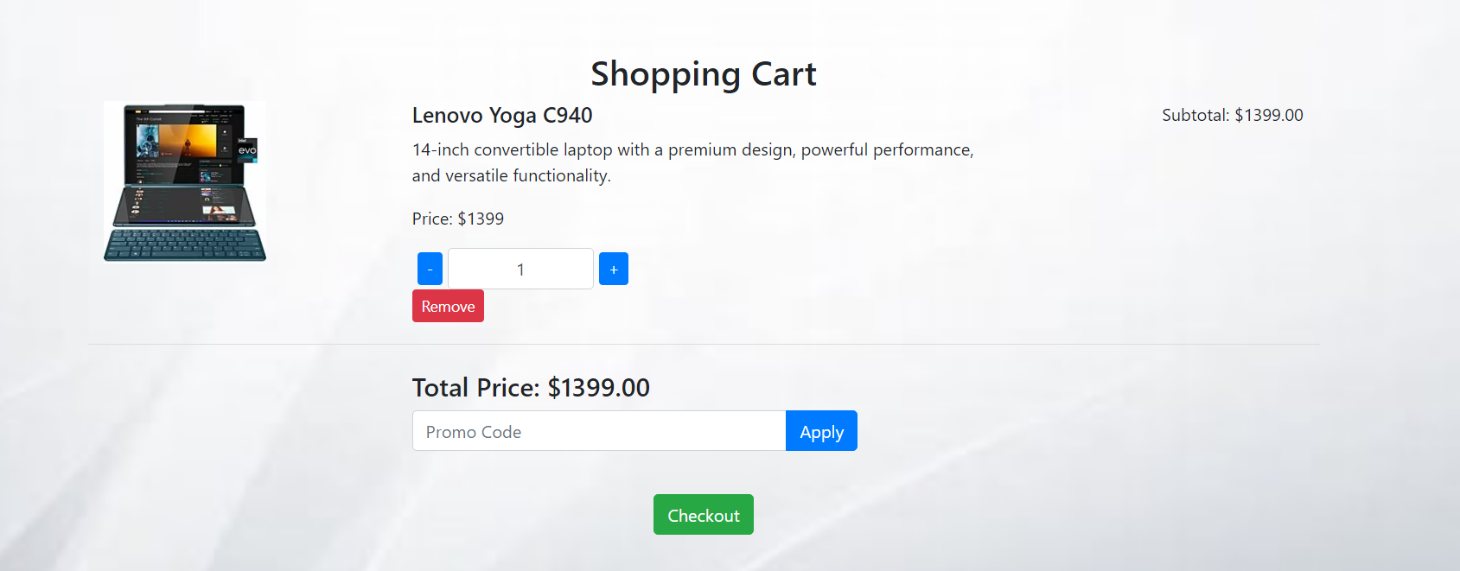
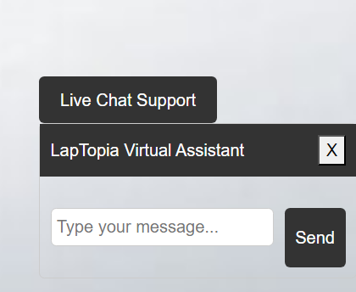
DESIGN PHASE
Seamless checkout experience.
Customer Service Support.
Allow users to redeem promos and discounts
Cart Integration
Emphasized intuitive navigation and user-friendly interface.
Implemented responsive design for seamless browsing across devices.
Leveraged modern design principles to enhance visual appeal and user engagement.

Slide 5
Development phase
TECHNOLOGIES USED
HTML:
Markup language for structuring the website content.
CSS:
Style sheet language used for styling the visual presentation of the website.
JavaScript:
Programming language used for adding interactivity and functionality to the website.
Functionality: Handling user interactions, form validation, dynamic content updates.
Framework: Bootstrap
Advantages:
Responsive Design: Ensures the website adapts seamlessly to different screen sizes and devices.
Pre-designed Components: Offers a library of pre-styled components for faster development.
Customizable: Allows customization to match the website's design requirements.
Why We Use It: Bootstrap simplifies and accelerates the development process, providing a solid foundation for creating modern and responsive websites.

Slide 6
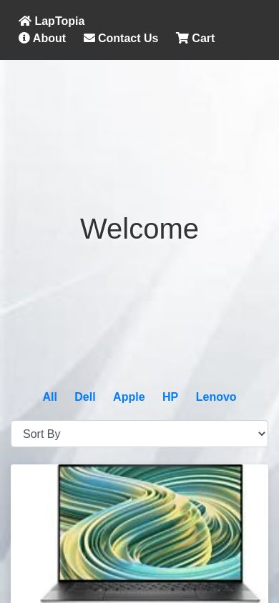
TESTING PHASE
Testing Procedures
Mobile-Friendliness: Ensured optimal performance on mobile devices.
Cross-Browser Compatibility: Tested compatibility across different browsers.
Loading Speed: Optimized website loading speed for better user experience.

Slide 7
DEPLOYMENT PHASE
Deployment Method: GitHub Pages
GitHub Pages is a static site hosting service that takes HTML, CSS, and JavaScript files straight from a repository on GitHub, optionally runs the files through a build process, and publishes a website.
Advantages:
Free Hosting: GitHub Pages offers free hosting for static websites, making it cost-effective.
Easy Setup: Deployment is straightforward, especially for projects hosted on GitHub repositories.
Version Control: Seamlessly integrates with Git, enabling version control for website development.
Process:
The website files were pushed to a GitHub repository.
GitHub Pages was configured to host the website directly from the repository.
The deployment process was automated, allowing for quick and efficient updates to the live site.

Slide 8
REFERENCES
GitHub Pages
GitHub Pages. (n.d.). Retrieved from https://pages.github.com/
Bootstrap
Bootstrap. (n.d.). Retrieved from https://getbootstrap.com/
jQuery
jQuery. (n.d.). Retrieved from https://jquery.com/

Slide 9
THANK YOU

