Slide 1
DAta analysis Summary
Uber Request Data Analysis
By: Arsh Dinesh Vijayvargiya

Slide 2
Data inspection
The given data is of Uber, a well known name in transportation industries.
The aim of analysis is to identify the root cause of the problem (i.e. cancellation and non-availability of cars) and recommend ways to improve the situation. As a result of your analysis, you should be able to present to the client the root cause(s) and possible hypotheses of the problem(s) and recommend ways to improve them.
The Data set initially had 6745 rows with 6 columns namely ‘Request id’, ‘Pickup point’, ‘Driver id’, ‘Status’, ‘Request timestamp’ and ‘Drop timestamp’.

Slide 3
Data Cleaning and manipulation
The next step after data inspection is to manage the provided data, removing columns that are unnecessary, imputing values etc in order to get a more understandable and analysable data.
In the dataset two columns had missing values i.e. ‘Driver id’ and ‘Drop timestamp’.
From analysis we were able to identify the reason for ‘Null’ values in above two columns –
For ‘Driver id’ – whenever there was no cars available to accept the request, thus no Driver id was registered.
For ‘Drop timestamp’ – whenever there was no cars available or cancelled by driver the drop timestamp was not registered.
But since these column aren’t much helpful in our analysis we can drop them instead of imputing.

Slide 4
Derived Matrices
For our analysis we created 3 columns that was necessary,
Req_hour – This column was created using ‘Request timestamp’ as it has time of request in it.
Time Period – To make our plot concise and not messy we divided the request hour in 6 categories each slot with 4 hrs. ‘late night’ [0:00–4:00], ‘early morning’ [4:00-8:00] , ‘morning’ [8:00-12:00], ‘afternoon’ [12:00-16:00], ‘evening’ [16:00-20:00] and ‘night’ [20:00-24:00].
Sup_or_Dem – To understand the supply and demand of uber on different routes.

Slide 5
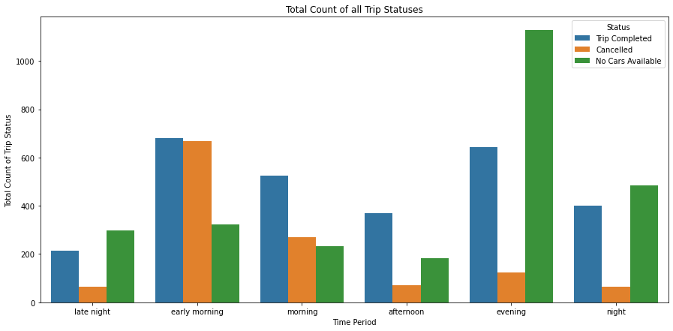
Analysis
We begin our analysis with checking the frequency of different Status with respect to Time Period.
In above graph we are able to see that in early morning the trip cancellation is most and as for no availability of cars it is in evening.

Slide 6
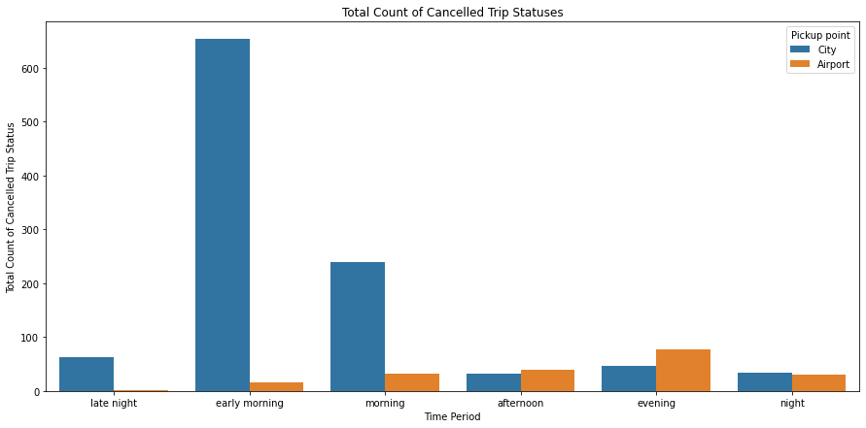
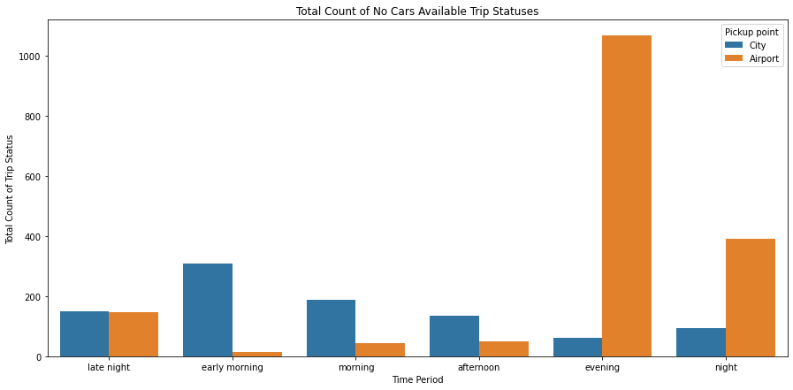
Next we dig deep in cancellation and no availability of rides and plot the frequencies of rides in different time periods with respect to the route of the ride.
From above we can see cancellation is most in early morning for rides from city to airport and in evening for rides airport to city.
As for non availability most frequency occurs in evening for rides airport to city and in early morning for city to airport.

Slide 7
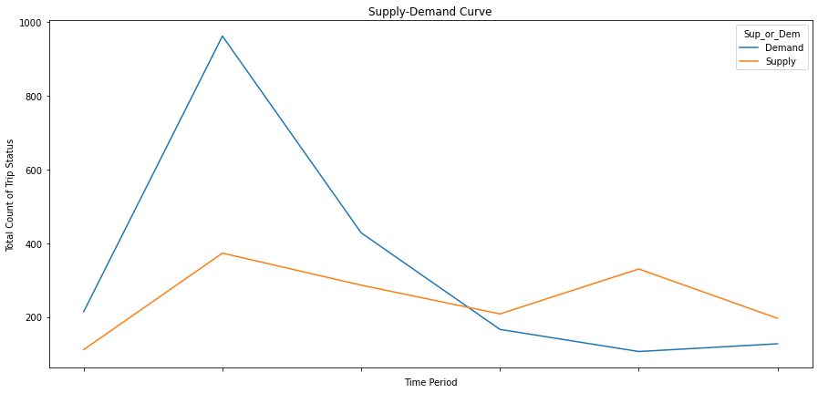
For next we wated to understand the demand and supply of cars on different routes.
For city to airport :
We can observe that in early morning there is high demand but supply is very low and on the other hand in evening there is high supply of rides for evening while demand is quite low for route city to airport .

Slide 8
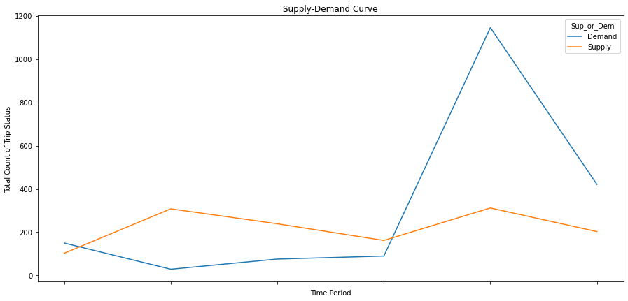
For Airport to City:
We can observe that in evening there is high demand but supply is very low and on the other hand in early morning there is high supply of rides while demand is quite low for route airport to city.

Slide 9
Conclusion
Correlating the two demand and supply plots, a possible hypothesis could be:
1. The demand during morning and afternoon hours from the Airport to City is quite low, which means that a driver who completed a City to Airport route in the morning hours may have to wait a really long time to get a ride back to the City, or he may have to come back without a passenger. Both situations are not idle for drivers, which might be the reason for highest number of "Cancelled" trips in the City to Airport trip in the morning hours
2. The vice versa happens in evening when there are too many flight coming in to the airport and hence there is a high demand for cabs and not enough supply. which is why most number of "No Cars Available" were observed in Evening in the Airport to City route.

Slide 10
Solution
Uber could provide compensation or fuel cost for the empty rides that driver earlier had to bear himself. This measure can drastically change the demand supply curve of uber. In our conclusion we saw the major problem for drivers was the extra cost they had to bear as in form of empty ride . This measure will support the drivers as well as providing a huge help for its users and simplify the process of booking a ride.

